Slide 1

Splash Screen
Chapter 5
Lesson 5-3

Slide 2








(over Lesson 5-1)
Write 60% as a fraction in simplest form.
A.
B.
C.
D.
A
B
C
D

Slide 3

(over Lesson 5-1)
Jana took a test and got 20 questions correct out of 25. What percent did she get correct?
A. 125 percent
B. 80 percent
C. 12.5 percent
D. 0.8 percent
A
B
C
D

Slide 4


5Min 3-1
(over Lesson 5-2)
Write 23% as a decimal.
A. 23
B. 2.3
C. 0.23
D. 0.023
A
B
C
D

Slide 5

(over Lesson 5-2)
Write 106% as a decimal.
A. 0.106
B. 1.06
C. 1.6
D. 10.6
A
B
C
D

Slide 6


Solve problems using the percent proportion.
percent proportion

Slide 7

Standard 7NS1.3 Convert fractions to decimals and percents and use these representations in estimations, computations, and applications.

Slide 8
Student Challenge 1: Find the Rule
part
25
100
7.5
30
part
25% of 30 is 7.5
=
whole
whole
part
20
100
12
60
part
12 is 20% of 60
=
whole
whole

Slide 9
Rule 1:
Percent problems can be solved using a proportion skeleton.
part
25
7.5
part
25% of 30 is 7.5
=
whole
100
30
whole
Rule 2:
Both ratios in the skeleton contain a part and a whole.

Slide 10
Rule 3:
The whole in the % ratio is always 100.
The whole in the other ratio always follows the word of.
25% of 30 is 7.5
Rule 4:
The part in the % ratio is always next to the % sign.
The part in the other ratio is always in front of or behind the word is.

Slide 11
Let’s see how that looks:
30
100
x
12
What is 30% of 12?
=
22
110
x
100
22 is what percent of 110?
=
65
100
x
90
What number is 65% of 90?
=
16.5
x
27
100
16.5 is 27% of what number?
=

Slide 12
Here’s how it works:
What is 30% of 12?
Use the key words what, %, and of to tell you how to set your proportion up:
30
100
x
12
part
part
What is
30%
=
of 12
whole
whole

Slide 13
22 is what percent of 110?
Here’s how it works:
Use the key words what, %, and of to tell you how to set your proportion up:
x
100
22
110
part
part
what
22 is
=
percent
of 110
whole
whole

Slide 14
Here’s how it works:
What number is 65% of 90?
Use the key words what, %, and of to tell you how to set your proportion up:
65
100
x
90
part
part
65
what number is
=
%
of 90
whole
whole

Slide 15
Here’s how it works:
16.5 is 27% of what number?
Use the key words what, %, and of to tell you how to set your proportion up:
27
100
16.5
x
part
part
27
16.5
=
%
of what number
whole
whole

Slide 16
Let’s Review
1) Set up a proportion skeleton.
=
2) Look for the key words:
- What (this is always the variable).
- % or percent (this is always 100 for the
percent ratio).
- Of (divisor for the non-percent ratio).
3) Put the data into the skeleton.

Slide 17

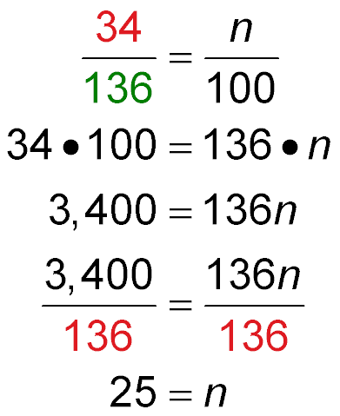
Find the Percent
34 is what percent of 136?
Since 34 is being compared to 136, 34 is the part and 136 is the whole. You need to find the percent. Let n represent the percent.
part
whole
Write the percent proportion.
Find the cross products.
Multiply.

Slide 18
Find the Percent
Use the Multiplicative Inverse.
Simplify.
Answer: 34 is 25% of 136.

Slide 19
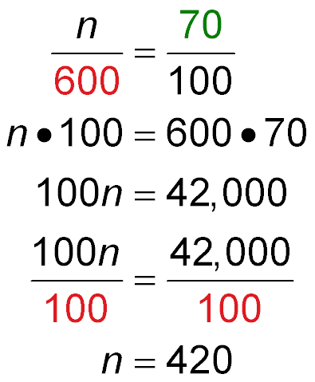
Find the Part
What number is 70% of 600?
The percent is 70, and the whole is 600. You need to find the part. Let n represent the part.
part
whole
Write the percent proportion.
Find the cross products.
Multiply.

Slide 20
Find the Part
Use the Multiplicative Inverse.
Simplify.
Answer: 420 is 70% of 600.

Slide 21
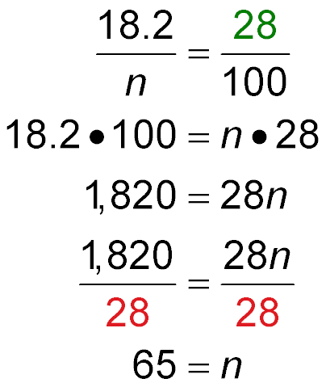
Find the Whole
18.2 is 28% of what number?
The percent is 28, and the part is 18.2. You need to find the whole. Let n represent the whole.
part
whole
Write the percent proportion.
Find the cross products.

Slide 22
Find the Whole
Multiply.
Use the Multiplicative Inverse.
Simplify.
Answer: 18.2 is 28% of 65.

Slide 23
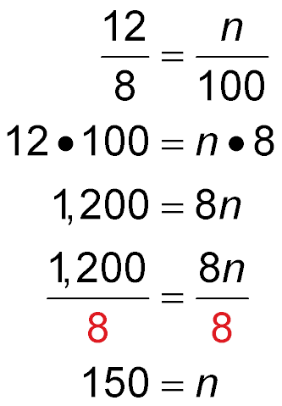
Percents Greater than 100
12 is what percent of 8?
12 is being compared to 8, so 8 is the whole and 12 is the part. You need to find the percent. Let n represent the percent.
part
whole
Write the percent proportion.
Find the cross products.
Multiply.

Slide 24
Percents Greater than 100
Use the Multiplicative Inverse.
150 = n
Simplify.
Answer: 12 is 150% of 8.

Slide 25

63 is what percent of 210?
A. 20%
B. 30%
C. 35%
D. 40%
A
B
C
D

Slide 26
What is 40% of 400?
A. 80
B. 120
C. 135
D. 160
A
B
C
D

Slide 27
14.7 is 42% of what number?
A. 27
B. 35
C. 37
D. 40
A
B
C
D

Slide 28
15 is what percent of 12?
A. 125%
B. 150%
C. 175%
D. 200%
A
B
C
D

Slide 29

BASEBALL In 2005, Alex Rodriguez had 194 hits. This was about 32% of his at-bats. How many times was he at bat?
A. about 522 times
B. about 588 times
C. about 606 times
D. about 621 times
A
B
C
D

Slide 30
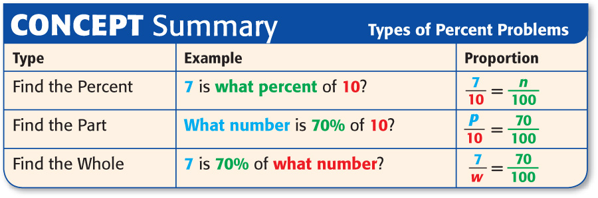

Slide 31






