Slide 1
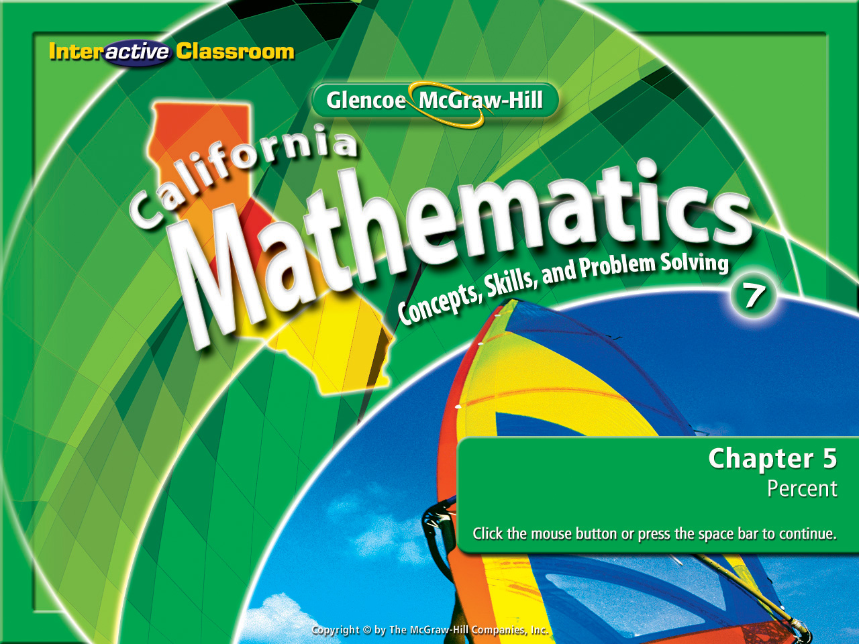
Splash Screen
Chapter 5
Lesson 5-4

Slide 2











(over Lesson 5-1)
Which value is not equal to the other values?
%
A.
B.
C.
D.
A
B
C
D

Slide 3


(over Lesson 5-2)
Write the decimal 0.0062 as a percent.
A. 62%
B. 6.2%
C. 0.62%
D. 0.062%
A
B
C
D

Slide 4


(over Lesson 5-2)
A. 173.4%
B. 57.5%
C. 17.4%
D. 5.75%
A
B
C
D

Slide 5

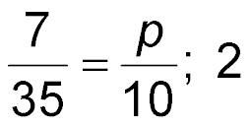
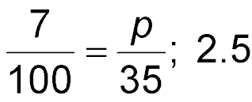
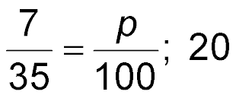
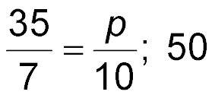

(over Lesson 5-3)
7 is what percent of 35? Write a percent proportion and solve. Round to the nearest tenth if necessary.
A.
B.
C.
D.
%
%
%
A
B
C
D
%

Slide 6

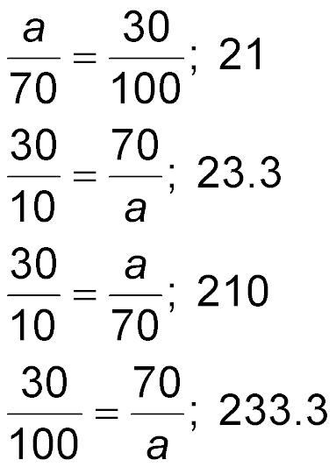
(over Lesson 5-3)
Find 30% of 70. Write a percent proportion and solve. Round to the nearest tenth if necessary.
A.
B.
C.
D.
A
B
C
D

Slide 7

Compute percents mentally.

Slide 8

Standard 7NS1.3 Convert fractions to decimals and percents and use these representations in estimations, computations, and applications.

Slide 9
Something to Ponder
1%
of
65
is
.65
10%
of
65
is
6.5
100%
of
65
is
65.
Is there a pattern?

Slide 10
Something to Ponder
1%
of
825
is
8.25
10%
of
825
is
82.5
100%
of
825
is
825
Is there a pattern?

Slide 11
What’s the pattern?
1%
of
65
is
.65
1%
of
825
is
8.25
To find 1% of any number: “move the decimal 2 places to the left”.

Slide 12
What’s the pattern?
10%
of
65
is
6.5
10%
of
825
is
82.5
To find 10% of any number: “move the decimal 1 place to the left”.

Slide 13
What’s the pattern?
100%
of
65
is
65.
100%
of
825
is
825.
To find 100% of any number: “don’t move the decimal”.

Slide 14
To find 1% of any number: “Move the decimal 2 places to the left.”
Computing Mental Percents
To find 10% of any number: “Move the decimal 1 place to the left.”
You will use this the rest of your life!
Three Simple Rules
To find 100% of any number: “Don’t move the decimal.”

Slide 15

Use Decimals to Compute Mentally
Compute 1% of 304 mentally.
Move the decimal 2 places to the left.
1% of 304 = 3.04
Answer: 3.04

Slide 16
Use Decimals to Compute Mentally
Compute 10% of 125 mentally.
10% of 125 = 12.5
Move the decimal 1 place to the left.
Answer: 12.5

Slide 17
Use Fractions to Compute Mentally
Compute 40% of 80 mentally.
10% of 80 is 8.
Think of what 10% of 80 is.
(8) (4) = 32
Multiply that amount by 4.
Answer: 32

Slide 18
Use Fractions to Compute Mentally
Compute 15% of 75.
10% of 75 is 7.5.
Think of what 10% of 75 is.
½ of 7.5 is 3.75.
For the other 5%, think of what ½ of 7.5 is.
7.5 + 3.75 = 11.25
Combine 7.5 and 3.75.
Answer: 11.25

Slide 19

Compute 20% of 60 mentally.
A. 6
B. 12
C. 15
D. 20
A
B
C
D

Slide 20
Compute 15% of 300.
A. 30
B. 35
C. 40
D. 45
A
B
C
D

Slide 21
Compute 10% of 13 mentally.
A. 0.13
B. 0.31
C. 1.3
D. 13
A
B
C
D

Slide 22
Compute 1% of 244 mentally.
A. 0.244
B. 2.44
C. 24.4
D. 244
A
B
C
D

Slide 23
