Slide 1
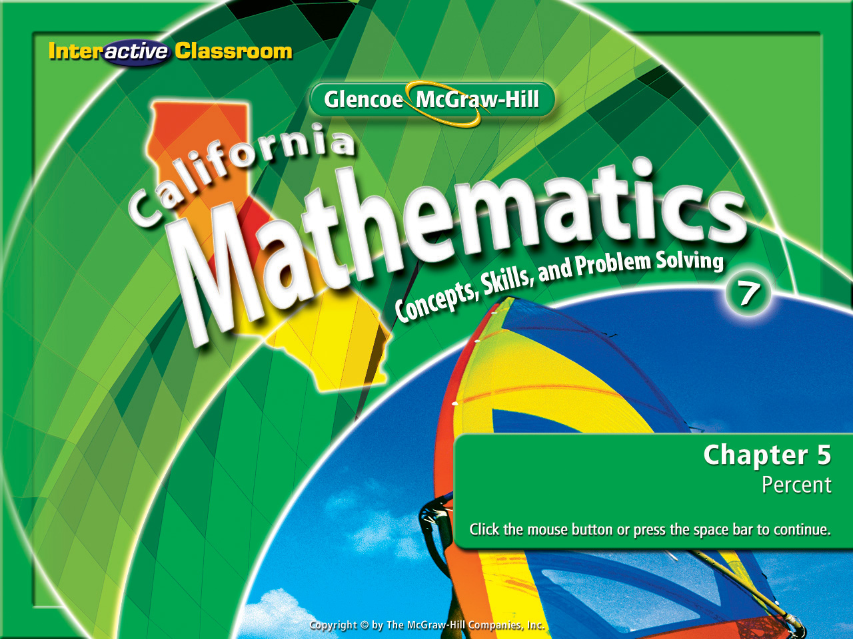
Splash Screen
Chapter 5
Lesson 5-7

Slide 2








(over Lesson 5-2)
Choose the fraction that is less than 23%.
7
20
A.
B.
C.
D.
10
25
A
B
C
D
3
10
15
75

Slide 3

(over Lesson 5-3)
A seafood restaurant had 75 pounds of fish. In one week, 20% of the fish was used. How many pounds of fish were used?
A. 25 pounds
B. 20 pounds
C. 15 pounds
D. 35 pounds
A
B
C
D

Slide 4


(over Lesson 5-4)
Eight ounces of milk provide 40% of a person’s daily recommended calcium. How many ounces are needed to provide 50% of the daily recommended dose?
A. 9 ounces
B. 10 ounces
C. 11 ounces
D. 12 ounces
A
B
C
D

Slide 5

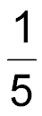
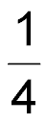
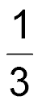
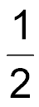

(over Lesson 5-6)
Estimate 21% of 85.
A. of 85 or 17
B. of 85 or 21.25
C. of 85 or 28.33
D. of 85 or 42.5
A
B
C
D

Slide 6


Solve problems using a percent equation.
percent equation

Slide 7


Standard 7NS1.3 Convert fractions to decimals and percents and use these representations in estimations, computations, and applications.
Standard 7NS1.7 Solve problems that involve discounts, markups, commissions, and profit and compute simple and compound interest.

Slide 8
Remember when we learned this?
1) Set up a proportion skeleton.
=
2) Look for the key words:
- What (this is always the variable).
- % or percent (this is always 100 for the
percent ratio).
- Is (dividend for the non-percent ratio).
- Of (divisor for the non-percent ratio).
per
is
3) Put the data into the skeleton.
=
cent (100)
of

Slide 9
Use that prior knowledge to help you with today’s concept.
It will look a bit different but not by much!

Slide 10
See if you can break the code & uncover the clues on how we change from words to equations.
F i n d 6 % o f 5 2 5 .
.0 6 • 5 2 5
4 2 i s w h a t p e r c e n t o f 6 0 ?
4 2 = x • 6 0
6 5 i s 5 2 % o f w h a t n u m b e r ?
6 5 = .5 2 • x

Slide 11
Let’s find our clues and break the code.
F i n d 6 % o f 5 2 5 .
.0 6
•
5 2 5
.0 6 • 5 2 5
4 2 i s w h a t p e r c e n t o f 6 0 ?
4 2
=
•
6 0
x
4 2 = 6 0x

Slide 12
Look for key words.
Here’s our code.
is means ……. =
of means…….multiply
386 is 53% of what number?
53 is what percent of 50?
12 is what percent of 40?
Find 8% of 25.
percents % are changed to a decimal
what or find describes the variable
(Use the clues & write the equation in the order the clues appear.)

Slide 13

Find the Part
Find 30% of 450.
30% of 450
.3
•
450
Answer: 135

Slide 14
Find the Percent
102 is what percent of 150?
102 is what percent of 150
p
102
=
•
150
Rewrite: 102 = 150p
Use the multiplicative inverse:
150
150
Answer: 102 is 68% of 150.

Slide 15
Find the Whole
144 is 45% of what number?
144 is 45% of what number?
n
144
=
.45
•
Rewrite: 144 = .45n
Use the multiplicative inverse:
.45
.45
Answer: So, 144 is 45% of 320.

Slide 16

Find 20% of 315.
A. 21
B. 49
C. 55
D. 63
is means ……. =
of means…….multiply
percents % are changed to a decimal
what or find describes the variable
A
B
C
D

Slide 17
135 is what percent of 250?
A. 42%
B. 54%
C. 58%
D. 65%
is means ……. =
of means…….multiply
percents % are changed to a decimal
what or find describes the variable
A
B
C
D

Slide 18
186 is 30% of what number?
A. 620
B. 582
C. 540
D. 476
is means ……. =
of means…….multiply
percents % are changed to a decimal
what or find describes the variable
A
B
C
D

Slide 19
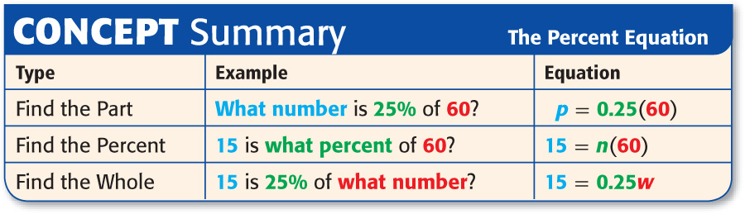
%..............means the decimal equivalent in hundredths
Do Your Notes Show Our…..
what………means that part is the variable (x)
is………..……means equals (=)
of………..……means multiply (•)
If these aren’t in your notes write them in now.

Slide 20
