Slide 1

Splash Screen
Chapter 6
Lesson 6-1

Slide 2







(over Chapter 5)
Write 7 out of 20 as a percent.
A. 0.035%
B. 0.35%
C. 3.5%
D. 35%
A
B
C
D

Slide 3






(over Chapter 5)
Express 48% as a fraction in simplest form.
A.
B.
C.
D.
A
B
C
D

Slide 4

(over Chapter 5)
9.5 is 95% of what number?
A. 1
B. 9
C. 10
D. 100
A
B
C
D

Slide 5

(over Chapter 5)
Find the percent of change from 15 to 18. State whether the percent of change is an increase or a decrease.
A. 20%; decrease
B. 20%; increase
C. 16.7%; decrease
D. 16.7%; increase
A
B
C
D

Slide 6


Identify special pairs of angles and relationships of angles formed by two parallel lines cut by a transversal.
vertical angles
interior angles
complementary angles
exterior angles
supplementary angles
alternate interior angles
perpendicular lines
alternate exterior angles
parallel lines
corresponding angles
transversal

Slide 7

Standard 7MG3.1 Identify and construct basic elements of geometric figures (e.g., altitudes, midpoints, diagonals, angle bisectors, and perpendicular bisectors; central angles, radii, diameters, and chords of circles) by using a compass and straightedge.

Slide 8
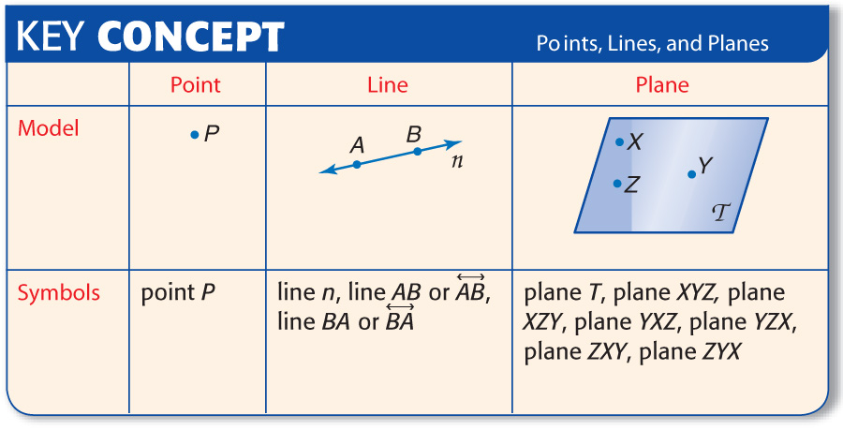

Slide 9

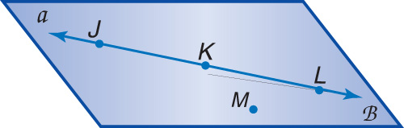
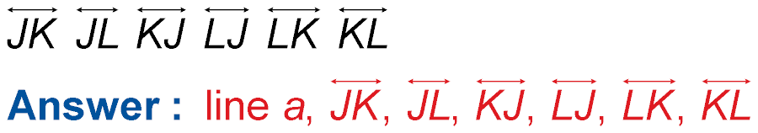
Name Lines and Planes
Use the figure to name a line containing point L.
There are three points on the line. Any two of the points can be used to name the line.
The line can also be named as line a.

Slide 10
Name Lines and Planes
Use the figure to name a plane containing point L.
The plane can be named as plane B. You can also use the letters of any three noncollinear points to name the plane.
plane JKM plane KLM plane JLM
Answer: plane B, plane JKM, plane KLM, plane JLM Reorder the letter in these names to create 15 other acceptable names.

Slide 11

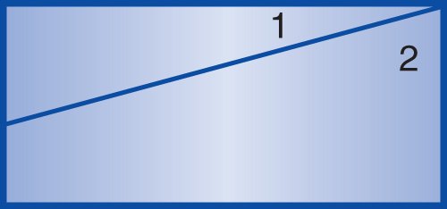
Find an Angle Measure
SEWING The drawing shows a piece of fabric marked for cutting. If the edges of the fabric meet at right angles and m< 1 = 15°, classify the relationship between <1 and <2. Then find m<2.
<1 and <2 are complementary. So, the sum of their measures is 90°.

Slide 12
15°
x°
Find an Angle Measure
m<1 + m<2 = 90 Write an equation.
15 + x = 90 m<1 = 15 and m<2 = x
–15 = –15 Combine the additive inverse to both sides to isolate the variable and find the solution for x.
x = 75 Do the math to find the solution for x.
Answer: So, m<2 = 75°.

Slide 13
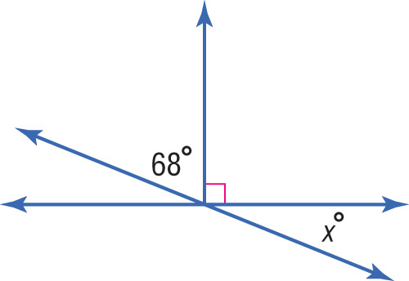
Find a Missing Angle Measure
Find the value of x in the figure.
Use the complementary angles to help you solve for x.
Angle x is vertical to the unknown measure in the complementary angles.
68 + x = 90 Write an equation.
– 68 – 68 Combine the additive inverse, -68 to each side.
x = 22 Do the math to find the solution for x.
Answer: 22°

Slide 14

Find a Missing Angle Measure
Find the value of x in the figure.
Two adjacent angles that form a straight line are called supplementary angles.
A straight line measures 180°.
180°
Use this fact to help you solve for x.
38 + x = 180 Write an equation.
– 38 – 38 Use the additive inverse, -38 & combine to each side.
x = 142 Do the math to find the solution for x.
Answer: 142°

Slide 15

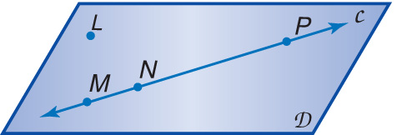
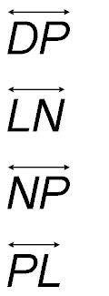
Use the figure to name a line containing point P.
A.
B.
C.
D.
A
B
C
D

Slide 16
Use the figure to name a plane containing point L.
A. plane MNP
B. plane LMP
C. Plane D
D. plane P
A
B
C
D

Slide 17
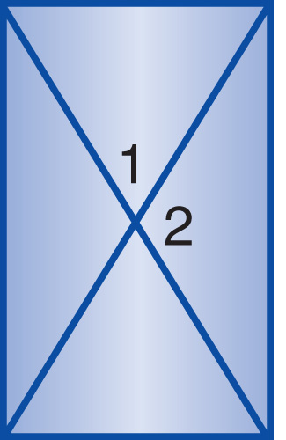
WINDOWS Classify the relationship between <1 and <2 in the diagram of a window. Then find m<2, if m<1 = 60°.
A. complementary; 30°
B. complementary; 60°
C. supplementary; 90°
D. supplementary; 120°
A
B
C
D

Slide 18
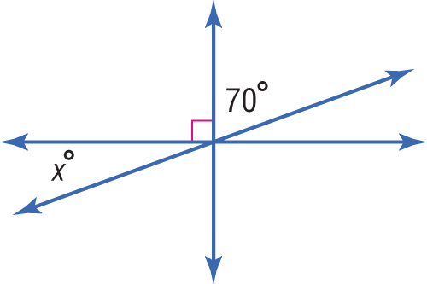
Find the value of x in the figure.
A
B
C
D
A. 20 B. 25
C. 30 D. 70

Slide 19
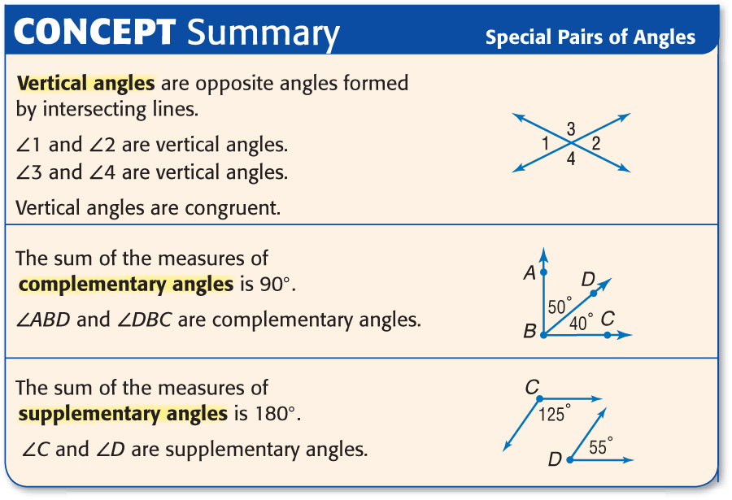

Slide 20





