Slide 1

Splash Screen
Chapter 6
Lesson 6-3

Slide 2







(over Chapter 5)
A grocery store manager prices items 30% above their cost. If the manager pays $0.90 per pound for strawberries, what price will he put on the strawberries?
A. $11.70/pound
B. $3/pound
C. $2.70/pound
D. $1.17/pound
A
B
C
D

Slide 3



(over Chapter 5)
Susan deposited $210 to open a savings account that pays 4.7% simple interest annually. If there are no other deposits or withdrawals from the account, how much will be in the account in 24 months?
A. $19.74
B. $20.20
C. $229.74
D. $230.20
A
B
C
D

Slide 4

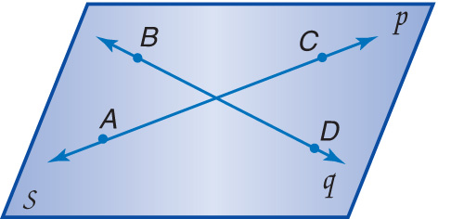

(over Lesson 6-1)
Name a line that contains point B.
A. q
B. A
C. p
D. C
A
B
C
D

Slide 5

(over Lesson 6-1)
Name the plane that contains lines p and q.
A. q
B. C
C. p
D. S
A
B
C
D

Slide 6


Find the sum of the angle measures of a polygon and the measure of an interior angle of a regular polygon.
interior angle
equilateral
equiangular
regular polygon

Slide 7

Standard 7MR3.3 Develop generalizations of the results obtained and the strategies used and apply them to new problem situations.
Standard 7AF1.1 Use variables and appropriate operations to write an expression, an equation, an inequality, or a system of equations or inequalities that represents a verbal description (e.g. three less than a number, half as large as area A).

Slide 8
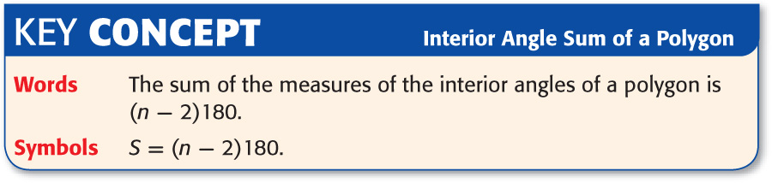

Slide 9
Famous Polygonal Facts
3 sided polygon
triangle
4 sided polygon
quadrilateral
5 sided polygon
pentagon
6 sided polygon
hexagon
7 sided polygon
heptagon
8 sided polygon
octagon
9 sided polygon
nonagon
10 sided polygon
decagon
11 sided polygon
hendecagon
12 sided polygon
dodecagon

Slide 10

Find the Sum of Interior Angle Measures
ALGEBRA Find the sum of the measures of the interior angles of a hexagon.
S = (n – 2)180 Write an equation.
S = (6 – 2)180 Replace n with 6.
S = (4)180 or 720 Simplify.
Is This Our Final Answer?
Answer: Yes, the sum of the measures of the interior angles of a hexagon is 720°.

Slide 11


DESIGN A designer is creating a new logo for a bank. The logo consists of a regular pentagon surrounded by isosceles triangles. Find the measure of an interior angle of a pentagon.
A pentagon has 5 sides.
Step 1 Find the sum of the measures of the angles.
S = (n – 2)180 Write an equation.
S = (5 – 2)180 Replace n with 5.
S = (3)180 or 540 Simplify.
Is This Our Final Answer?

Slide 12
No, the sum of the measures of the interior angles of a regular pentagon is 540, we are looking for the measure of only one of the interior angles.
Step 2 Divide 540 by 5, the number of interior angles, to find the measure of one interior angle. So, the measure of one interior angle of a regular pentagon is:
540° ÷ 5 or 108°.
Answer: 108°

Slide 13

ALGEBRA Find the sum of the measures of the interior angles of a heptagon (7-sided figure).
A. 540°
B. 720°
C. 810°
D. 900°
A
B
C
D

Slide 14

DESIGN Michelle is designing a new logo for the math club. She wants to use a regular nonagon as part of the logo. Find the measure of an interior angle of a nonagon.
A. 108°
B. 122°
C. 140°
D. 148°
A
B
C
D

Slide 15





