Slide 1
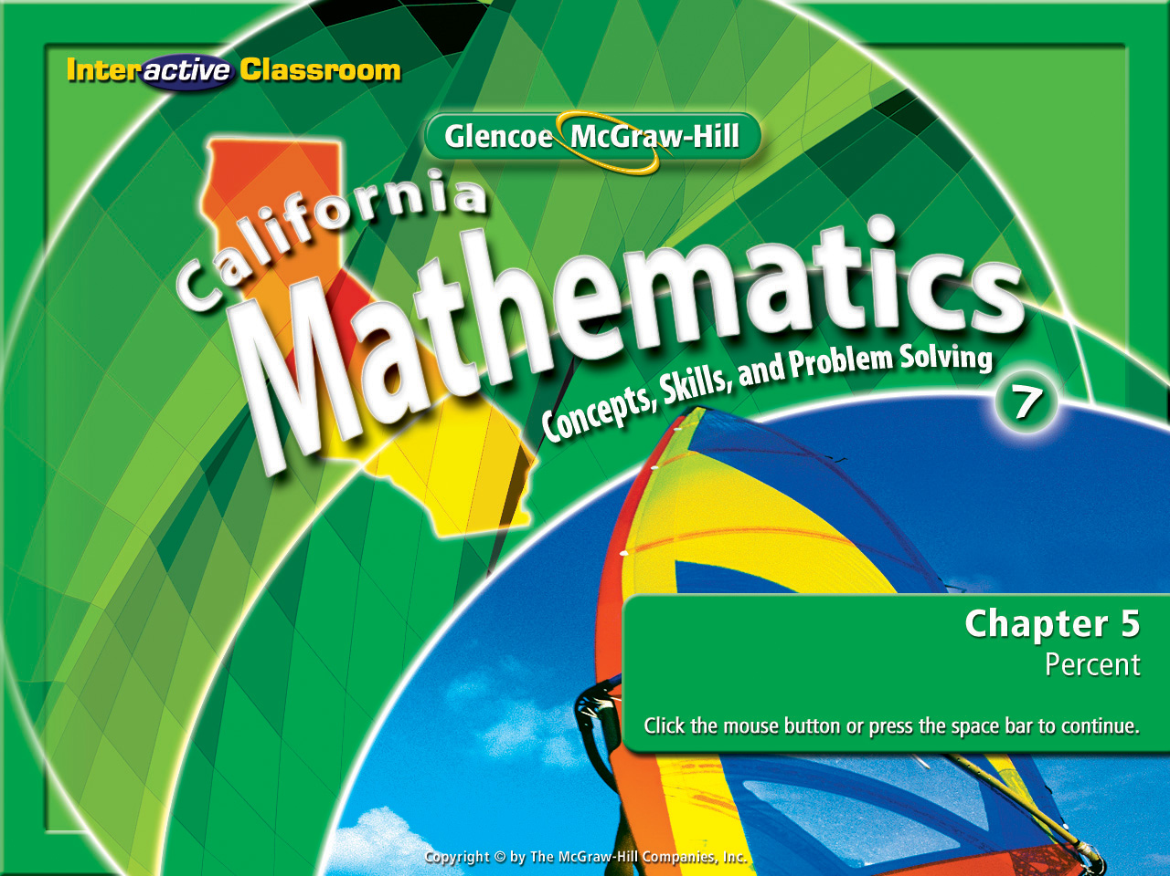
Splash Screen
Chapter 6
Lesson 6-5

Slide 2




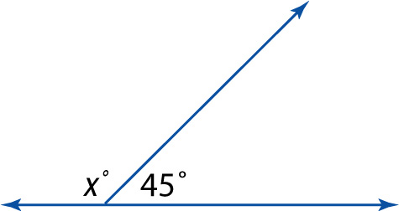



(over Lesson 6-1)
Find the value of x in the figure.
A. x = 225
B. x = 135
C. x = 90
D. x = 45
A
B
C
D

Slide 3

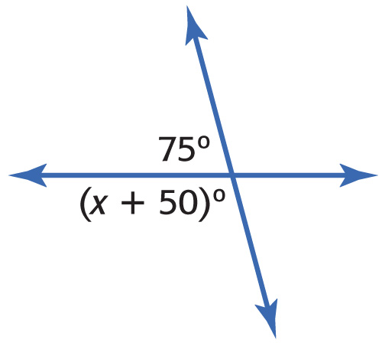


(over Lesson 6-1)
Find the value of x.
A. 40
B. 45
C. 50
D. 55
A
B
C
D

Slide 4

(over Lesson 6-3)
Find the measure of one interior angle in a regular octagon. Round to the nearest tenth if necessary.
A. 135°
B. 270°
C. 540°
D. 1080°
A
B
C
D

Slide 5

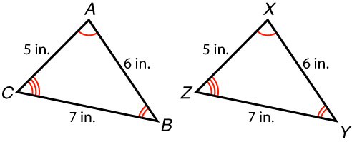

(over Lesson 6-4)
Are the 2 polygons congruent? If so, list their congruent parts.
A. yes; ∠A ≅ ∠X, ∠B ≅ ∠Z, ∠C ≅ ∠Y, AB ≅ XY, BC ≅ YZ, AC ≅ XZ, ΔABC ≅ ΔXYZ
B. yes; ∠A ≅ ∠X, ∠B ≅ ∠Y, ∠C ≅ ∠Z, AB ≅ XY, BC ≅ YZ, AC ≅ XZ, ΔABC ≅ ΔXYZ
C. yes; ∠A ≅ ∠X, ∠B ≅ ∠Y, ∠C ≅ ∠Z, AB ≅ XZ, BC ≅ YZ, AC ≅ XY, ΔABC ≅ ΔXYZ
D. no
A
B
C
D

Slide 6
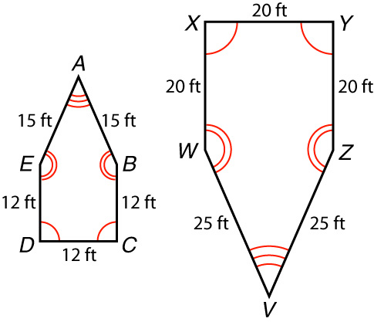

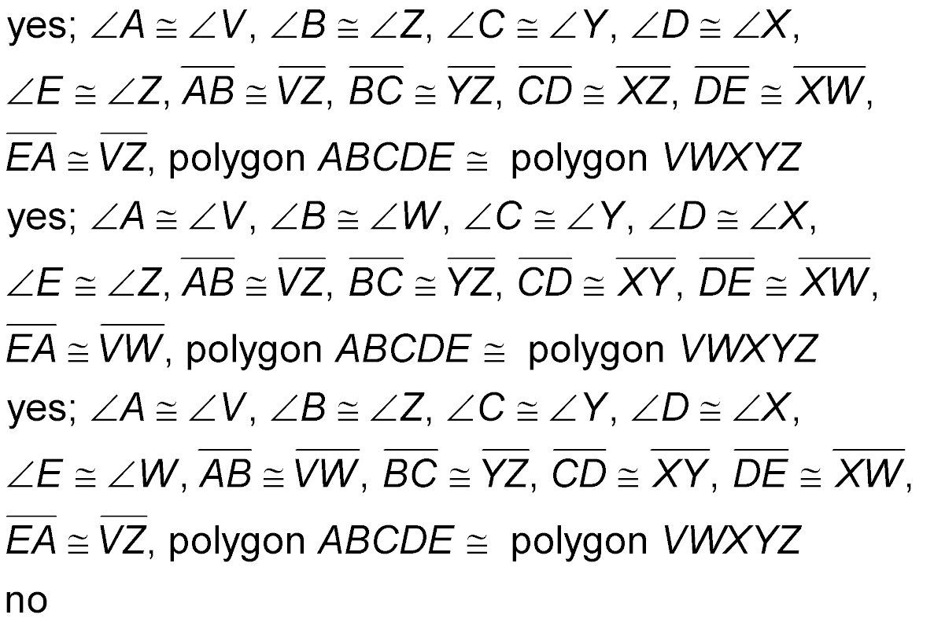
(over Lesson 6-4)
Are the 2 polygons congruent? If so, list their congruent parts.
A.
B.
C.
D. no
A
B
C
D

Slide 7


Identify line symmetry and rotational symmetry.
line symmetry
line of symmetry
rotational symmetry
angle of rotation

Slide 8

Standard 7MG3.2 Understand and use coordinate graphs to plot simple figures, determine lengths and areas related to them, and determine their image under translations and reflections.

Slide 9
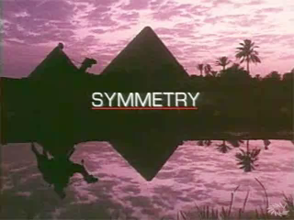

Slide 10

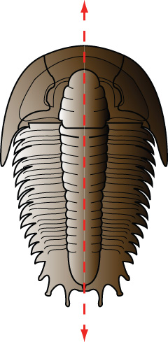

Identify Line Symmetry
Determine whether the figure has line symmetry. If it does, draw all lines of symmetry. If not, write none.
Answer: This figure has one vertical line of symmetry.

Slide 11

Identify Line Symmetry
Determine whether the figure has line symmetry. If it does, trace the figure and draw all lines of symmetry. If not, write none.
Answer: This figure has no lines of symmetry.

Slide 12

Identify Rotational Symmetry
FLOWERS Determine whether the flower design has rotational symmetry. Write yes or no. If yes, name its angle(s) of rotation.

Slide 13
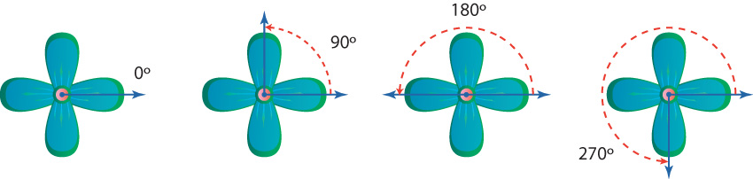
Identify Rotational Symmetry
Answer: Yes, this figure has rotational symmetry. It will match itself after being rotated 90°, 180°, and 270°.

Slide 14
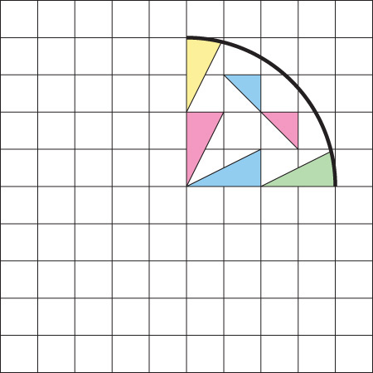
Use a Rotation
ARCHITECTURE A rosette is a painted or sculptured ornament, usually circular, having designs that radiate symmetrically from the center. Copy and complete the picture of the rosette shown so that the completed figure has rotational symmetry with 90°, 180°, and 270° as its angles of rotation.

Slide 15
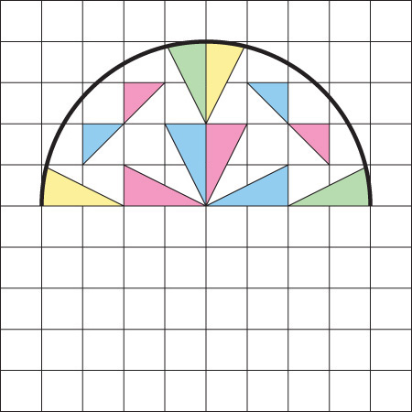
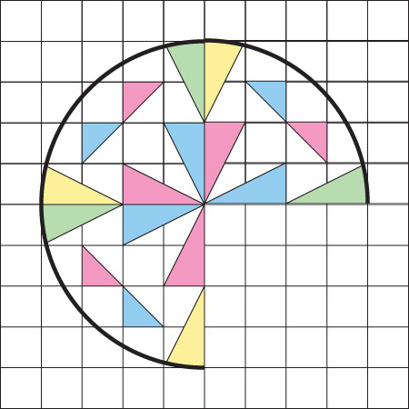
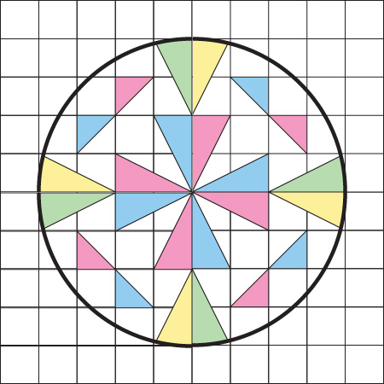
Use a Rotation
Use the procedure described above and the points indicated to rotate the figure 90°, 180, and 270° counterclockwise. Use a 90° rotation clockwise to produce the same rotation as a 270° rotation counterclockwise.
Answer:
90° counterclockwise
180° counterclockwise
90° clockwise

Slide 16


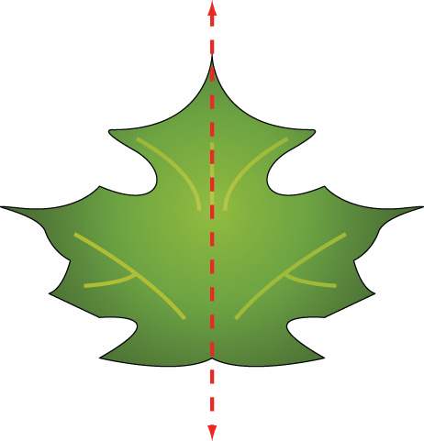
BOTANY Determine whether the leaf has line symmetry. If it does, draw all lines of symmetry. If not, write none.
Answer: This figure has one vertical line of symmetry.

Slide 17

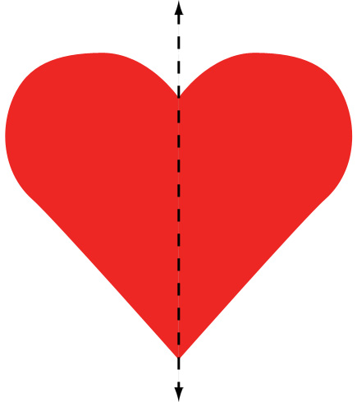
Determine whether the figure has line symmetry. If it does, trace the figure and draw all lines of symmetry. If not, write none.
Answer: This figure has one vertical line of symmetry.

Slide 18

FLOWERS Determine whether the flower design has rotational symmetry. Write yes or no. If yes, name its angle(s) of rotation.
A
B
C
D
A. yes, 90° B. yes, 120°
C. yes, 180° D. no

Slide 19
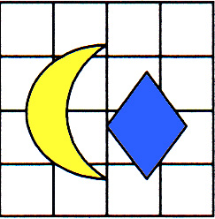
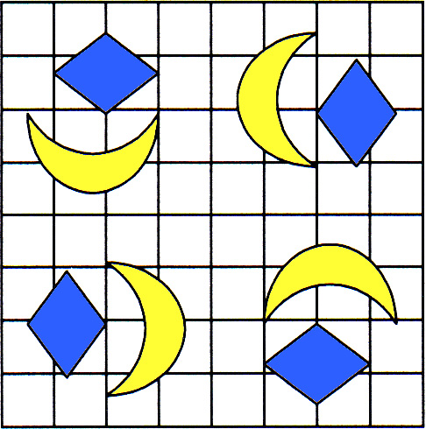
DESIGN Copy and complete the figure so that the completed design has rotational symmetry with 90°, 180°, and 270° as its angles of counter clockwise rotation.
Answer:

Slide 20
