Slide 1
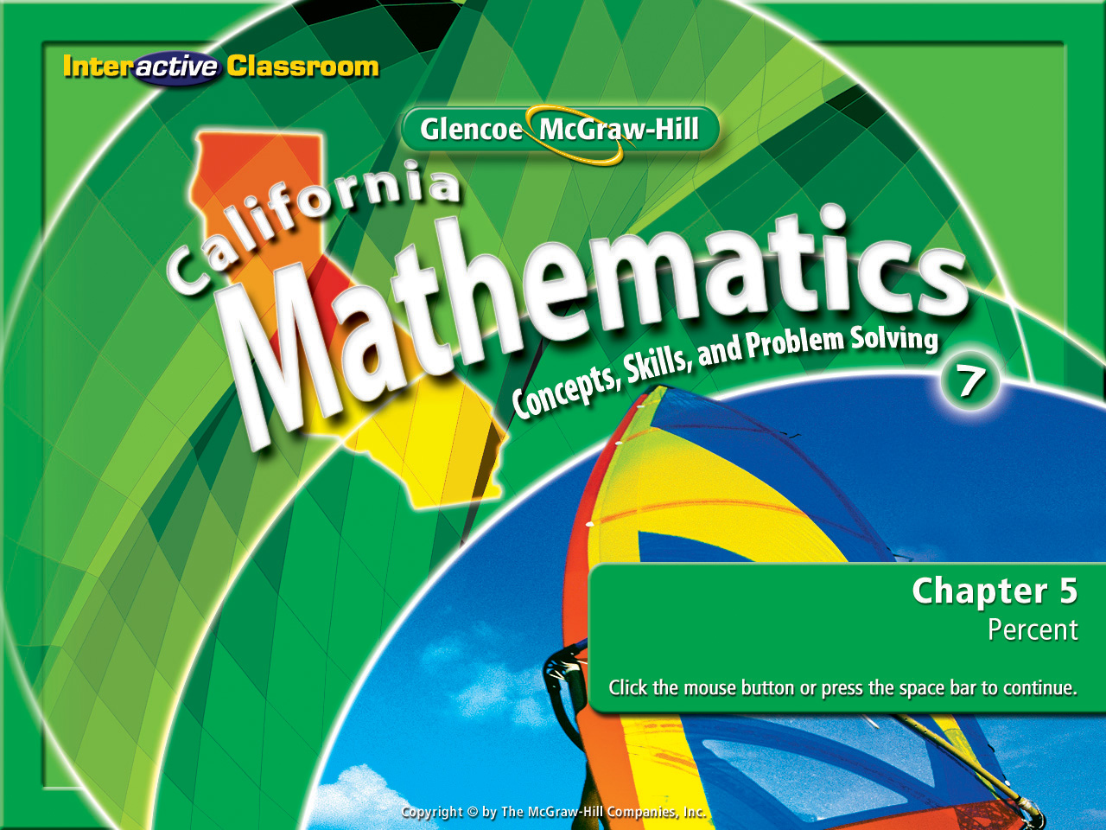
Splash Screen
Chapter 6
Lesson 6-6

Slide 2







(over Lesson 6-3)
Find the measure of one interior angle in a regular 56-gon. Round to the nearest tenth if necessary.
A. 86.8°
B. 9720°
C. 3992.8°
D. 173.6°
A
B
C
D

Slide 3

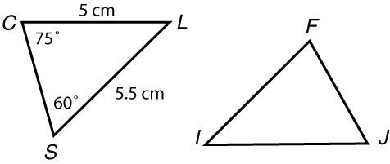
(over Lesson 6-4)
In the figure, ΔCLS ≅ ΔFIJ. Find m∠I.
A. 30°
B. 45°
C. 60°
D. 75°
A
B
C
D

Slide 4


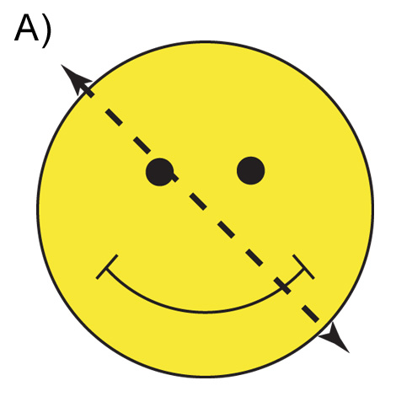
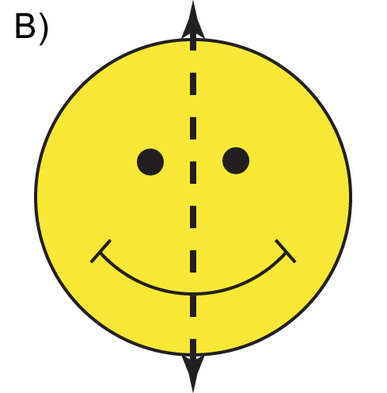
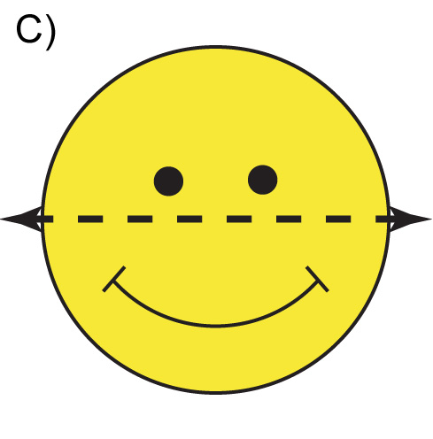

(over Lesson 6-5)
Determine whether the figure has line symmetry. If it does, identify the figure that shows all lines of symmetry. If not, choose none.
A. B.
C. D. none
A
B
C
D

Slide 5
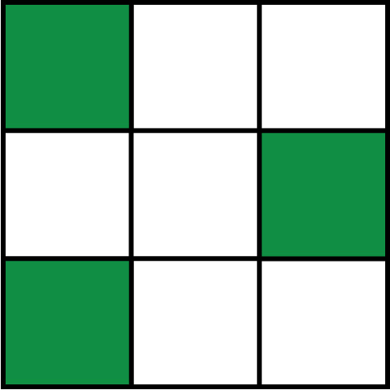

(over Lesson 6-5)
Determine whether the figure has rotational symmetry. If yes, name its angle(s) of rotation.
A. yes; 45°, 90°, and 180°
B. yes; 90°, 180°, and 270°
C. yes; 90°, 180°, and 360°
D. no
A
B
C
D

Slide 6


Graph reflections on a coordinate plane.
reflection
line of reflection
transformation

Slide 7

Standard 7MG3.2 Understand and use coordinate graphs to plot simple figures, determine lengths and areas related to them, and determine their image under translations and reflections.

Slide 8
Using a coordinate board, plot the following coordinates:
K(1, 3), L(4, 2), M(3, -2)
Now, plot the following coordinates:
K(-1, 3), L(-4, 2), M(-3, -2)

Slide 9
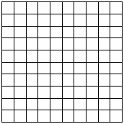
It should look like this:
y
x

Slide 10
This is called a reflection over the y-axis.
What do you notice about this?
y
x

Slide 11

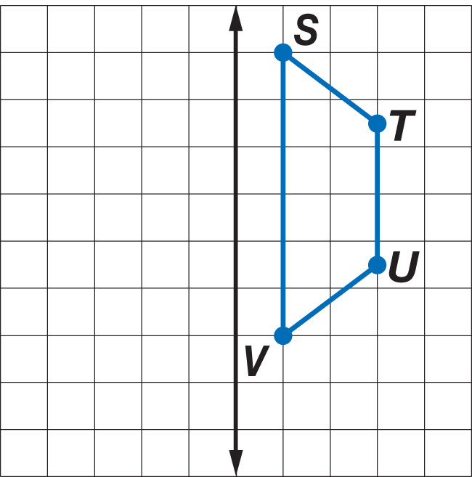
Draw a Reflection
Copy trapezoid STUV below on graph paper. Then draw the image of the figure after a reflection over the given line.

Slide 12
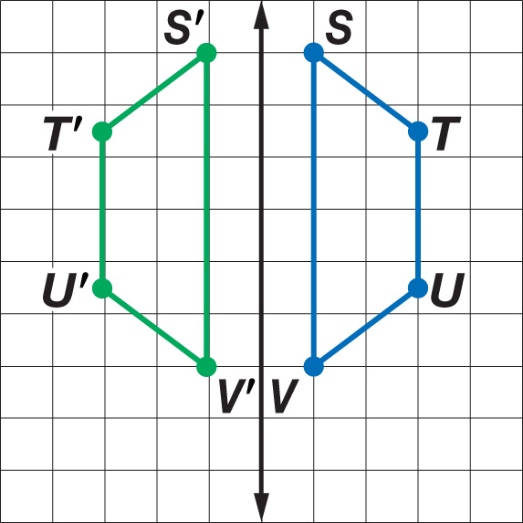
Draw a Reflection
Step 1 Count the number of units between each vertex and the line of reflection.
Answer:
Step 2 Plot a point for each vertex the same distance away from the line on the other side.
Step 3 Connect the new vertices to form the image of trapezoid STUV, trapezoid S'T'U'V'.

Slide 13
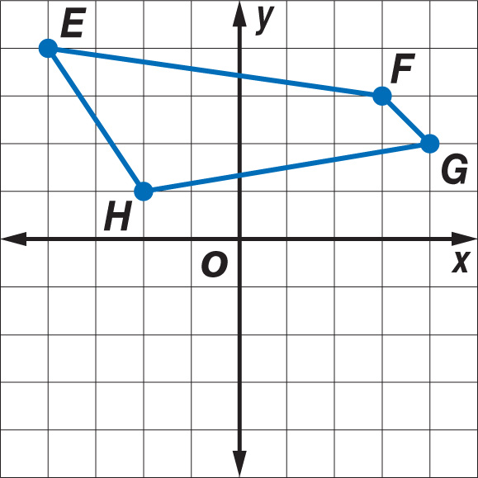
Reflect a Figure Over an Axis
Graph quadrilateral EFGH with vertices E(–4, 4), F(3, 3), G(4, 2) and H(–2, 1). Then graph the image of EFGH after a reflection over the x-axis and write the coordinates of its vertices.

Slide 14
Reflect a Figure Over an Axis
The coordinates of the vertices of the reflected image are E'(–4, –4), F'(3, –3), G'(4, –2), and H'(–2, –1).
Notice that the y-coordinate of a point reflected over the x-axis is the opposite of the y-coordinate of the original point.
same
opposites
E(–4, 4)
E'(–4, –4)
Coordinates of the original shape.
F(3, 3)
F'(3, –3)
Coordinates of the shape reflected over the x-axis.
G(4, 2)
G'(4, –2)
H(–2, 1)
H'(–2, –1)

Slide 15
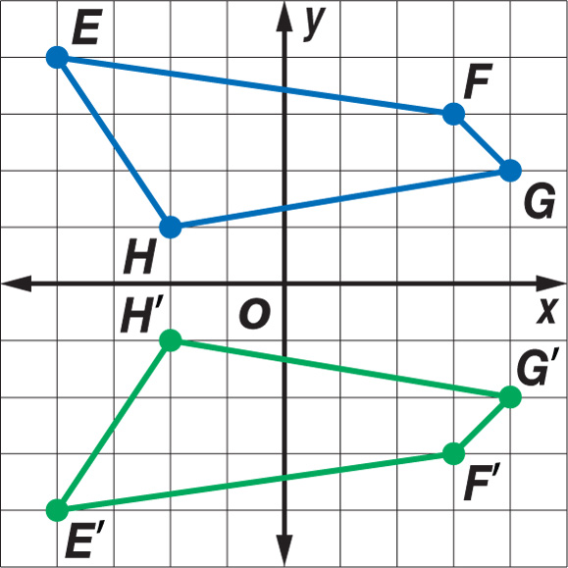
Reflect a Figure Over an Axis
Answer: E'(–4, –4), F'(3, –3), G'(4, –2), and H'(–2, –1).

Slide 16
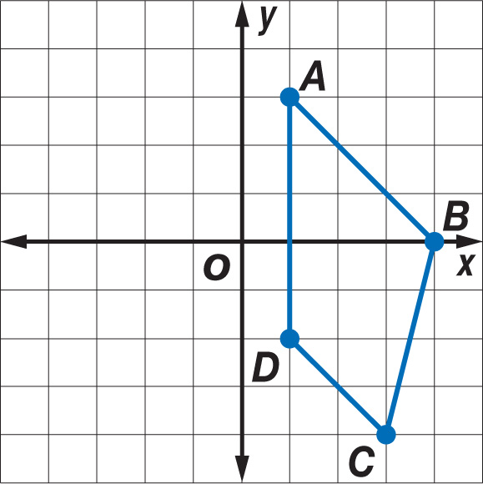
Reflect a Figure Over an Axis
Graph quadrilateral ABCD with vertices A(1, 3), B(4, 0), C(3, –4), and D(1, –2). Then graph the image of ABCD after a reflection over the y-axis, and write the coordinates of its vertices.

Slide 17
Reflect a Figure Over an Axis
The coordinates of the vertices of the image are A'(–1, 3), B'(–4, 0), C'(–3, –4), and D'(–1, –2).
Notice that the x-coordinate of a point reflected over the y-axis is the opposite of the x-coordinate of the original point.
opposites
same
A(1, 3)
A'(–1, 3)
Coordinates of the original shape.
B(4, 0)
B'(–4, 0)
Coordinates of the shape reflected over the y-axis.
C(3, –4)
C'(–3, –4)
D(1, –2)
D'(–1, –2)

Slide 18
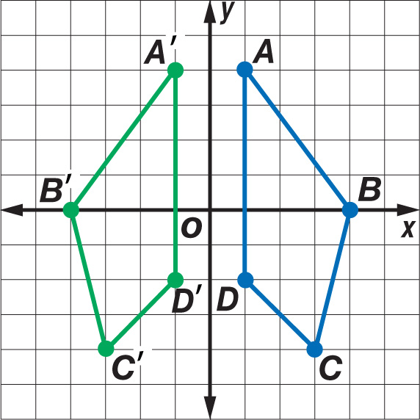
Reflect a Figure Over an Axis
Answer: A'(–1, 3), B'(–4, 0), C'(–3, –4), and D'(–1, –2).

Slide 19
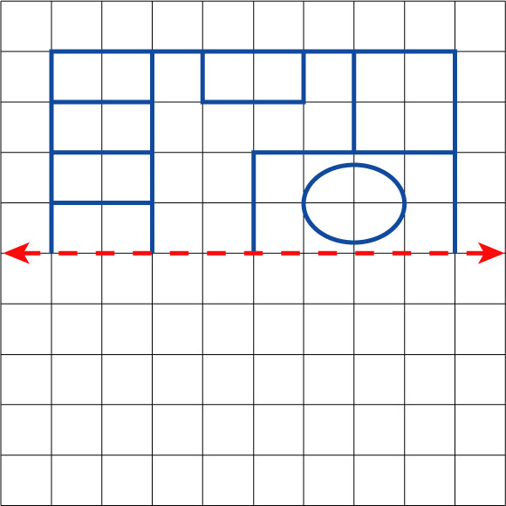
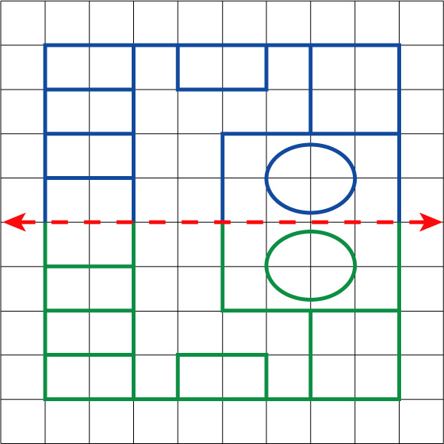
Use a Reflection
ARCHITECTURE Copy and complete the office floor plan shown below so that the completed office has a horizontal line of symmetry.
You can reflect the half of the office floor plan shown over the indicated horizontal line.
Find the distance from each vertex on the figure to the line of reflection.
Then plot a point the same distance away on the opposite side of the line.
Connect vertices as appropriate.
Answer:

Slide 20

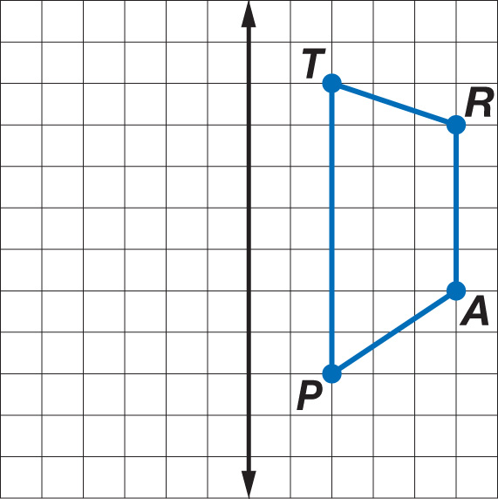
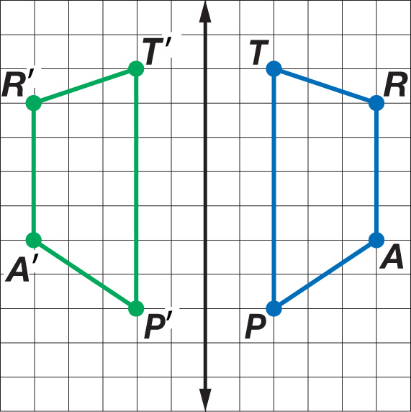
Copy trapezoid TRAP below on graph paper. Then draw the image of the figure after a reflection over the given line.
Answer:

Slide 21
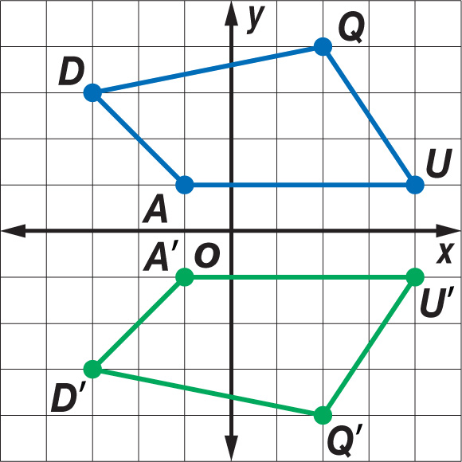
Graph quadrilateral QUAD with vertices Q(2, 4), U(4, 1), A(–1, 1), and D(–3, 3). Then graph the image of QUAD after a reflection over the x-axis, and write the coordinates of its vertices.
Answer: Q'(2, –4), U'(4, –1), A'(–1, –1), and D'(–3, –3).

Slide 22
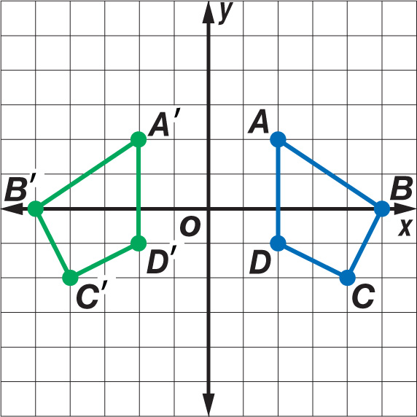
Graph quadrilateral ABCD with vertices A(2, 2), B(5, 0), C(4, –2), and D(2, –1). Then graph the image of ABCD after a reflection over the y-axis, and write the coordinates of its vertices.
Answer: A'(–2, 2), B'(–5, 0), C'(–4, –2), and D'(–2, –1).

Slide 23
