Slide 1
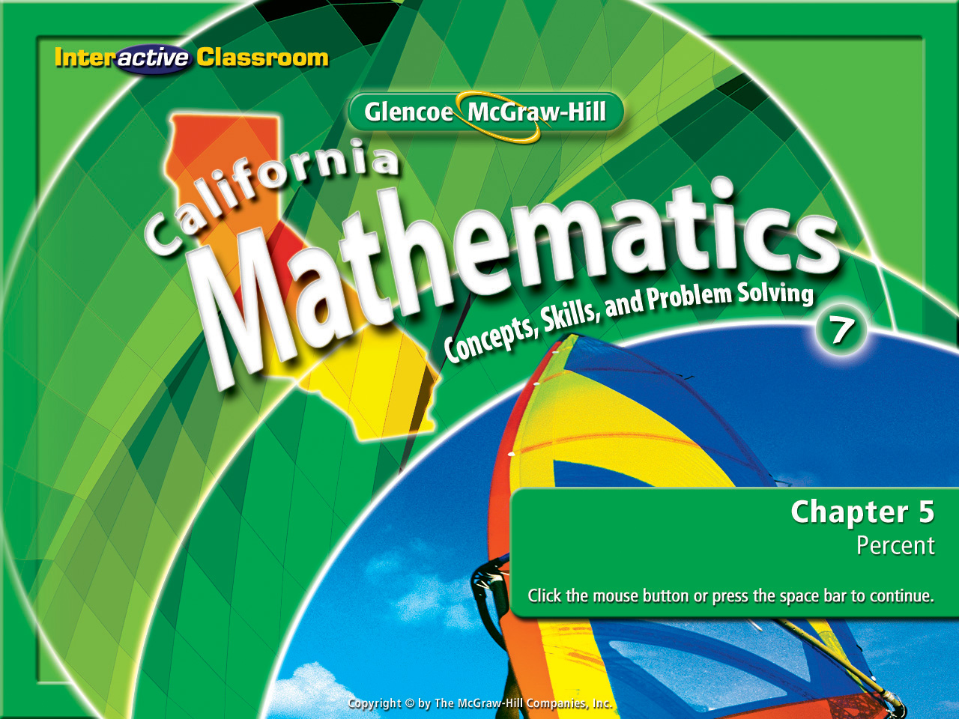
Splash Screen
Chapter 6
Lesson 6-7

Slide 2







(over Lesson 6-3)
Find the measure of one interior angle in a regular 14-gon. Round to the nearest tenth is necessary.
A. 308.6°
B. 154.3°
C. 1080°
D. 2160°
A
B
C
D

Slide 3


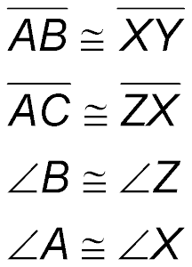
(over Lesson 6-4)
If ΔABC ≅ ΔXYZ, which of the following options is not true?
A.
B.
C.
D.
A
B
C
D

Slide 4


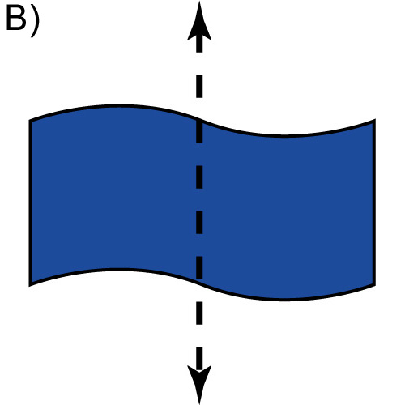
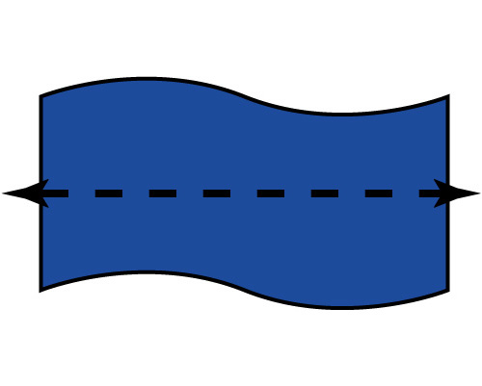
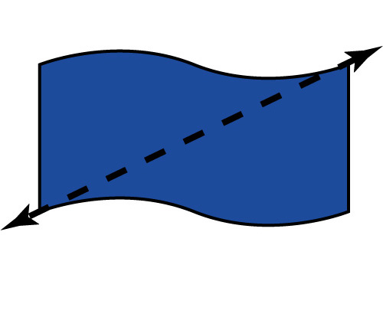
(over Lesson 6-5)
Determine whether the figure has line symmetry. If it does, identify the figure that shows all lines of symmetry. If not, choose none.
A. B.
C. D. none
A
B
C
D

Slide 5

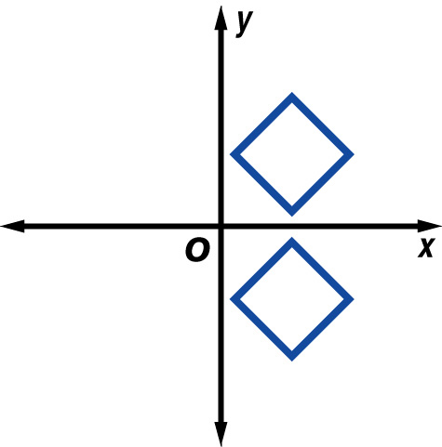

(over Lesson 6-6)
Name the line of reflection for the pair of figures in the picture.
A. x-axis
B. y-axis
C. y = x
D. y = –x
A
B
C
D

Slide 6

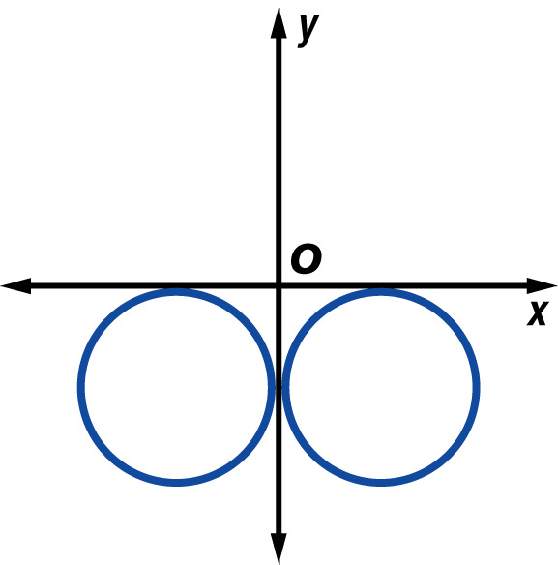
(over Lesson 6-6)
Name the line of reflection for the pair of figures in the picture.
A. x-axis
B. y-axis
C. y = x
D. y = –x
A
B
C
D

Slide 7


Graph translations on a coordinate plane.
translation

Slide 8

Standard 7MG3.2 Understand and use coordinate graphs to plot simple figures, determine lengths and areas related to them, and determine their image under translations and reflections.

Slide 9
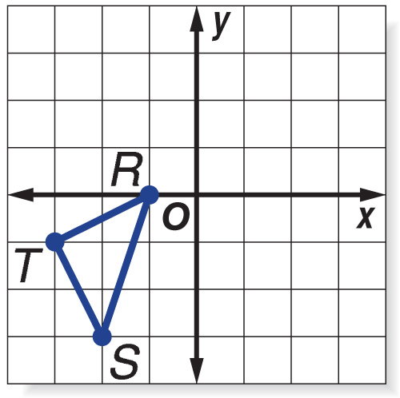
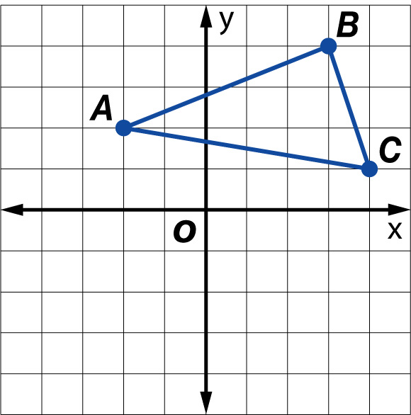
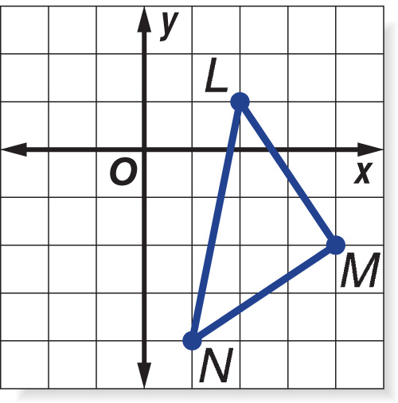
Carefully watch and determine what is happening each time.

Slide 10
These are all examples of a translation.

Slide 11
Let’s see how that’s done.

Slide 12

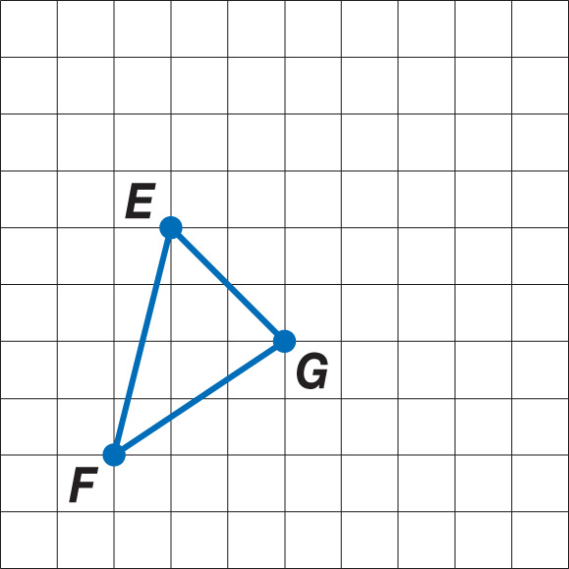
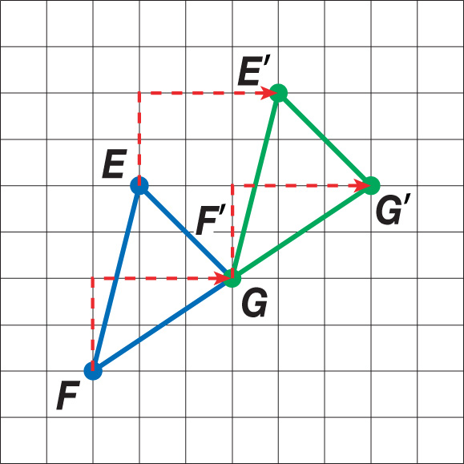
Draw a Translation
Copy ΔEFG below on graph paper. Then draw the image of the figure after a translation of 3 units right and 2 units up.
Answer:
Step 1 Move each vertex of the triangle 3 units right and 2 units up.
Step 2 Connect the new vertices to form the image.

Slide 13
Translation in the Coordinate Plane
Graph ΔABC with vertices A(–2, 2), B(3, 4), and C(4, 1). Then graph the image of ΔABC after a translation of 2 units left and 5 units down. Write the coordinates of its vertices.
Next Slide Please

Slide 14
Translation in the Coordinate Plane
The coordinates of the vertices of the image are A'(–4, –3), B'(1, –1), and C'(2, –4). Notice that these vertices can also be found by combining –2 (two units left) to the x-coordinates and –5 ( five units down) to the y-coordinates, or (–2, –5).
Original Combine (–2, –5) Image
A(–2, 2) (–2 + (–2), 2 + (–5)) (–4, –3)
B(3, 4) (3 + (–2), 4 + (–5)) (1, –1)
C(4, 1) (4 + (–2), 1 + (–5)) (2, –4)

Slide 15
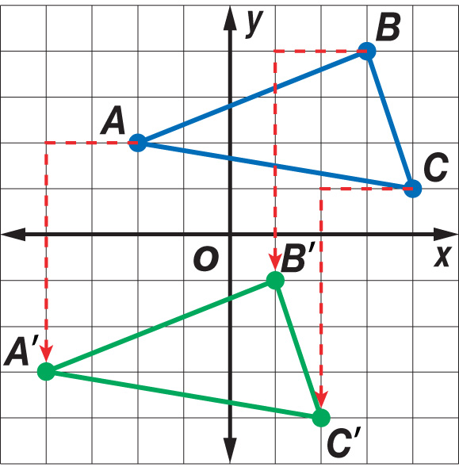
Translation in the Coordinate Plane
Answer: A'(–4, –3), B'(1, –1), and C'(2, –4)

Slide 16

If triangle RST is translated 4 units to the right (+4) and 3 units up (+3), what are the coordinates of point T' ?
A. (0, 3) B. (1, 2)
C. (2, 1) D. (1, 1)

Slide 17
Read the Item
You are asked to find the coordinates of point T' after the original figure has been translated 4 units right and 3 units up.
Solve the Item
You can answer this question without translating the entire triangle.

Slide 18
The coordinates of point T are (–3, –1).
The x-coordinate of T is –3, so the x-coordinate of T' is –3 + 4 or 1.
Translating 4 units right is the same as combining 4 to the x-coordinate.
The y-coordinate of T is –1, so the y-coordinate of T' is –1 + 3 or 2.
Translating 3 units up is the same as combining 3 to the y-coordinate.
The coordinates of T' are:
A. (0, 3) B. (1, 2)
C. (2, 1) D. (1, 1)

Slide 19

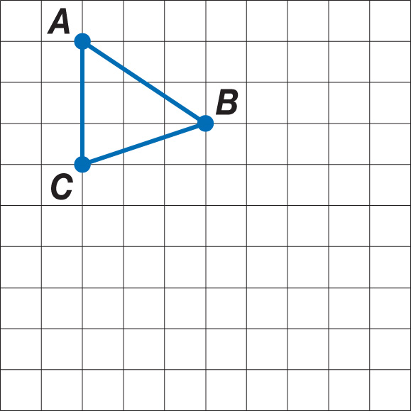
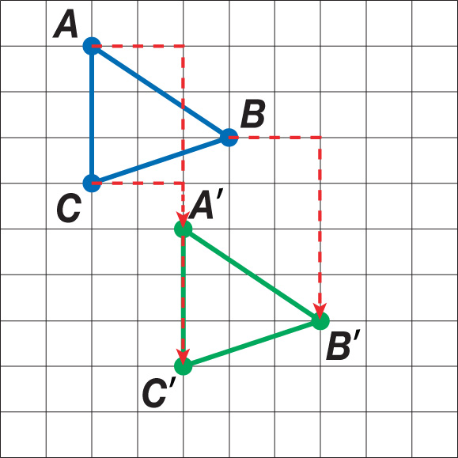
Copy ΔABC below on graph paper. Then draw the image of the figure after a translation of 2 units right and 4 units down.
Answer:

Slide 20
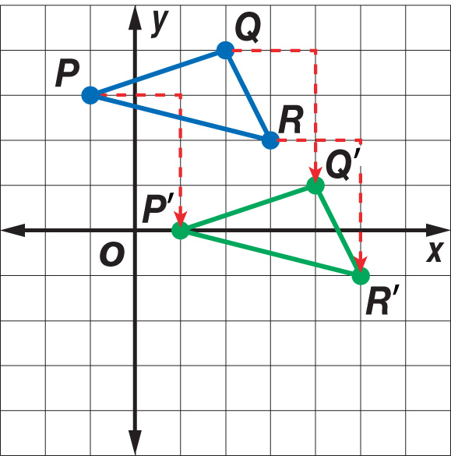
Graph ΔPQR with vertices P(–1, 3), Q(2, 4), and R(3, 2). Then graph the image of ΔPQR after a translation of 2 units right and 3 units down. Write the coordinates of its vertices.
Answer: P'(1, 0), Q'(4, 1), and R'(5, –1)

Slide 21
If triangle LMN is translated 4 units left and 2 units up, what are the coordinates of point L'?
A. (0, –1) B. (–3, 2)
C. (–1, –4) D. (–2, 3)
A
B
C
D

Slide 22
