Slide 1
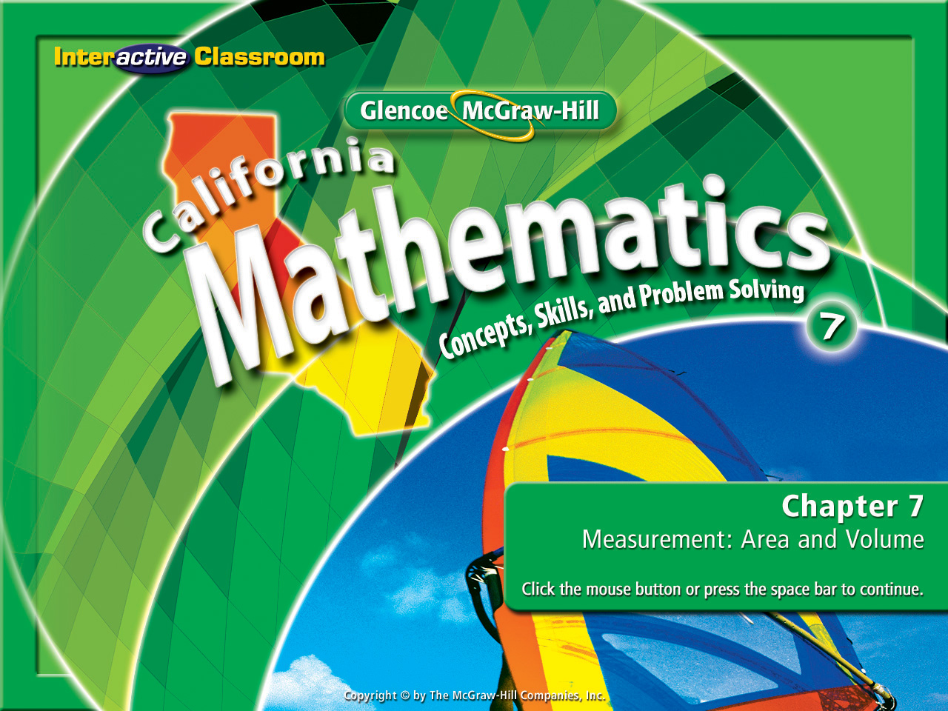
Splash Screen
Chapter 7
Lesson 7-1

Slide 2




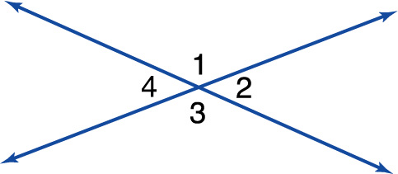



(over Chapter 6)
Refer to the figure. Find m∠1 if m∠2 is 35°.
A. 145
B. 125
C. 55
D. 35
A
B
C
D

Slide 3


(over Chapter 6)
Find the coordinates of the vertices of triangle LMN with vertices L(2, –1), M(0, –3), and N(4, –3) translated by (–2, 3).
A. L'(0, 2), M'(–2, 0), N'(2, 0)
B. L'(0, 4), M'(–2, 0), N'(2, 0)
C. L'(4, 2), M'(2, 0), N'(6, 0)
D. L'(4, –4), M'(2, –6), N'(6, –6)
A
B
C
D

Slide 4

(over Chapter 6)
Find the coordinates of the vertices of rectangle JKLM with vertices J(–5, 4), K(–2, 4), L(–2, 3), and M(–5, 3) translated by (1, –2).
A. J'(–4, 2), K'(–1, 2), L'(–1, 1), M'(6, 1)
B. J'(–4, 2), K'(3, 2), L'(–1, 1), M'(–4, 1)
C. J'(–4, 2), K'(–1, 2), L'(–1, 1), M'(–4, 1)
D. J'(6, 2), K'(–1, 2), L'(–1, 1), M'(–4, 1)
A
B
C
D

Slide 5

(over Chapter 6)
Find the coordinates of the vertices of trapezoid PQRS with vertices P(–4, –3), Q(–1, –3), R(–1, –2), and S(–4, –1) translated by (5, 1).
A. P'(1, –2), Q'(4, –2), R'(4, –1), S'(1, 2)
B. P'(1, –2), Q'(4, –2), R'(4, –1), S'(1, 0)
C. P'(1,4), Q'(4, –2), R'(4, –1), S'(1, 0)
D. P'(1, –2), Q'(4, 4), R'(4, –1), S'(1, 0)
A
B
C
D

Slide 6


Find the circumference and area of circles.
circle
center
radius
chord
diameter
circumference
Area
pi
3.14 or 22/7

Slide 7

Standard 7MG2.1
Use formulas routinely for finding the perimeter and area of basic two-dimensional figures and the surface area and volume of basic three-dimensional figures, including rectangles, parallelograms, trapezoids, squares, triangles, circles, prisms, and cylinders.
Standard 7MG3.1
Identify and construct basic elements of geometric figures (e.g., altitudes, midpoints, diagonals, angle bisectors, and perpendicular bisectors; central angles, radii, diameters, and chords of circles) by using a compass and straightedge.

Slide 8
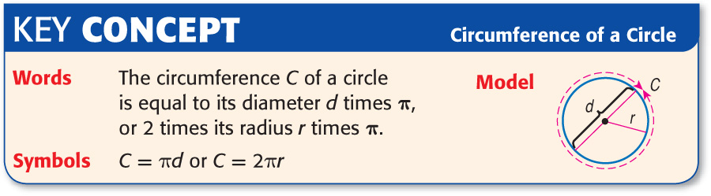

Slide 9
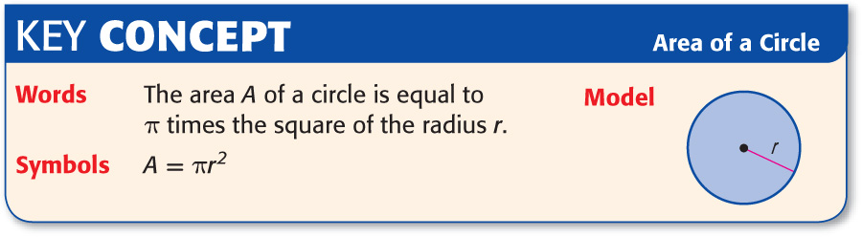

Slide 10

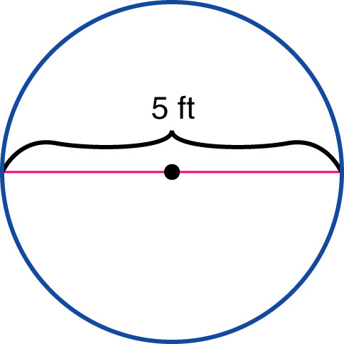
Find the Circumferences of Circles
Find the circumference of the circle. Round to the nearest tenth.
C = πd Circumference of a circle
C = π • 5 Replace d with 5.
C = 5π This is the exact circumference.
Answer: The circumference is about 15.7 feet.

Slide 11
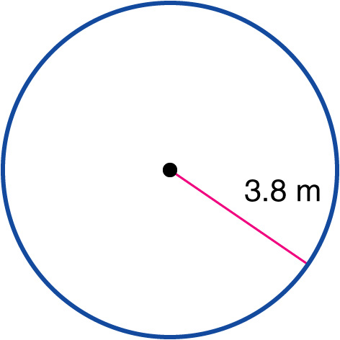
Find the Circumferences of Circles
Find the circumference of the circle. Round to the nearest tenth.
C = 2πr Circumference of a circle
C = 2 • π • 3.8 Replace r with 3.8.
C ≈ 2 • 3.14 • 3.8 Replace π with 3.14 & multiply.
Answer: The circumference is about 23.9 meters.

Slide 12
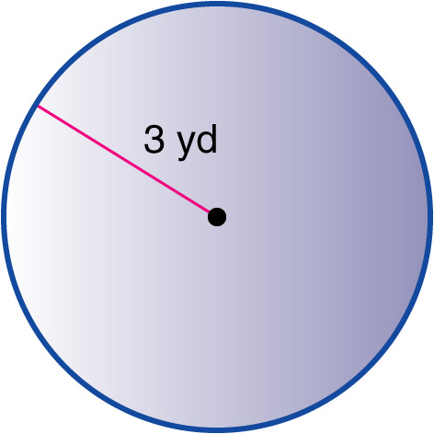
Find the Areas of Circles
Find the area of the circle. Round to the nearest tenth.
A = πr² Area of a circle
A = π • 3² Replace r with 3.
A = π • 9 Evaluate 3².
A ≈ 3.14 • 9 Replace π with 3.14 and multiply.
Answer: The area is about 28.3 square yards.

Slide 13
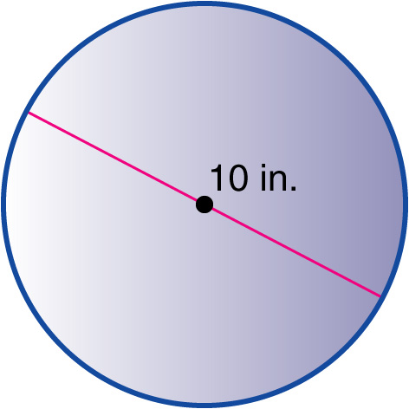
Find the Areas of Circles
Find the area of the circle. Round to the nearest tenth.
A = πr² Area of a circle
A = π • 5² Replace r with half of 10 or 5.
A = π • 25 Evaluate 5².
A ≈ 78.5 Replace π with 3.14 and multiply.
Answer: The area is about 78.5 square inches.

Slide 14

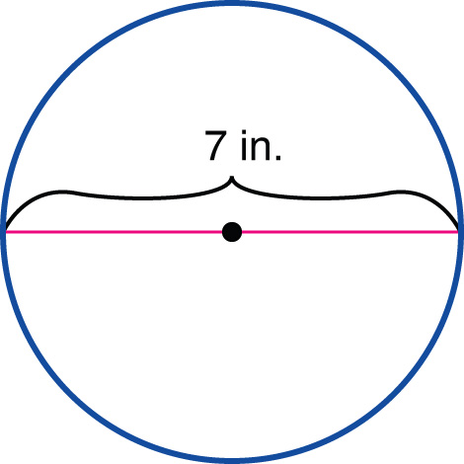
Find the circumference of the circle. Round to the nearest tenth.
A. 38.5 in.
B. 31.4 in.
C. 22.0 in.
D. 19.7 in.
A
B
C
D

Slide 15
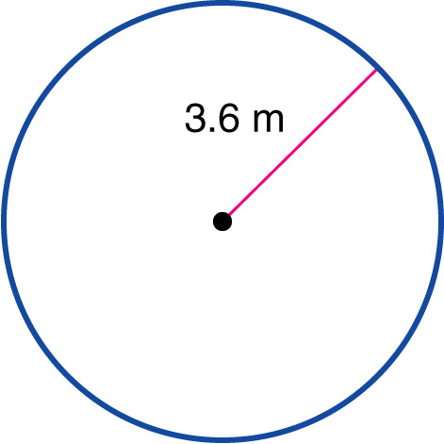
Find the circumference of the circle. Round to the nearest tenth.
A. 9.4 m
B. 11.3 m
C. 18.5 m
D. 22.6 m
A
B
C
D

Slide 16
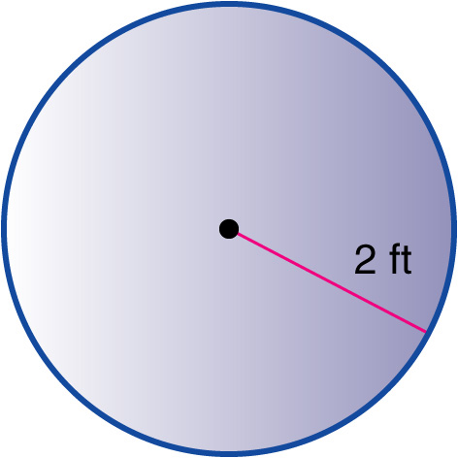
Find the area of the circle. Round to the nearest tenth.
A. 12.6 ft²
B. 14.1 ft²
C. 15.3 ft²
D. 17.4 ft²
A
B
C
D

Slide 17
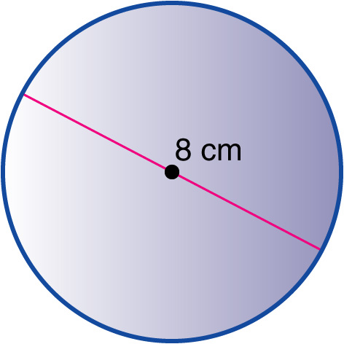
Find the area of the circle. Round to the nearest tenth.
A. 42.7 cm²
B. 50.2 cm²
C. 52.1 cm²
D. 54.6 cm²
A
B
C
D

Slide 18
Divide Your Paper in 1/2
Write the formula for
circumference of a circle:
Write the formula for
area of a circle:
C = πd
A = πr²
When I say go, write the
formula for circumference
as many times as you can
in 1 minute.
When I say go, write the
formula for are
as many times as you can
in 1 minute.
Count up how many times
You wrote it. Who had the most?
Count up how many times
You wrote it. Who had the most?

Slide 19

Write down 1 thing you will do differently during our next lesson that will improve your learning.
Reflect upon how you participated in the lesson today. Ask yourself:
“Did I take good notes, did I ask questions when I did not understand something?”

Slide 20
