Slide 1
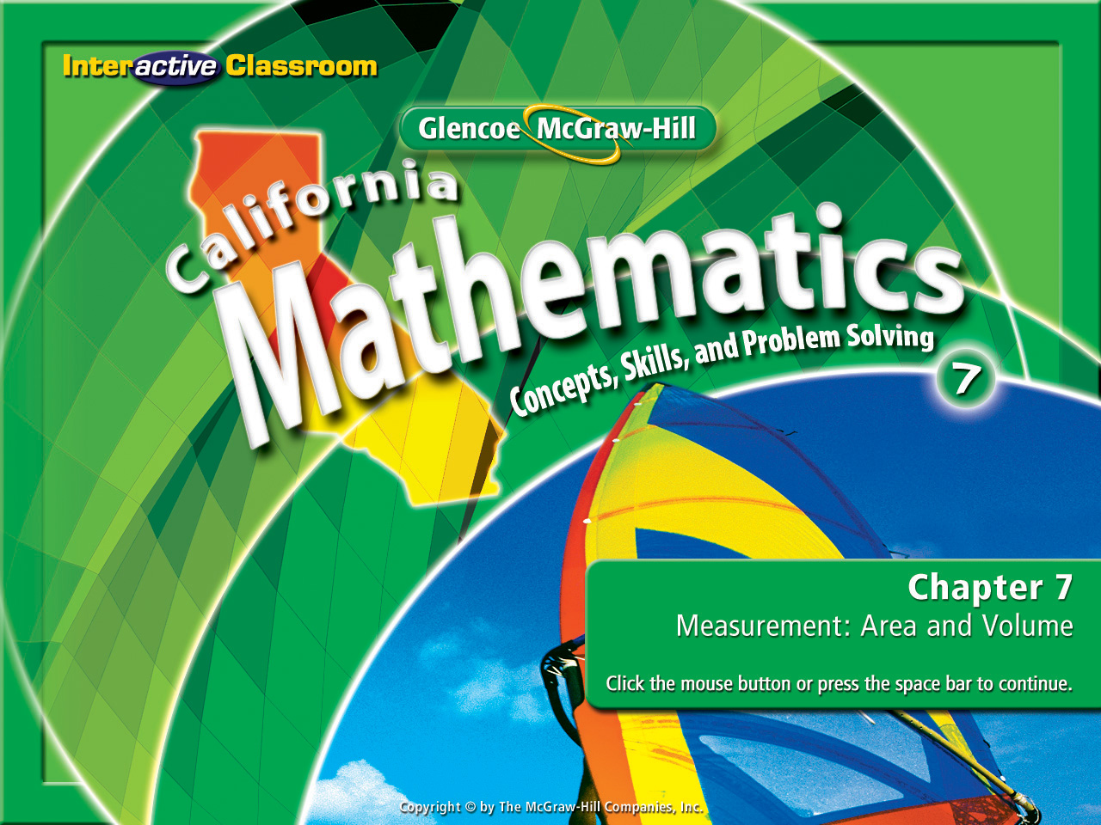
Splash Screen
Chapter 7
Lesson 7-3

Slide 2

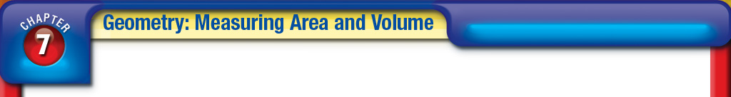





(over Chapter 6)
Find the coordinates of the vertices of triangle LMN with vertices L(2, –1), M(0, –3), and N(4, –3) translated by (–2, 3).
A. L'(0, 2), M'(–2, 0), N'(2, 0)
B. L'(0, 4), M'(–2, 0), N'(2, 0)
C. L'(4, 2), M'(2, 0), N'(6, 0)
D. L'(4, –4), M'(2, –6), N'(6, –6)
A
B
C
D

Slide 3

(over Chapter 6)
Find the coordinates of the vertices of rectangle JKLM with vertices J(–5, 4), K(–2, 4), L(–2, 3), and M(–5, 3) translated by (1, –2).
A. J'(–4, 2), K'(–1, 2), L'(–1, 1), M'(6, 1)
B. J'(–4, 2), K'(3, 2), L'(–1, 1), M'(–4, 1)
C. J'(–4, 2), K'(–1, 2), L'(–1, 1), M'(–4, 1)
D. J'(6, 2), K'(–1, 2), L'(–1, 1), M'(–4, 1)
A
B
C
D

Slide 4

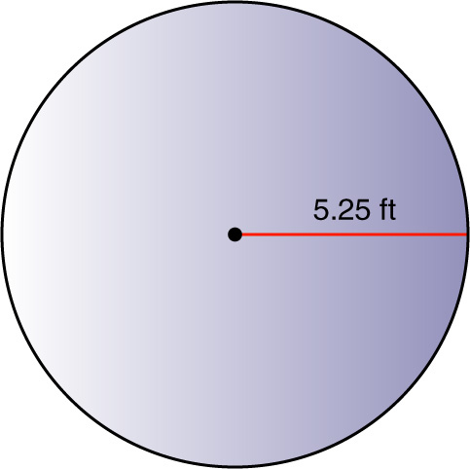
(over Lesson 7-1)
Find the circumference and area of the circle in the figure. Round to the nearest tenth.
A. 16.5 ft; 86.6 ft²
B. 33.0 ft; 86.6 ft²
C. 16.5 ft; 33.0 ft²
D. 33.0 ft; 43.3 ft²
A
B
C
D

Slide 5
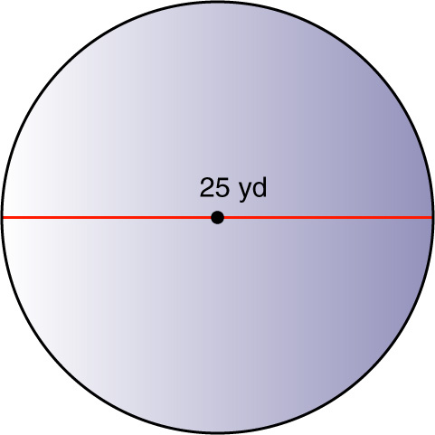

(over Lesson 7-1)
Find the circumference and area of the circle in the figure. Round to the nearest tenth.
A. 157.1 yd; 1963.5 yd²
B. 157 yd; 490.9 yd²
C. 78.5 yd; 490.9 yd²
D. 78.5 yd; 245.3 yd²
A
B
C
D

Slide 6
Last lesson you were asked to write down 1 thing you would do this lesson that would improve your learning.
To begin today’s lesson, write down that goal at the top of your paper.

Slide 7


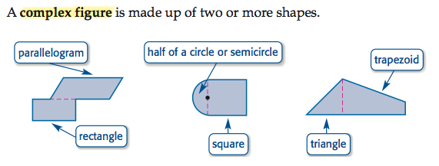
Find the area of complex figures.
complex figure

Slide 8

Standard 7MG2.1
Use formulas routinely for finding the perimeter and area of basic two-dimensional figures and the surface area and volume of basic three-dimensional figures, including rectangles, parallelograms, trapezoids, squares, triangles, circles, prisms, and cylinders.
Standard 7MG2.2
Estimate and compute the area of more complex or irregular two- and three-dimensional figures by breaking the figures down into more basic geometric objects.

Slide 9
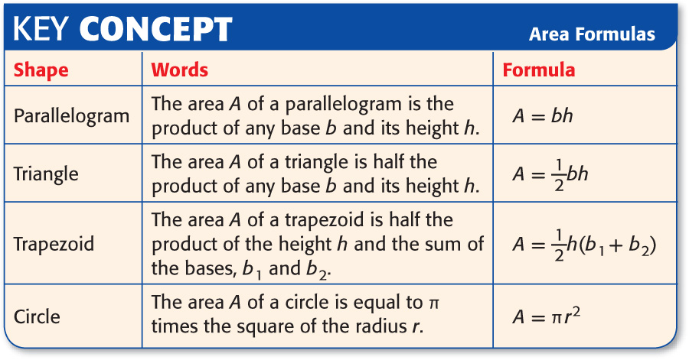
You will be given an index card. As we review each of the following formulas, write the name, draw the shape, and record the appropriate formula.

Slide 10
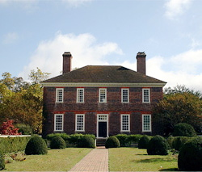
- You have been asked to paint the front of this building, including the door, water seal the roof and chimneys, and place new screen material over the windows.
- To do so you must calculate the square footage for each shape the house contains. How many different shapes are there, what are they, and how many of each one are there?
1 Trapezoid
13 Rectangle’s

Slide 11

- You have been asked to paint the Kuwait national flag for display at the United nations. You have to determine the amount of green, white, red, and black paint that you need.
- To do so you must calculate the square footage for each shape contained in the flag. How many different shapes are there and how many of each one are in the flag?
1 Trapezoid
2 Triangles
3 Rectangles

Slide 12

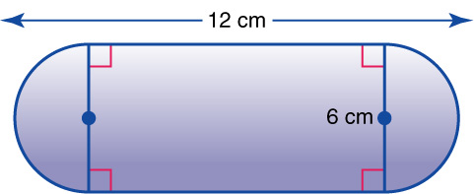
Find the Area of a Complex Figure
Find the area of the complex figure. Round to the nearest tenth.
The figure can be separated into two semicircles and a rectangle.
Cover up the semi circles and calculate the area of the rectangle.

Slide 13
Find the Area of a Complex Figure
Find the area of the complex figure. Round to the nearest tenth.
Write the formula for area of a rectangle: A = lw
Replace the variables with the known values: A = (12cm) (6cm)
Calculate the value: A = 72 cm²

Slide 14
Find the Area of a Complex Figure
Find the area of the complex figure. Round to the nearest tenth.
Now cover up the rectangle and calculate the area of the semi circles .

Slide 15
Find the Area of a Complex Figure
Find the area of the complex figure. Round to the nearest tenth.
Write the formula for area of a circle: A = π r²
Replace the variables with the known values: A = (3.14) (3²)
Evaluate the equation: A = (3.14) (9cm)
Calculate the solution: A = 28.26cm²
Round to the nearest tenth: A = 28.3cm²

Slide 16
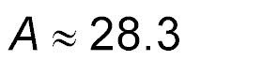
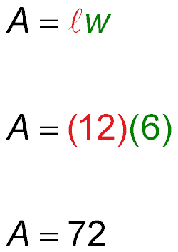
Area Complex Figures
Area of semicircles
Area of rectangle
+
Answer: The area of the figure is about 28.3 + 72 or 100.3 square centimeters.

Slide 17

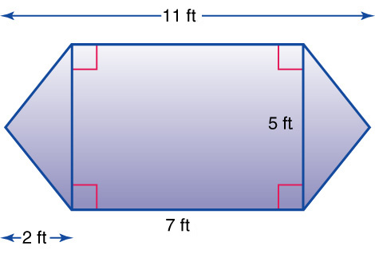
GARDENING The dimensions of a flower garden are shown. What is the area of the garden?
The garden can be separated into a rectangle and two congruent triangles.
Cover up the triangles and calculate the area of the rectangle.

Slide 18
GARDENING The dimensions of a flower garden are shown. What is the area of the garden?
Write the formula for area of a rectangle: A = lw
Replace the variables with the known values: A = (7 ft) (5 ft)
Calculate the value: A = 35 ft²

Slide 19
GARDENING The dimensions of a flower garden are shown. What is the area of the garden?
Cover up the rectangle and calculate the area of the triangles.

Slide 20
GARDENING The dimensions of a flower garden are shown. What is the area of the garden?
Write the formula for area of a triangle: A = ½ bh or bh/2
Replace the variables with the known values: A = ½ (5 ft) (2 ft)
Evaluate the equation: A = ½ (10 ft)
Calculate the solution: A = 5 ft²
Remember there are 2 triangles: A = (5 ft²) (5 ft²) or 10 ft²

Slide 21
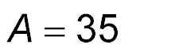
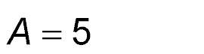
Area of rectangle
Area of one triangle
+
Answer: The area of the garden is 35 + 5 + 5 or 45 square feet.

Slide 22
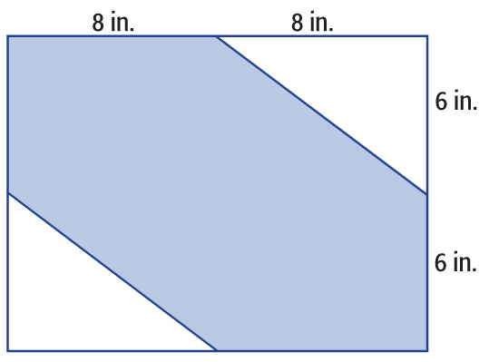
Find the Area of a Shaded Region
Find the area of the shaded figure. Round to the nearest tenth if necessary.
Find the area of the rectangle and subtract the area of the two triangles.

Slide 23
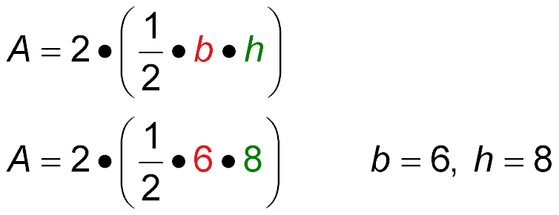
Find the Area of a Shaded Region
Area of rectangle
Area of triangles
A = 16 ● 12 ℓ = 8 + 8 or 16, w = 6 + 6 or 12
A = 192 Simplify.
A = 48 Simplify.
Answer: The area of the shaded region is 192 – 48 or 144 square inches.

Slide 24

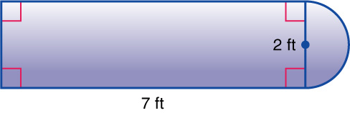
Find the area of the complex figure. Round to the nearest tenth.
A. 15.6 ft²
B. 16.2 ft²
C. 16.8 ft²
D. 17.1 ft²
A
B
C
D

Slide 25
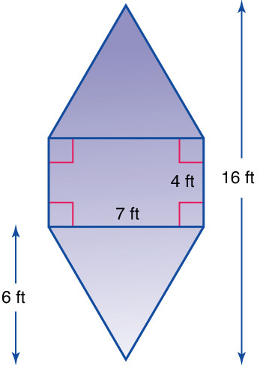
GARDENING The dimensions of a flower garden are shown. What is the area of the garden?
A. 48 ft²
B. 56 ft²
C. 64 ft²
D. 70 ft²
A
B
C
D

Slide 26
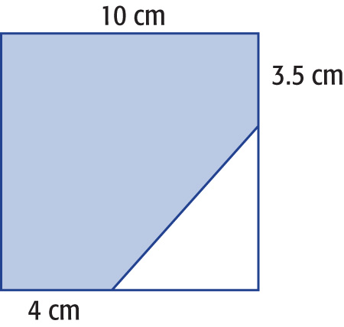
Find the area of the shaded portion of the square. Round to the nearest tenth if necessary.
A. 92.5 cm²
B. 80.5cm²
C. 86 cm²
D. 39 cm²
A
B
C
D

Slide 27
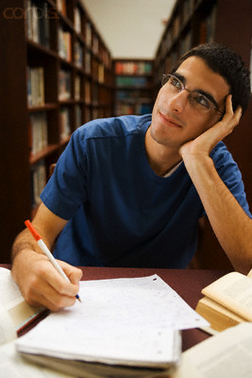
Reflect upon how you participated in the lesson today. Ask yourself:
“Was I a team player. Did I distract anyone, was I distracted by anyone?”
Write down 1 thing you will do differently during our next lesson that will improve your learning.

Slide 28
