Slide 1

Splash Screen
Chapter 7
Lesson 7-4

Slide 2







(over Chapter 6)
Find the coordinates of the vertices of trapezoid PQRS with vertices P(–4, –3), Q(–1, –3), R(–1, –2), and S(–4, –1) translated by (5, 1).
A. P'(1, –2), Q'(4, –2), R'(4, –1), S'(1, 2)
B. P'(1, –2), Q'(4, –2), R'(4, –1), S'(1, 0)
C. P'(1,4), Q'(4, –2), R'(4, –1), S'(1, 0)
D. P'(1, –2), Q'(4, 4), R'(4, –1), S'(1, 0)
A
B
C
D

Slide 3

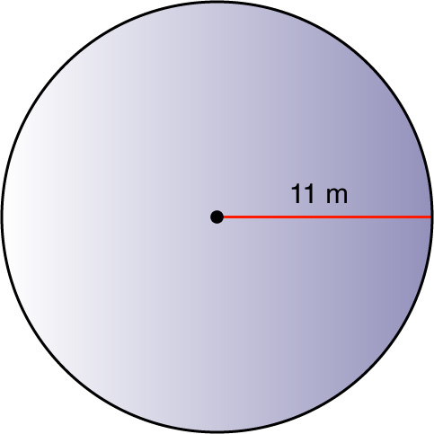

(over Lesson 7-1)
Find the circumference and area of the circle in the figure. Round to the nearest tenth.
A. 34.5 m; 121 m²
B. 34.5 m; 380.1 m²
C. 69.1 m; 190.1 m²
D. 69.1 m; 380.1 m²
A
B
C
D

Slide 4
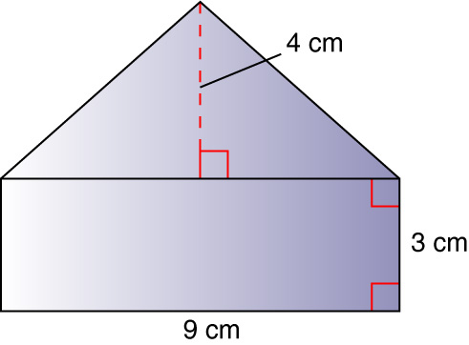

(over Lesson 7-3)
Find the area of the figure shown. Round to the nearest tenth if necessary.
A. 18 cm²
B. 27 cm²
C. 36 cm²
D. 45 cm²
A
B
C
D

Slide 5

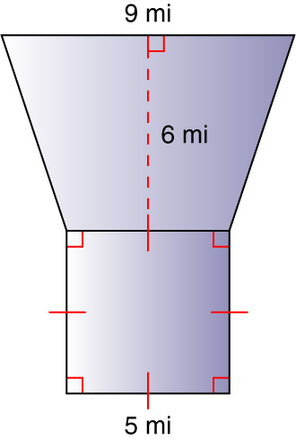
(over Lesson 7-3)
Find the area of the figure shown. Round to the nearest tenth if necessary.
A. 25 mi²
B. 36 mi²
C. 67 mi²
D. 79 mi²
A
B
C
D

Slide 6
Last lesson you were again asked to write down 1 thing you would do during this lesson that would improve your learning.
To begin today’s lesson, write down that goal at the top of your paper.

Slide 7


Identify and draw three-dimensional figures.
coplanar
parallel
solid
polyhedron
edge
face
vertex
diagonal
skew lines
prism
base
pyramid
Please go to page 368 in your math textbook and write the definitions onto your student-built glossary for the New Vocabulary.

Slide 8


Standard 7MG3.6
Identify elements of three-dimensional geometric objects (e.g., diagonals of rectangular solids) and describe how two or more objects are related in space (e.g., skew lines, and the possible ways three planes might intersect).

Slide 9
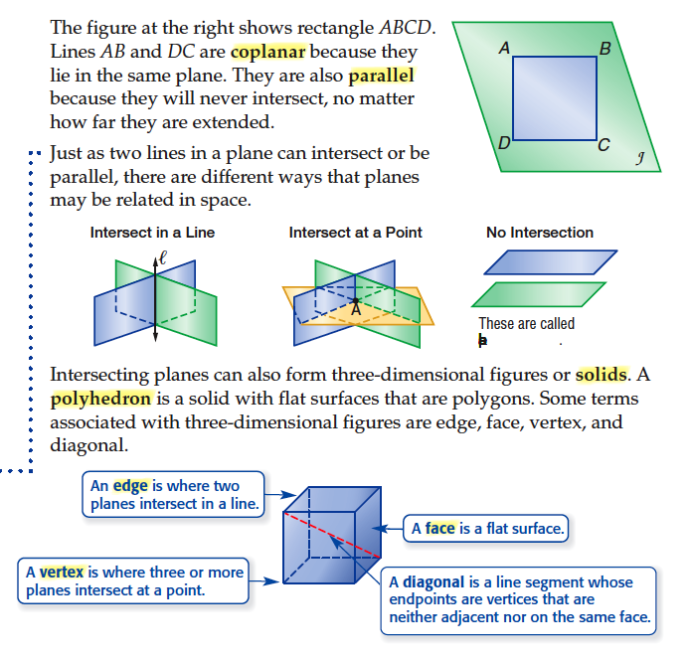

Slide 10
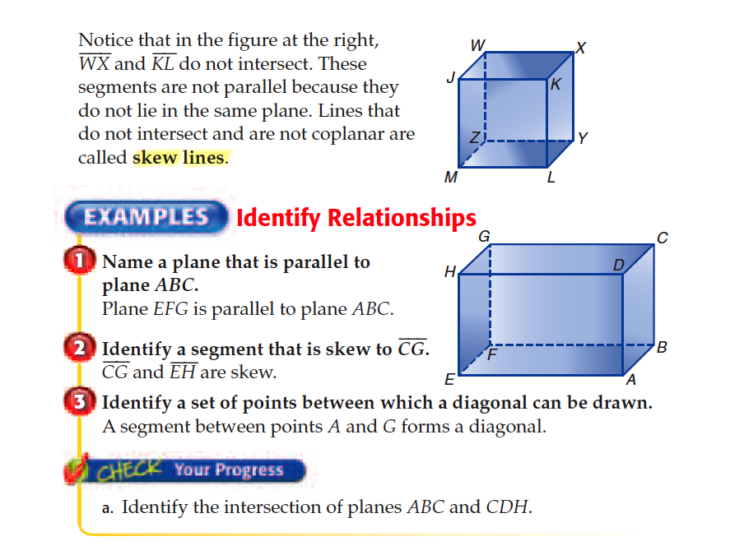

Slide 11
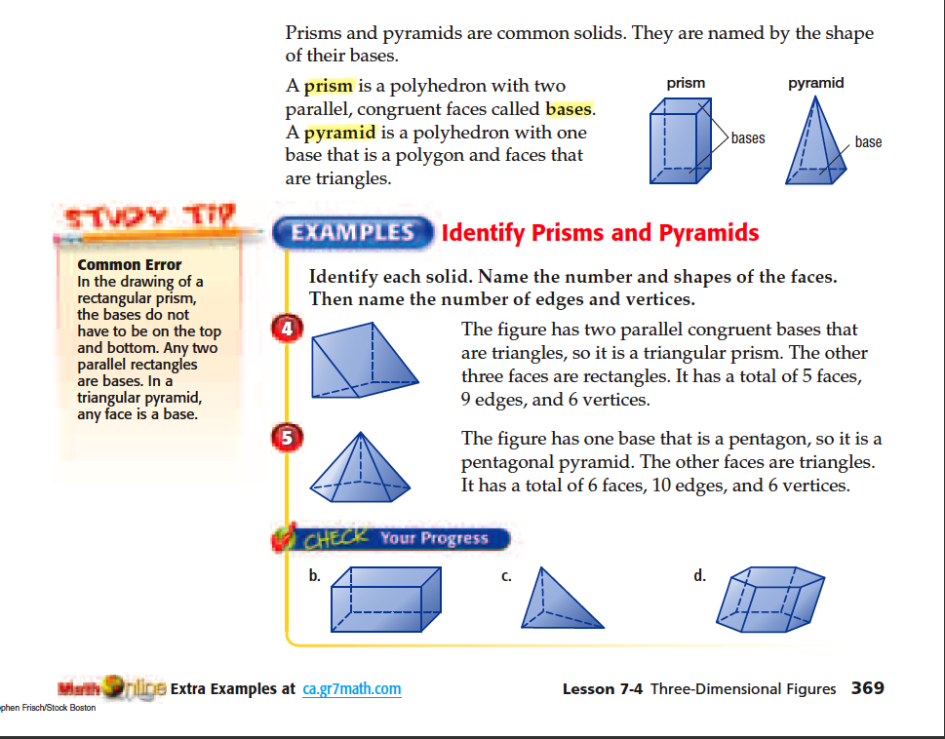

Slide 12

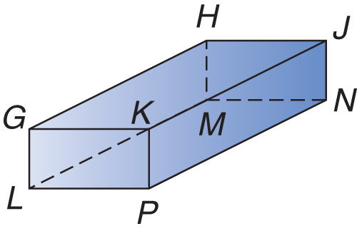
Identify Relationships
Name all planes that are parallel to plane GKJ.
In order for a plane to be parallel to plane GKJ , it cannot intersect it.
The only plane that does not intersect plane GKJ is plane LPN. All other planes intersect plane GKJ.
Answer: Plane LPN is parallel to plane GKJ.

Slide 13

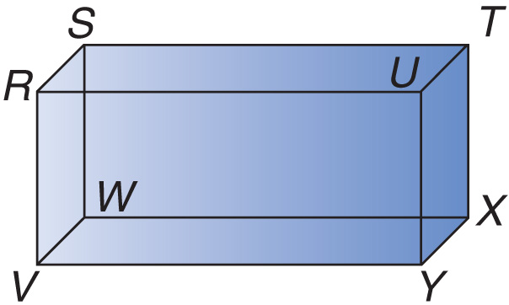
Name a plane that is parallel to plane STX.
A. plane UYX
B. plane WXY
C. plane STU
D. plane RVY
A
B
C
D

Slide 14
Identify Relationships
Identify a segment that is skew to JN.
-Skew lines cannot intersect and cannot be coplanar (lie in the same plane).
- Segment LM is skew to segment JN.
- Also, segment GH, segment GK, and segment LP are skew to segment JN.
Answer: JN and LM are skew because they do not intersect and are not coplanar.

Slide 15
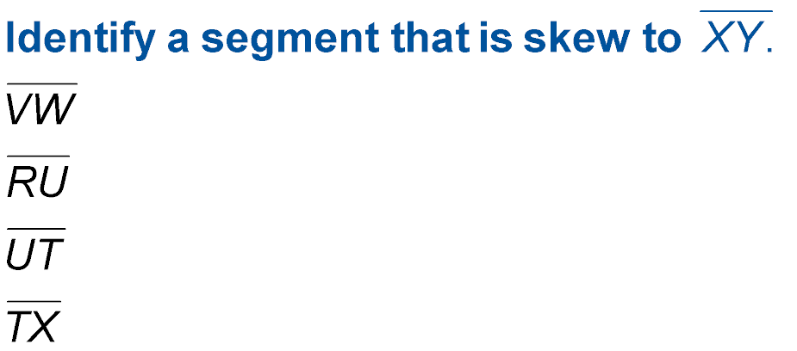
A.
B.
C.
D.
A
B
C
D

Slide 16
Identify Relationships
Identify two sets of points between which a diagonal can be drawn.
A diagonal connects two opposite points on parallel planes.
Answer: Lines drawn between points G and N and points L and J would form diagonals.

Slide 17
Identify a set of points between which a diagonal can be drawn.
A. points S and U
B. points Y and X
C. points T and V
D. points R and W
A
B
C
D

Slide 18
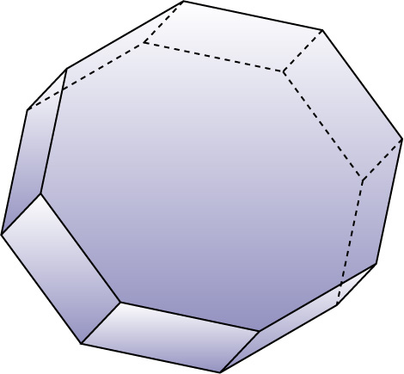
Identify Prisms and Pyramids
Identify the solid. Name the number and shapes of the faces. Then name the number of edges and vertices.
•
✓
✓
•
•
•
•
✓
•
✓
•
✓
•
✓
•
•
✓
✓
•
•
•
✓
✓
•
•
•
Answer: The figure has two parallel congruent bases that are octagons, so it is an octagonal prism.
It has a total of 10 faces.
It has 24 edges.
It has 16 vertices.

Slide 19
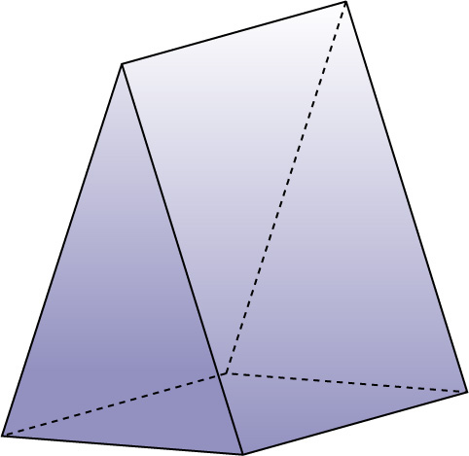
Identify the solid. Name the number and shapes of the faces. Then name the number of edges and vertices.
•
•
✓
✓
•
•
✓
•
•
Answer: - Triangular prism; 2 triangular faces.
- 3 rectangular faces.
- 9 edges.
- 6 vertices.

Slide 20

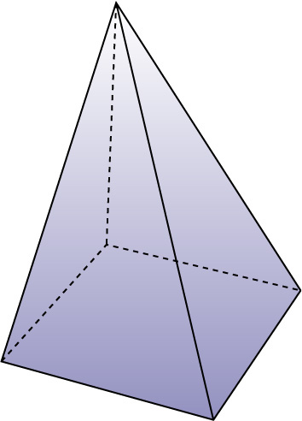
Identify Prisms and Pyramids
Identify the solid. Name the number and shapes of the faces. Then name the number of edges and vertices.
•
✓
✓
•
✓
✓
•
•
✓
•
Answer: - The figure has one base that is a rectangle, so it is a rectangular pyramid. The other four faces are triangles.
- It has a total of 5 faces.
- 8 edges.
- 5 vertices.

Slide 21
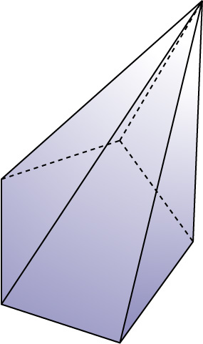
Identify the solid. Name the number and shapes of the faces. Then name the number of edges and vertices.
Answer: ____ pyramid
____ pentagonal base
____ triangular faces
____ edges
____ vertices

Slide 22

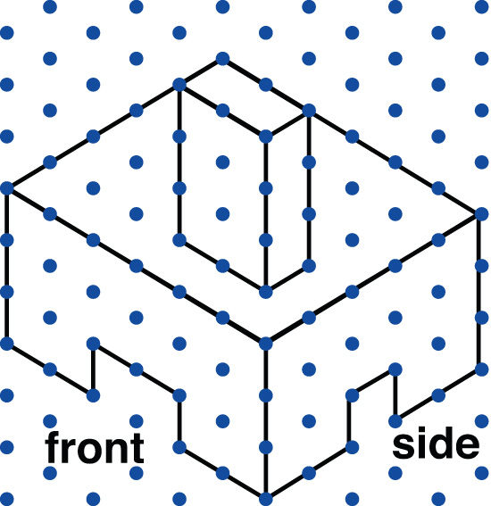
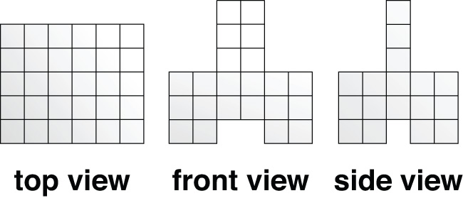
Analyze Drawings
ARCHITECTURE The plans for a hotel fireplace are shown below. Draw and label the top, front, and side views.
Answer Choices:

Slide 23
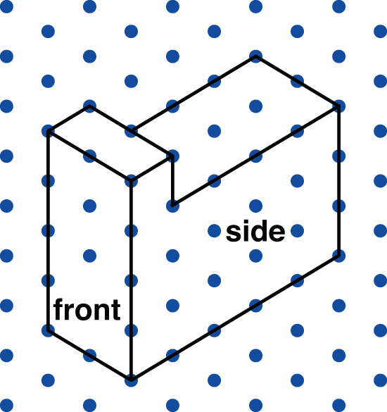
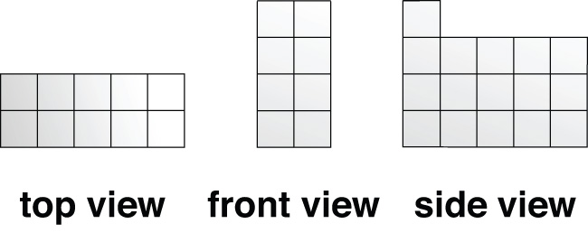
ARCHITECTURE The plans for a building are shown below. Draw and label the top, front, and side views.
Answer Choices:

Slide 24

Write down 1 thing you will do differently during our next lesson that will improve your learning.
Reflect upon how you participated in the lesson today. Ask yourself:
“Was I focused, did I participate & write my answers on my response board?”

Slide 25
