Slide 1
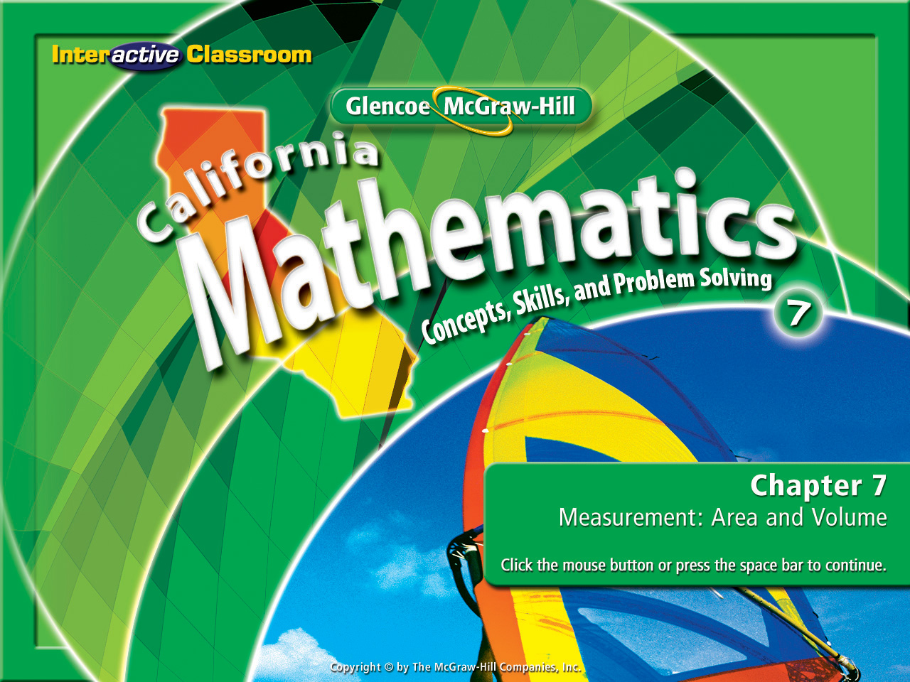
Splash Screen
Chapter 7
Lesson 7-1

Slide 2








5Min 6-5
(over Lesson 7-5)
Find the volume of a rectangular prism if the length is 4.6 m, width is 8.2 m, and height is 5.3 m. Round to the nearest tenth if necessary.
A. 199.9 m³
B. 99.9 m³
C. 67.8 m³
D. 33.9 m³
A
B
C
D

Slide 3

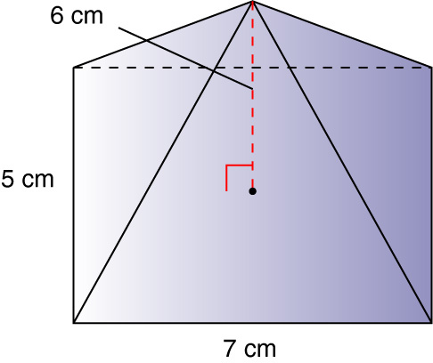
5Min 7-3
(over Lesson 7-6)
Find the volume of the given solid. Round to the nearest tenth if necessary.
A. 35 cm³
B. 50 cm³
C. 70 cm³
D. 105 cm³
A
B
C
D

Slide 4
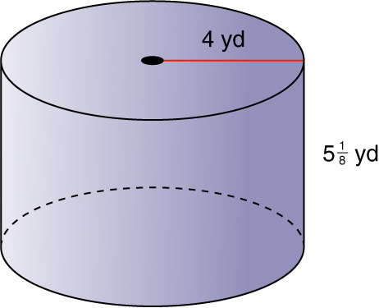


5Min 8-1
(over Lesson 7-7)
Find the surface area of the given solid. Round to the nearest tenth if necessary.
A. 257.6 yd²
B. 229.3 yd²
C. 116.2 yd²
D. 58.1 yd²
A
B
C
D

Slide 5
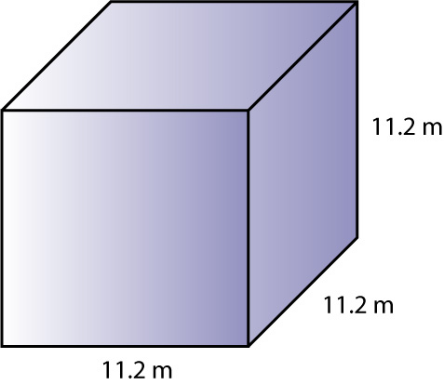
5Min 8-3
(over Lesson 7-7)
Find the surface area of the given solid. Round to the nearest tenth if necessary.
A. 1,442.9 m²
B. 752.6 m²
C. 501.8 m²
D. 201.6 m²
A
B
C
D

Slide 6


Find the lateral and total surface areas of pyramids.
Please go to page 381 in your math textbook and write a definition onto your student-built glossary for the “New Vocabulary”.
regular pyramid
slant height

Slide 7

Lesson 8 CA
Standard 7MG2.1 Use formulas routinely for finding the perimeter and area of basic two-dimensional figures and the surface area and volume of basic three-dimensional figures, including rectangles, parallelograms, trapezoids, squares, triangles, circles, prisms, and cylinders.

Slide 8
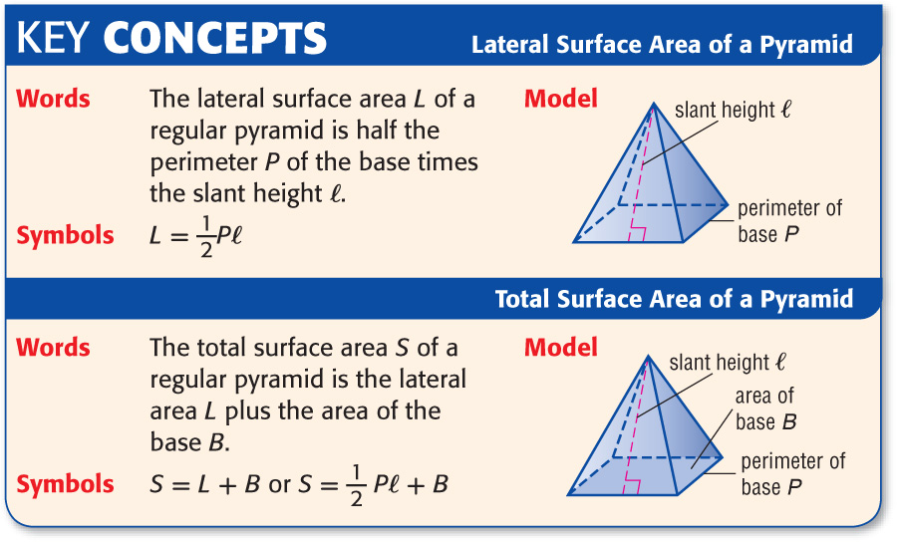
Lesson 8 Key Concept 1

Slide 9

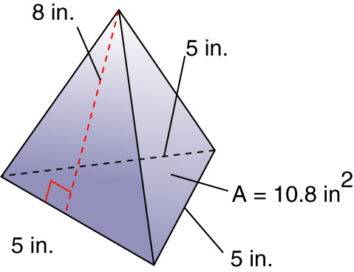
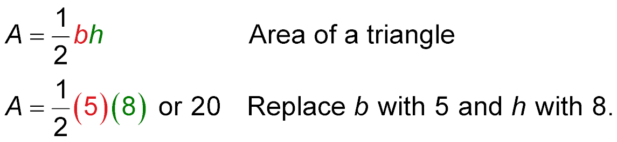
Lesson 8 Ex1
Surface Areas of a Pyramid
Find the lateral and total surface areas of the triangular pyramid.
Find the lateral area and the area of the base.
Area of each lateral face
Area of a triangle
Replace b with 5 and h with 8.

Slide 10
Lesson 8 Ex1
Surface Areas of a Pyramid
There are 3 faces, so the lateral area is 3(20) or 60 square inches.
Area of base
A = 10.8 in²
Answer: The lateral surface area of the pyramid is 60 square inches. The total surface area is 60 + 10.8 or 70.8 square inches.

Slide 11

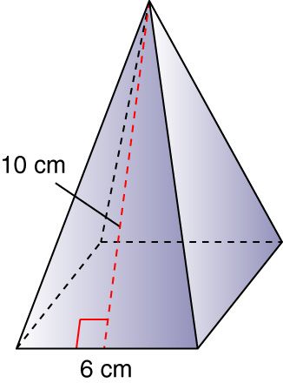
Lesson 8 CYP1
Find the total surface area of the square pyramid.
A. 156 cm²
B. 174 cm²
C. 182 cm²
D. 204 cm²
A
B
C
D

Slide 12


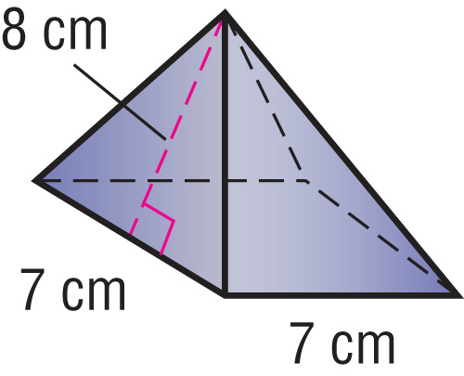
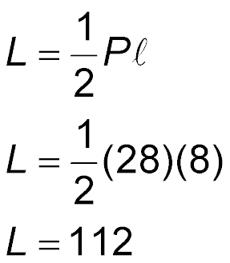

Lesson 8 Ex2
TOYS A toy block has the shape of a regular pyramid with a square base. The manufacturer wants to paint the lateral surface green. How many square centimeters will be painted green?
Lateral surface area of a pyramid
P = 7(4) or 28 and = 8
Simplify.
Answer: The lateral surface area is 112 square centimeters.

Slide 13
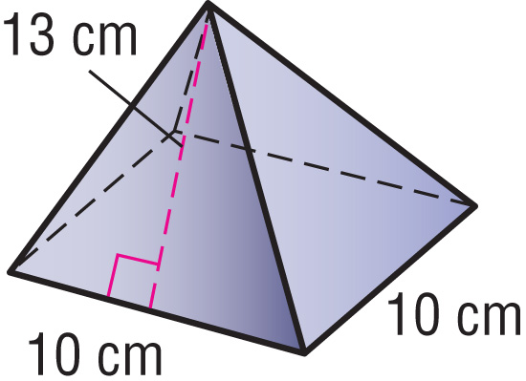
Lesson 8 CYP2
TOYS A toy block has the shape of a regular pyramid with a square base. The manufacturer wants to paint the lateral surface green. How many square centimeters will be painted green?
A. 175 cm²
B. 210 cm²
C. 235 cm²
D. 260 cm²
A
B
C
D

Slide 14
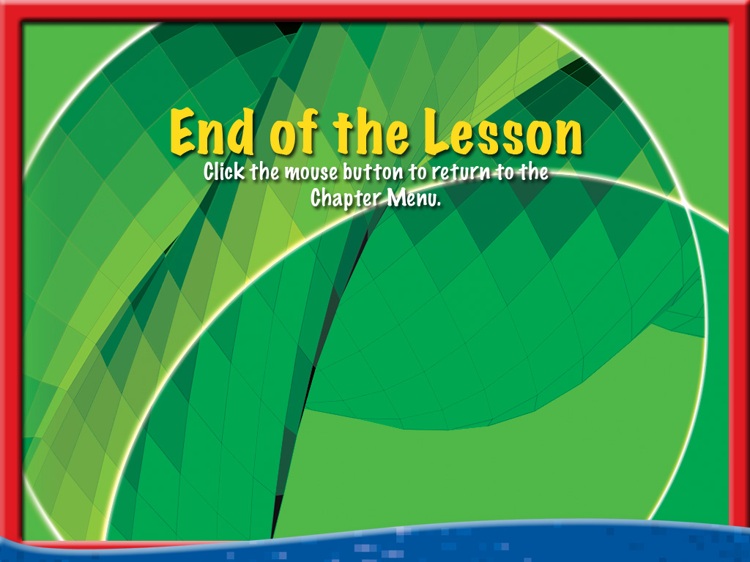




End of Lesson 8

