Slide 1
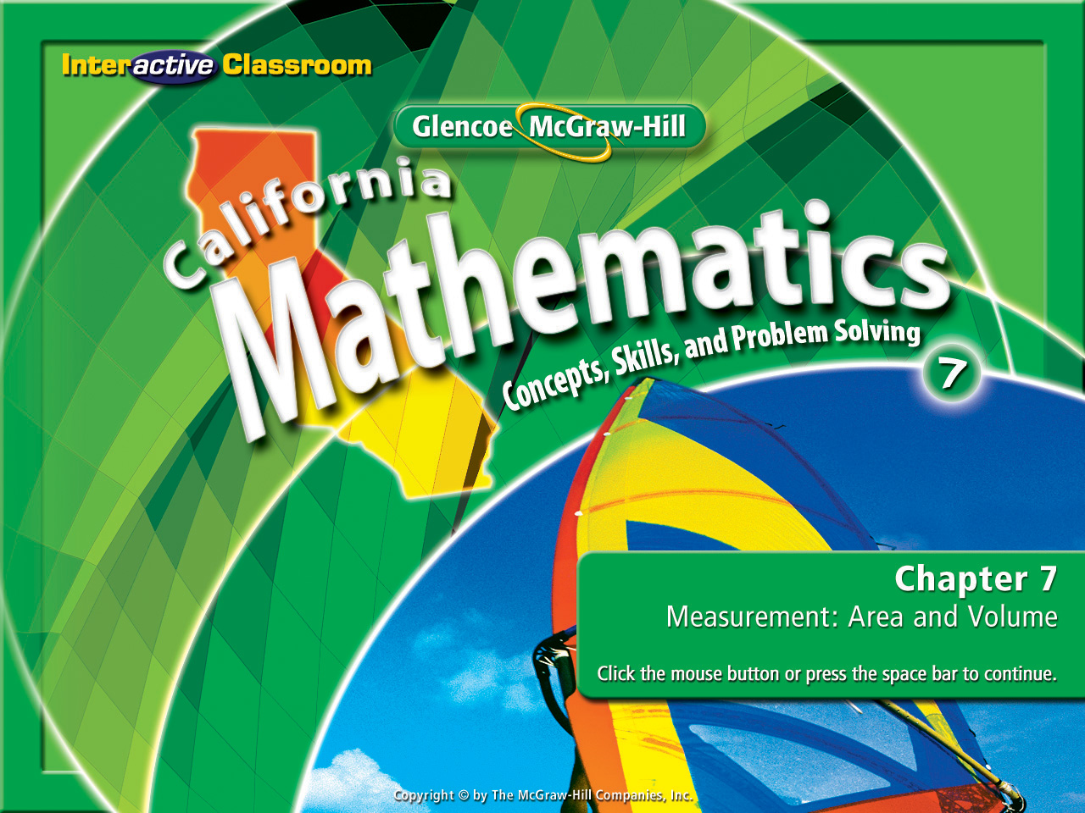
Splash Screen
Chapter 8
Lesson 8-1

Slide 2







(over Chapter 7)
Find the volume of a cone with diameter 9 ft and height 5 ft. Round to the nearest tenth if necessary.
A. 106 ft³
B. 159 ft³
C. 318 ft³
D. 424 ft³
A
B
C
D

Slide 3

(over Chapter 7)
Find the surface area of a rectangular prism that is 15 cm long, 20 cm wide, and 25 cm tall.
A. 1,175 cm²
B. 2,350 cm²
C. 3,750 cm²
D. 7,500 cm²
A
B
C
D

Slide 4



(over Chapter 7)
Find the total surface area of a square pyramid if each side of the base is 9 inches and the slant height is 8 inches. Round your answer to the nearest hundredth.
A. 144 in²
B. 225 in²
C. 288 in²
D. 369 in²
A
B
C
D

Slide 5


Use the Distributive Property to simplify algebraic expressions.
equivalent expressions
term
coefficient
like terms
constant
simplest form
simplifying the expression

Slide 6


Standard 7AF1.1 Use variables and appropriate operations to write an expression, an equation, an inequality, or a system of equations or inequalities that represents a verbal description (e.g. three less than a number, half as large as area A).
Standard 7AF1.3 Simplify numerical expressions by applying properties of rational numbers (e.g., identity, inverse, distributive, associative, commutative) and justify the process used.
Standard 7AF1.4 Use algebraic terminology (e.g. variable, equation, term, coefficient, inequality, expression, constant) correctly.

Slide 7

Write Expressions With Addition
Use the Distributive Property to rewrite 3(x + 5).
3(x + 5) = 3(x) + 3(5)

Slide 8
Write Expressions With Addition
Use the Distributive Property to rewrite (a + 4)7.
(a + 4)7 =

Slide 9
Write Expressions With Subtraction
Use the Distributive Property to rewrite (q – 3)9.
(q – 3)9 = [q + (–3)]9

Slide 10

Write Expressions With Subtraction
Use the Distributive Property to rewrite –3(z – 7).
–3(z – 7) = –3[z + (–7)]

Slide 11

Identify Parts of an Expression
Identify the terms, like terms, coefficients, and constants in 3x – 5 + 2x – x.
3x – 5 + 2x – x

Slide 12

Simplify Algebraic Expressions
Simplify the expression 6n – n.
6n – n (are like terms)

Slide 13

Simplify Algebraic Expressions
Simplify 8z + z – 5 – 9z + 2.
8z, z, and –9z are like terms. (–5 and 2 are also like terms).
8z + z – 5 – 9z + 2 =

Slide 14

Use the Distributive Property to rewrite 2(x + 6).
A. x + 8
B. x + 12
C. 2x + 6
D. 2x + 12
A
B
C
D

Slide 15
Use the Distributive Property to rewrite (a + 6)3.
A. 3a + 27
B. 3a + 18
C. 3a + 9
D. a + 18
A
B
C
D

Slide 16
Use the Distributive Property to rewrite (q – 2)8.
A. q – 16
B. q – 10
C. 8q – 16
D. 8q – 10
A
B
C
D

Slide 17
Use the Distributive Property to rewrite –2(z – 4).
A. –2z + 8
B. –2z – 8
C. –2z – 4
D. –2z
A
B
C
D

Slide 18
Identify the terms, like terms, coefficients, and constants in 6x – 2 + x – 4x.
6x – 2 + x – 4x

Slide 19
Simplify the expression 7n + n.
A. 10n
B. 8n
C. 7n
D. 6n
A
B
C
D

Slide 20
Simplify 6z + z – 2 – 8z + 2.
A. –z
B. –z + 2
C. z –1
D. –2z
A
B
C
D

Slide 21
