Slide 1
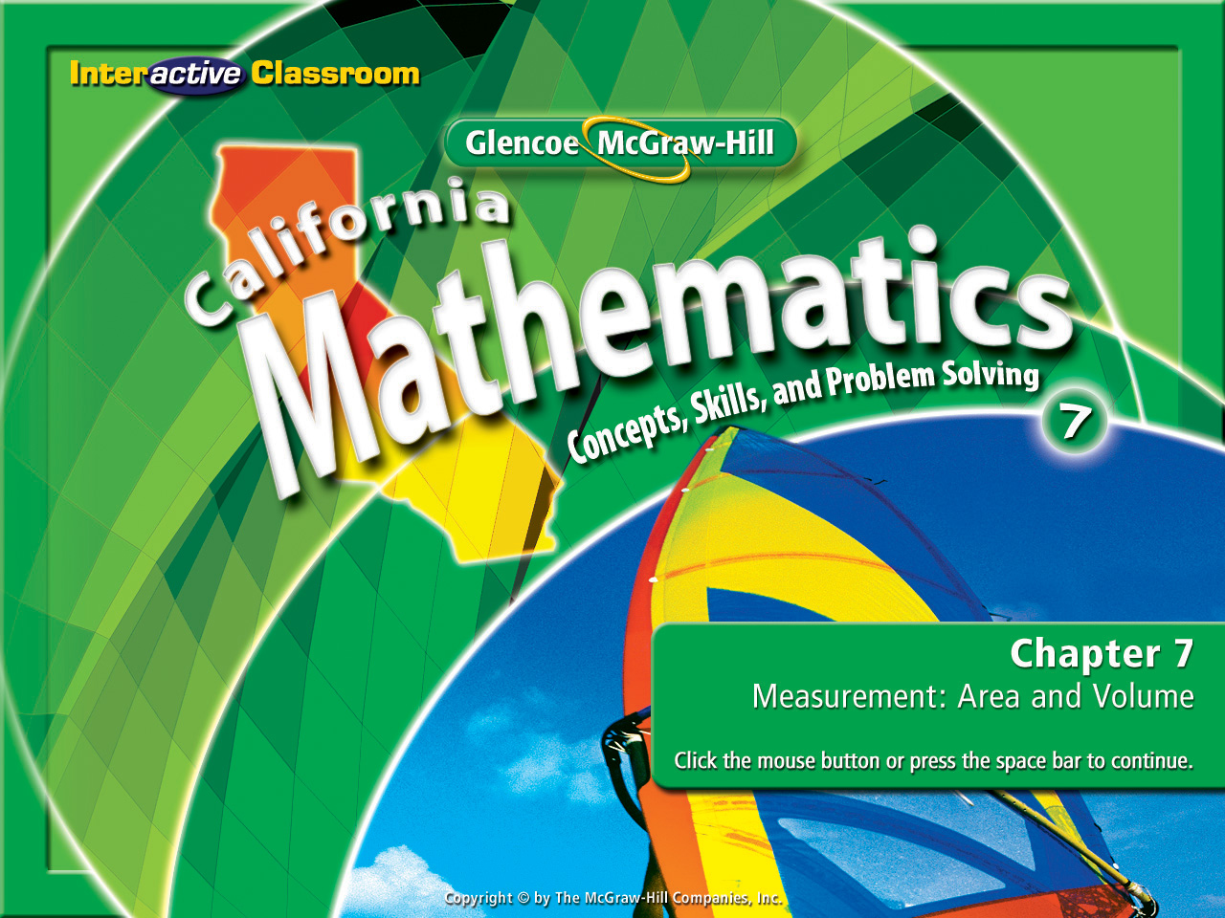
Splash Screen
Chapter 8
Lesson 8-4

Slide 2




(over Lesson 8-1)
Simplify 7k + 9k.
A. 15k
B. 16k
C. 17k
D. 18k
A
B
C
D

Slide 3

(over Lesson 8-1)
Use the Distributive Property to rewrite the expression –2(11m – n).
A. –22m + 2n
B. –22m – n
C. –11m + n
D. –11m – n
A
B
C
D

Slide 4

(over Lesson 8-2)
Solve 2 = 3 – a
A. –5
B. –1
C. 1
D. 5
A
B
C
D

Slide 5


(over Lesson 8-2)
Solve 6n – 3 = 21
A.
B. 3
C.
D. 4
A
B
C
D

Slide 6

Solve equations with variables on each side.

Slide 7


Standard 7AF1.1 Use variables and appropriate operations to write an expression, an equation, an inequality, or a system of equations or inequalities that represents a verbal description (e.g. three less than a number, half as large as area A).
Standard 7AF4.1 Solve two-step linear equations and inequalities in one variable over the rational numbers, interpret the solution or solutions in the context from which they arose, and verify the reasonableness of the results.

Slide 8

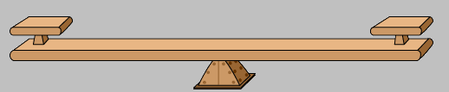
Equations with Variables on Each Side
Solve 7x + 4 = 9x
In solving equations our goal is to always isolate the variable. Begin by eliminating the smallest term with the smallest coefficient 1st.
7x + 4 = 9x
Remember, when working with equations, we think of a balance scale. What we do to one side of the equation must be done on the other side of the equation.
7x + 4
9x
7x + 4 = 9x
To eliminate the term 7x, you combine a -7x to both sides.
-7x -7x

Slide 9
Our last step: 7x + 4 = 9x
-7x -7x
Equations with Variables on Each Side
We now have: 4 = 2x
Remember, our goal is to always isolate the variable. To do so we now have to eliminate the coefficient next to the variable.
4 = 2x
2
2
To eliminate the coefficient 2, we must use the Multiplicative Inverse. The Multiplicative Inverse in this equation is to divide both sides by 2.

Slide 10
Our last step: 4 = 2x
2 2
Equations with Variables on Each Side
We’ve isolated the variable & identified it’s value: x = 2
Let’s review what we did:
Our original equation:
7x + 4 = 9x
Next we eliminated the term with the smallest coefficient:
7x + 4 = 9x
-7x -7x
We then eliminated the coefficient with the variable:
4 = 2x
2 2
We isolated the variable and identified it’s value:
x = 2

Slide 11

Equations with Variables on Each Side
I don’t have a clue about this one!!!!
Okay so let’s solve this one:
3x – 2 = 8x + 13.

Slide 12
Equations with Variables on Each Side
Now let’s give it a try:
3x – 2 = 8x + 13

Slide 13

Let’s try another one:
6n – 1 = 4n - 5

Slide 14

Solve 3x + 6 = x
A. –5
B. –3
C. –1
D. 1
A
B
C
D

Slide 15
Solve: 4x – 3 = 5x + 7
A. –4
B. –7
C. –10
D. –12
A
B
C
D

Slide 16
7y – 8 = 6y + 1
A. -9
B. 7
C. 9
D. -1
A
B
C
D

Slide 17
