Slide 1

Splash Screen
Chapter 8
Lesson 8-6

Slide 2




(over Chapter 7)
Find the volume of a rectangular prism with length 3 yd, width 5 yd, and height 7 yd. Round to the nearest tenth if necessary.
A. 15 yd³
B. 52.5 yd³
C. 71 yd³
D. 105 yd³
A
B
C
D

Slide 3

(over Lesson 8-1)
Use the Distributive Property to rewrite the expression 8(y – 3).
A. 8y – 3
B. y – 24
C. 8y – 24
D. 8y + 24
A
B
C
D

Slide 4

(over Lesson 8-1)
Simplify: 14h – 3 – 11h
A. 3h – 3
B. –3h + 3
C. –3h – 3
D. 3h + 3
A
B
C
D

Slide 5

(over Lesson 8-2)
Solve: –5 + 2a – 3a = 11
A. –16
B. –6
C. 6
D. 16
A
B
C
D

Slide 6

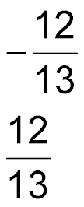
(over Lesson 8-4)
Solve: 8b – 12 = 5b
–4
B.
C.
D. 4
A
B
C
D

Slide 7

Write and graph inequalities.

Slide 8


Standard 7AF1.1 Use variables and appropriate operations to write an expression, an equation, an inequality, or a system of equations or inequalities that represents a verbal description (e.g. three less than a number, half as large as area A).

Slide 9
One of the following is an
“ I n e q u a l I t y ”
Is it…..
12x -9 = 56
34y > 9
2x + 8 = 5 – 7x

Slide 10

Write Inequalities with < or >
SPORTS Members of the little league team must be under 14 years old. Write an inequality for the sentence.
Let a = person’s age.
Answer: a < 14

Slide 11
Write Inequalities with < or >
CONSTRUCTION The ladder must be over 30 feet tall to reach the top of the building. Write an inequality for the sentence.
Let b = ladder’s height.
Answer: b > 30

Slide 12
Write Inequalities with ≤ or ≥
POLITICS The president of the United States must be at least 35. Write an inequality for the sentence.
Let a = president’s age.
Answer: a ≥ 35

Slide 13
Write Inequalities with ≤ or ≥
CAPACITY A theater can hold a maximum of 300 people. Write an inequality for the sentence.
Let p = theater’s capacity.
Answer: p ≤ 300

Slide 14
Determine the Truth of an Inequality
For the given value, state whether the inequality is true or false.
x – 4 < 6; x = 0
x – 4 < 6 Write the inequality.
0 – 4 < 6 Replace x with 0.
–4 < 6 Simplify
Answer: Since –4 is less than 6, –4 < 6 is true.

Slide 15

Determine the Truth of an Inequality
For the given value, state whether the inequality is true or false.
3x ≥ 4; x = 1
3x ≥ 4 Write the inequality.
3(1) ≥ 4 Replace x with 1.
3 ≥ 4 Simplify.
Answer: Since 3 is not greater than or equal to 4, the sentence is false.

Slide 16

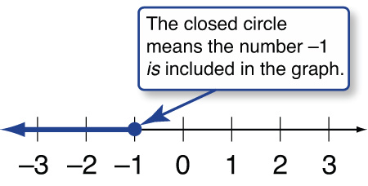
Graph an Inequality
Graph n ≤ –1 on a number line.
Place a closed circle at –1.
- Then draw a line and an arrow to the left.
Answer:

Slide 17

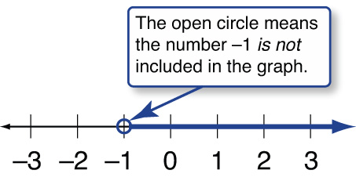
Graph an Inequality
Graph n > –1 on a number line.
- Place an open circle at –1.
- Then draw a line and an arrow to the right.
Answer:

Slide 18

SPORTS Members of the peewee football team must be under 10 years old. Write an inequality for the sentence.
A. a < 10
B. a ≤ 10
C. a > 10
D. a ≥ 10
A
B
C
D

Slide 19
CONSTRUCTION The new building must be over 300 feet tall. Write an inequality for the sentence.
A. h < 300
B. h ≤ 300
C. h > 300
D. h ≥ 300
A
B
C
D

Slide 20
SOFTBALL The home team needs at least 7 points to win. Which of the following inequalities describes how many points are needed to win?
A. p > 7
B. p ≥ 7
C. p < 7
D. p ≤ 7
A
B
C
D

Slide 21
CAPACITY A football stadium can hold a maximum of 10,000 people. Write an inequality for the sentence.
A. p < 10,000
B. p ≤ 10,000
C. p > 10,000
D. p ≥ 10,000
A
B
C
D

Slide 22
For the given value, state whether the inequality is true or false.
x – 5 < 8; x = 16
A. true
B. false
A
B

Slide 23
For the given value, state whether the inequality is true or false.
2x ≥ 9; x = 5
A. true
B. false
A
B

Slide 24

Graph n ≤ –3 on a number line.
Answer:

Slide 25

Graph n > –3 on a number line.
Answer:

Slide 26








