Slide 1
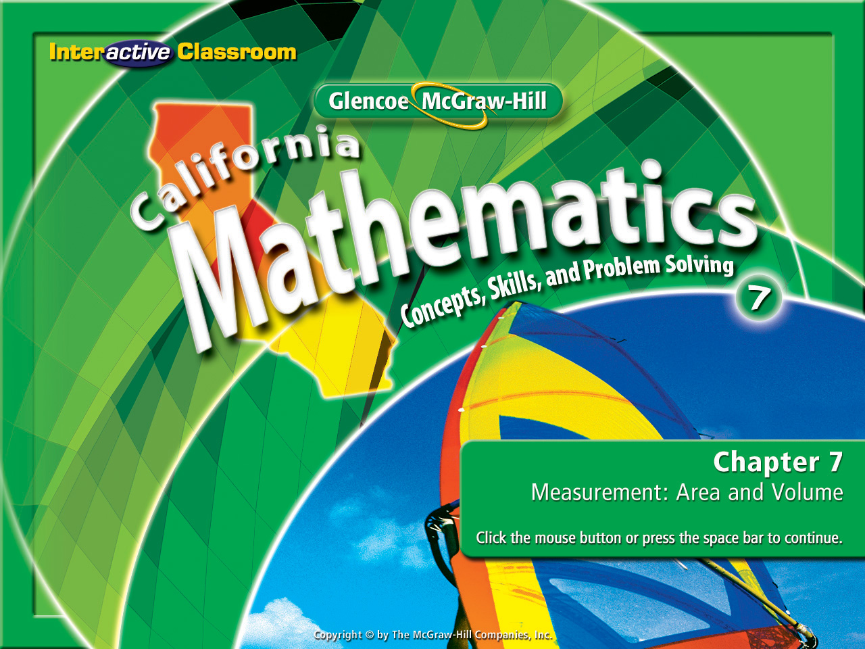

Splash Screen
Chapter 8
Lesson 8-8

Slide 2




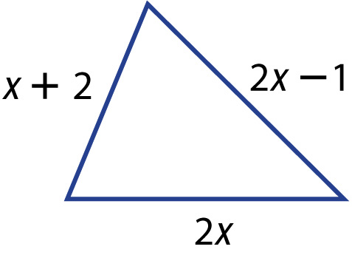

(over Lesson 8-1)
Which expression represents the perimeter of the triangle?
A. 5x + 1
B. 3x
C. 2x – 1
D. 6x
A
B
C
D

Slide 3

(over Lesson 8-4)
Solve: 4n – 3 = 2n + 7
A. 5
B. 2
C. –2
D. –5
A
B
C
D

Slide 4

(over Lesson 8-6)
Write an inequality for the sentence. A grade of no less than 90 is considered an "A."
A. g > 90
B. g ≥ 90
C. g < 90
D. g ≤ 90
A
B
C
D

Slide 5

5Min 7-4
(over Lesson 8-6)
For the given value, state whether the inequality
is true or false. y – 15 ≤ –7; y = 8
A. true
B. false
A
B

Slide 6


(over Lesson 8-6)
Which inequality is graphed on the number line?
A. n > 5
B. n ≥ 5
C. n < 5
D. n ≤ 5
A
B
C
D

Slide 7

(over Lesson 8-7)
Solve: y – 8 < –3
A. y < 5
B. y < –5
C. y < 11
D. y > –11
A
B
C
D

Slide 8

(over Lesson 8-7)
Solve: –6 ≤ 7 + g
A. g ≥ 1
B. g ≤ –13
C. g ≥ –13
D. g ≤ 1
A
B
C
D

Slide 9

Solve inequalities by using the Multiplication or Division Properties of Inequality.

Slide 10


Standard 7AF1.1 Use variables and appropriate operations to write an expression, an equation, an inequality, or a system of equations or inequalities that represents a verbal description (e.g. three less than a number, half as large as area A).
Standard 7AF4.1 Solve two-step linear equations and inequalities in one variable over the rational numbers, interpret the solution or solutions in the context from which they arose, and verify the reasonableness of the results.

Slide 11
Better Look Closely!
Or You’ll Be Left
Behind!
It’s Different!
It’s New!

Slide 12
Study these carefully:
7y > -42
-7y > -42
7y > -42
7 7
7y > -42
-7 -7
y > -6
y < 6
Think about what you see.

Slide 13
Now study these carefully:
a
a
≥
8
≥
8
2
-2
a
a
2 •
≥
8
• 2
-2 •
≥
8
• -2
2
-2
a
≥
16
a
≤
-16
Notice anything similar to the last slide?

Slide 14
Let’s take a 2nd look:
7y > -42
-7y > -42
a
a
≥
≥
8
8
2
-2
7y > -42
7 7
7y > -42
-7 -7
a
a
8
•2
8
•-2
2•
≥
-2•
≥
2
-2
a
16
a
-16
y > -6
y < 6
≥
≤
So why didn’t these signs reverse?
But these signs did reverse.

Slide 15
New rule!
New rule!
New rule!
Okay, so here’s a new rule!
New rule!
New rule!
New rule!

Slide 16
When dividing or multiplying by a negative in solving an inequality, reverse the sign in your final answer.
When dividing or multiplying by a negative in solving an inequality, reverse the sign in your final answer.
When dividing or multiplying by a negative in solving an inequality, reverse the sign in your final answer.
When dividing or multiplying by a negative in solving an inequality, reverse the sign in your final answer.
When dividing or multiplying by a negative in solving an inequality, reverse the sign in your final answer.

Slide 17

Solve Inequalities by Dividing
Solve: 6x < –30

Slide 18
Solve Inequalities by Multiplying
1
2
Solve: p ≥ 9

Slide 19
Multiply or Divide by a Negative Number
b
-4
Solve: ≤ 5

Slide 20
Multiply or Divide by a Negative Number
Solve: -4n > –60

Slide 21

Solve 4x < –24.
A. x < –6
B. x < 6
C. x > –6
D. x > 6
A
B
C
D

Slide 22
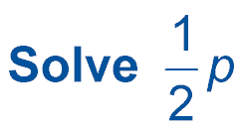
> 5
A. p < 10
B. p > –10
C. p > 10
D. p > 7
A
B
C
D

Slide 23
n
-2
Solve: ≤ 7
A. n > 14
B. n ≥ –14
C. n ≤ 14
D. n < –14
A
B
C
D

Slide 24
Solve: –3n > –18
A. n < 6
B. n < –6
C. n > 6
D. n > –6
A
B
C
D

Slide 25








