Slide 1
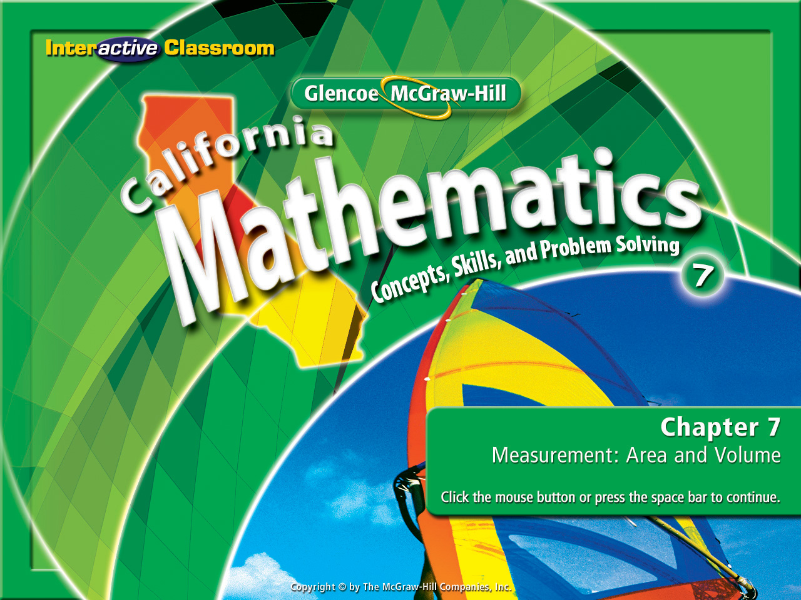
Splash Screen
Chapter 9
Lesson 9-1

Slide 2




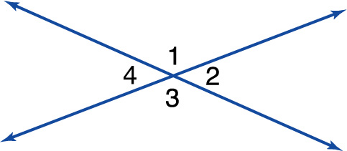
(over Chapter 6)
Refer to the figure. Find m<1 if m<2 is 35°.
A. 145
B. 125
C. 55
D. 35
A
B
C
D

Slide 3
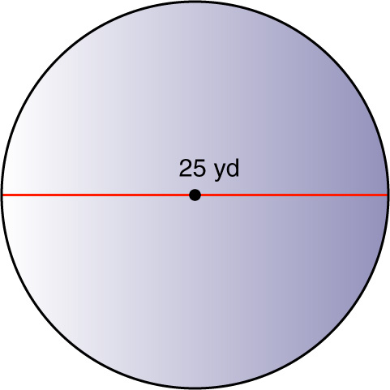

(over Lesson 7-1)
Find the circumference and area of the circle in the figure. Round to the nearest tenth.
A. 157.1 yd; 1963.5 yd²
B. 157 yd; 490.9 yd²
C. 78.5 yd; 490.9 yd²
D. 78.5 yd; 245.3 yd²
A
B
C
D

Slide 4

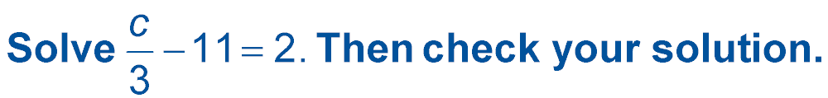

(over Chapter 8)
A. 17
B. 31
C. 35
D. 39
A
B
C
D

Slide 5


Complete function tables.
function
domain
range
function table

Slide 6


Preparation for Standard 7AF3.3 Graph linear functions, noting that the vertical change (change in
y-value) per unit of horizontal change (change in
x-value) is always the same and know that the ratio (“rise over run”) is called the slope of a graph.
Standard 7MR2.5 Use a variety of methods, such as words, numbers, symbols, charts, graphs, tables, diagrams, and models, to explain mathematical reasoning.

Slide 7
Functions!
They’re Difficult!
Stay Focused!
Ask Questions!

Slide 8
These are “Functions”:
f(9) if f(x) = x - 5
f(-3) if f(x) = 2x + 1
f(x) = x - 5
f(x) = 2x + 1
f(9) = 9 - 5
f(-3) = 2(-3) + 1
f(9) = 4
f(-3) = -6 + 1
f(-3) = -5

Slide 9
These are also “Functions”:
f(2) if f(x) = x - 4
f(6) if f(x) = 2x - 8
f(x) = x - 4
f(x) = 2x - 8
f(2) = 2 - 4
f(6) = 2(6) - 8
f(2) = -2
f(-3) = 12 - 8
f(-3) = 4

Slide 10
Let’s analyze what a function is:
f(2) if f(x) = x - 4
This is how they are presented.
This is called the function. The
f(x) portion is read “the function of x”. The = sign is telling you what the “function rule” is for the value of x.
f(x) = x - 4
The f(2) is giving you the value of x. You then substitute the value of x (in this case “2”) into the “function rule”.
f(2) = 2 - 4
Once the value of x is substituted into the “function rule” the rule is simplified.
f(2) = -2

Slide 11
Let’s take another look:
f(6) if f(x) = 2x - 8
This is how they are presented.
f(x) = 2x - 8
We start by writing the function rule.
We substitute the value of x into the function rule.
f(6) = 2(6) - 8
f(6) = 12 - 8
We now start to evaluate the function rule and simplify it.
f(6) = 4

Slide 12

Find a Function Value
Find f(4) if f(x) = x – 8
f(x) = x – 8
Write the function.
Substitute 4 for x into the function rule.
f(4) = 4 – 8
f(4) = –4
Evaluate and simplify.

Slide 13
Find a Function Value
Find f(-6) if f(x) = 3x + 4
f(x) = 3x + 4
Write the function.
Substitute -6 for x into the function rule.
f(-6) = 3(-6) + 4
f(-6) = –18 + 4
Evaluate and simplify.
f(-6) = –14

Slide 14
You can’t eat off this table!
Now let’s use our new found skill!
But you can rack up a good grade with it!
We are going to make a function table!

Slide 15
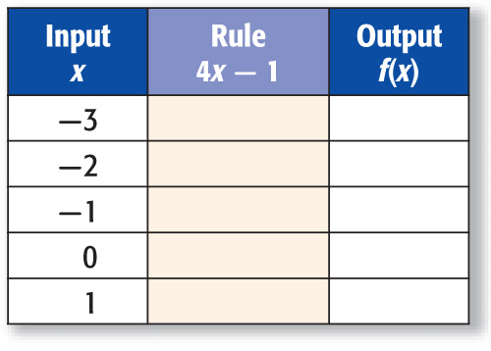
To start we need to learn what each part of the table is:
The “Input” lists the values for x and is called the “Domain”.
The “Rule” gives us the function rule:
The “Output” is the function rule simplified & is called the “range”.

Slide 16
Make a Function Table
Now let’s complete our very 1st “Function Table”.
Complete the function table for f(x) = 4x – 1. Then state the domain and
range of the function.
Substitute each value of x, or input, into the function rule.
Then simplify to find the output.

Slide 17
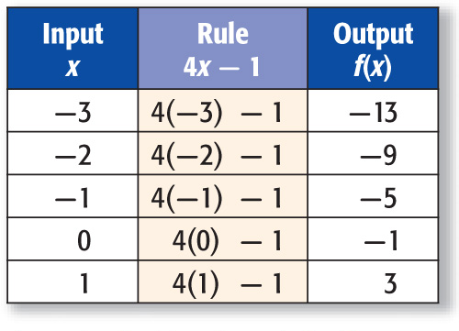
Make a Function Table
f(x) = 4x – 1
f(–3) = 4(–3) – 1 or –13
f(–2) = 4(–2) – 1 or –9
f(–1) = 4(–1) – 1 or –5
f(0) = 4(0) – 1 or –1
f(1) = 4(1) – 1 or 3
The domain is {–3, –2, –1, 0, 1}.
The range is {–13, –9, –5, –1, 3}.

Slide 18

Find f(2) if f(x) = x – 7.
A. –5
B. –2
C. 1
D. 4
A
B
C
D

Slide 19
Find f(–2) if f(x) = 2x + 6.
A. –4
B. –1
C. 2
D. 5
A
B
C
D

Slide 20
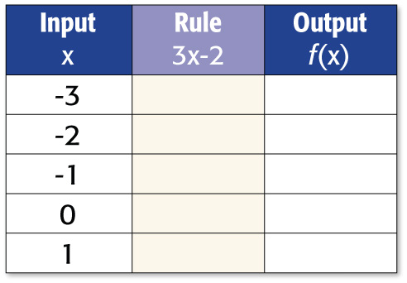
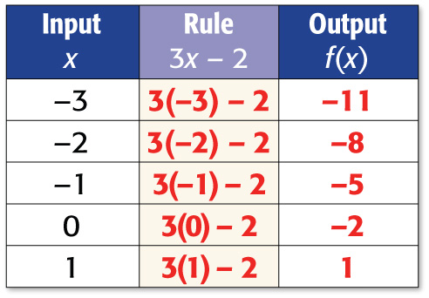
Complete the function table for f(x) = 3x – 2. Then state the domain and range of the function.
Answer:
The domain is {–3, –2, –1, 0, 1}.
The range is {–11, –8, –5, –2, 1}.

Slide 21
