Slide 1
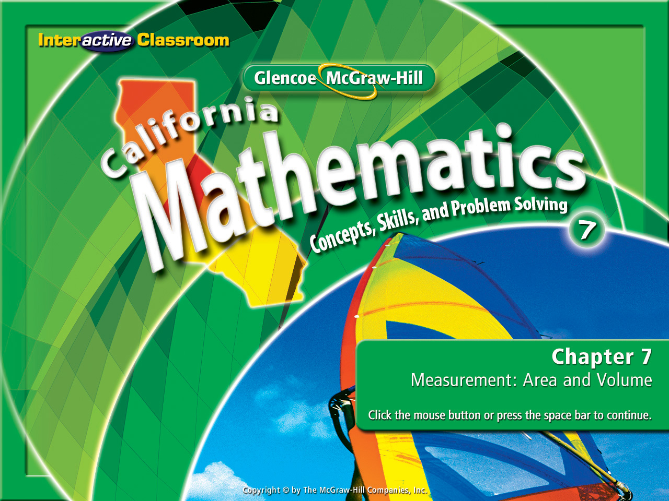
Splash Screen
Chapter 9
Lesson 9-2

Slide 2



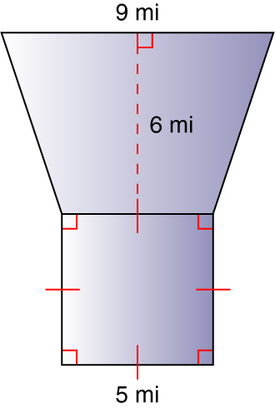

(over Lesson 7-3)
Find the area of the figure shown. Round to the nearest tenth if necessary.
A. 25 mi²
B. 36 mi²
C. 67 mi²
D. 74 mi²
A
B
C
D

Slide 3

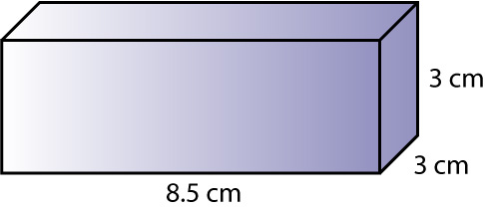
(over Lesson 7-5)
Find the volume of the given solid. Round to the nearest tenth if necessary.
A. 25.5 cm³
B. 51 cm³
C. 76.5 cm³
D. 153 cm³
A
B
C
D

Slide 4


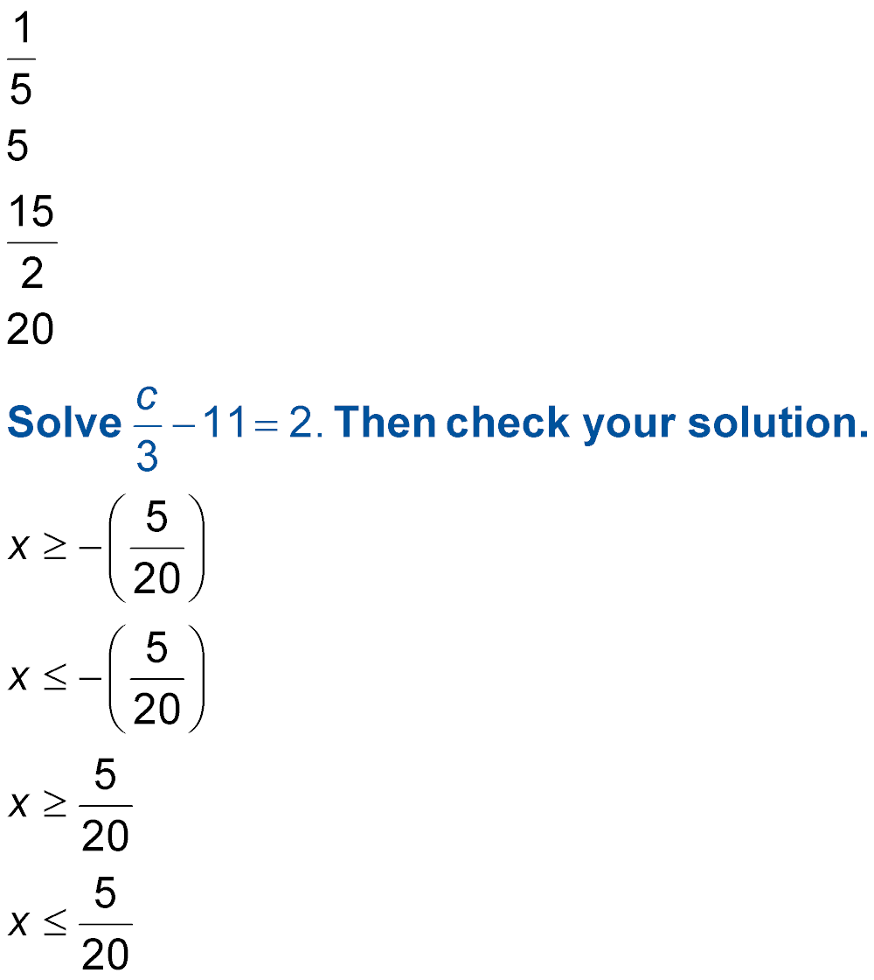
(over Chapter 8)
Solve 4m + 5 = 25. Then check your solution.
A.
B.
C.
D.
A
B
C
D

Slide 5

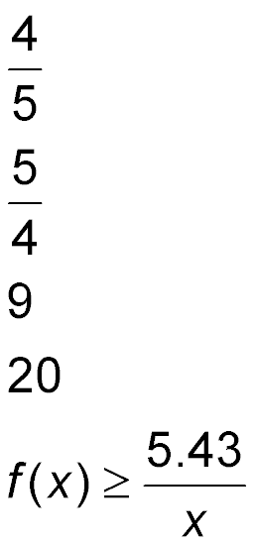
(over Lesson 9-1)
Find f(5) if f(x) = 4x.
A. AnsA
B. AnsB
C.
D.
A
B
C
D

Slide 6


Represent linear functions using function tables and graphs.
linear function

Slide 7

Standard 7AF1.5 Represent quantitative relationships graphically and interpret the meaning of a specific part of a graph in the situation represented by the graph.

Slide 8
You can’t have these:
3x + y = 2
y + 4 = 2x
2x – 9 + y = 2
Y must always be on the left side & the function rule must always be on the right side.
So What’s the Rule?
But You can have these:
y = 2 – 3x
y = 2x - 4
y = -2x + 11

Slide 9

Graph a Function
MUSIC During a clearance sale, a music store is selling CDs for $3 and tapes for $1. Graph the function 3x + y = 6 to find how many CDs and tapes Bill can buy with $6.
First, rewrite the equation by solving for y.
3x + y = 6
Write the equation.
3x – 3x + y = 6 – 3x
Subtract 3x from each side.
y = 6 – 3x
Simplify into a function.

Slide 10
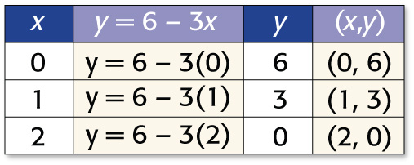
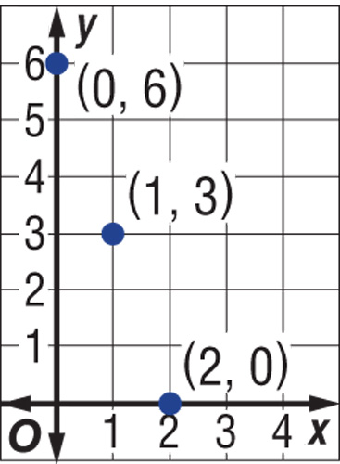
Graph a Function
Use the function for y (y = 6 – 3x) & set up a function table.
Answer:
Choose values for x and substitute them to find y.
Lastly, graph the ordered pairs.

Slide 11

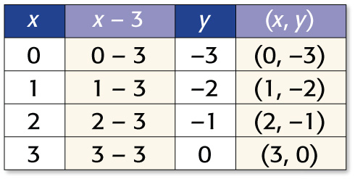
Graph a Function
Graph y = x – 3
Step 1 Choose some values for x. Make a function table. Include a column of ordered pairs of the form (x, y).

Slide 12
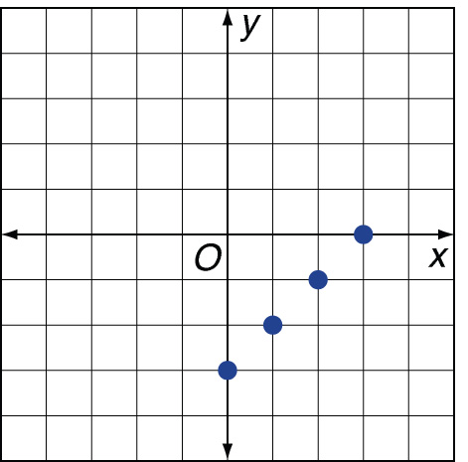
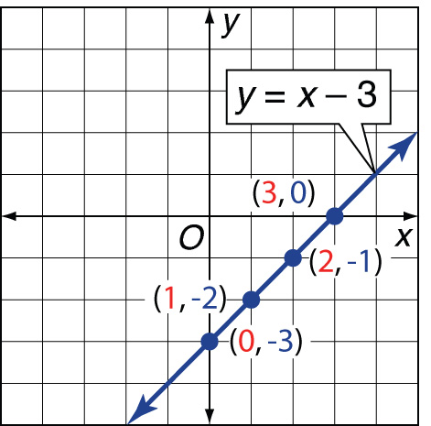
Graph a Function
Step 2 - Graph each ordered pair.
- Draw a line that passes through each point.
(Note that the ordered pair for any point on this line is a solution of y = x – 3. The line is the complete graph of the function.)

Slide 13
Graph a Function
Check It appears from the graph that (–1, –4) is also a solution. Check this by substitution.
y = x – 3. Write the function.
?
–4 = –1 – 3 Replace x with –1 and y with –4.
–4 = –4 Simplify.
✓

Slide 14

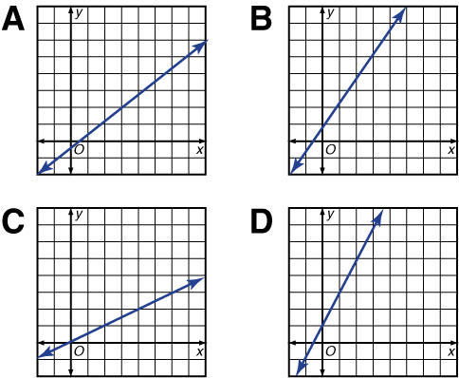
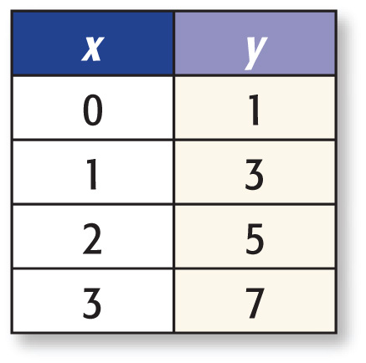
Which line graphed below best represents the table of values for the ordered pairs (x, y)?
B.
C. D.

Slide 15

BAKE SALE During a bake sale, a plate of brownies is sold for $2 and a plate of cookies is sold for $1. Graph the function 2x + y = 4 to find how many plates of brownies and cookies Craig can buy with $4.
X
2x + y = 4
Y
( X, Y )
Start by making a function table:

Slide 16
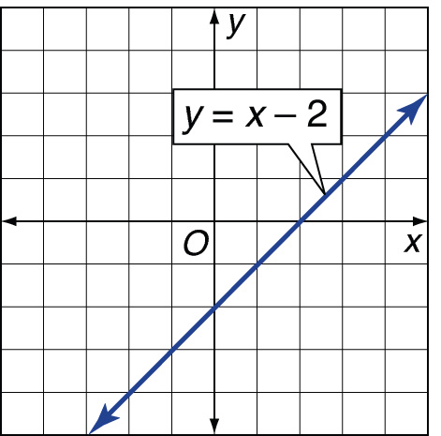
Graph y = x –2
Answer:

Slide 17
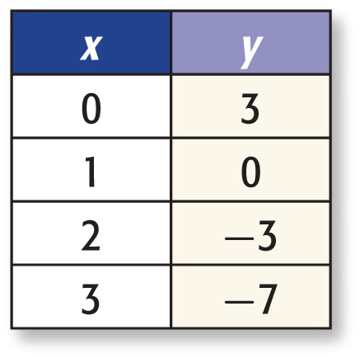
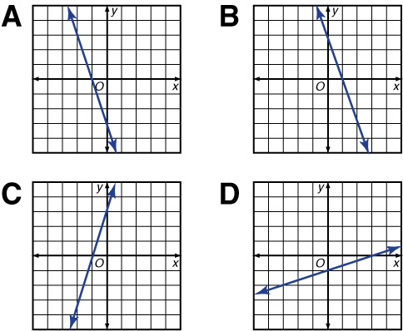
Which line graphed below best represents the table of values for the ordered pairs (x, y)?
A. B.
C. D.
A
C
D

Slide 18
