Slide 1
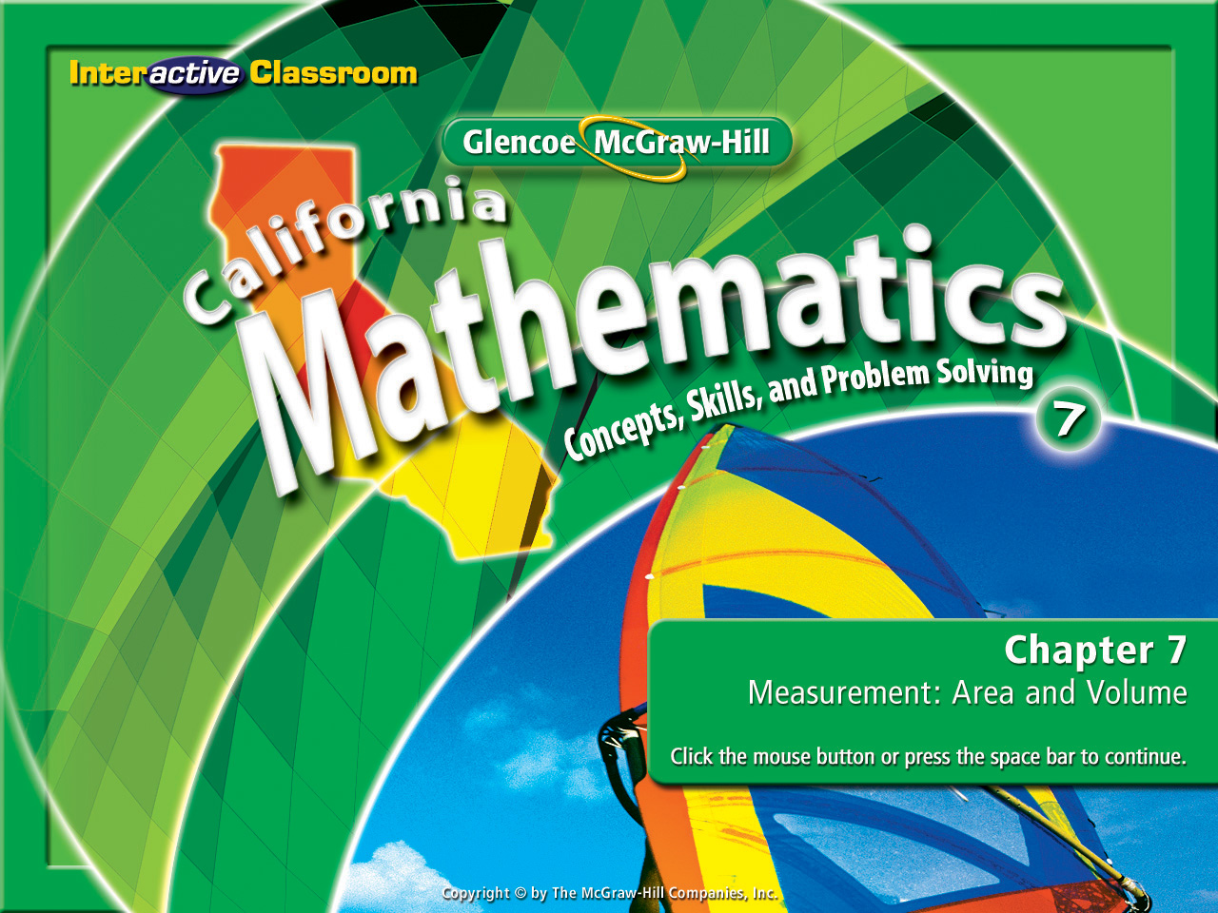
Splash Screen
Chapter 9
Lesson 9-3

Slide 2




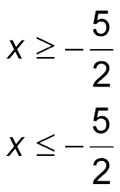
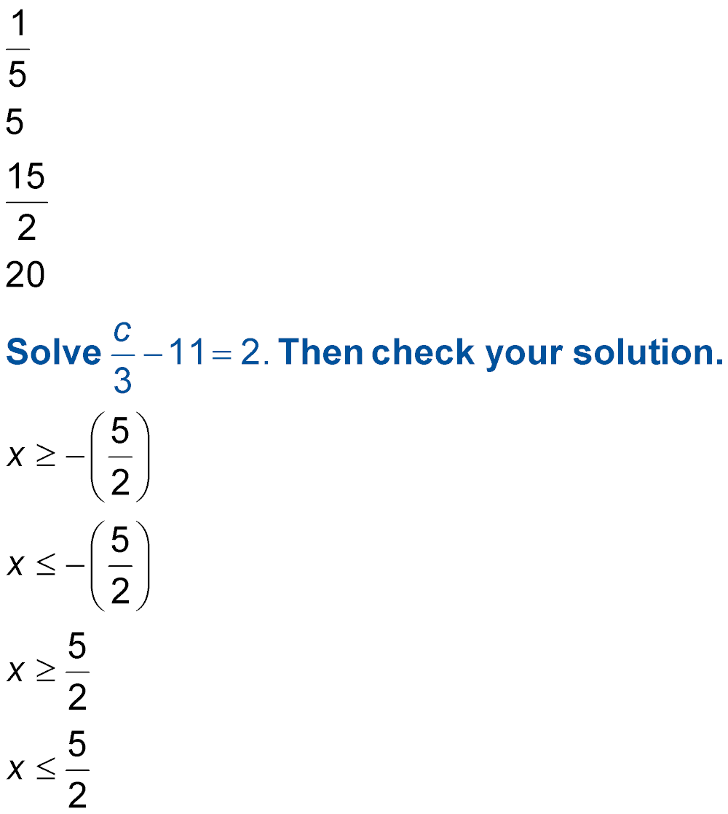
(over Chapter 8)
Solve the inequality –2x ≤ 5. Then check your solution.
A.
B.
C.
D.
A
B
C
D

Slide 3


(over Chapter 8)
The perimeter of a square with side length x is no less than 36 inches. Which inequality represents all possible values for x?
A. x > 9
B. x ≤ 4
C. x ≥ 9
D. x ≥ 4
A
B
C
D

Slide 4

(over Lesson 9-1)
Find f(3) if f(x) = x + 12.
A. 4
B. 9
C. 15
D. 36
A
B
C
D

Slide 5

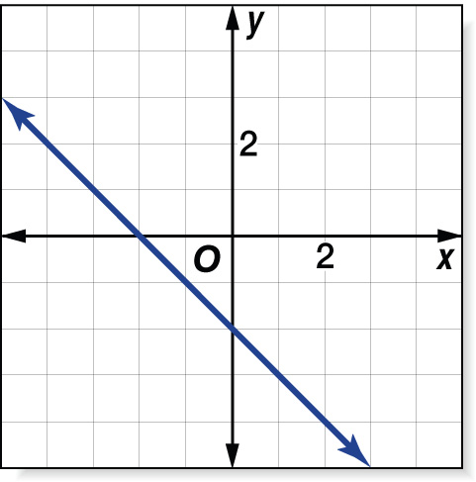
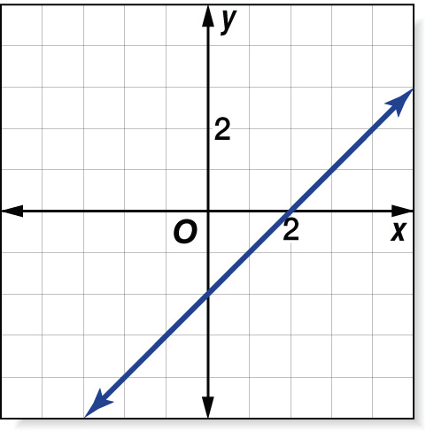
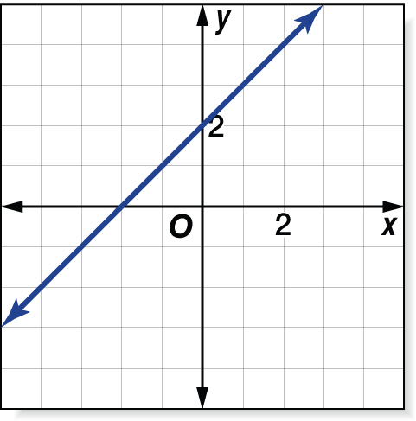
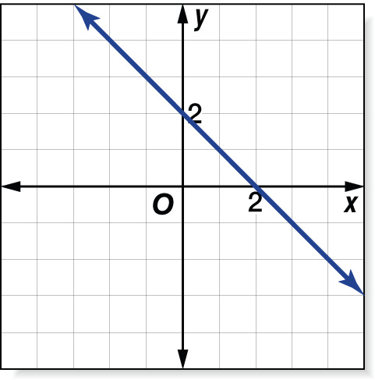
(over Lesson 9-2)
Which of the following is a graph of the function y = x – 2?
A. B.
C. D.
A
B
C
D

Slide 6

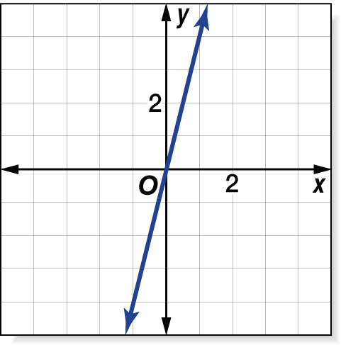
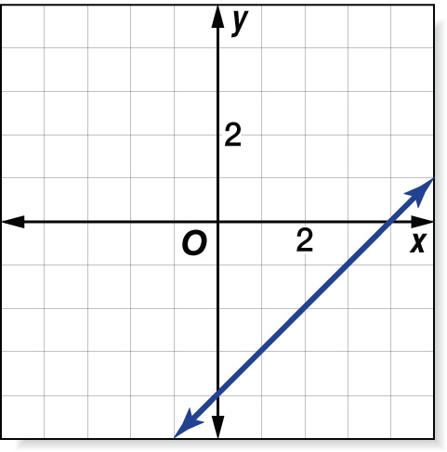
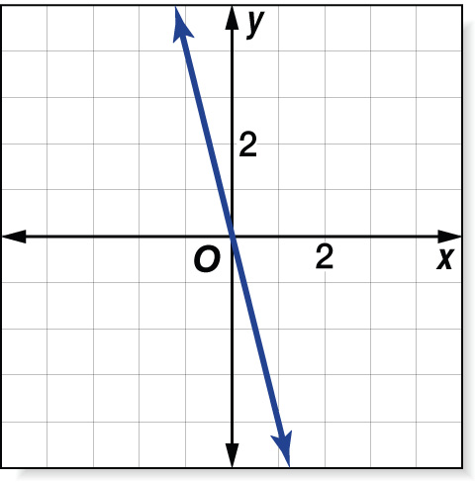
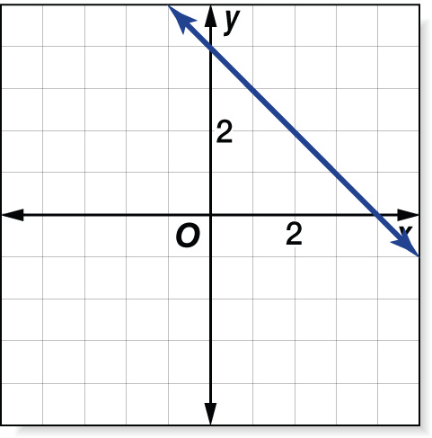
(over Lesson 9-2)
Which of the following is a graph of the function y = 4x?
A. B.
C. D.
A
B
C
D

Slide 7


Find the slope of a line.
slope
rise
run

Slide 8


Standard 7AF3.3 Graph linear functions, noting that the vertical change (change in y-value) per unit of horizontal change (change in x-value) is always the same and know that the ratio (“rise over run”) is called the slope of a graph.

Slide 9

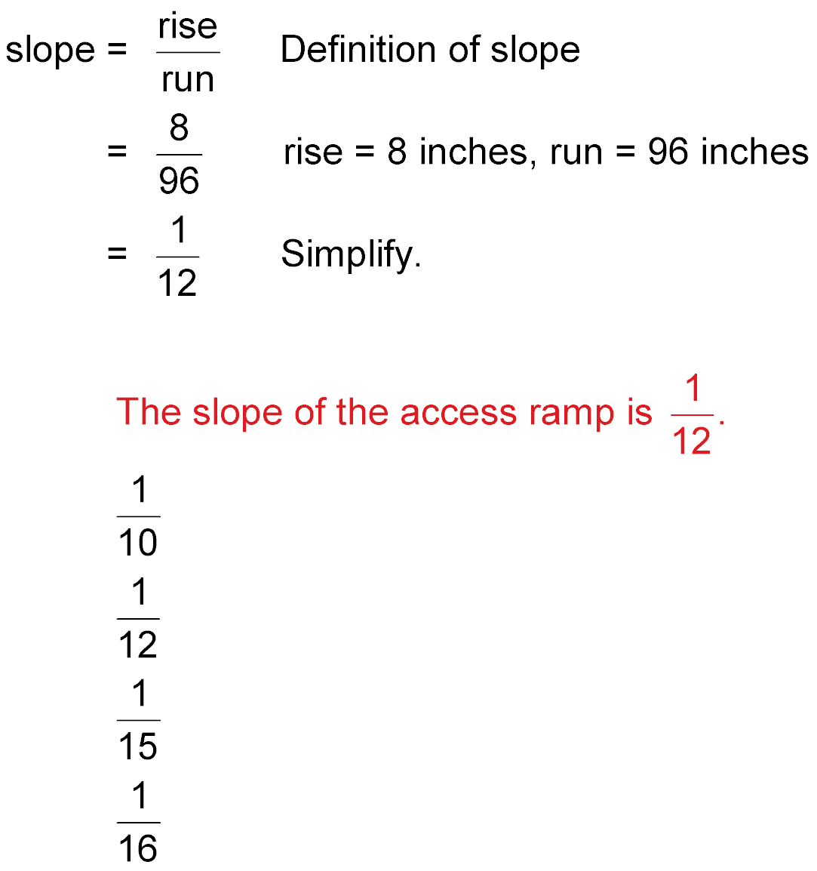
ACCESS RAMPS The access ramp from the sidewalk to the door of a hotel rises 8 inches for every horizontal change of 96 inches. What is the slope of the access ramp?
Answer:

Slide 10
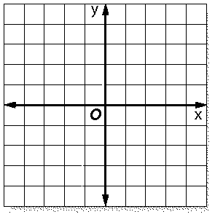
These are negative slopes:
These are positive slopes:

Slide 11

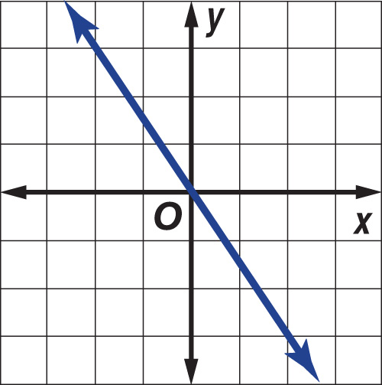
Find Slope Using a Graph
Find the slope of the line.
This is a negative slope because
when going from left to right, the
graph of the line slants downward.
Choose two points on the line. They must be located at perfect intersections.
The vertical change is always along the y axis. It is called the rise (y) The rise here is –3 units.
The horizontal change is always along the x axis. It is called the run (x). The run here is 2 units.

Slide 12
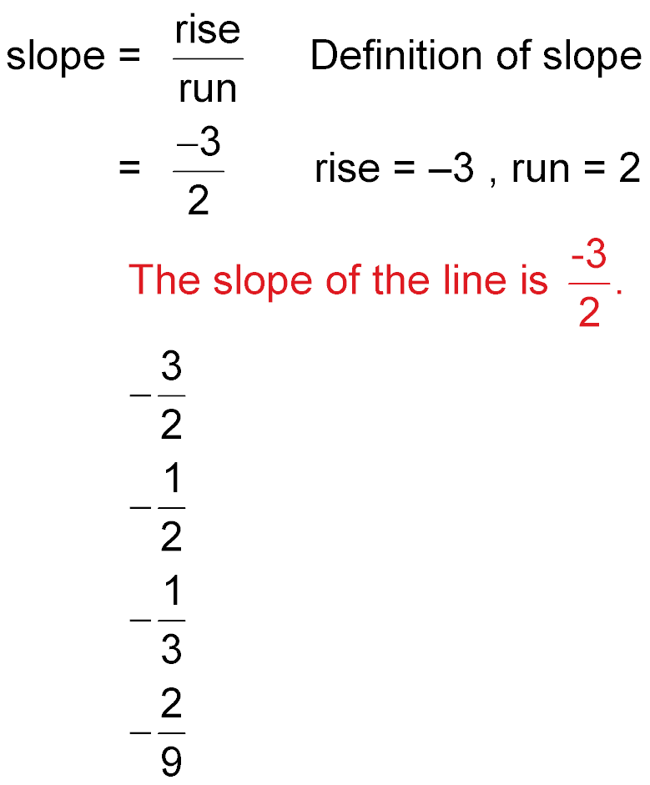
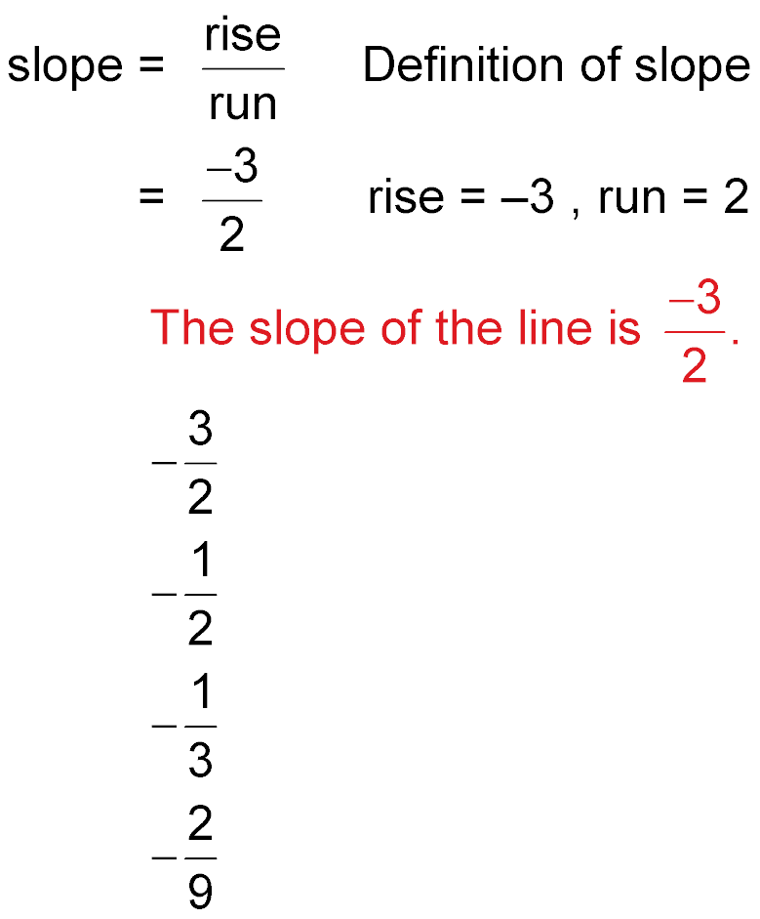
Find Slope Using a Graph
y
x
or
Answer:

Slide 13
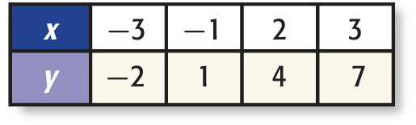
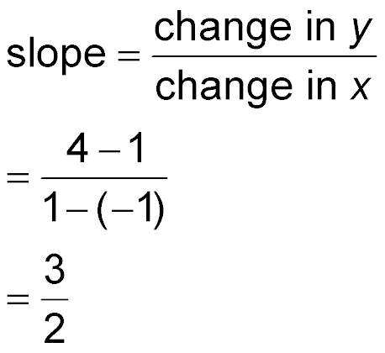
Find Slope Using a Table
- Sometimes you don’t have a graph to work with. You are only given a table with coordinate points.
- We can use the coordinate points to find the slope of the line.
We already know this:
So now we just apply this:
y
or
x
We pick two sets of coordinates from the table and do the math:
Our final answer gives us the slope:

Slide 14

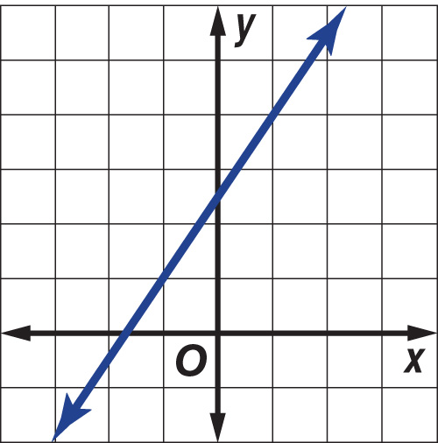
Find Slope Using a Table
Answer:
We can plot the coordinate
points in the table & connect
them to find our line.
up 3 units
over 2 units
We can then prove the slope
by using two points along the
line.

Slide 15
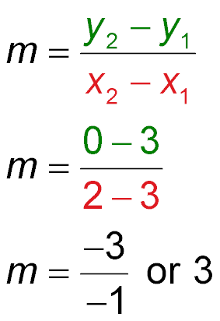
Find Slope Using Coordinates
Find the slope of the line that passes through
A(3, 3) and B(2, 0).
Definition of slope
(x₁, y₁) = (3, 3), (x₂, y₂) = (2,0)
Simplify.

Slide 16
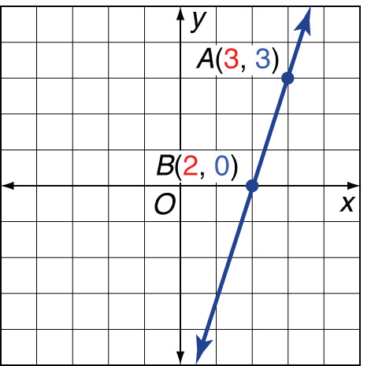
Find Slope Using Coordinates
3
1
up 3 units
=
over 1 unit
Check When going from left to right, the graph of the line slants upward. This is correct for positive slope.
Answer: The slope is 3.

Slide 17
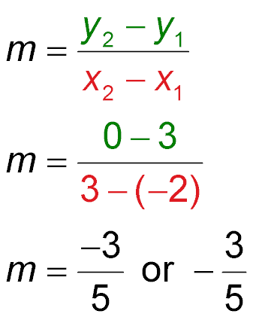
Find Slope Using Coordinates
Find the slope of the line that passes through
X(–2, 3) and Y(3, 0).
Definition of slope
(x₁, y₁) = (–2, 3), (x₂, y₂) = (3,0)
Simplify.

Slide 18
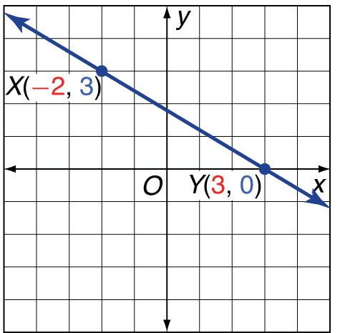
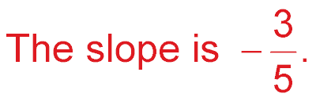
Find Slope Using Coordinates
-3
5
down -3 units
=
over 5 units
Check When going from left to right, the graph of the line
slants downward. This is correct for a negative slope.
Answer:

Slide 19

ACCESS RAMPS The access ramp from the sidewalk to the door of an office building rises 14 inches for every horizontal change of 210 inches. What is the slope of the access ramp?
A.
B.
C.
D.
A
B
C
D

Slide 20
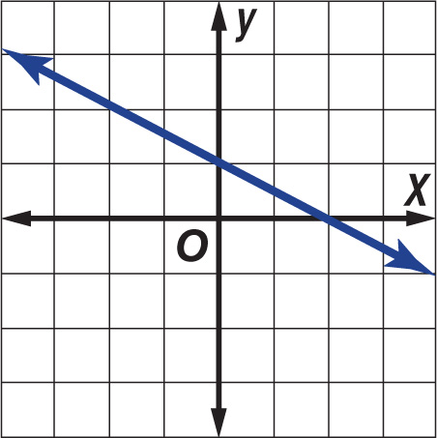
Find the slope of the line.
A.
B.
C.
D.
A
B
C
D

Slide 21
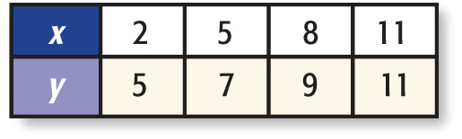
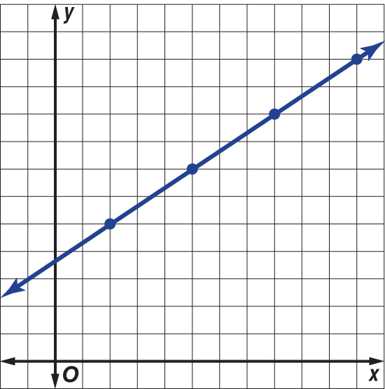
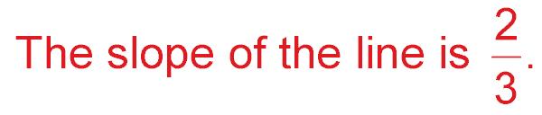
The points given in the table lie on a line. Find the slope of the line. Then graph the line.
Answer:

Slide 22
Find the slope of the line that passes through
A(4, 3) and B(1, 0).
A. –1
B. 1
C. 2
D. 5
A
B
C
D

Slide 23

Find the slope of the line that passes through
X(–3, 3) and Y(1, 0).
A.
B.
C.
D.
A
B
C
D

Slide 24
Key Concept
Must Formulas
Memorize These!
rise
run
y
x
y₂ – y₁
x₂ – x₁
=
=

Slide 25





