Slide 1
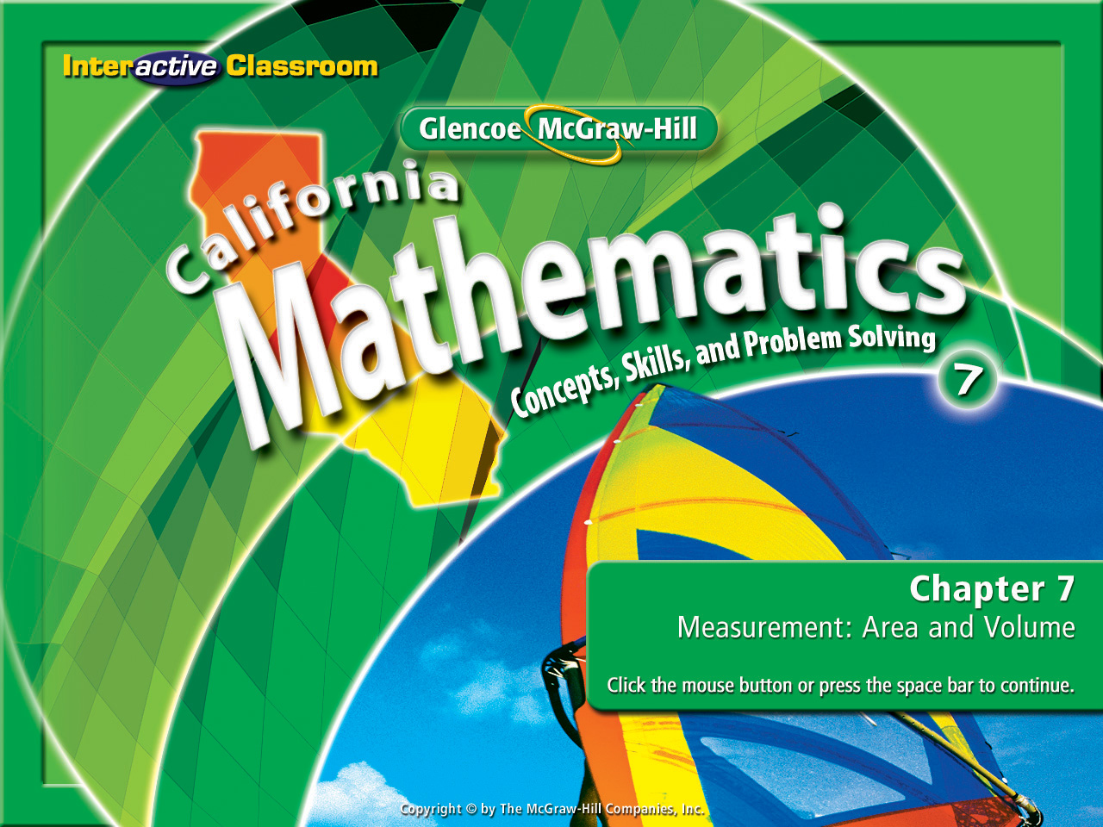
Splash Screen
Chapter 9
Lesson 9-4

Slide 2



(over Lesson 9-1)
Find f(6) if f(x) = 2x – 1.
A. 2
B. 11
C. 12
D. 13
A
B
C
D

Slide 3
(over Lesson 9-1)
Find f(6) if f(x) = 2x – 1.
A. 2
B. 11
C. 12
D. 13
A
B
C
D

Slide 4
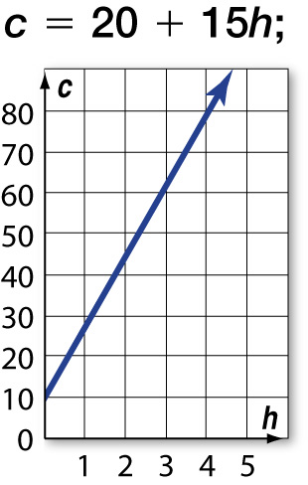
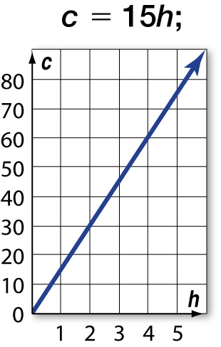
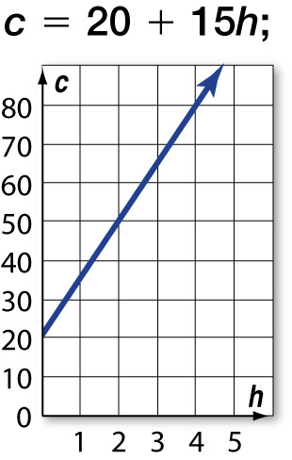
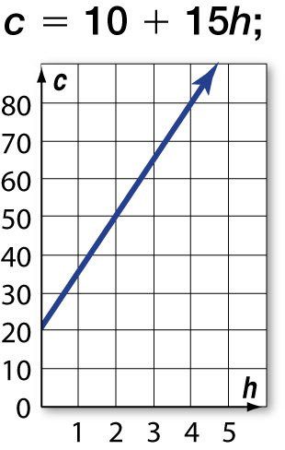
(over Lesson 9-2)
A local repairman charges $20 per visit plus $15 per hour of work. Which choice shows an equation for the repairman’s rates and a graph of the equation?
A. B. C. D.
A
B
C
D

Slide 5

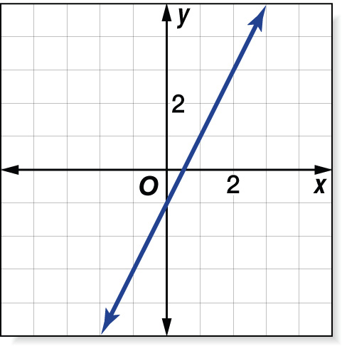
(over Lesson 9-2)
Which function is graphed in the figure shown?
A. y = x – 1
B. y = 2x – 1
C. y = x
D. y = 3x – 3
A
B
C
D

Slide 6


(over Lesson 9-3)
Find the slope of the line that passes through the points A(0, 0) and B(4, 3).
A.
B.
C.
D.
A
B
C
D

Slide 7
(over Lesson 9-3)
Find the slope of the line that passes through the points M(–3, 2) and N(7, –5).
A. -4/7
B. -7/4
C. 4/7
D. 7/4
A
B
C
D

Slide 8


Use direct variation to solve problems.
direct variation
constant of variation

Slide 9


Standard 7AF3.4 Plot the values of quantities whose ratios are always the same (e.g., cost to the number of an item, feet to inches, circumference to diameter of a circle). Fit a line to the plot and understand that the slope of the line equals the quantities.
Standard 7AF4.2 Solve multi-step problems involving rate, average speed, distance, and time or a direct variation.

Slide 10
These are special coordinates:
x y
x y
x y
2
4
7
11
4
8
14
22
3
6
9
12
9
18
27
36
1
5
12
20
5
25
60
100
In our last lesson we learned that a
slope is always the rise (y) over run (x).
We call these “constant ratios”.
4
2
9
3
5
1
= 2
= 3
= 5
8
4
18
6
25
5
= 2
= 3
= 5
4
2
27
9
60
12
= 2
= 3
= 5
8
4
36
12
100
20
= 2
= 3
= 5

Slide 11

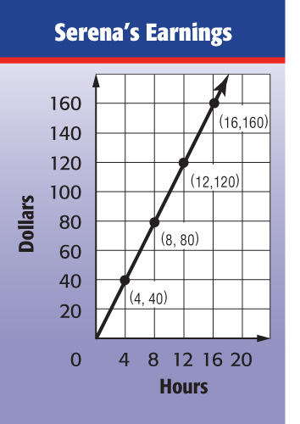
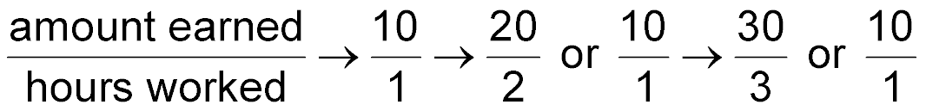
Find a Constant Ratio
EARNINGS The amount of money Serena earns at her job varies directly as the number of hours she works. Determine the amount Serena earns per hour.
Since the graph of the data forms a line, the rate of change is constant. Use the graph to find the constant ratio. Pick 2 points and use their coordinates to find the constant ratio.
x
y
40
4
10
1
120
12
10
1
or
Answer: Serena earns $10 per hour.

Slide 12
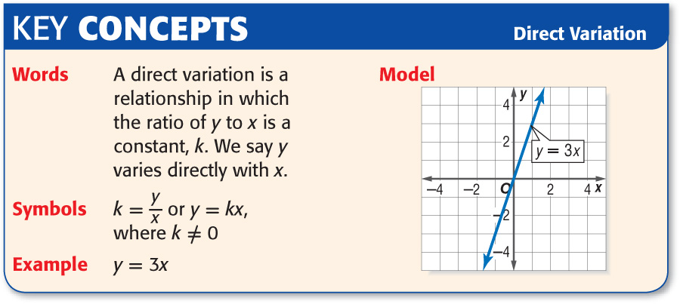
y = k x
9
3
x y
= 3
3
6
9
12
9
18
27
36
(y = k x)
18
6
y = 3x
= 3
27
9
= 3

Slide 13

Solve a Direct Variation
SHOPPING A grocery store sells 4 cans of soup for $5. How much would it cost to buy 8 cans?
Method 1 Use an equation.
Write an equation of direct variation. Let x represent the number of cans and let y represent the cost.
y = k x
Write the direct variation equation.
5 = k(4)
Cost: y = 5 Number of cans: x = 4
5 = k(4)
Isolate the variable & determine the value of k.
4 = 4
y = 1.25x
The constant k = 1.25

Slide 14
Direct Variation Equation
y = kx
SHOPPING A grocery store sells 4 cans of soup for $5. How much would it cost to buy 8 cans?
Now we can use the equation to find y when x = 8 (cans).
y = 1.25x
Write the direct variation equation with the value of the constant (k = 1.25).
y = 1.25(8)
Replace the variable with it’s value (x = 8)
y = 10
Multiply
Answer: It would cost $10 to buy 8 cans.

Slide 15
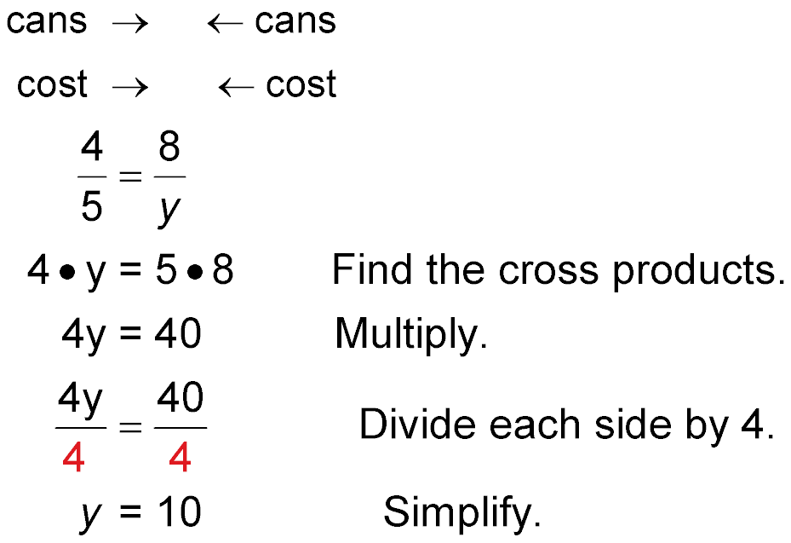
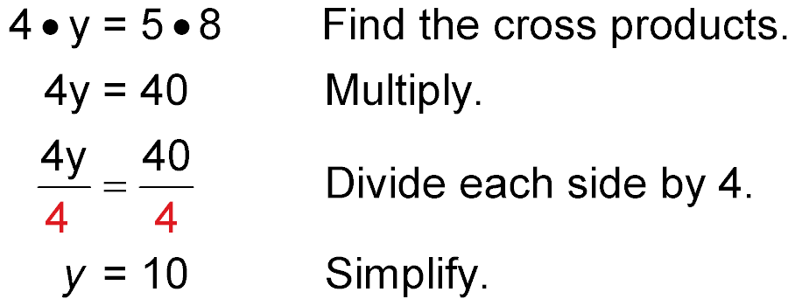
SHOPPING A grocery store sells 4 cans of soup for $5. How much would it cost to buy 8 cans?
Method 2 Use a proportion. Remember the cans to cost is
4 cans : $5 or 4/5
Answer: It would cost $10 to buy 8 cans.

Slide 16


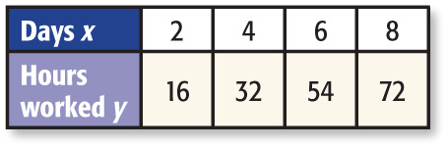
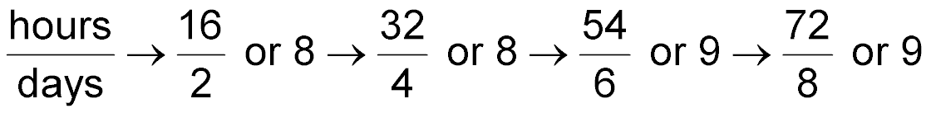
Identify Direct Variation
Determine whether the linear function is a direct variation. If so, state the constant of variation.
Compare the ratios to check for a common ratio.
Answer: The ratios are not proportional, so the function is not a direct variation.

Slide 17

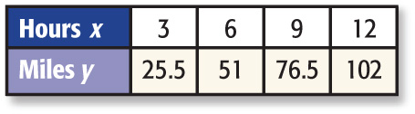
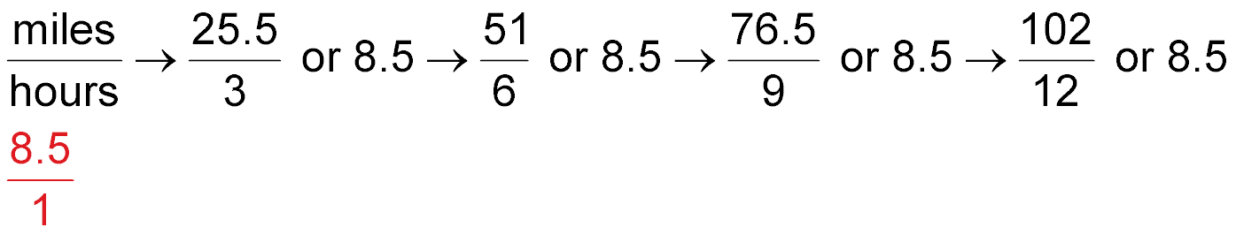

Identify Direct Variation
Determine whether the linear function is a direct variation. If so, state the constant of variation.
Compare the ratios to check for a common ratio.
Answer: Since the ratios are proportional, the function is a direct variation. The constant of variation is or 8.5.

Slide 18

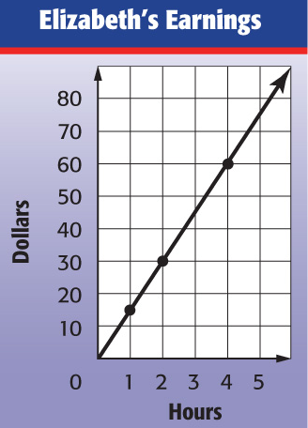
EARNINGS The amount of money Elizabeth earns at her job varies directly as the number of hours she works. Determine the amount Elizabeth earns per hour.
$8 per hour
$10 per hour
$12 per hour
D. $15 per hour
A
B
C
D

Slide 19
SHOPPING A grocery store sells 6 apples for $2.70. How much would it cost to buy 10 apples?
A. $4.50
B. $4.85
C. $5.00
D. $5.20
A
B
C
D

Slide 20

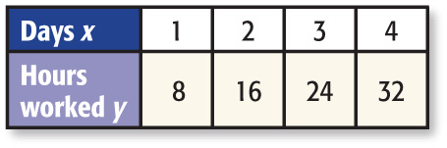
Determine whether the linear function is a direct variation. If so, state the constant of variation.
A. yes;
B. yes; 8
C. yes; 4
D. no
A
B
C
D

Slide 21

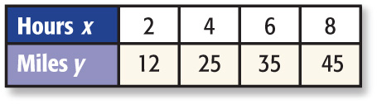
Determine whether the linear function is a direct variation. If so, state the constant of variation.
A. yes;
B. yes; 6
C. yes;
D. no
A
B
C
D

Slide 22
