Slide 1
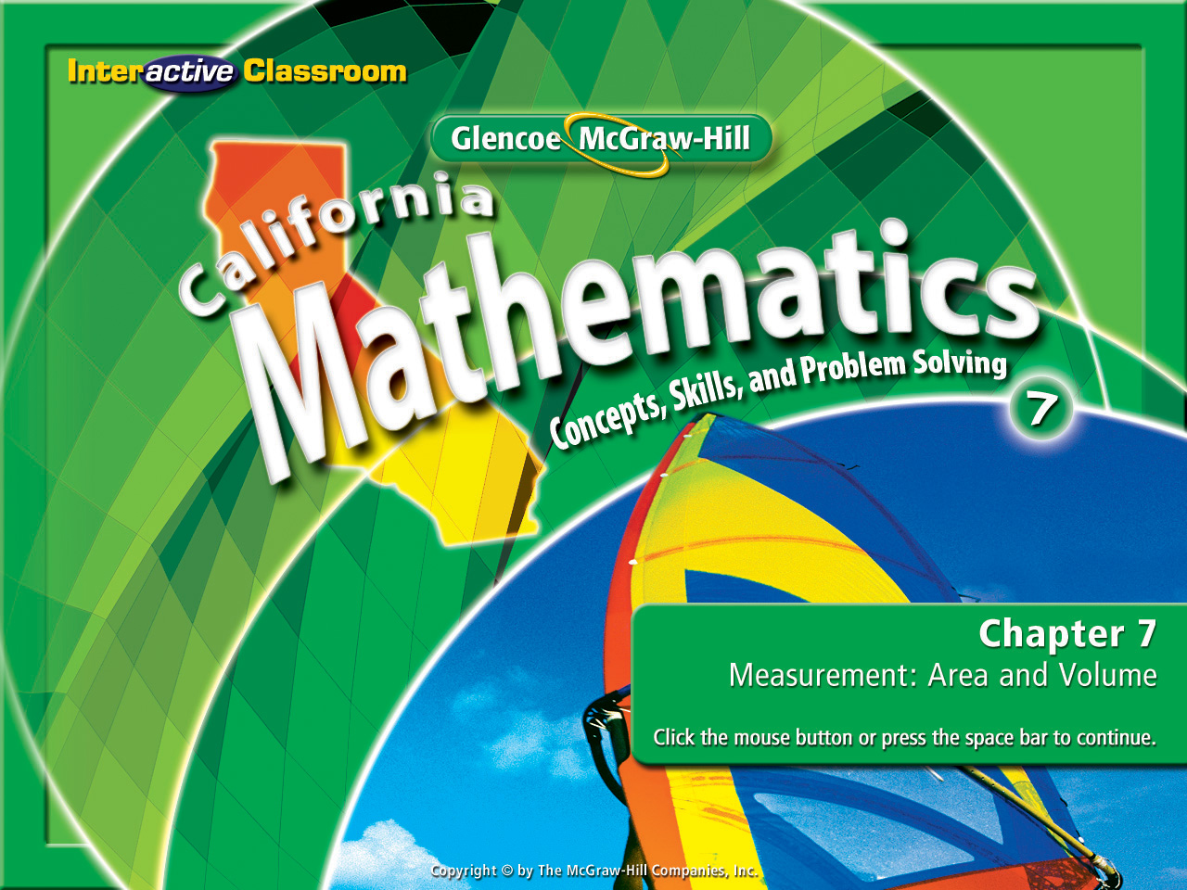
Splash Screen
Chapter 9
Lesson 9-5

Slide 2



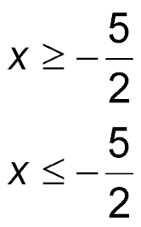
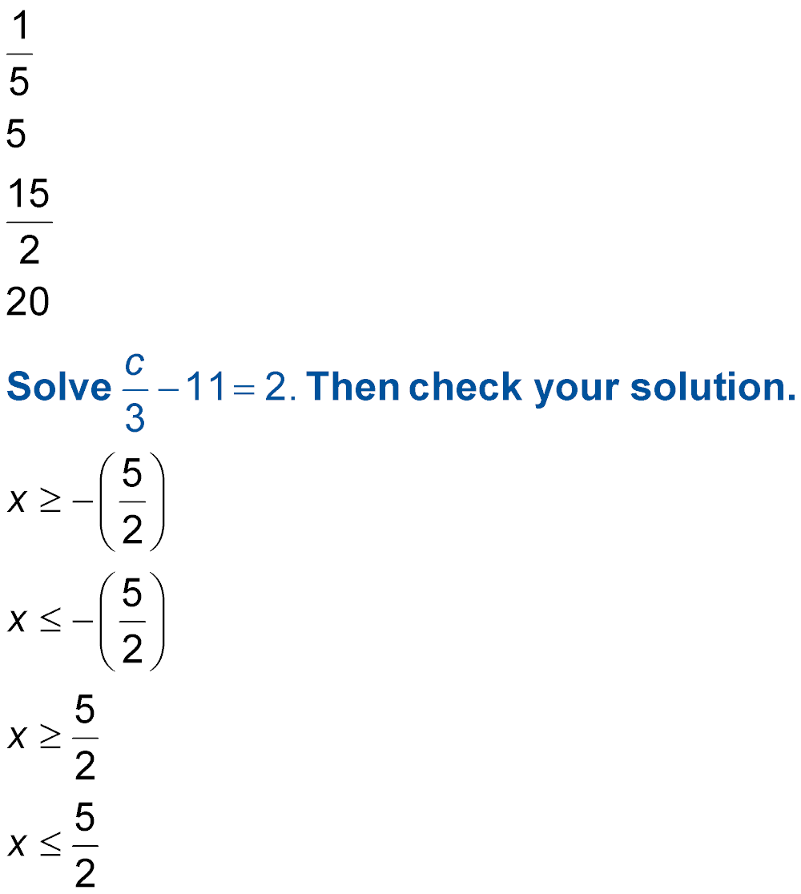
(over Chapter 8)
Solve the inequality –2x ≤ 5. Then check your solution.
A.
B.
C.
D.
A
B
C
D

Slide 3
(over Lesson 9-1)
Find f(–7) if f(x) = –3x + 2.
A. –23
B. –21
C. 21
D. 23
A
B
C
D

Slide 4

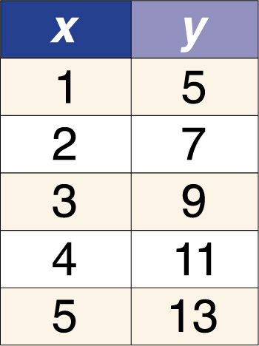
(over Lesson 9-1)
Which function matches the function table?
A. y = x + 45
B. y = 3x
C. y = 3x + 4
D. y = 2x + 3
A
B
C
D

Slide 5

(over Lesson 9-3)
Find the slope of the line that passes through the points A(0, 0) and B(4, 3).
A.
B.
C.
D.
A
B
C
D

Slide 6

(over Lesson 9-3)
Find the slope of the line that passes through the points P(–6, –9) and Q(2, 7).
A. –2
B.
C.
D. 2
A
B
C
D

Slide 7
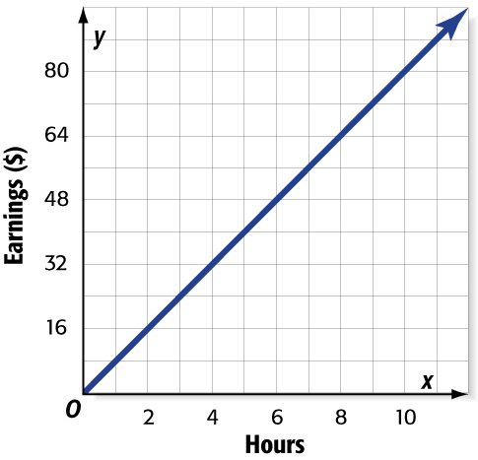

(over Lesson 9-4)
Refer to the graph. The amount of money Aisha earns is directly proportional to the number of hours she works at the bookstore. What is the ratio of money earned to hours worked?
A.
B.
C.
D.
A
B
C
D

Slide 8
(over Lesson 9-4)
At the farmer’s market, they are selling 10 ears of corn for $4.00. How much would it cost to buy 17 ears of corn?
A. $4.75
B. $6.80
C. $7.40
D. $8.50
A
B
C
D

Slide 9


Graph linear equations using the slope and y-intercept.
slope-intercept form
y-intercept

Slide 10


Standard 7AF3.3 Graph linear functions, noting that the vertical change (change in y-value) per unit of horizontal change (change in x-value) is always the same and know that the ratio (“rise over run”) is called the slope of a graph.

Slide 11
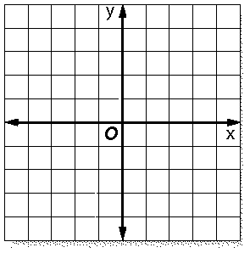
Pay close attention to these:
y = 2x + 2
y = ⅓x - 4
y = -3x + 4

Slide 12


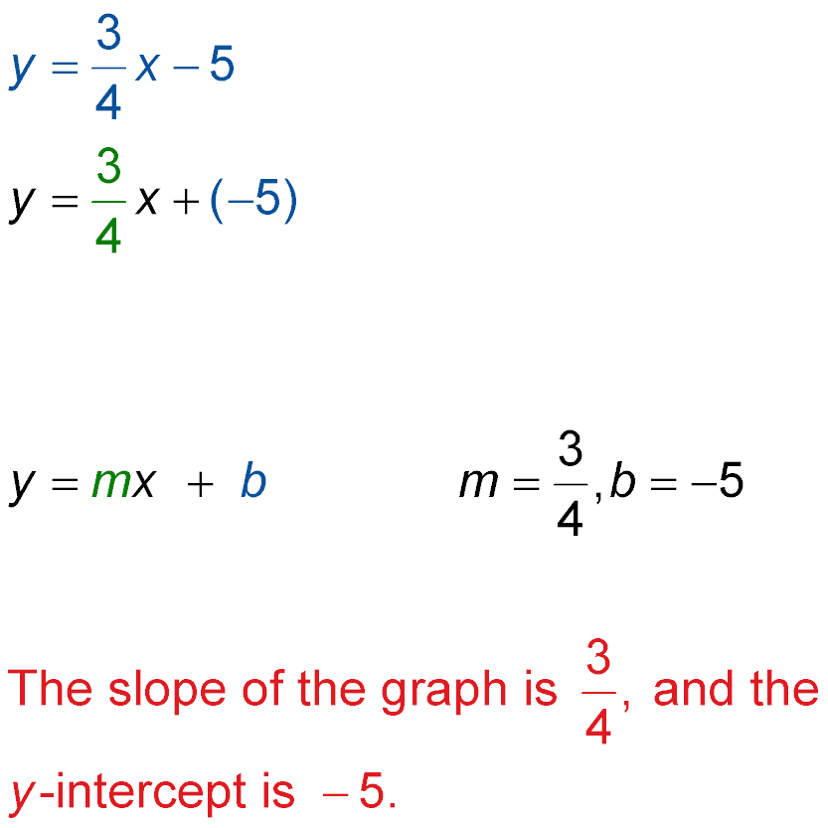
Find Slopes and y-intercepts of Graphs
State the slope and the y-intercept of the graph of the equation below:
Check to make sure the variable term is listed 1st & the constant is listed last.
The coefficient represents the slope and the constant represents the y-intercept.
Answer:

Slide 13

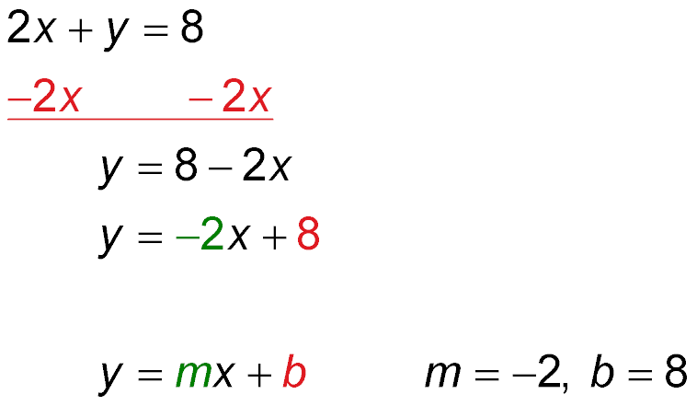
Find Slopes and y-intercepts of Graphs
State the slope and the y-intercept of the graph of the equation 2x + y = 8.
Write the original equation.
Y is not isolated therefore we have to combine a -2x to each side.
Simplify.
Re-write the equation listing the variable term 1st & the constant last.
The coefficient represents the slope and the constant represents the y-intercept.
Answer: The slope of the graph is –2 and the y-intercept is 8.

Slide 14
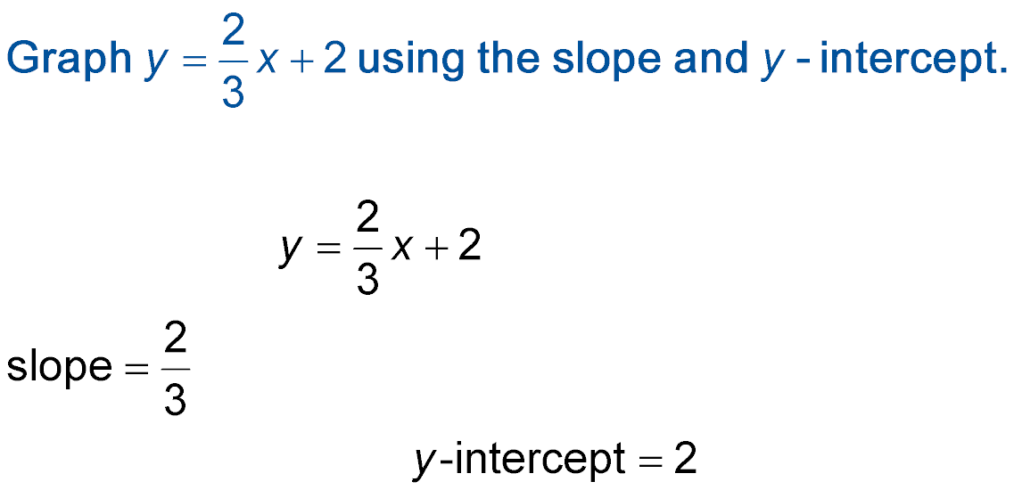

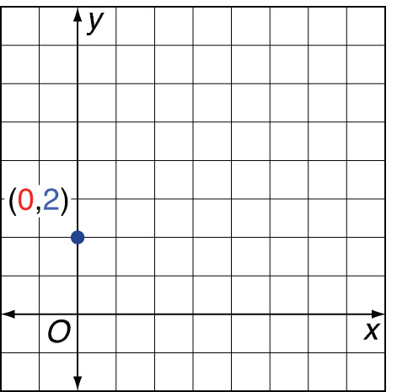
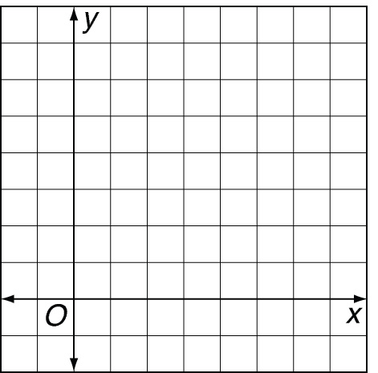
Graph Using Slope-Intercept Form
Graph using the slope and y-intercept.
Step 1 Find the slope and y-intercept.
Step 2 Graph the y-intercept (0, 2).

Slide 15
Graph Using Slope-Intercept Form
Step 3 Use the slope to locate a second point on the line.
change in y: up 2 units
slope = ⅔
change in x: right 3 units
Step 4 Draw a line through the two points.

Slide 16

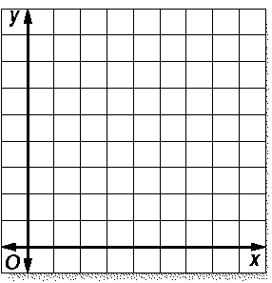
Graph an Equation to Solve Problems
Graph y = 3x + 4. First, find the slope and the y-intercept.
y = 3x + 4
slope = 3
y-intercept = 4
Plot the point (0, 4).
Then locate another point up 3 and right 1.
Draw the line.

Slide 17

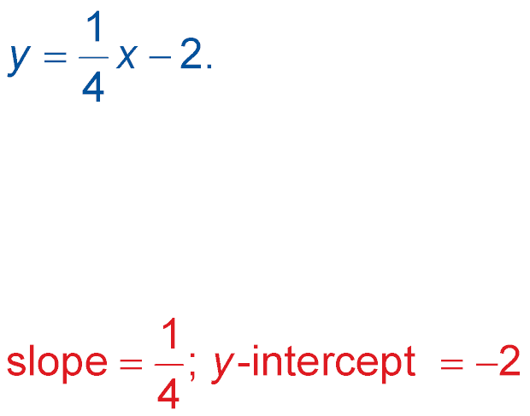
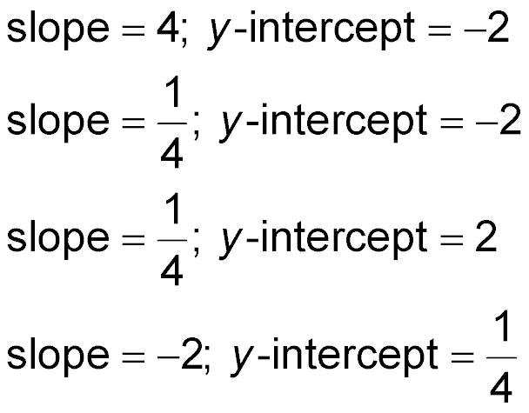
State the slope and the y-intercept of the graph of the equation:
A.
B.
C.
D.
A
B
C
D

Slide 18
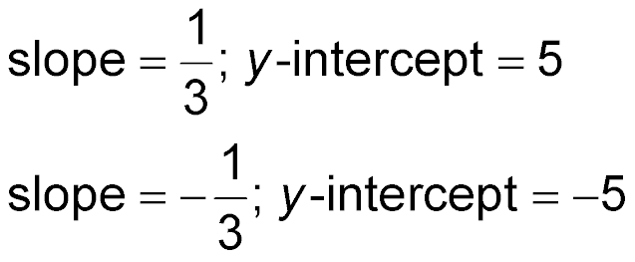
State the slope and the y-intercept of the graph of the equation 3x + y = 5.
A. slope = –3; y-intercept = 5
B. slope = –3; y-intercept = –5
C.
D.
A
B
C
D

Slide 19

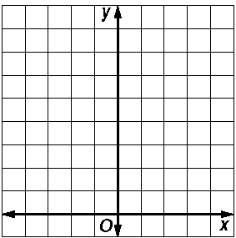
Graph using the slope and y-intercept.
Answer:

Slide 20
Graph the equation y = 4x + 5
Answer:

Slide 21
