Slide 1
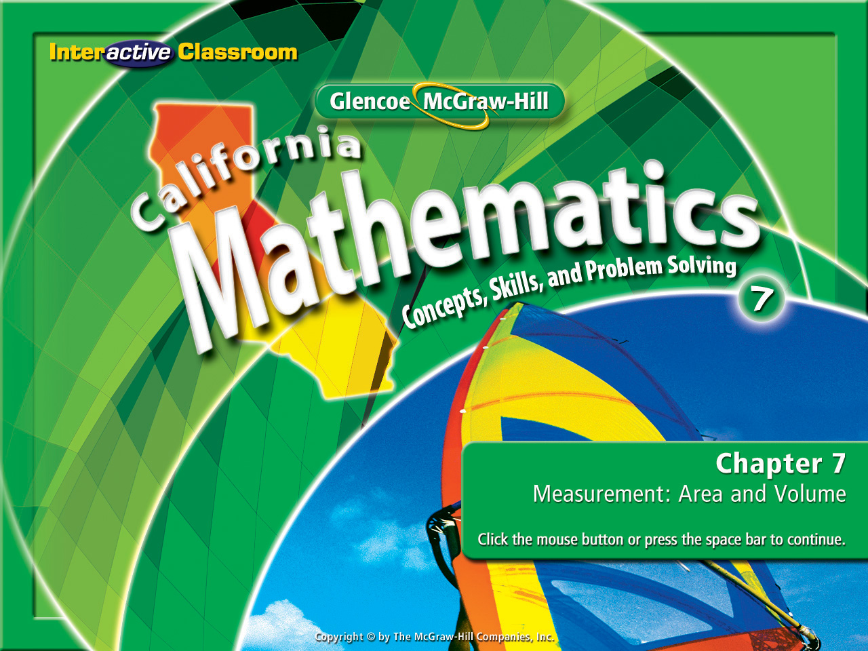
Splash Screen
Chapter 9
Lesson 9-8

Slide 2



(over Chapter 8)
Solve the inequality a + 2 > –7. Then check your solution.
A. a < –9
B. a > –9
C. a > 9
D. a < 9
A
B
C
D

Slide 3
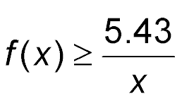
(over Lesson 9-1)
Elizabeth is buying candles. They are $5.43 each. She is not sure how many she wants to buy. Write a function to calculate the total cost for any given number of candles.
A. f(x) = 5.43x
B.
C. f(x) = 5.43 + x
D. f(x) = 5.43 – x
A
B
C
D

Slide 4

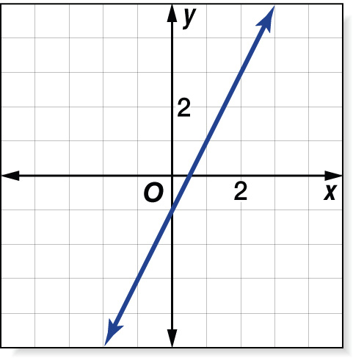
(over Lesson 9-2)
Which function is graphed in the figure shown?
A. y = x – 1
B. y = 2x – 1
C. y = x
D. y = 3x – 3
A
B
C
D

Slide 5
(over Lesson 9-3)
Find the slope of the line that passes through the points
M(–3, 2) and N(7, –5).
A. -3/4
B. -7/10
C. 3/4
D. 7/10
A
B
C
D

Slide 6
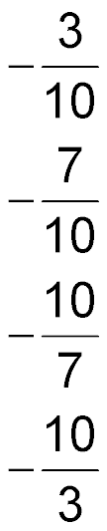
(over Lesson 9-3)
Find the slope of the line that passes through the points
K(6, –3) and L(16, –4).
A.
B.
C.
D.
A
B
C
D

Slide 7
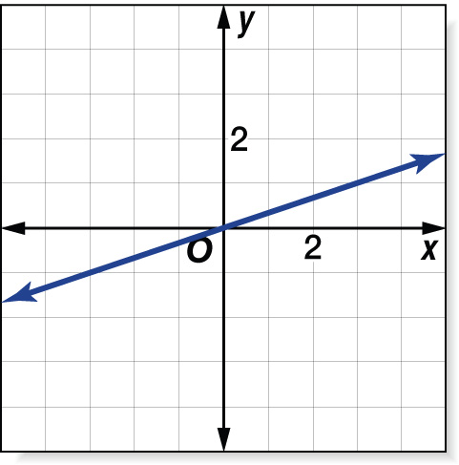

(over Lesson 9-3)
Refer to the figure. What is the slope of the graph?
A. 3
B.
C.
D. –3
A
B
C
D

Slide 8

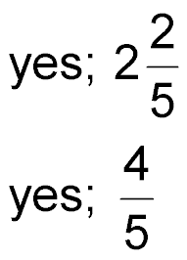
(over Lesson 9-4)
Determine whether the linear function is a direct variation. If so, state the constant of variation.
A. no B. yes; 2
C. D.
A
B
C
D

Slide 9
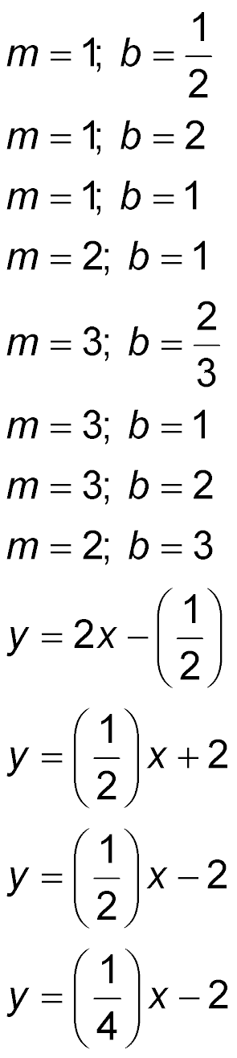
(over Lesson 9-5)
State the slope and the y-intercept for the graph of the equation y = 2x + 1.
A.
5
B.
C.
D.
A
B
C
D

Slide 10
(over Lesson 9-5)
State the slope and the y-intercept for the graph of the equation y = –2x + 4.5.
A. m = –2; b = 4.5
B. m = –2; b = –4.5
C. m = 4.5; b = 2
D. m = 4.5; b = –2
A
B
C
D

Slide 11
(over Lesson 9-5)
State the slope and the y-intercept for the graph of the equation 3x – y = 4.
A. m = –4; b = 3
B. m = –3; b = 4
C. m = 3; b = –4
D. m = 4; b = –3
A
B
C
D

Slide 12
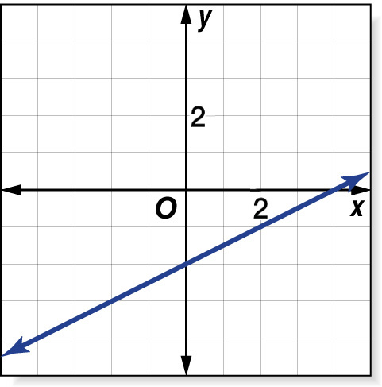
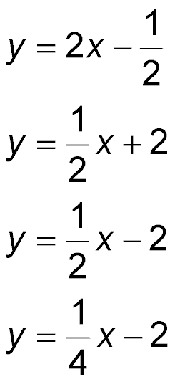
(over Lesson 9-5)
What is the equation of the graph shown?
A.
B.
C.
D.
A
B
C
D

Slide 13


Construct and interpret scatter plots.
scatter plot
line of fit

Slide 14

Standard 7SDAP1.2 Represent two numerical variables on a scatter plot and informally describe how the data points are distributed and any apparent relationship that exists between the two variables (e.g., between time spent on homework and grade level).

Slide 15
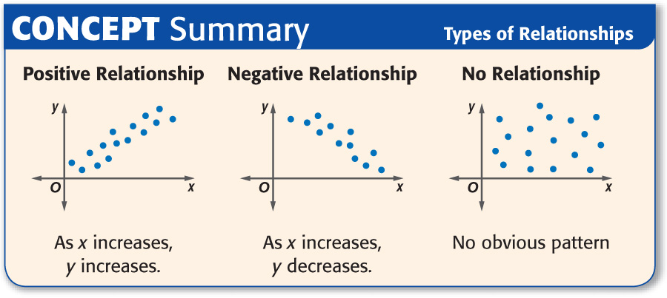

Slide 16


Identify a Relationship
Explain whether a scatter plot of the data for the number of cups of hot chocolate sold at a concession stand and the outside temperature might show a positive, negative, or no relationship.
As the temperature decreases, the number of cups of hot chocolate sold increases.
Cups
Sold
Answer: negative
Temperature

Slide 17

Identify a Relationship
Explain whether a scatter plot of the data for the birthday and number of sports played might show a positive, negative, or no relationship.
The number of sports played does not depend on your birthday.
Sports
Played
Answer: Therefore the scatter plot shows no relationship between age and sports.
Age

Slide 18

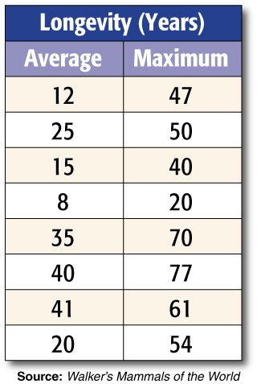
Line of Fit
ZOOS The table to the right shows the average and maximum longevity of various animals in captivity. Make a scatter plot using the data. Then draw a line that seems to best represent the data.

Slide 19
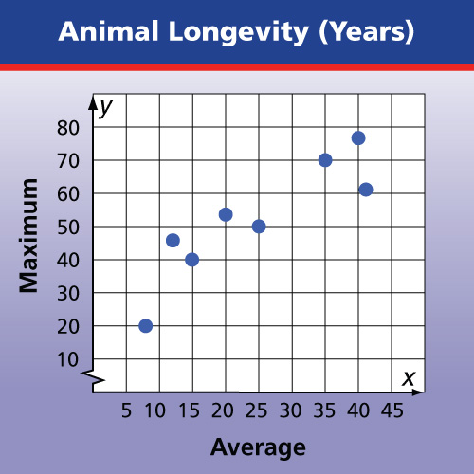
Line of Fit
Graph each of the data points.
Draw a line that best fits the data.
Answer:

Slide 20

Line of Fit
ZOOS The table to the right shows the average and maximum longevity of various animals in captivity. Write an equation for the line of fit.
The line passes through the points at (15, 40) and (35, 70). Use these points to find the slope of the line.

Slide 21
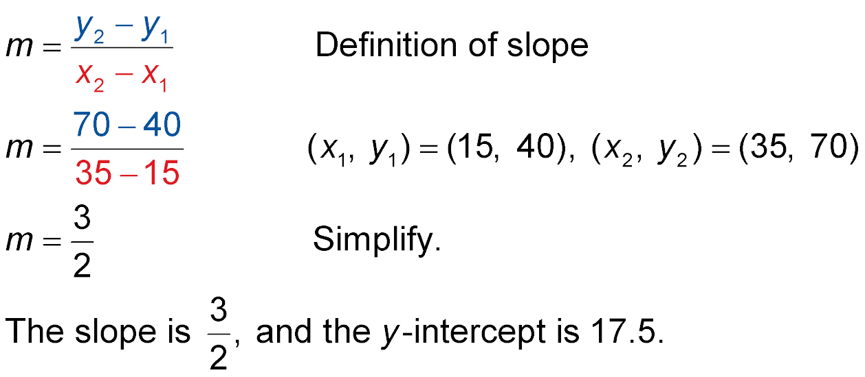
Line of Fit

Slide 22
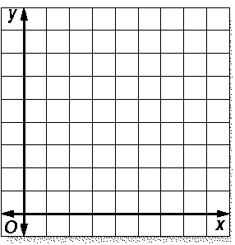
Line of Fit
We now need to plot our coordinates:
80
We now need to draw a line of fit. We do so by looking for largest amount of points we can connect.
70
60
50
40
30
20
The slope intercepts y at approximately 17.5 on the y-axis.
10
10
20
30
40
50
60
70

Slide 23
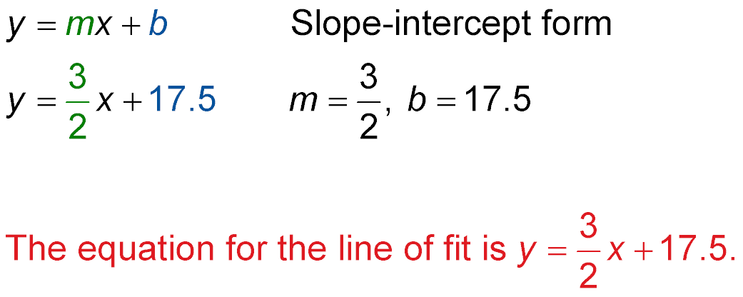
Line of Fit
Use the slope and the y-intercept to write the equation.
Slope
y-intercept
Answer:

Slide 24

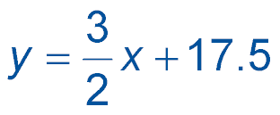
Line of Fit
ZOOS We worked with the table to the right earlier. It shows the average and maximum longevity of various animals in captivity. We can use the equation to predict the maximum longevity for an animal with an average longevity of 33 years.
Using the coordinates (15, 40) & (35, 70) our equation for a line of fit was

Slide 25
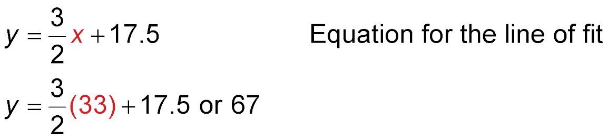
Predict the maximum longevity for an animal with an average longevity of 33 years.
Line of Fit
Using our equation, we replace the variable with the value 33.
Answer: We can calculate the maximum longevity would be 67.

Slide 26

Determine whether a scatter plot of the data for the number of cups of lemonade sold at a concession stand and the outside temperature might show a positive, negative, or no relationship.
A. positive
B. negative
C. no relationship
A
B
C

Slide 27
Determine whether a scatter plot of the data for your age and the color of your hair might show a positive, negative, or no relationship.
A. positive
B. negative
C. no relationship
A
B
C

Slide 28
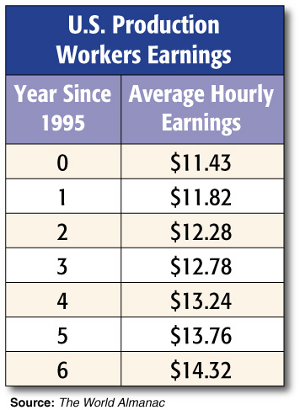
PRODUCTION The table to the right shows the average hourly earnings of U.S. production workers since 1995. Make a scatter plot using the data. Then draw a line that seems to best represent the data.

Slide 29
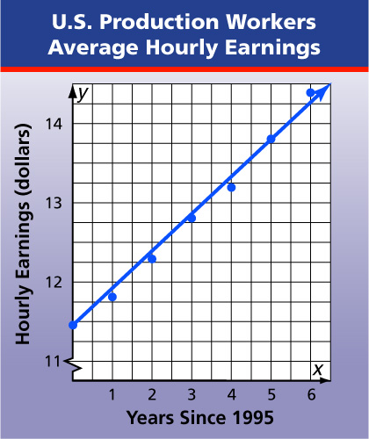
Answer:

Slide 30
PRODUCTION The table to the right shows the average hourly earnings of U.S. production workers since 1995. Write an equation for the line of fit using the points (0, 11.43) and (5, 13.76).
A. y = 1.4x + 12.15
B. y = 0.924x + 3.07
C. y = 0.815x + 9.21
D. y = 0.466x + 11.43
A
B
C
D

Slide 31
PRODUCTION The table to the right shows the average hourly earnings of U.S. production workers since 1995. Use the equation y = 0.466x + 11.43 to predict the average hourly earnings of U.S. production workers in 2004.
A. $14.81 B. $15.62
C. $15.92 D. $16.07
A
B
C
D

Slide 32





