Slide 1
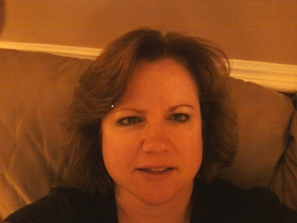
Mary Norris eportfolio
SITE MAP:
Vita Page
Research Page
Artifacts Page
Home Page
Educational Philosophy

Slide 2
VITA PAGE
SITE MAP:
Home Page
Research Page
Artifacts Page
Vita for Mary Norris

Slide 3
RESEARCH PAGE
SITE MAP:
Home Page
Vita Page
Artifacts Page
Impact of Mobile Learning
Blended Learning
Technology Uses and Student Achievement
One-to-One Laptop Initiative

Slide 4
ARTIFACTS PAGE
SITE MAP:
Home Page
Vita Page
Research Page
Judicial Review and You Lesson Plan
Political Parties in Our Democracy Lesson Plan
Senators, Representatives, and President Oh My!
Webquest : Coming to America

