Slide 1
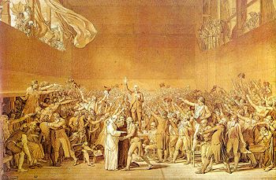
Age of Absolutism

Slide 2
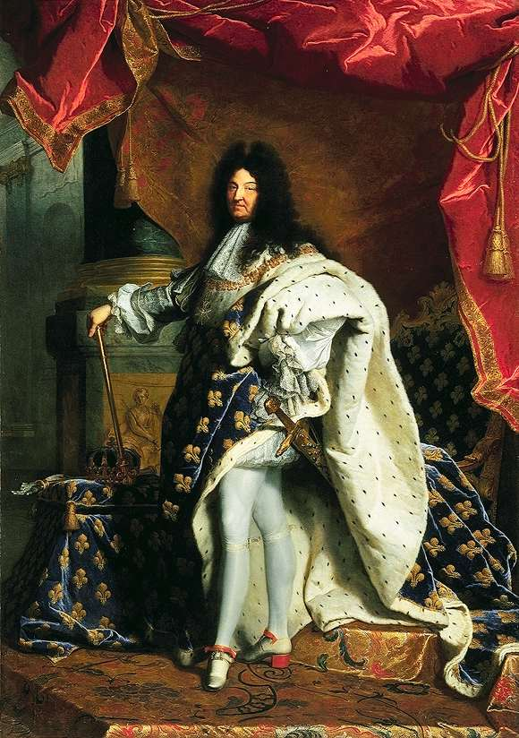
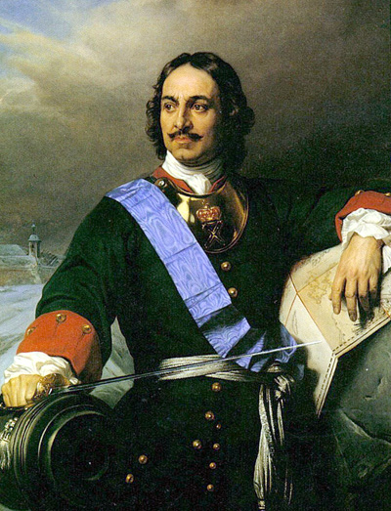
The Age of Absolutism takes its name from a series of European monarchs who increased the power of their central governments
Louis XIV of France
Peter the Great of Russia

Slide 4
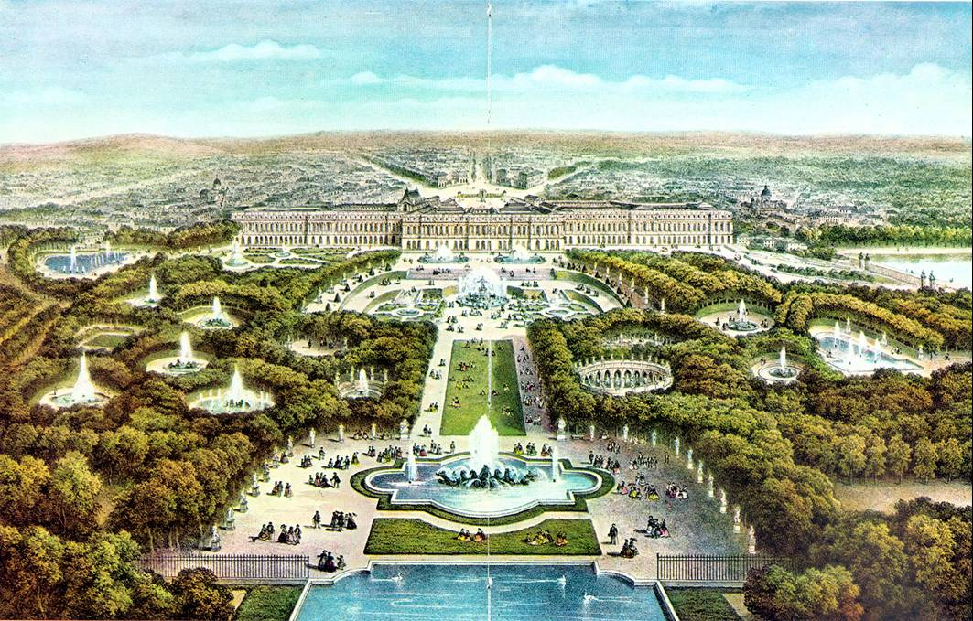

Slide 6
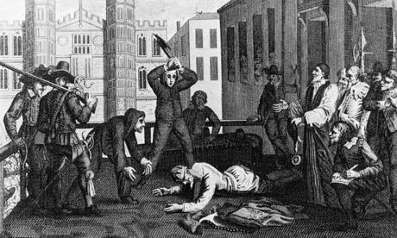
Outcomes of English Civil War
Development of political parties and factions
Increase of Parliamentary power over royal power
English Bill of Rights

Slide 7
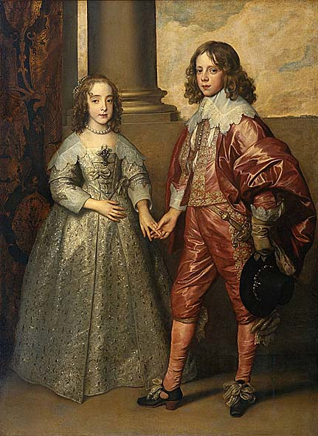
English Bill of Rights 1689
No taxation without consent of Parliament
No royal interference with the law or the election of members of Parliament
Freedom of speech
No cruel or unusual punishments

Slide 8
The Enlightenment
Human progress was possible through the application of scientific knowledge and reason to issues of law and government
Applied reason to the human world
Stimulated religious tolerance
Caused democratic revolutions around the world
Influenced Declaration of Independence

Slide 9
The Enlightenment
Thomas Hobbes – Leviathan – Humans exist in a primitive state of nature and consent to government for self protection
John Locke – Two Treatises on Government – People consent to government for protection of natural rights of life, liberty, and property
Montesquieu – The Spirit of Laws – The best form of government includes separation of powers
Rousseau – The Social Contract – Government is a contract between rulers and people
Voltaire – Separation of Church and State

Slide 10
The Enlightenment
Political philosophies of the Enlightenment fueled revolution in the Americas and France
Thomas Jefferson’s Declaration of Independence incorporated Enlightenment ideas
The Constitution of the United States of America and Bill of Rights incorporated Enlightenment ideas

Slide 11
Artists, Philosophers, and Writers
Johann Sebastian Bach – Baroque Composer
Wolfgang Amadeus Mozart – Classical Composer
Eugene Delacroix – Romantic School Painter
Miguel Cervantes – Novelist – Don Quixote
Paintings depicted classical subjects, public events, natural scenes, and living people
New forms of literature involved the novel

Slide 12
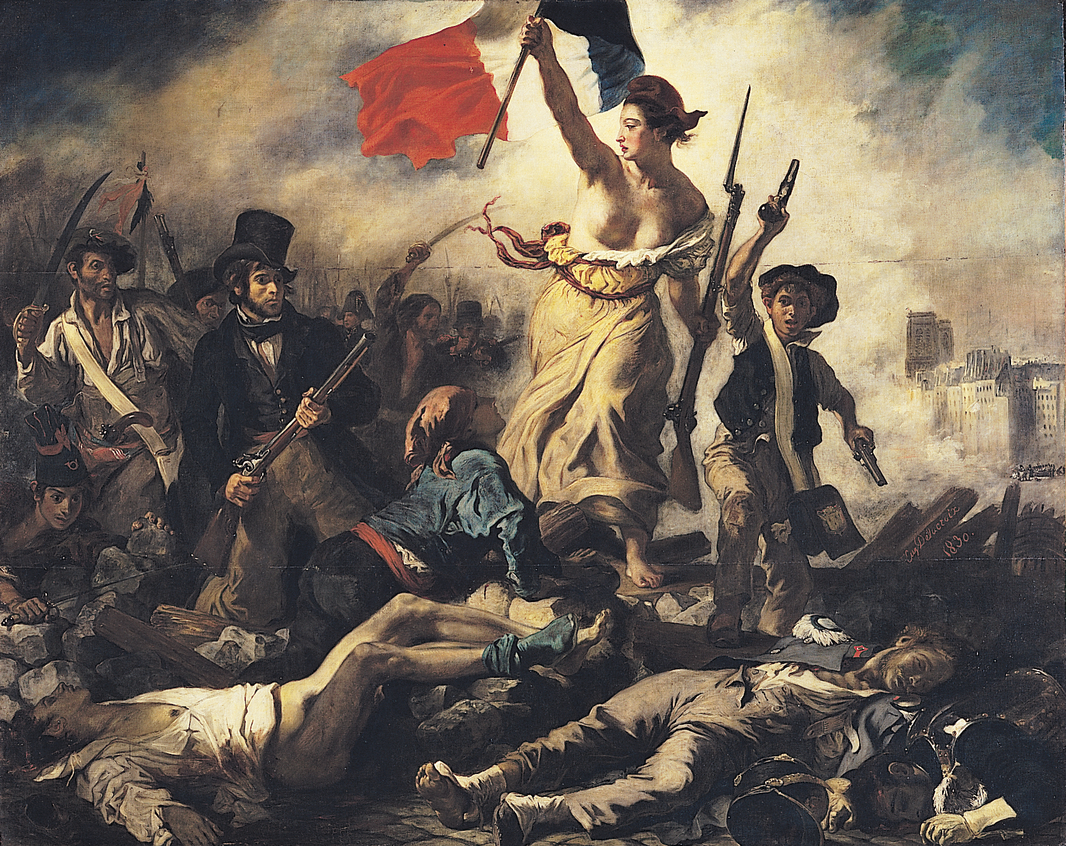
Liberty by Delacroix

