Slide 1
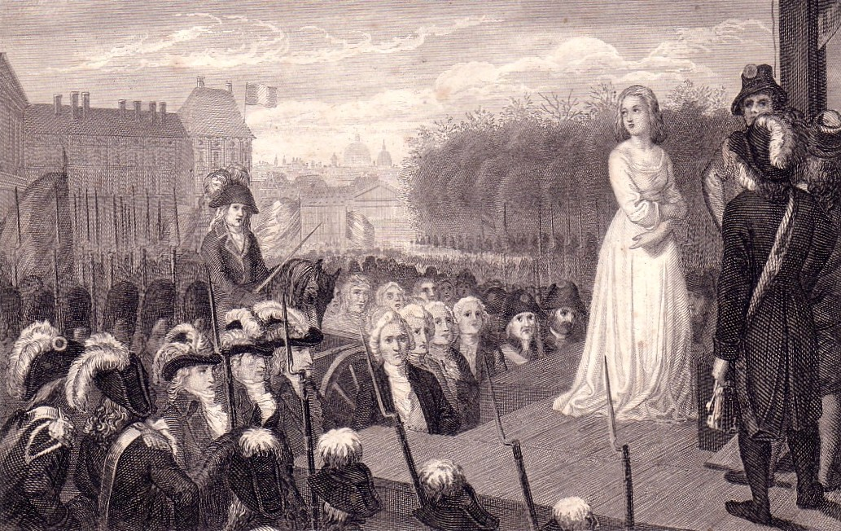
French Revolution

Slide 2
French Revolution
In 1788, the King of France, Louis the XVI called the Estates General to a meeting to solve France’s problems.
France was close to bankruptcy, harvests were poor, and bad economic policies made the problems worse.
The Estates General was an elected body composed of three social classes; the clergy, the nobles, and the commoners.

Slide 3
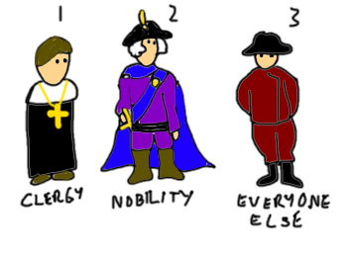
About 10,000
clergy
About 400,000
nobles
About 25 million
people

Slide 4
National Assembly
The Estates General could not reach an agreement in 1789
Members of the third estate (commoners) moved to a Tennis Court and made an oath to keep meeting until a new constitution for France was written.
The National Assembly write the Declaration of the Rights of Man

Slide 5
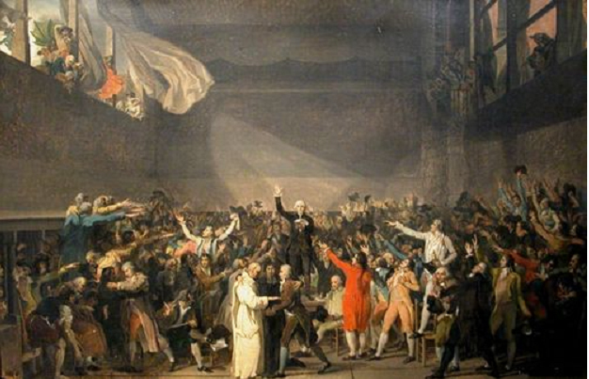
1789 - The Tennis Court Oath

Slide 8
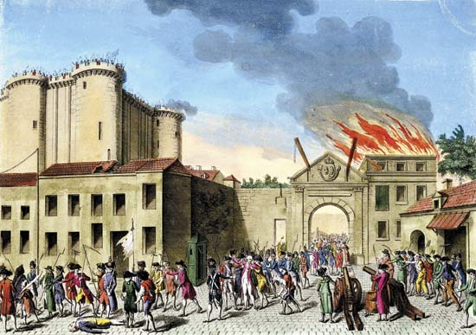
1789 – Storming of the Bastille by angry French citizens

Slide 9
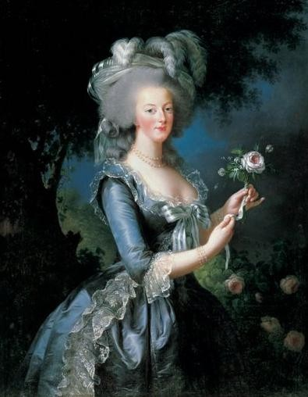
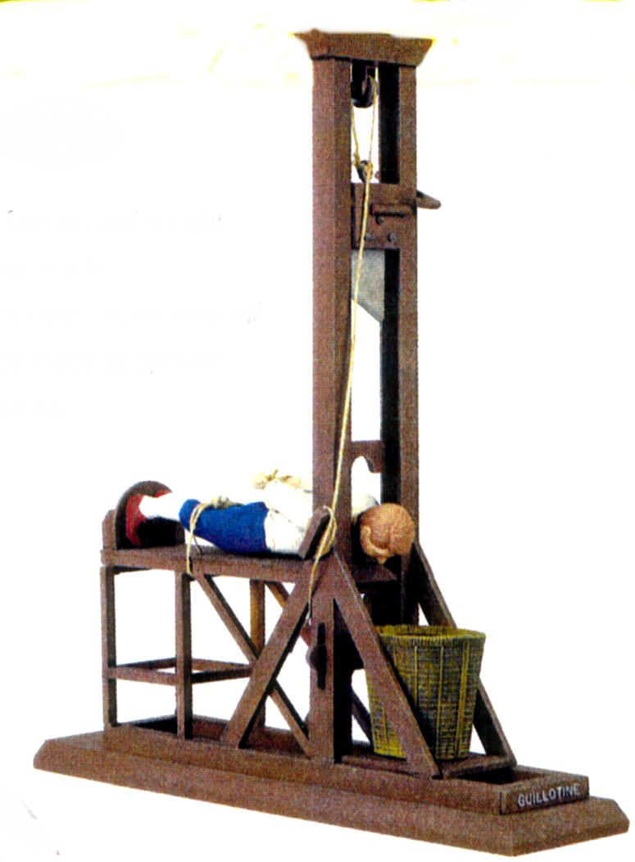
The Guillotine
This device was used during the Reign of Terror
Marie Antoinette
She was eventually executed by the revolutionaries

Slide 10
Napoleon
Napoleon comes to power in 1799. He eventually becomes the emperor of France from 1804 – 1815
Napoleon creates an empire that covers most of Europe

Slide 11
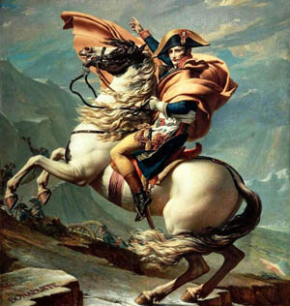

Slide 12
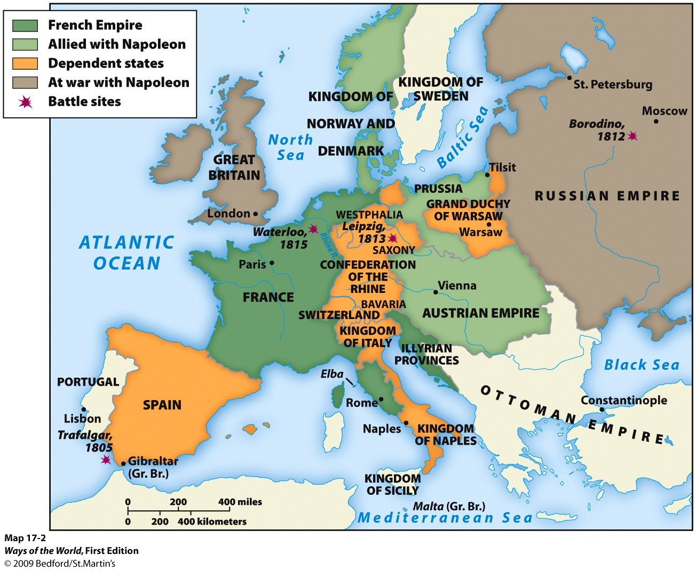

Slide 13
Napoleon’s Reforms

Slide 14
Napoleon

Slide 15
Napoleon

Slide 16
Congress of Vienna

Slide 17
