Slide 1
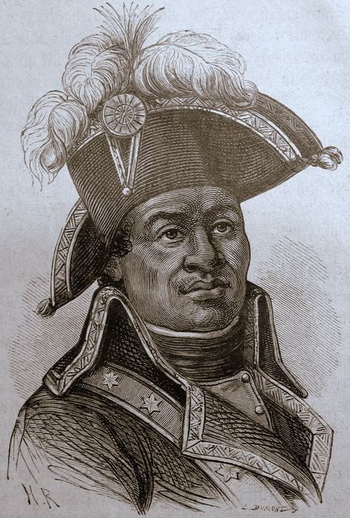
Latin American Colonies

Slide 2
The Colonial System

Slide 3
Colonial Authority
The Spanish established major cities as outposts of colonial authority in Latin America
Havana
Mexico City
Lima
Sao Paulo
Buenos Aires

Slide 4
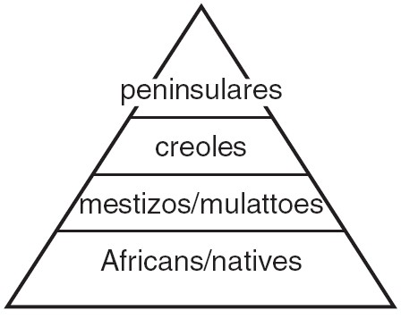
Class System
Latin America had a very rigid class system
Peninsulares were born in Spain or Portugal
Mestizos were mixed European and Native or Black

Slide 5
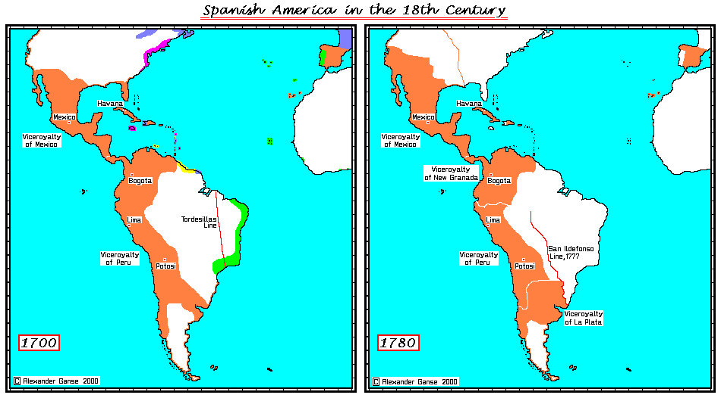

Slide 6
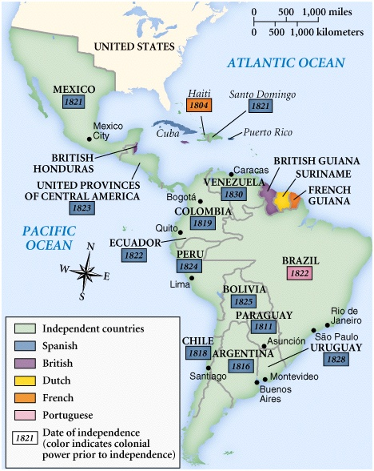

Slide 7
Influence of the American and French Revolutions
Slaves in Haiti rebelled, abolished slavery, and won independence
Father Miguel Hidalgo started the Mexican independence movement
Most French, Spanish, and Portuguese colonies became independent

Slide 8
Toussaint L’Ouverture

Slide 9
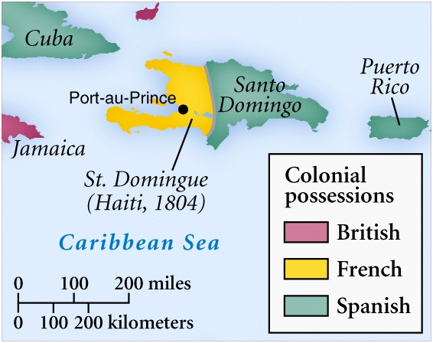

Slide 10
Simon Bolivar

Slide 11
Monroe Doctrine
Latin American nations were acknowledged to be independent
The United States would regard as a threat to its own peace and safety any attempt by European powers to impose their system on any independent state in the Western Hemisphere

