Slide 1
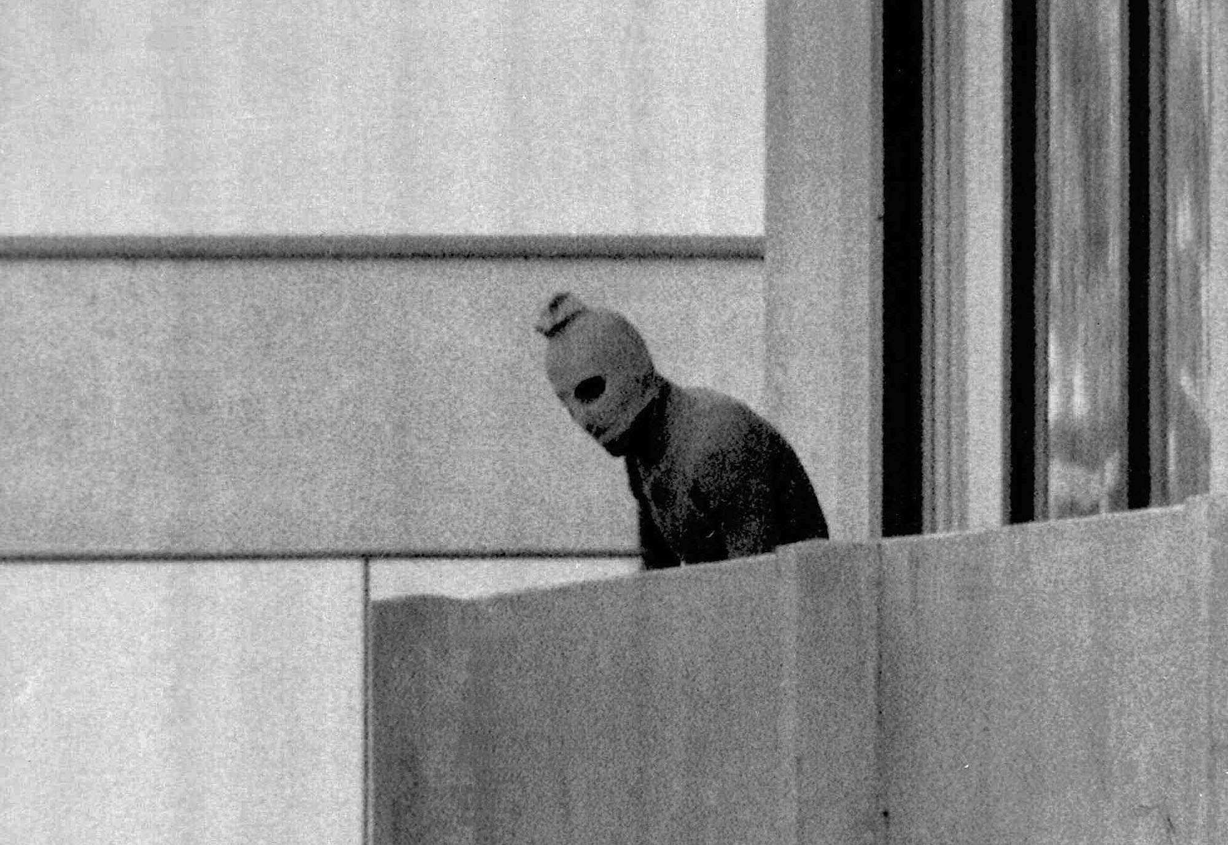
India, Israel, and Modern World

Slide 2
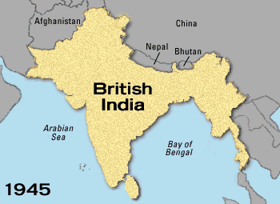
British India

Slide 3
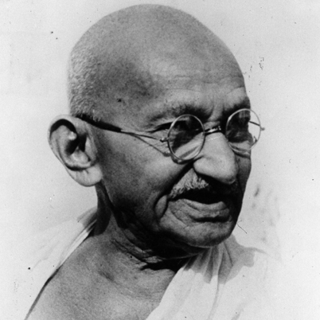
Indian Independence
Indian National Congress – Democratic Indian political party founded in 1885
Struggled against British rule
Mohandas Gandhi led independence movement
Advocated civil disobedience and passive resistance

Slide 4
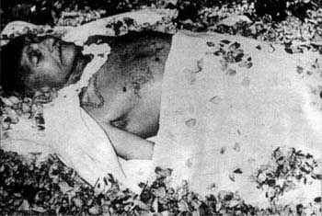

Indian Independence
Gandhi was assassinated in 1948 by a Hindu nationalist

Slide 5
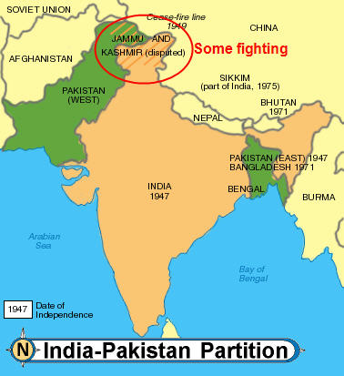
Partition of India 1947

Slide 6
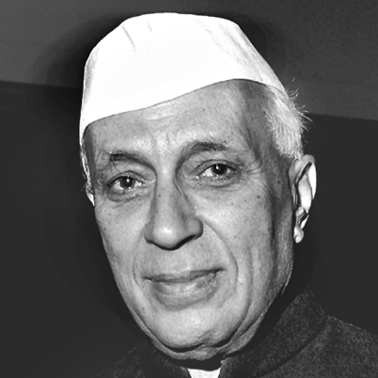
India
Jawaharlal Nehru became first Prime Minister of India
1950 Constitution sought to prohibit caste discrimination
Nehru supported western style industrialization
India is world’s largest democratic nation
Federal system gives many powers to the state

Slide 7
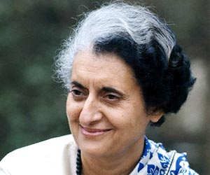
Indira Gandhi
3rd Prime Minister of India from 1966 – 1977 and 1980 to 1984
Member of Indian National Congress
Forged closer relationship with Soviet Union during Cold War
Supported Indian nuclear program
Assassinated by bodyguards

Slide 8
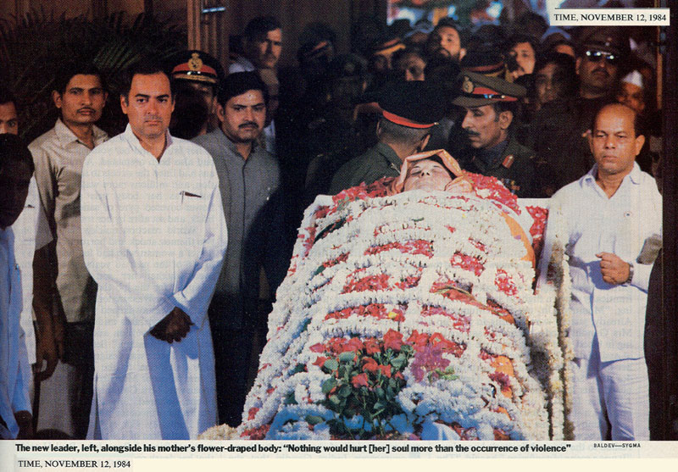
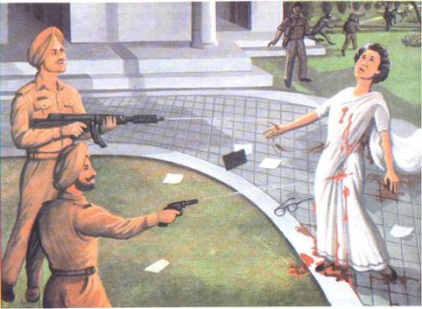
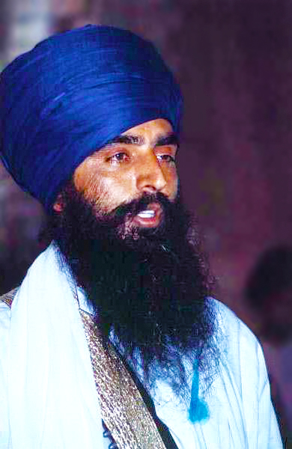
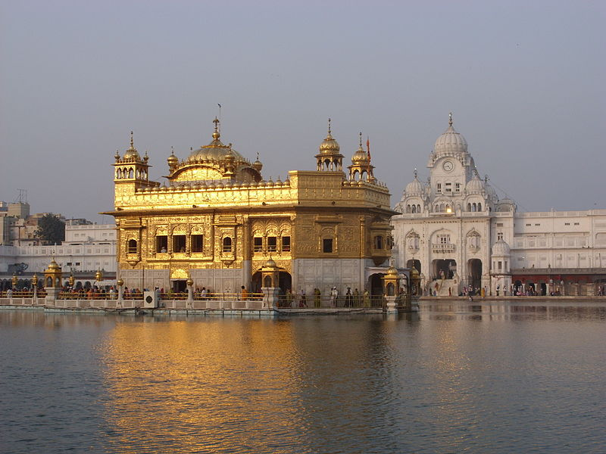

Slide 9
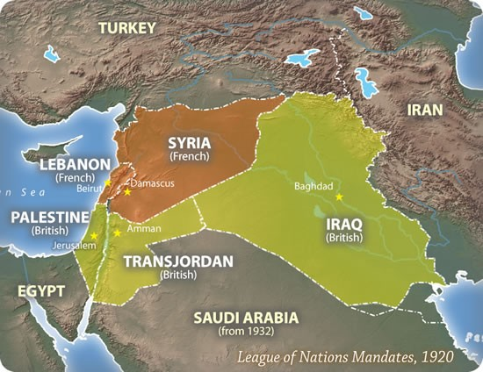
Mandate Regions after WWI

Slide 10
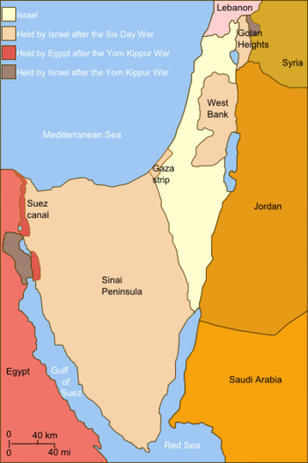
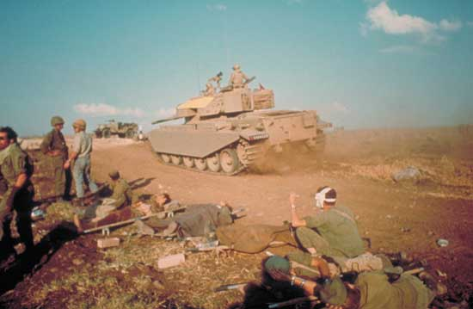
Israel
Israel created in 1948 by UN resolution and war with Arab states.

Slide 11
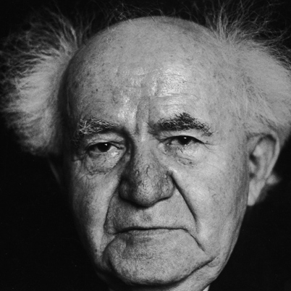
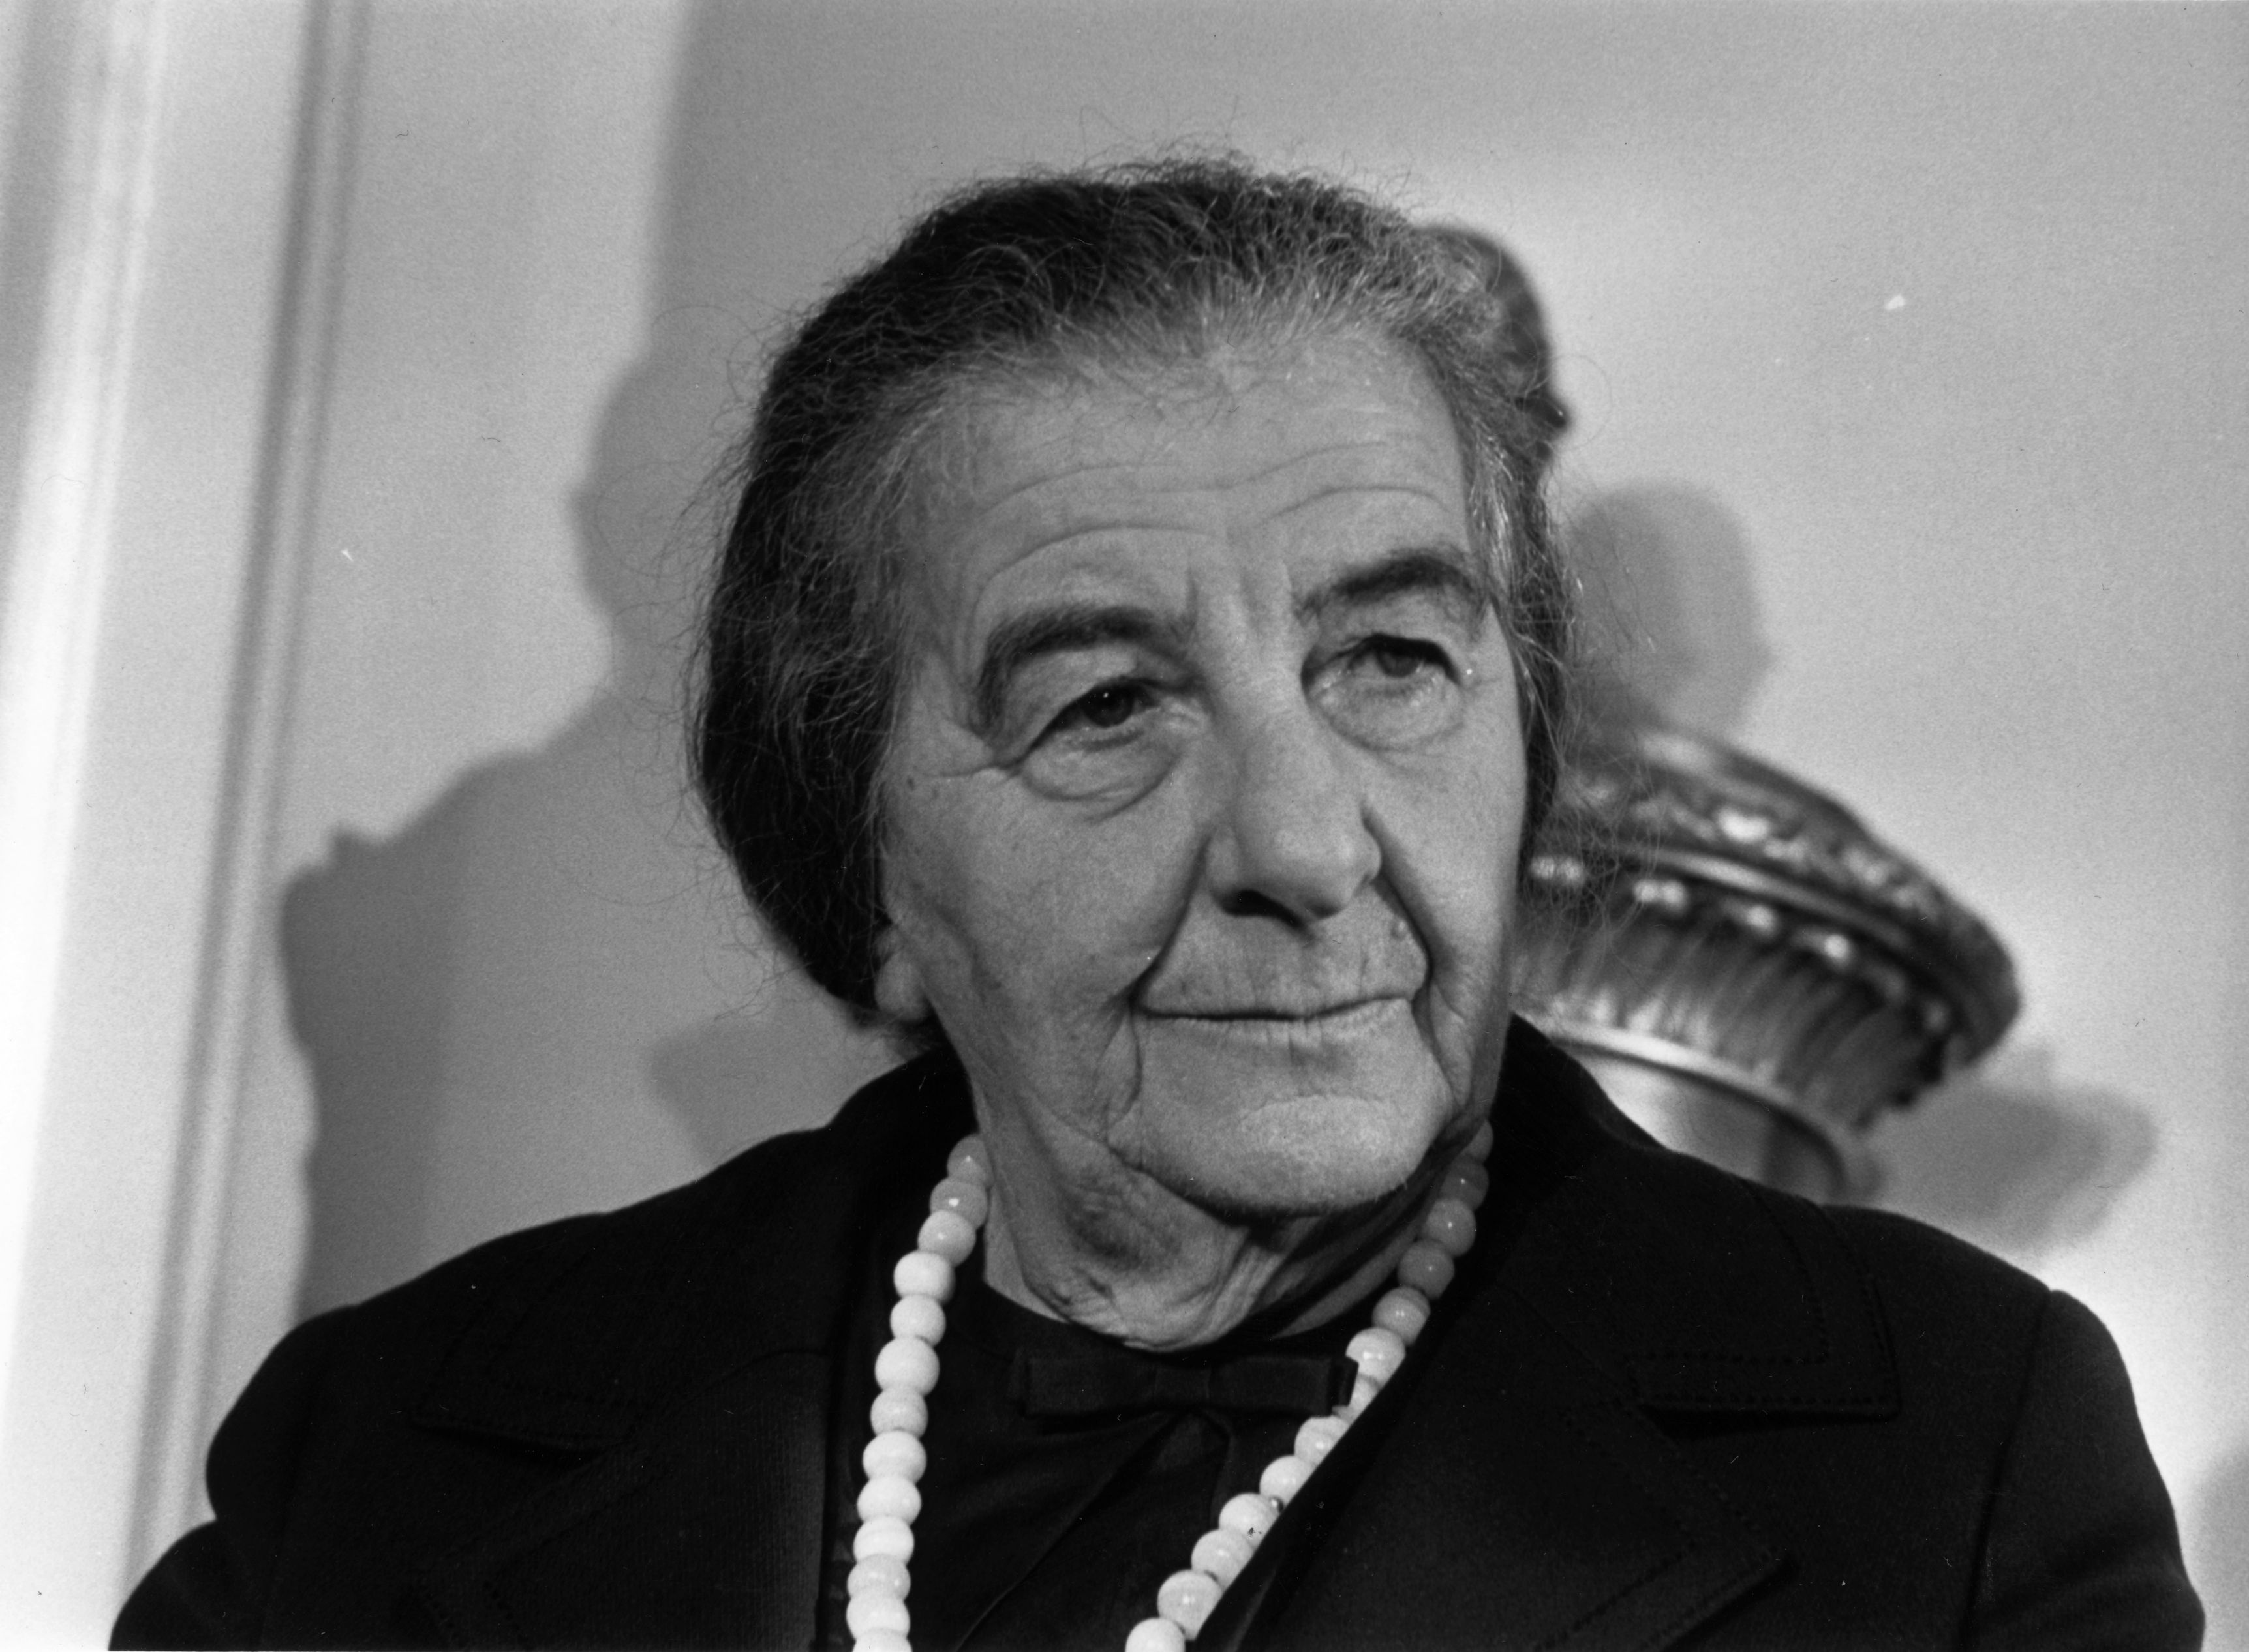
Leaders
David Ben Gurion
1st Prime Minister
Golda Meir PM 1969 - 1974

Slide 12
Middle East Wars

Slide 13
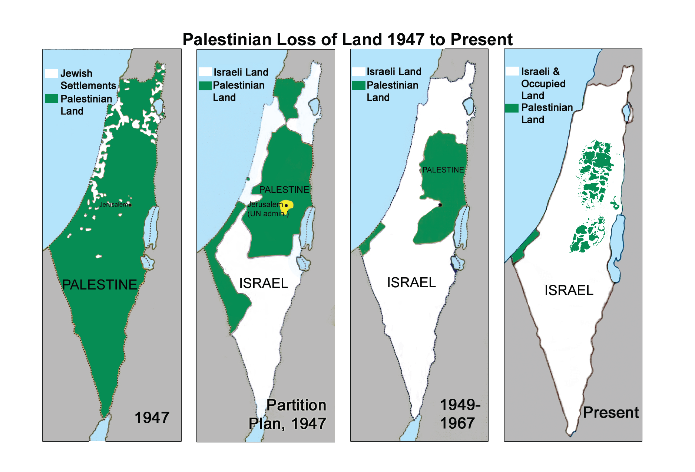
Israel and Palestine

Slide 14
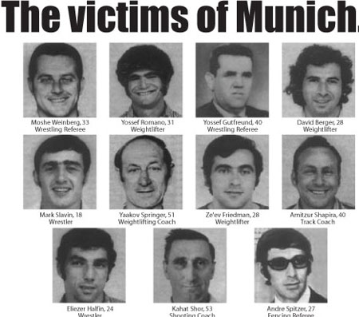
Palestinian Terrorism
At the 1972 Olympics Palestinian terrorists took Israeli athletes hostage.

Slide 15
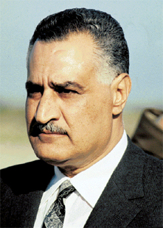
Gamal Abdul Nasser
President of Egypt from 1956 – 1970
Nationalized the Suez Canal which led to war with Britain, France, and Israel
Invaded Israel in 1967
Built Aswan Dam
Close relationship with Soviets

Slide 16
African Independence

Slide 17
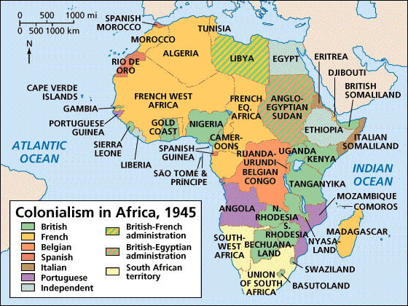
Violent
Violent
Violent

Slide 19
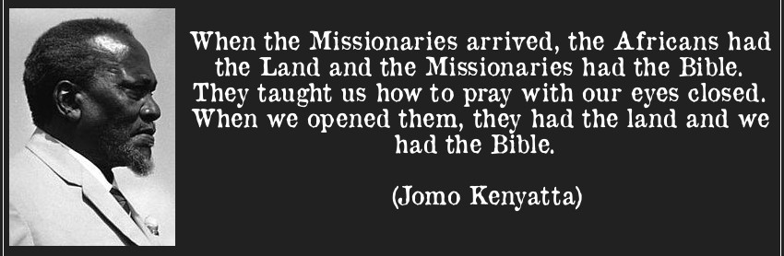

Slide 20
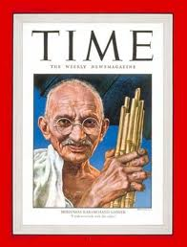
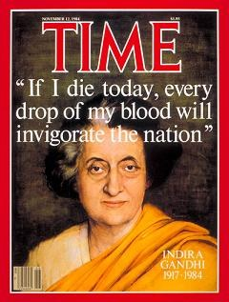
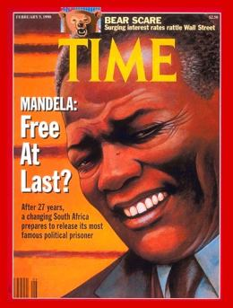
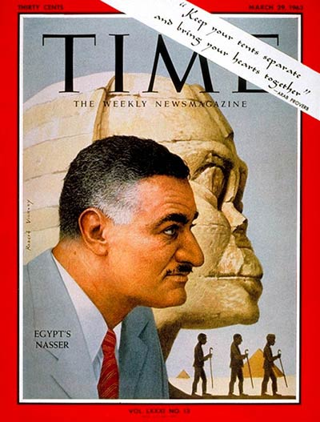
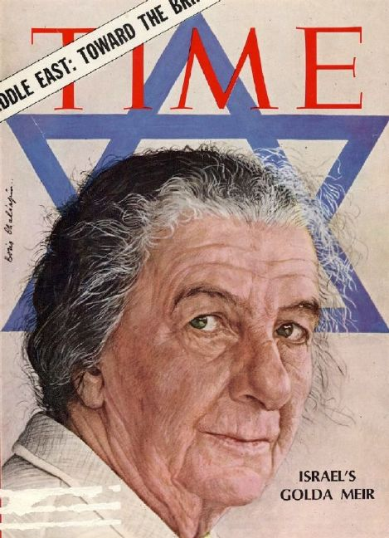

Slide 21
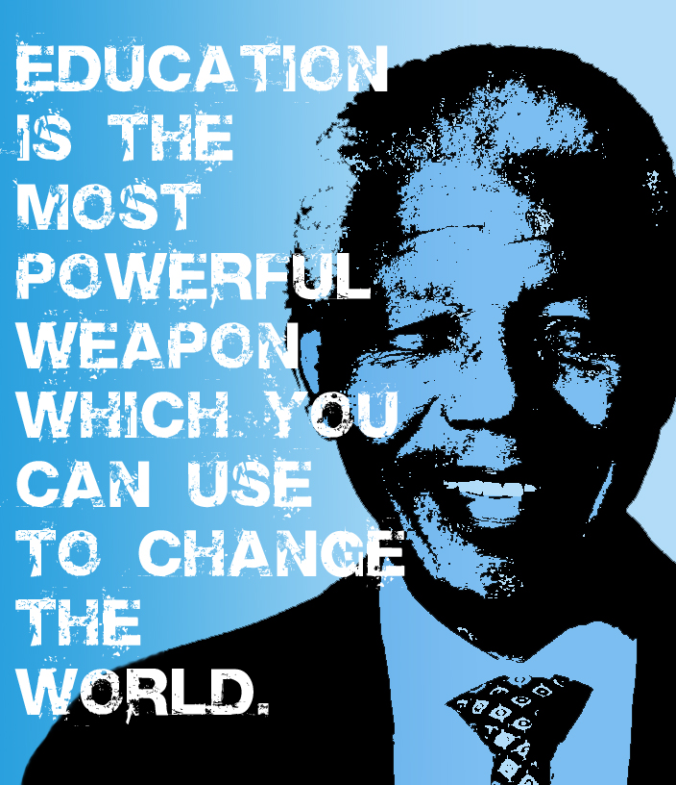
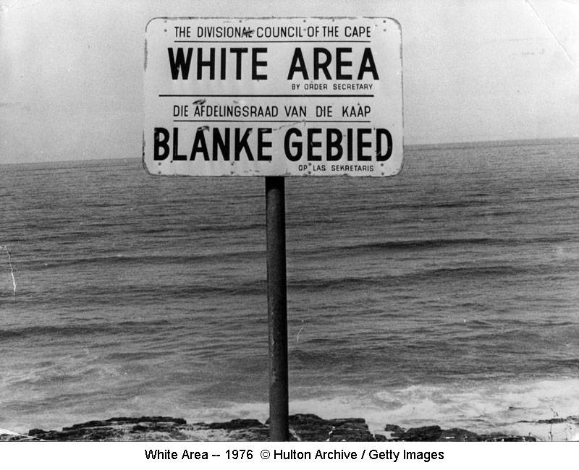
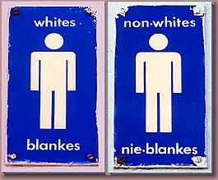
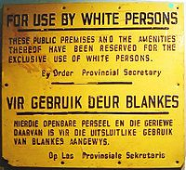

Slide 22
Modern Challenges
Refugees as an issue in international conflicts
Migrations of “guest workers” to European cities
Widespread but unequal access to computers and instantaneous communications
Genetic engineering and bioethics
Ethnic and Religious Conflicts
Middle East
Northern Ireland
Balkans
Horn of Africa
South Asia

Slide 23
More Random Stuff
Developed/Developing
Environment
Population size and rate of growth
Social conditions (literacy, access to health care)
Economic Conditions
Pollution
Loss of habitat
Global climate change

Slide 24
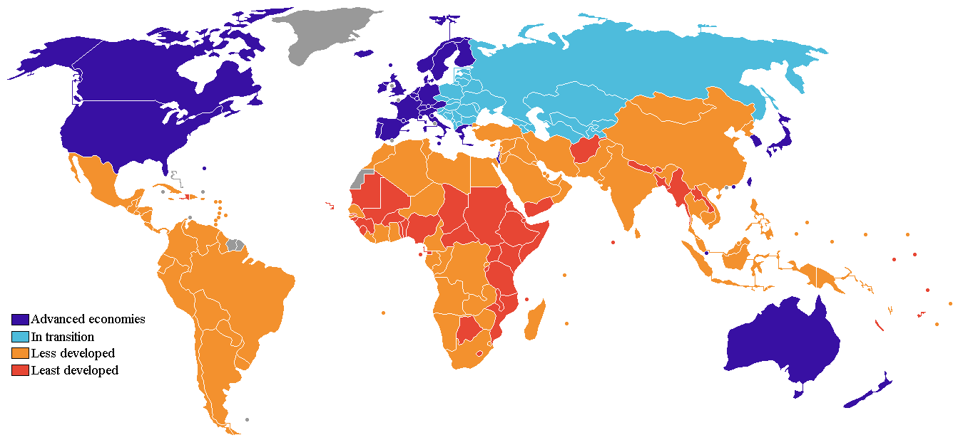

Slide 25
More Random Garbage
Economic Interdependence
Social Challenges
Multinational corporations
Regional Integration (EU)
Trade Agreements (NAFTA), World Trade Organization
United Nations, International Monetary Fund
Poverty
Poor health
Illiteracy
Famine
Migration

Slide 26
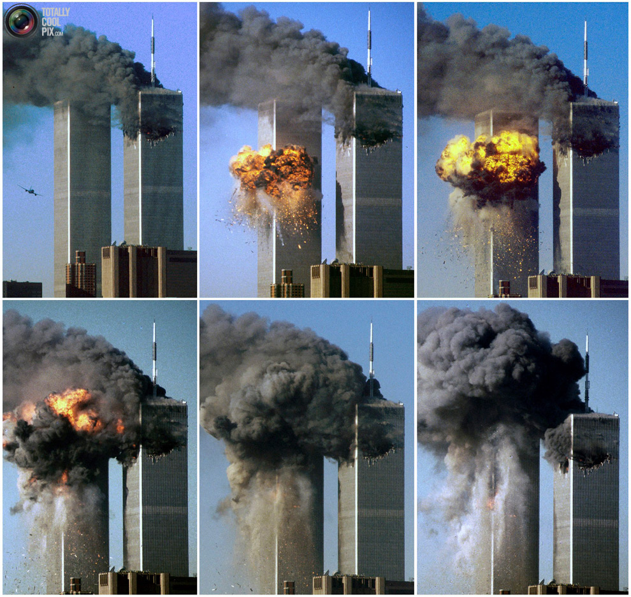
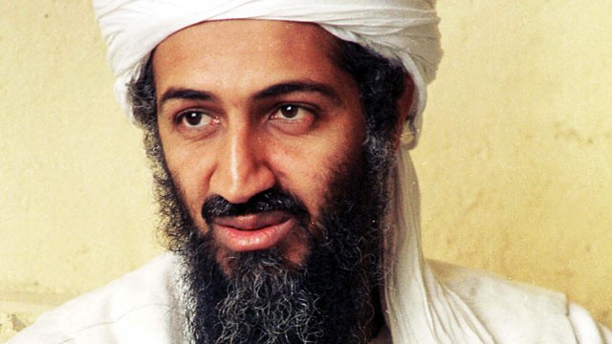
Terrorism
Surveillance and privacy rights
Security at ports and airports
Identification badges and photos

