Slide 1
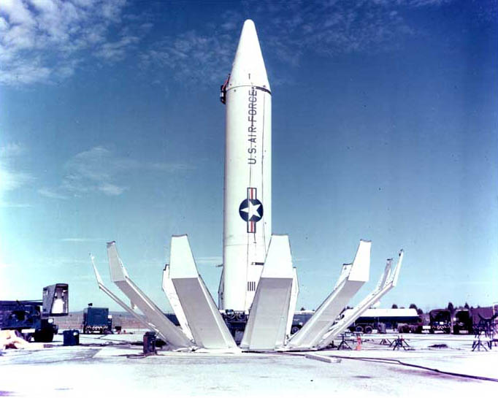
Cold War

Slide 2
Cold War

Slide 3
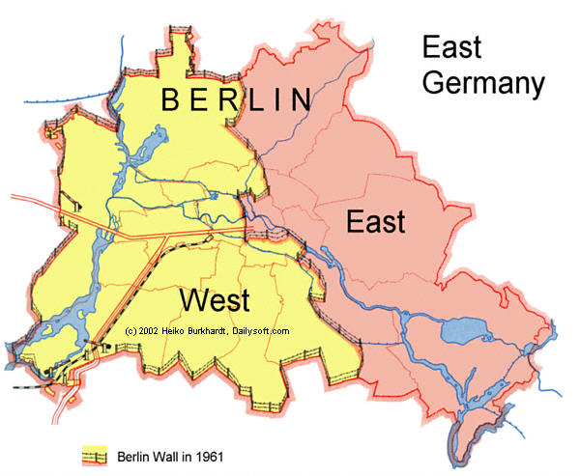
Berlin after WWII
Berlin was divided between the Allies
East Berlin was communist
Thousands of people fled from East Berlin to West Berlin to escape communism
The Berlin Wall was built to stop people from leaving East Germany

Slide 4
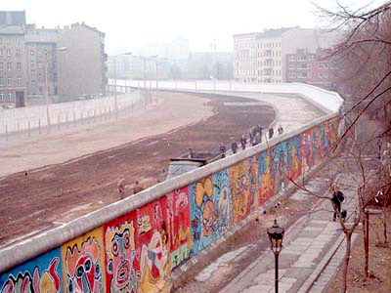
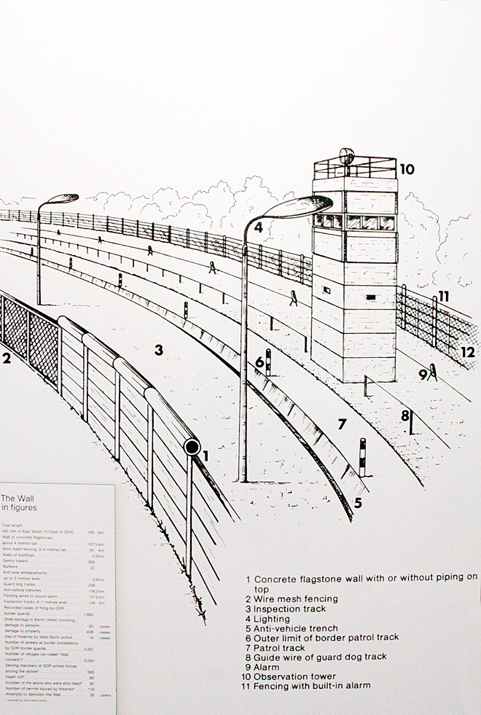
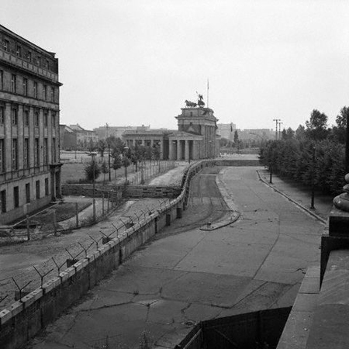

Slide 5
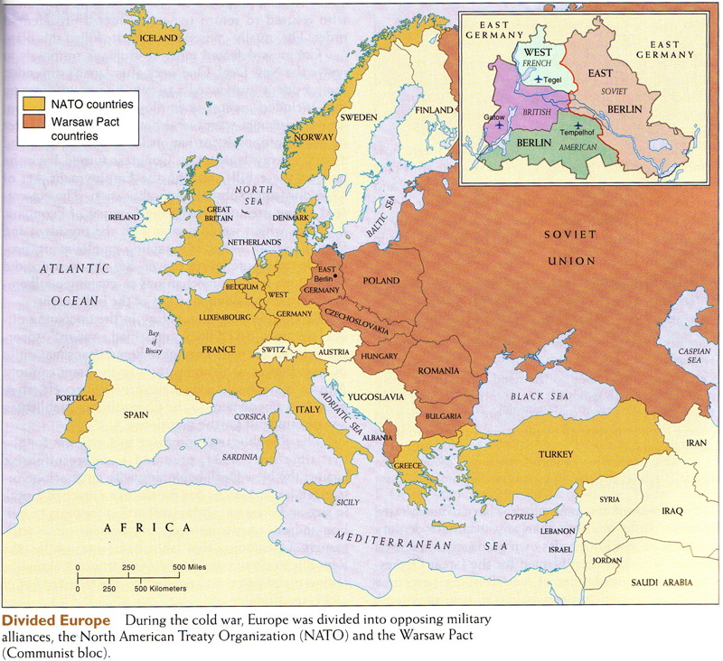

Slide 6
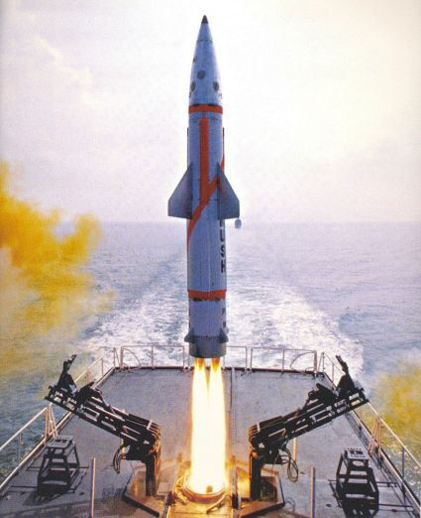
Cold War
NATO – North Atlantic Treaty Organization
Warsaw Pact – Organization of communist countries
Nuclear Deterrence – The idea that no one will use a nuclear weapon because they will be destroyed by retaliation

Slide 8
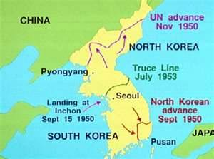
Korean War
Fought from 1950 – 1953
Communist North Korea invaded South Korea with the help of the Soviet Union and China
U.S. and United Nations defended South Korea
The Korean Peninsula was still divided at the end of the war

Slide 9
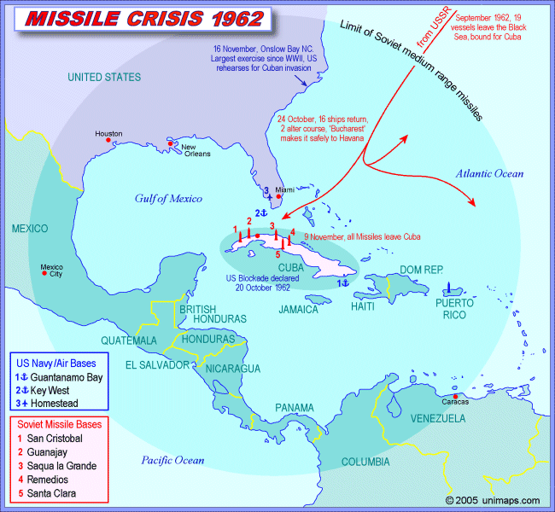
Cuban Missile Crisis
The Soviet Union placed nuclear missiles in Cuba in 1962
Cuba was ruled by Fidel Castro, a communist
U.S. discovered missiles with a U-2 spy plane and demanded they be removed
The U.S. and U.S.S.R. almost went to nuclear war

Slide 10
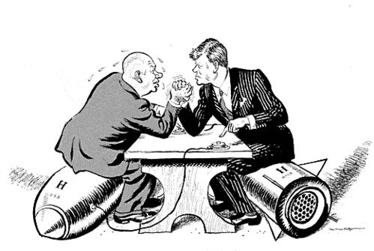

Slide 11
Important Leaders

Slide 12
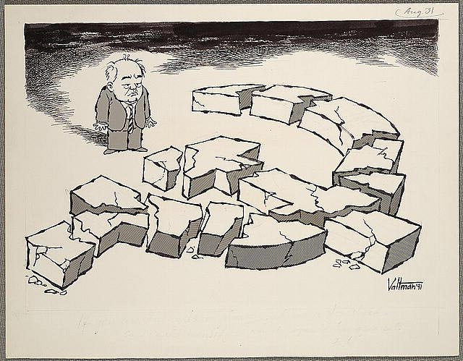
Cold War
Margaret Thatcher – Promoted free trade, Asserted United Kingdom’s military power, close relationship with the U.S.
Glasnost – When Gorbachev reformed the economy of the Soviet Union
Perestroika – When Gorbachev allowed more freedom in the Soviet Union

Slide 13
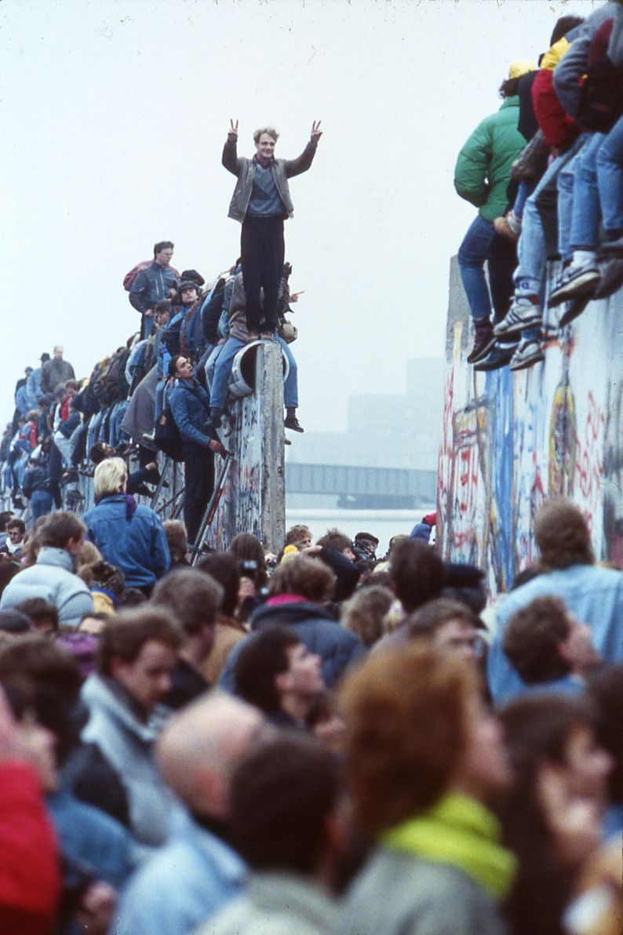
Cold War
The Cold War ended in 1991 with the economic collapse of the Soviet Union
The Soviet Union broke up
Eastern European countries became democratic
1989, Berlin Wall was torn down

Slide 14
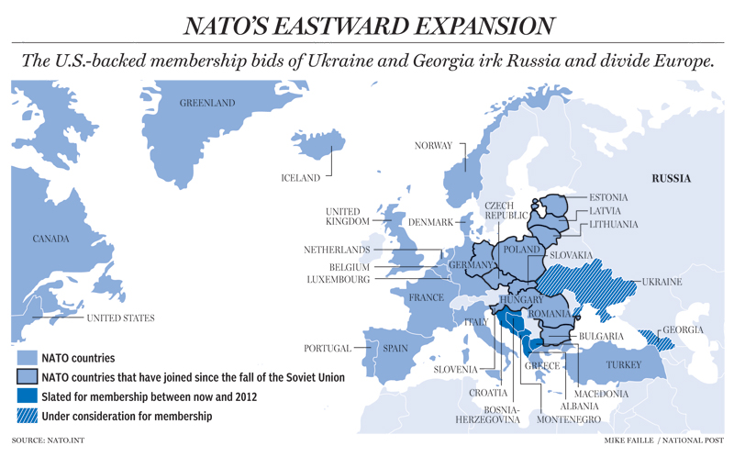
Expansion of NATO

Slide 15
Cold War in Asia
China was divided into two nations at the end of the Chinese civil war in 1950
Chiang Kai Shek – Nationalist China (Taiwan)
Mao Zedong – Communist China (mainland China)
Communist China helped the North Koreans during the Korean War
Communist China helped the North Vietnamese during the Vietnam War

Slide 16
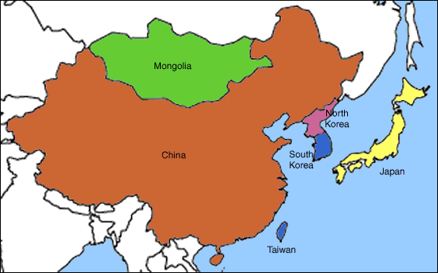
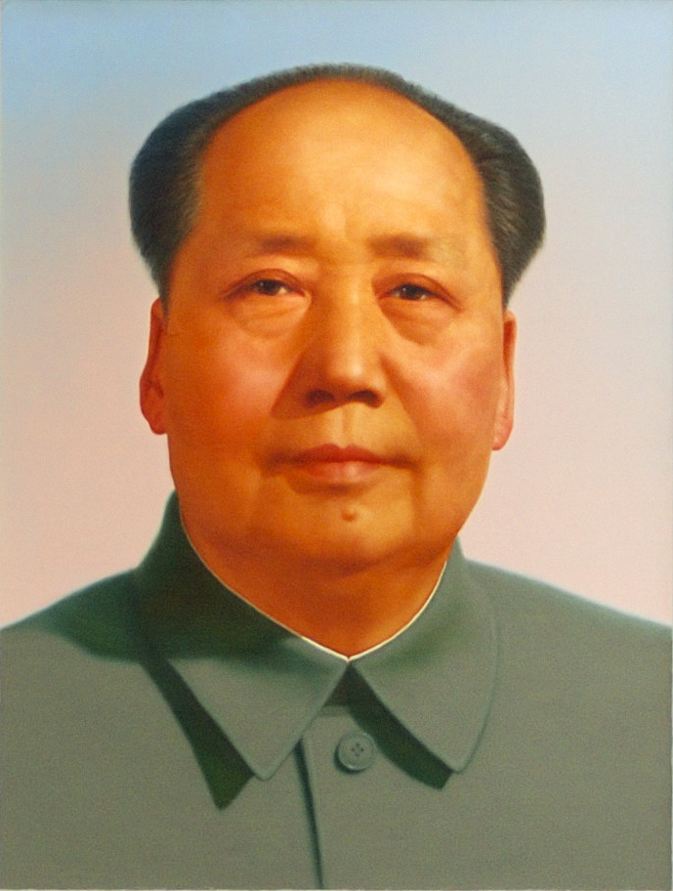
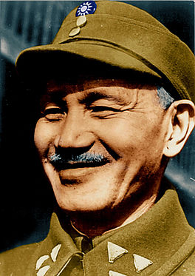
China and Taiwan
Dude, Taiwan is part
of China and it should
be communist!
Taiwan is not communist,
so leave us alone!

Slide 17
Important Leaders

Slide 18
Vietnam War in One Slide!
Southeast Asia was a French colony called Indochina
At the end of WWII, the French wanted Southeast Asia back
Ho Chi Minh, a Vietnamese nationalist fought the French until 1954
The French lost Vietnam
Vietnam was split into North and South
North tried to incite communist rebellion in the south
U.S. helped government of South Vietnam fight the communists

Slide 19
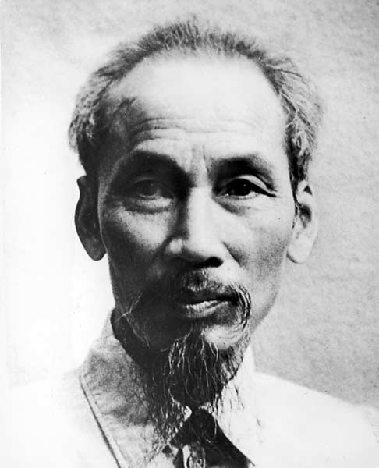
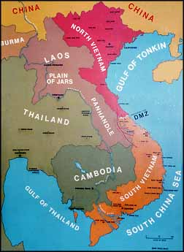
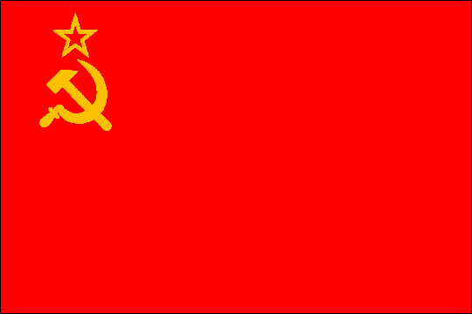
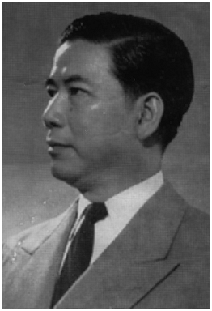
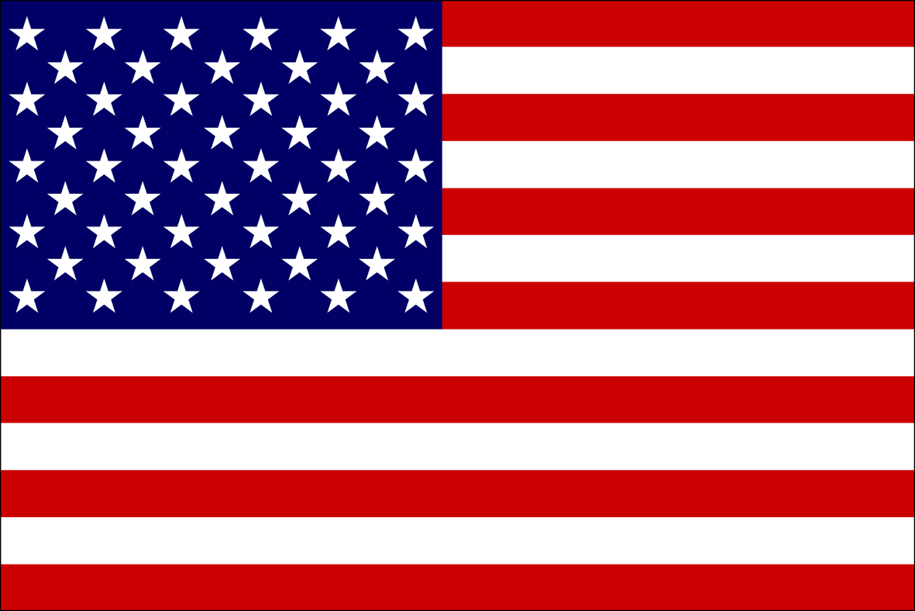
South Vietnam doesn’t want to be communist!
Vietnam should be a communist country!

