Slide 1
Exploration and Colonization
European Discovery
WHII 4a - f

Slide 2
European Discovery of Lands
Demand for gold, spices, and natural resources in Europe
Desire to spread Christianity
Political and economic competition between European empires
Innovations in navigational arts
Role of Prince Henry the Navigator

Slide 3
Famous Explorers

Slide 4
Famous Explorers

Slide 5
Famous Explorers

Slide 6
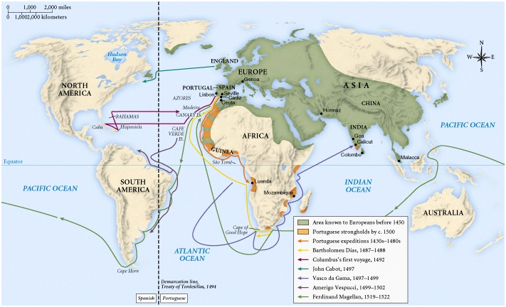

Slide 7
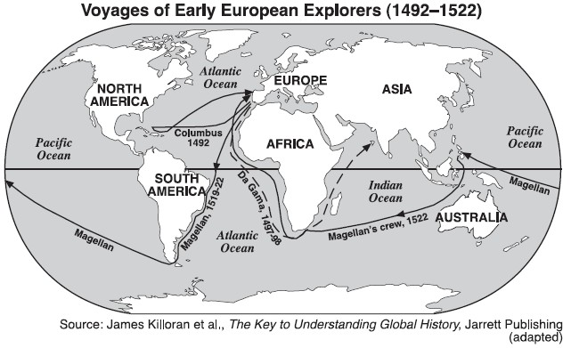

Slide 8
How did other lands become Christian?

Slide 9
Effect of European Migration on America
Expansion of overseas territorial claims and European emigration to North and South America
Demise of Aztec, and Inca Empires
Rigid class system in Latin America
Forced migration of Africans into slavery
Colonies’ imitation of the culture and social patterns of their parent country

Slide 10
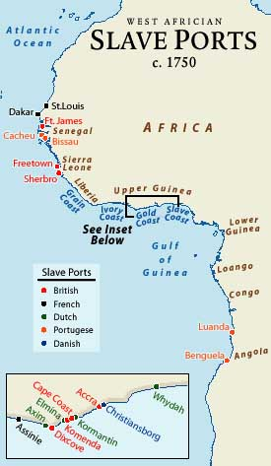
Effect of European Migration on Africa
European trading posts along the coast
Trade in slaves, gold, and other products

Slide 11
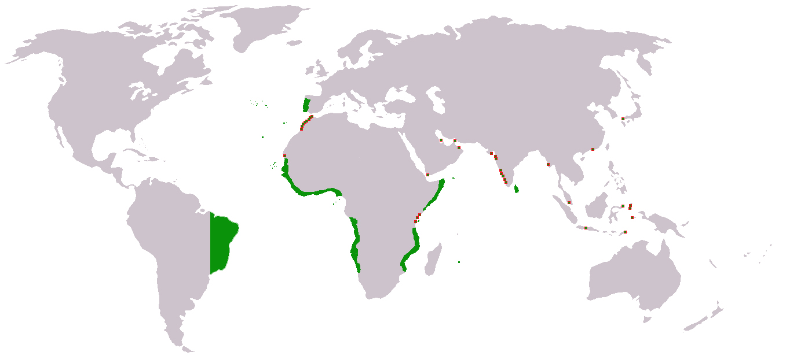
Effect of European Migration on Asia
Colonization by small groups of merchants (India, the Indies, China)
Influence of trading companies (Portuguese, Dutch, British)

Slide 12
Columbian Exchange
Western Hemisphere agricultural products such as corn, potatoes, and tobacco changed European lifestyles.
European horses and cattle changed the lifestyles of American Indians.
European diseases like smallpox killed many Indians.
Shortage of labor to grow cash crops led to the use of African slaves.
Slavery based on race.
European plantation system in the Caribbean and the Americas destroyed indigenous economics and damaged the environment.

Slide 13
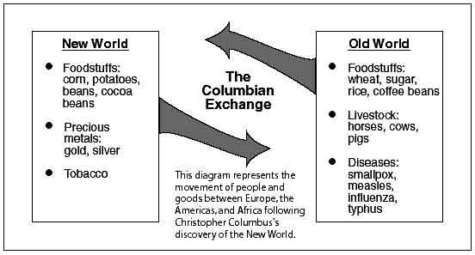

Slide 14
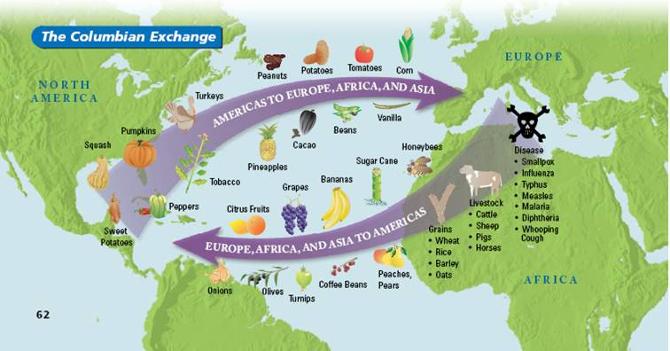

Slide 15
Triangular Trade
A trade network that linked Europe, Africa, and the Americas
Gold and precious metals exported to Europe and Asia
Slaves exported to colonies in Americas
Raw resources exported to Europe

Slide 16
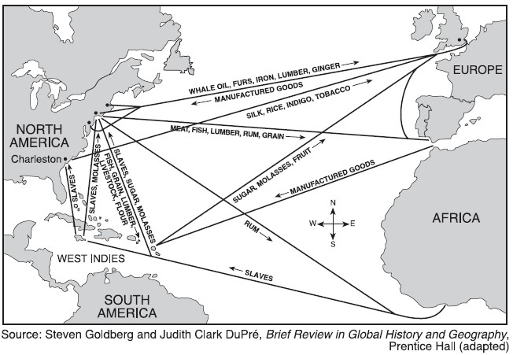

Slide 17
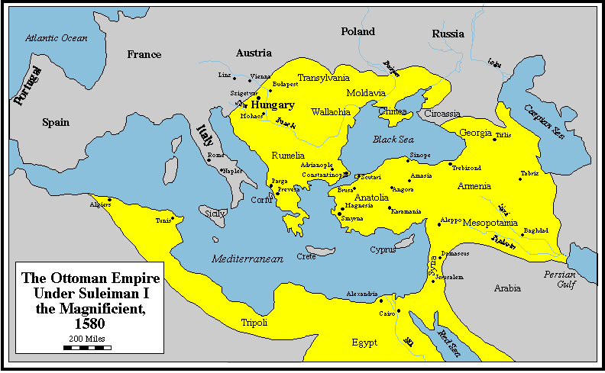
Ottoman Empire

Slide 18
Ottoman Empire

Slide 19
Mughal Empire (India)

Slide 20
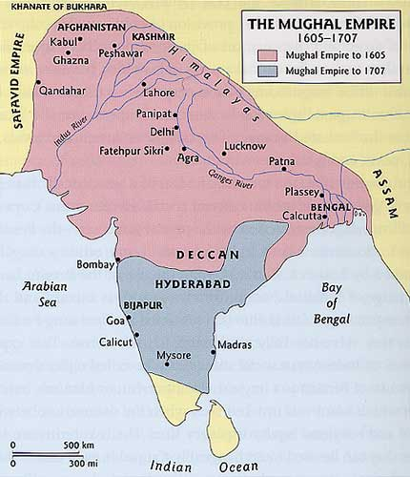

Slide 21
Mughal Empire
During the Mughal Empire most of southern India was independent and traded with Europeans
Europeans set up trading posts on the coast and traded for gems, spices, textiles, and silks
Portugal, England, and the Netherlands competed for the Indian Ocean trade

Slide 22
China and Japan
China and Japan tried to limit the influence of Europeans
China only allowed foreigners to trade in certain areas called enclaves
The imperial policy of China was to control foreign trade
Europeans traded gold for tea, porcelains, and silk
Japan was ruled by a military leader called a Shogun
Japan adopted a policy of isolationism

Slide 23
Mercantilism
European countries competed for overseas markets, colonies, and resources
Mercantilism was an economic practice that said colonies only existed for the benefit of the home country

