Slide 1
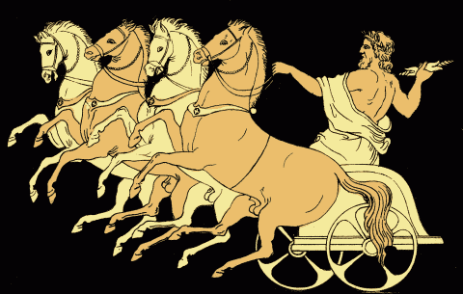
Ancient Greece
Myth and Culture
WHI 5b, e, f

Slide 2
Essential Questions

Slide 3
Greek Gods
Early Greek mythology attempted to explain natural phenomena by attributing it to the actions of gods.
Greek religion influenced politics, culture, and art.

Slide 4
Greek Religion
Why does the earth turn cold in the winter?
Why do volcanic islands smoke?
Why does the sun set?

Slide 5
Greek Religion
Demeter is mourning for her abducted daughter Persephone
Smoke comes from the forges of the god Hephaestus
The sun is drawn by the sun god Helios (Apollo)

Slide 6
Greek Gods

Slide 7
Greek Gods

Slide 8
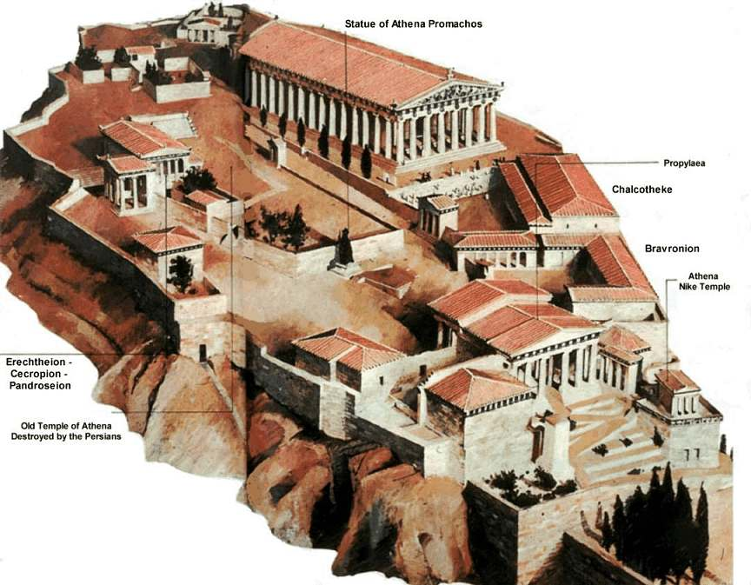

Slide 9
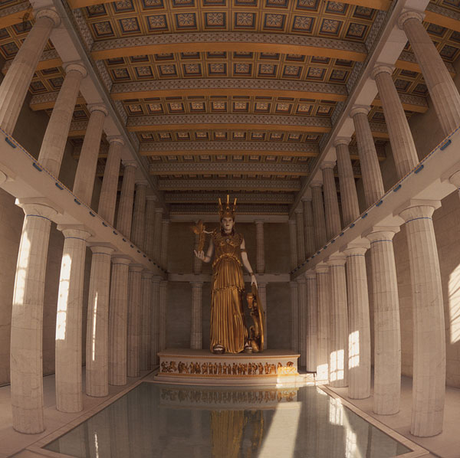

Slide 10
Essential Questions

Slide 11
The Golden Age
The high point of classical Greek culture in Athens is called the Golden Age
The Golden Age lasted from 448 BCE – 429 BCE. This period was between the end of the Persian wars and the beginning of the Peloponnesian War

Slide 12
Pericles

Slide 13
Famous Greeks (Playwrights)

Slide 14
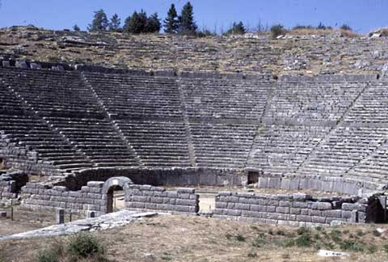
Greek Theatre

Slide 15
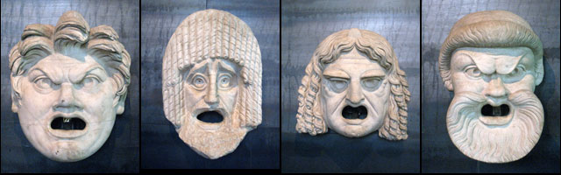
Greek Masks

Slide 16
Greek Historians

Slide 17
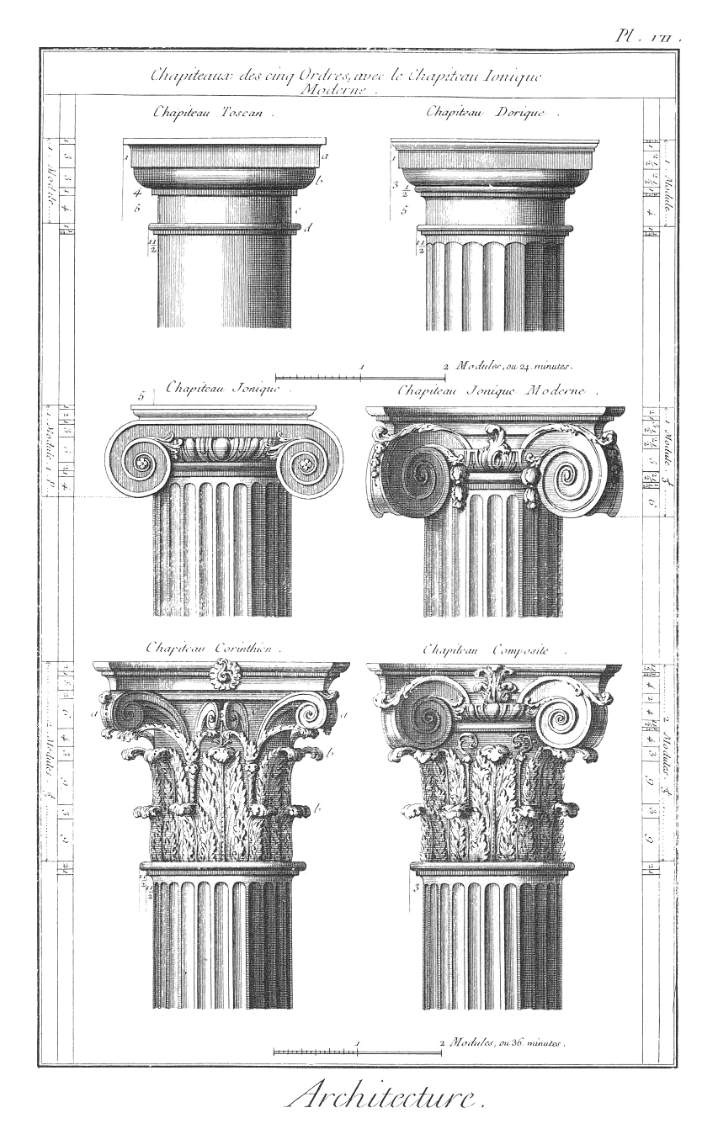
Greek Architecture
Dorian
Ionian
Corinthian

Slide 18
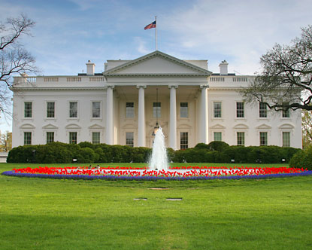

Slide 19
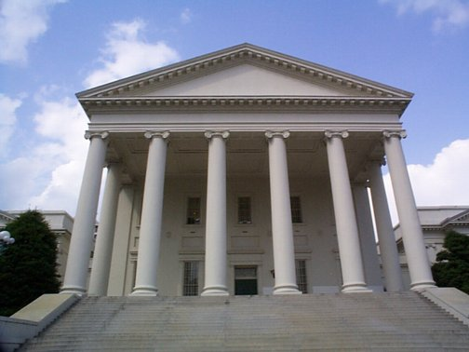

Slide 20
Greek Scientists

Slide 21
Greek Mathematicians

Slide 22
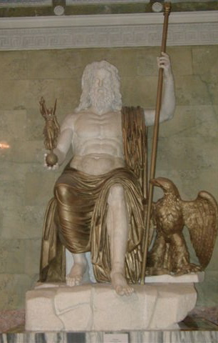
Phidias (Sculptor)
Phidias made a statue of Zeus and a statue of Athena that was in the Parthenon

Slide 23
Greek Philosophers

