Slide 1
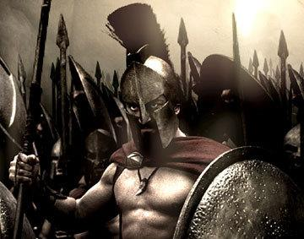
Ancient Greece
Physical Geography
WHI 5a

Slide 2
Essential Question
How did the mountains, seas, islands, harbors, peninsulas, and straits of the Aegean Basin shape Greek economic, social, and political development and patterns of trade and colonization?

Slide 3
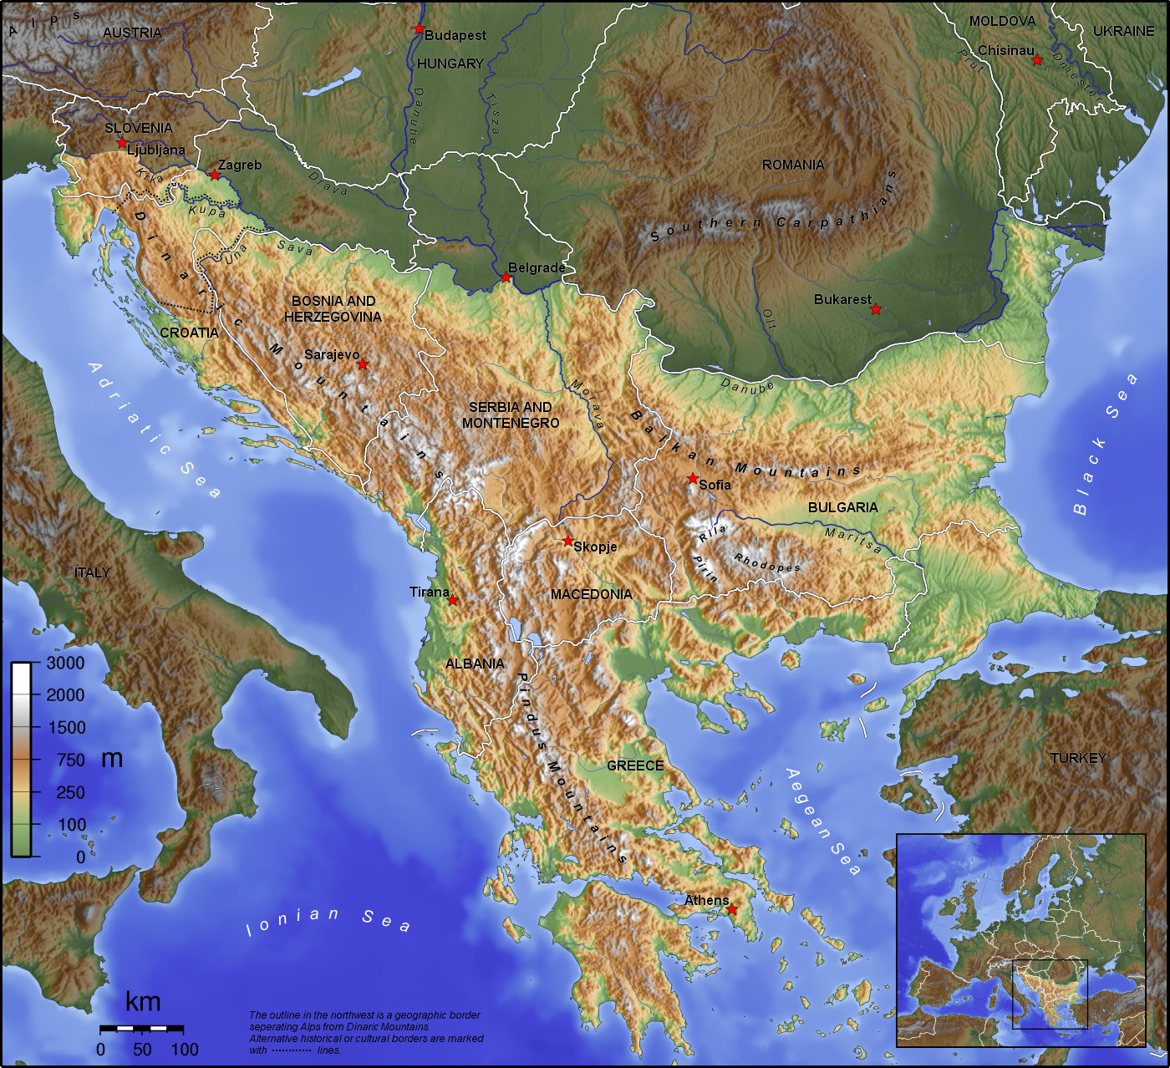

Slide 4
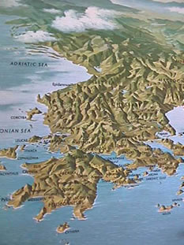

Slide 6
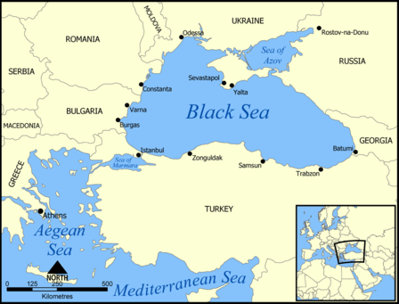

Slide 7
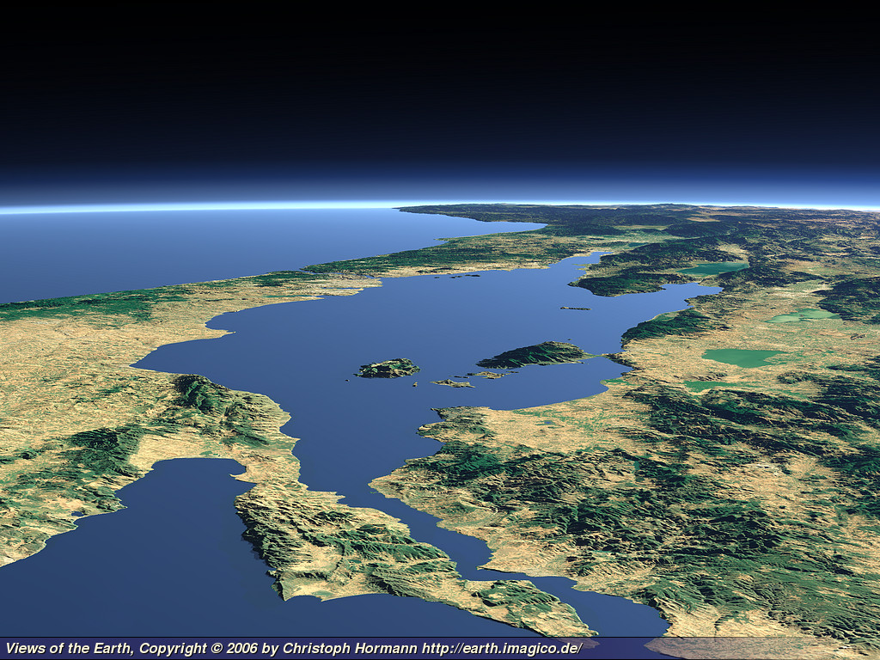

Slide 8
Topography of Greece

Slide 9
Greece Climate and Crops

Slide 10
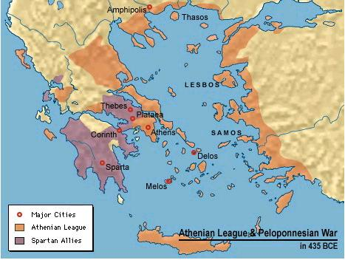

Slide 12
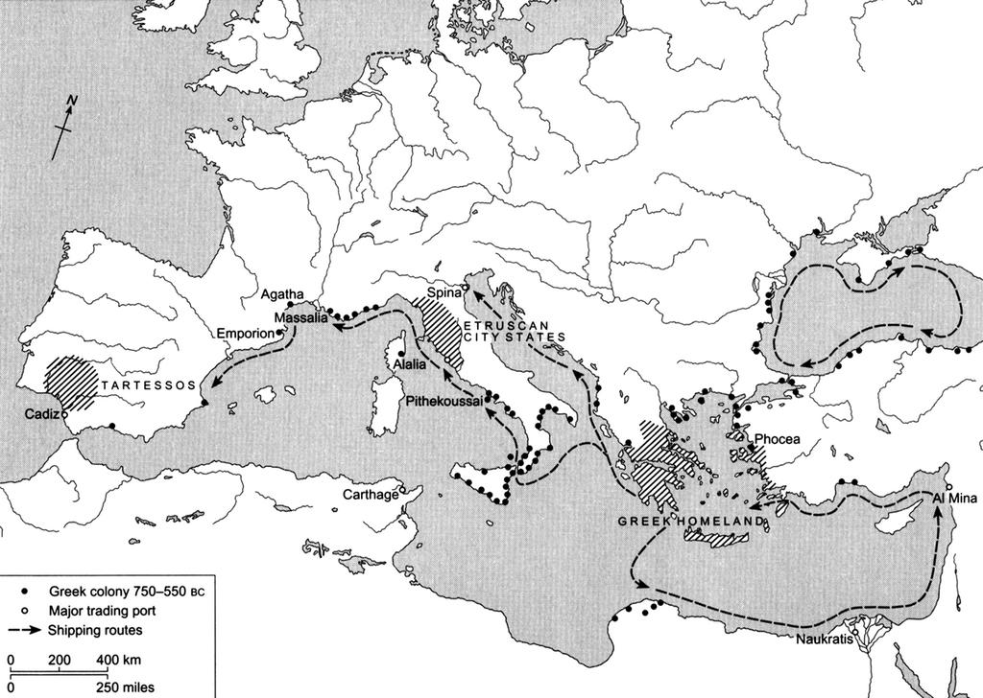
Greek Trade

Slide 13
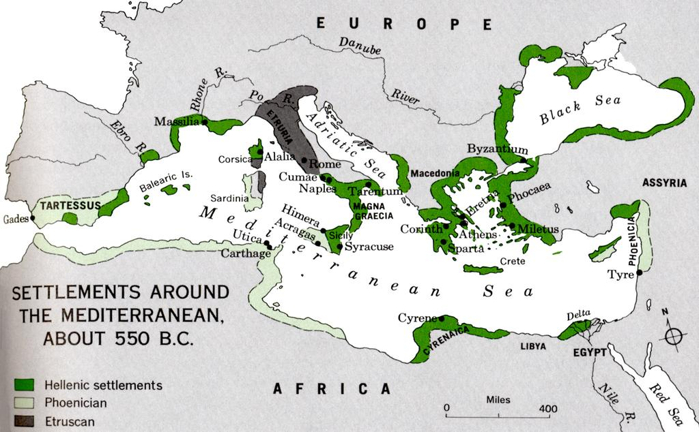
Greek Colonization

Slide 14
Greek City States
Greek city states developed different political structures but they did have some similarities.
Most cities had an idea of citizenship. Citizens shared equal rights and responsibilities.
City states promoted the idea of civil duty and promoted commercial activity.

