Slide 1
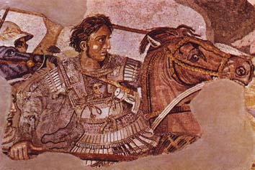
Hellenistic Culture
WHI 5g

Slide 2
Essential Question

Slide 3
Macedon

Slide 4
Kings of Macedon

Slide 5
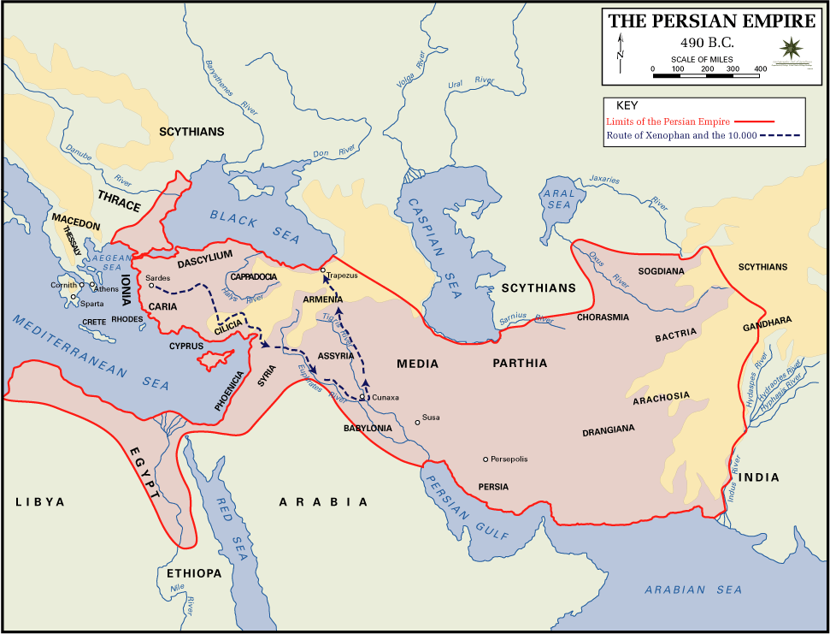

Slide 6
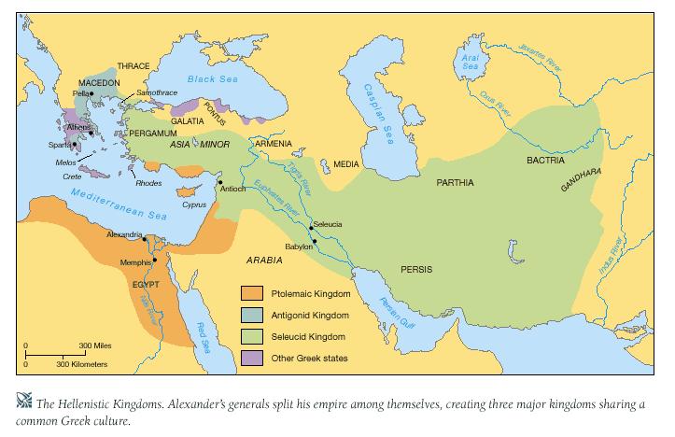

Slide 8
Hellenism
Hellenism was a blend of political, social, and cultural traditions of the Greeks with Oriental customs and traditions.
Hellenistic Age lasted from 323 BCE – 30 BCE

Slide 9
Hellenistic Age
Hellene means Greek. When Alexander conquered new territory he appointed Greeks to rule over them.
The Greek rulers in Egypt and the Middle East spoke Greek, read Greek philosophy, and followed Greek religion.

Slide 10
Examples of Hellenism

