Slide 1
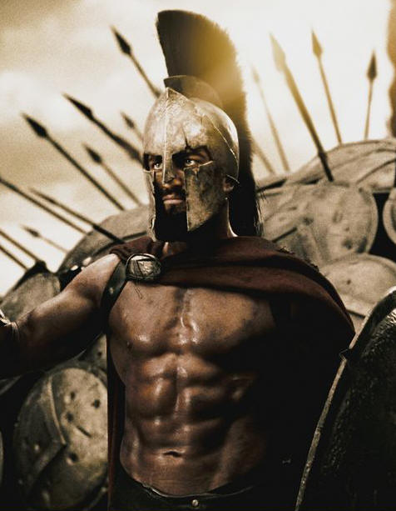
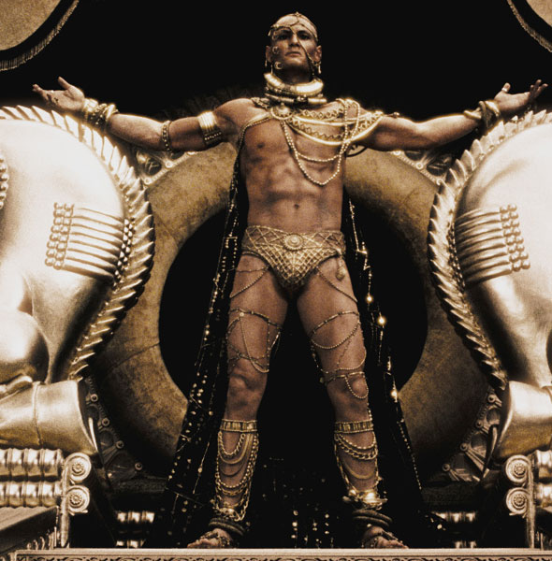
Ancient Greece
Persian and Peloponnesian Wars
WHI 5d

Slide 2
Essential Question

Slide 3
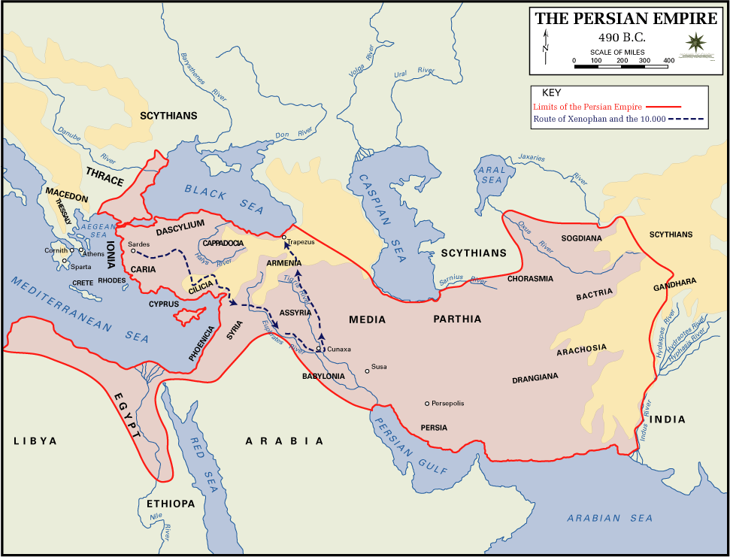
Persian Empire

Slide 4
Persian War

Slide 5
Persian War

Slide 6
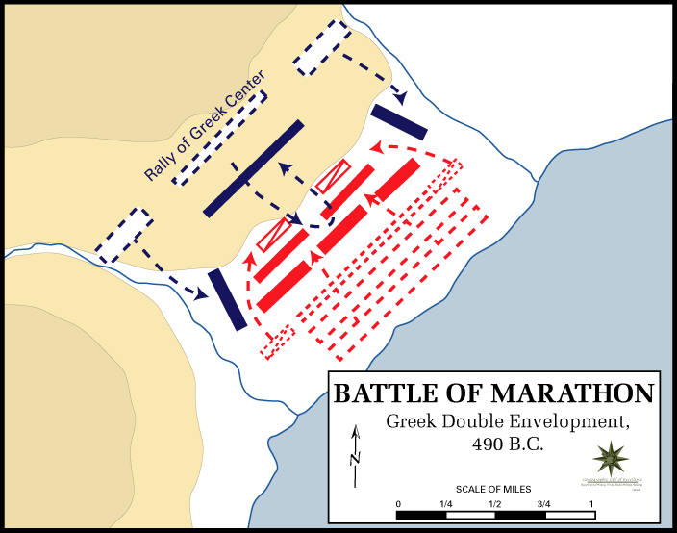

Slide 7
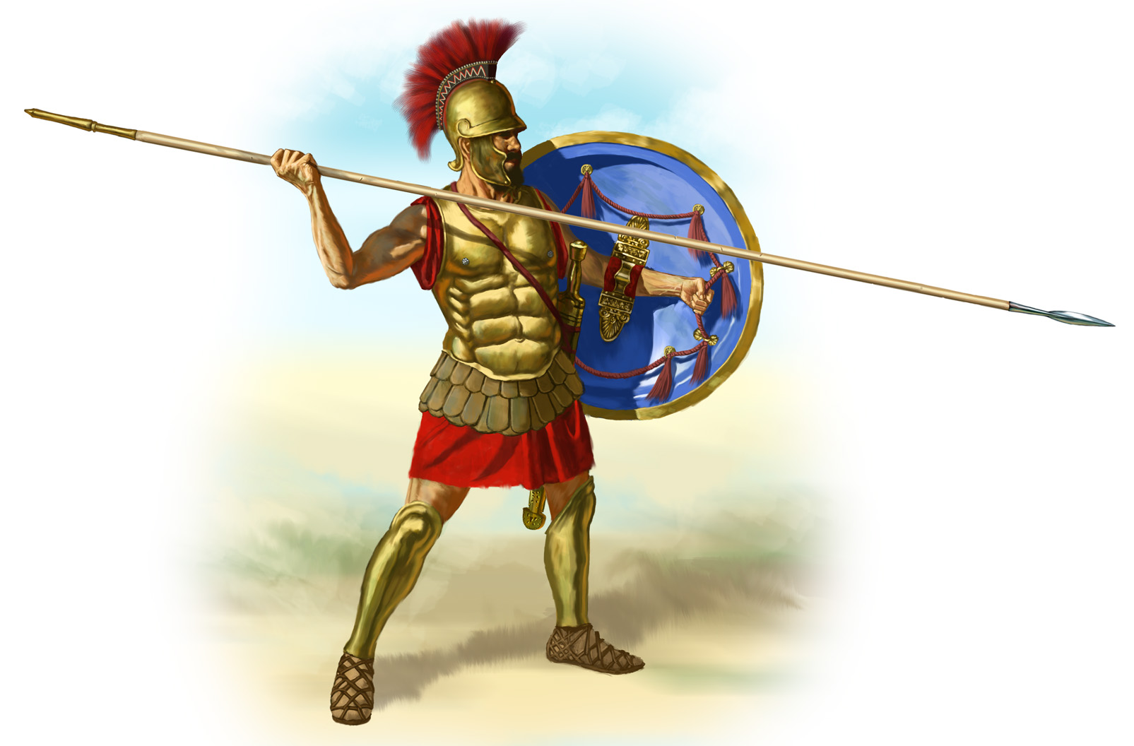
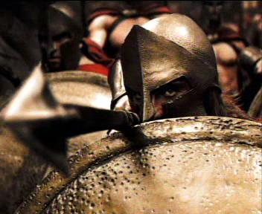
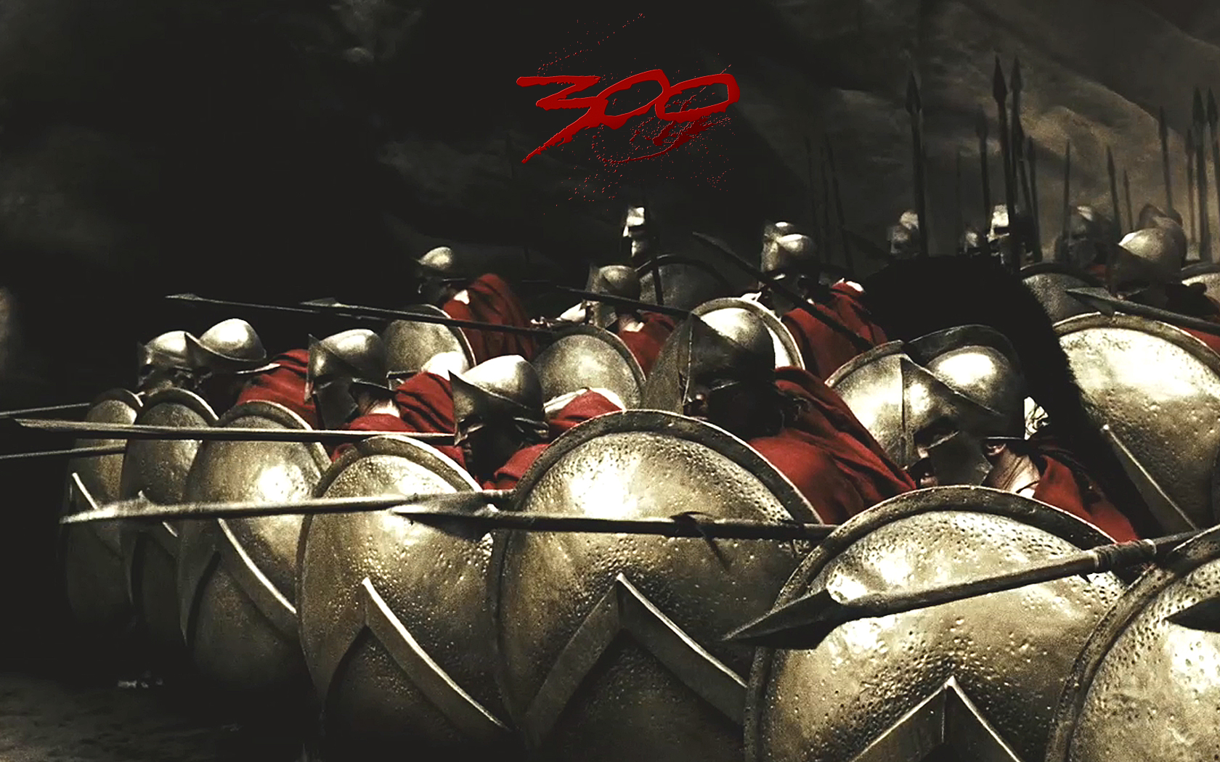
Greek Hoplite

Slide 8
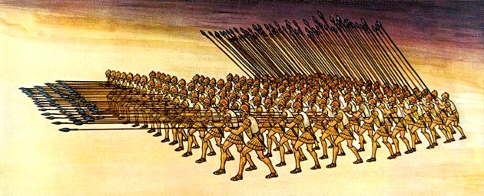

Slide 9
2nd Persian War

Slide 10
2nd Persian War, Battles

Slide 11
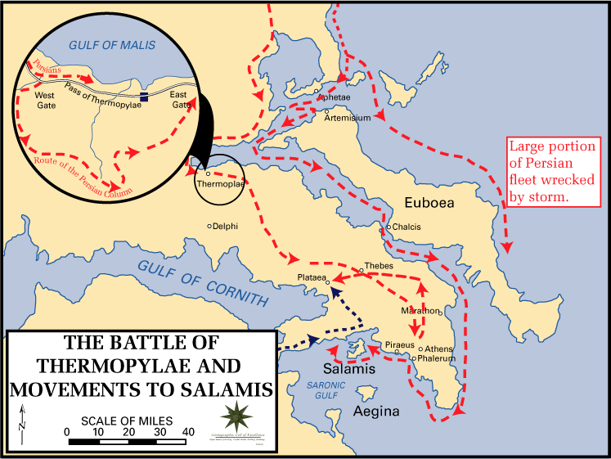
Thermopylae

Slide 12
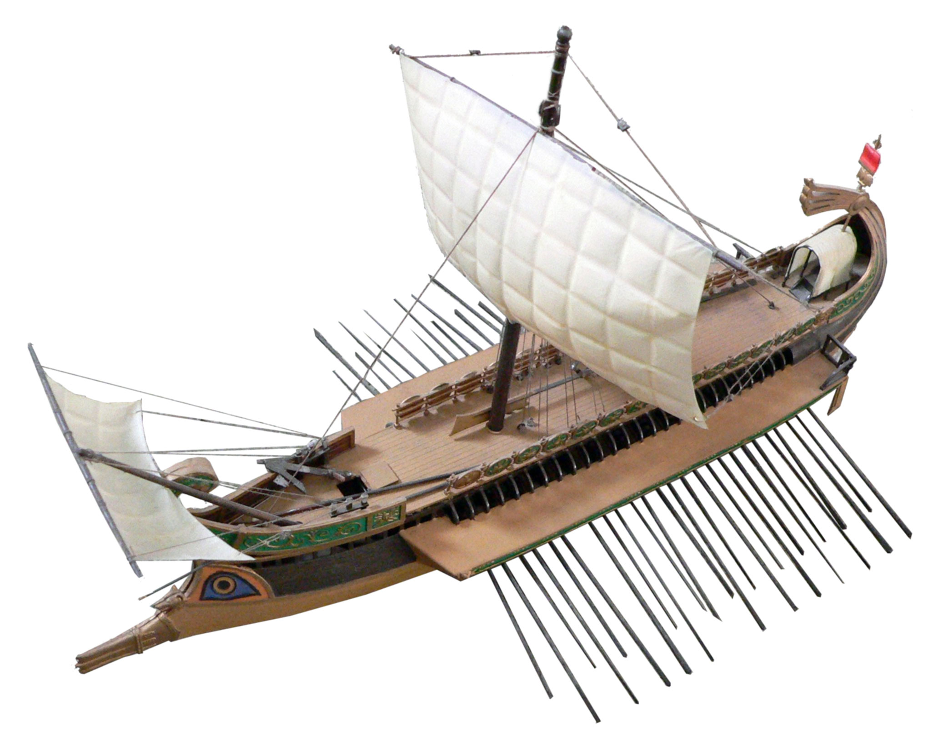
Trireme

Slide 13
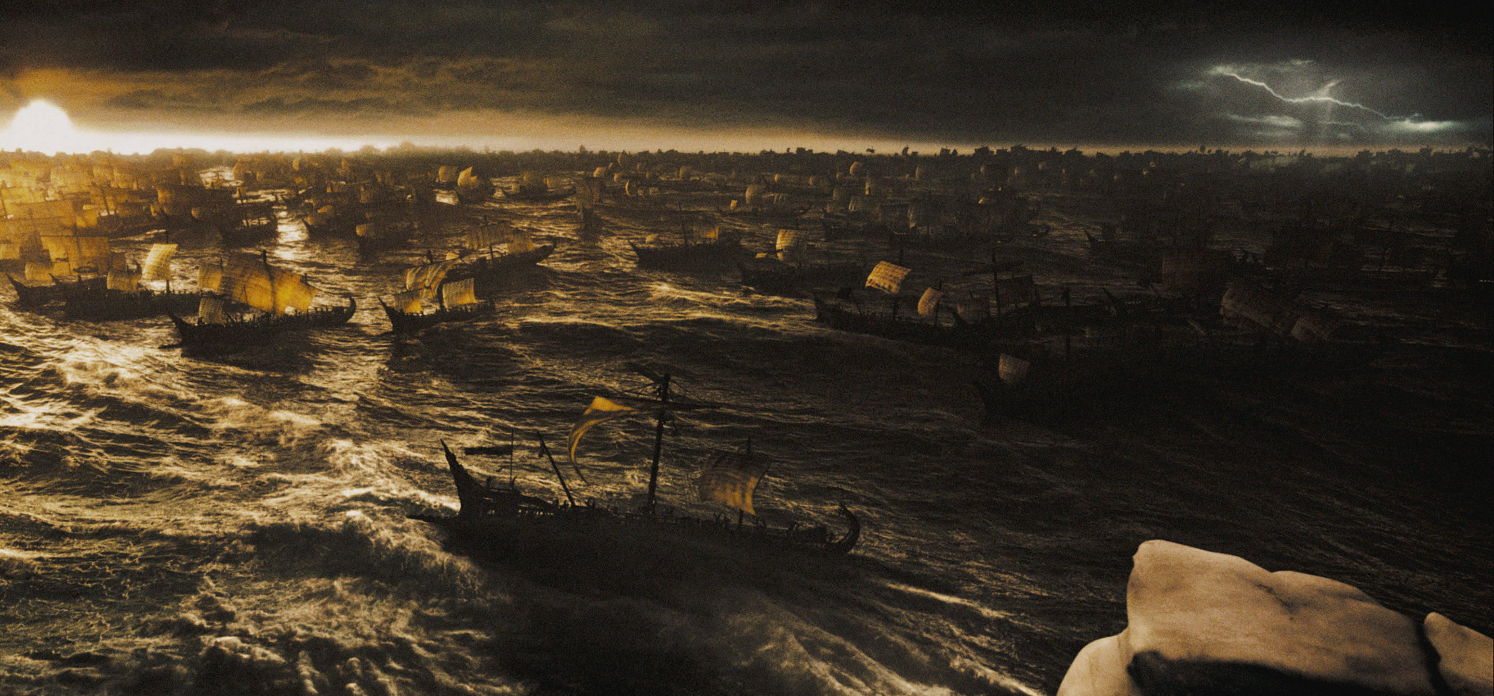
Persian Fleet

Slide 14
Outcome of Persian Wars

Slide 15
Peloponnesian War
In 431 BCE the Peloponnesian War started between Athens and Sparta
The war lasted until 404 BCE when Athens surrendered
The war weakened both Sparta and Athens and led to the decline of the Greek city states

Slide 16
Peloponnesian War
Competition between Sparta and Athens caused the Peloponnesian War
Athens controlled the Delian League and Sparta controlled the Peloponnesian League
Both cities feared the power of the other and this fear and distrust was the primary cause of the war

Slide 17
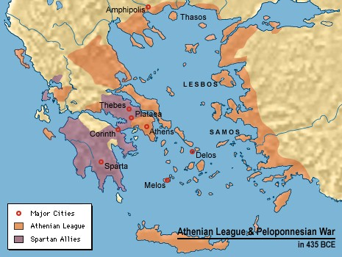
Peloponnesian League

Slide 18
Sparta vs. Athens
Sparta
Land Power
Oligarchy
Economy based on agriculture
Little money
Athens
Naval Power
Democracy
Economy based on agriculture and trade
Reserves of gold and silver

Slide 19
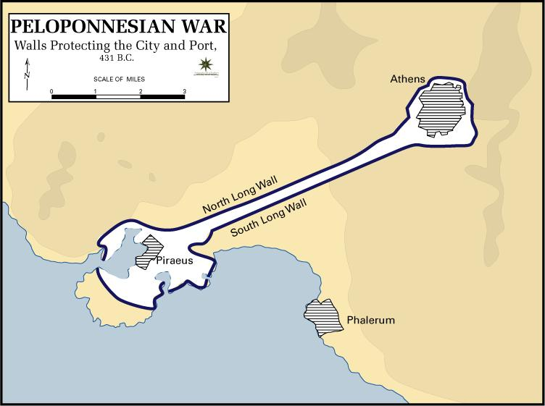
Athens Walls

Slide 20
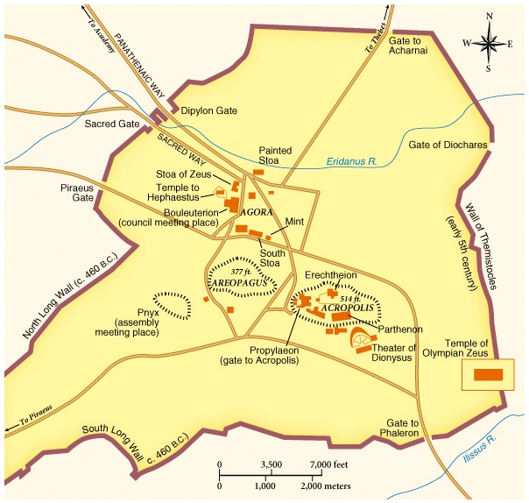
Athens

Slide 21
Outcome of Peloponnesian War

