Slide 1
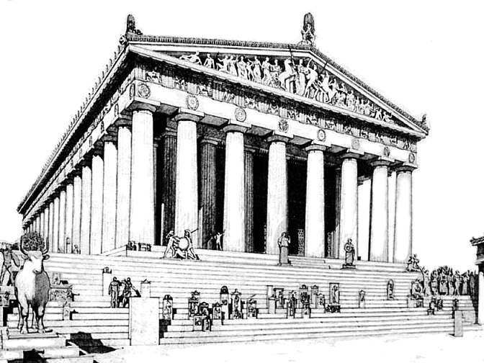
Ancient Greece
Social Structure and Citizenship
SOL WHI 5c

Slide 2
Essential Questions

Slide 3
Evolution of Athenian Government

Slide 4
Tyrants
Some city-states rebelled against the aristocrats by installing tyrants
Tyrants gave more rights to common people and limited the power of the aristocracy.
Some Tyrants attempted to keep power

Slide 5
Athens

Slide 6
Athens

Slide 7
Democracy in Athens

Slide 8
Sparta

Slide 9
Spartan Training (Agoge)
Spartan boys were taken from their parents at age 7 to live and train in barracks
Allowed to marry at 20, but they still had to live in barracks
Spartan males did not farm, their land was farmed by slaves called helots while they trained

Slide 10
Sparta

Slide 11
Athens vs. Sparta
Democracy
Athenian League
Sea Power
Traders/Farmers
Oligarchy
Militaristic
Peloponnesian League
Two Kings
Land Power

Slide 12
Greek City-States

