Slide 1
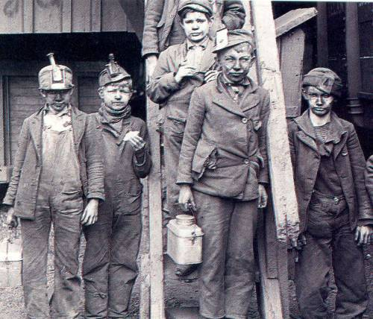
Industrial Revolution

Slide 2
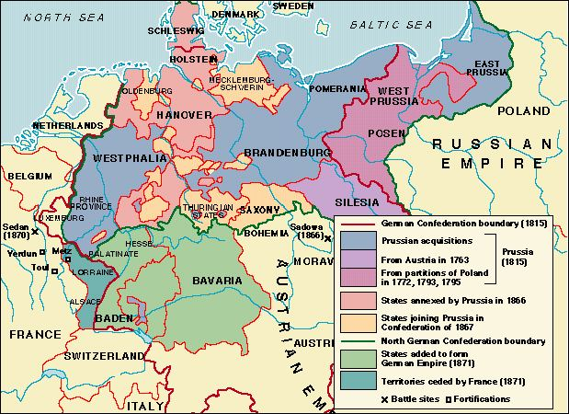
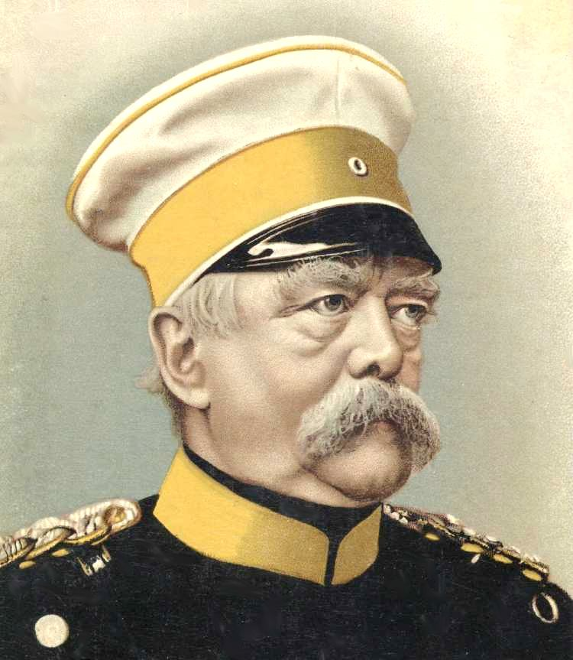
Unification of Germany
Germany late 1800s
Otto von Bismarck

Slide 3
Otto Von Bismarck
Goals
Methods
Unification of Germany
Increase Prussian Power
Decrease Austrian Influence in Germany
“Blood and Iron”
War (Franco-Prussian War of 1870)
Trickery
Realpolitik – do whatever is necessary to achieve goals, not what is moral

Slide 4
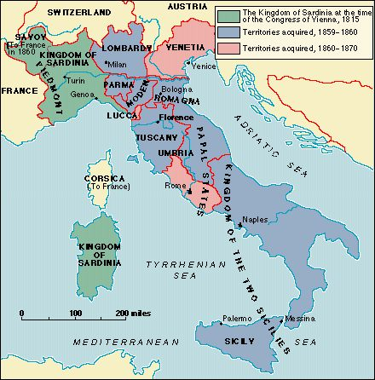
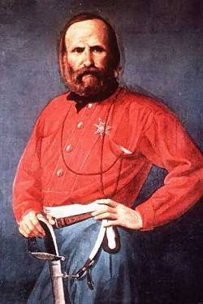
Unification of Italy
Italy late 1800s
Giuseppe Garibaldi and Count Cavour

Slide 5
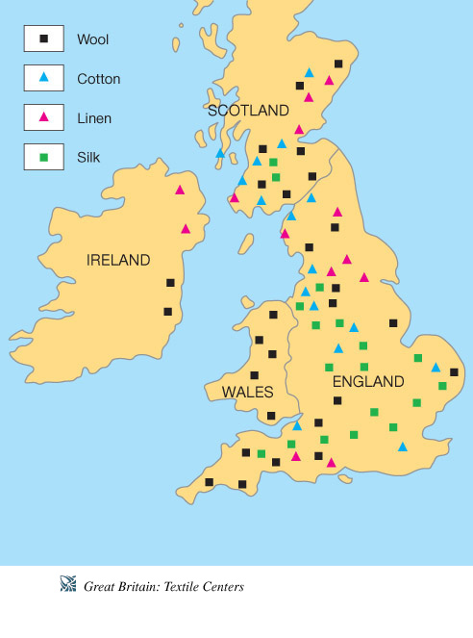
Industrial Revolution
Started in England
Spread to Europe and the United States
Replaced cottage industries
Textile, iron, and steel industries
Led to increased imperialism in search of raw materials

Slide 6
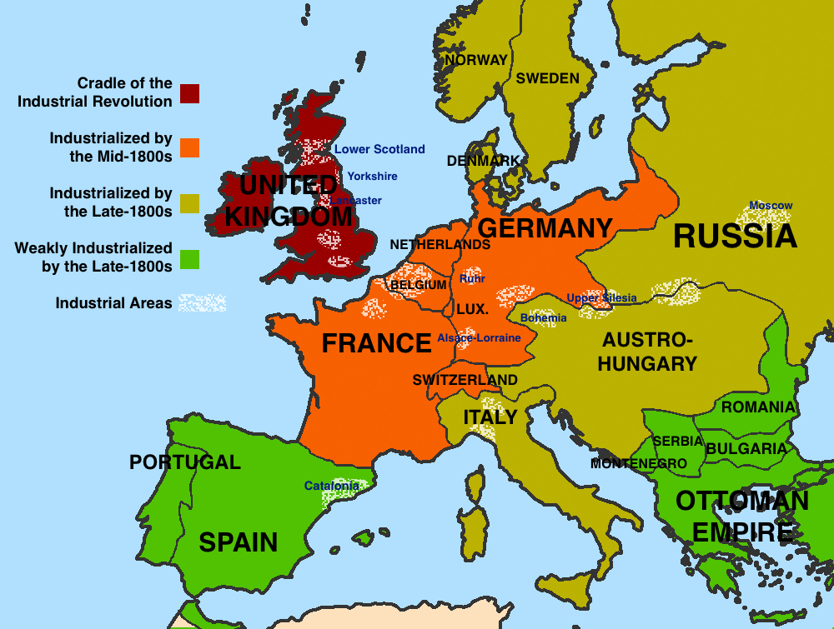

Slide 7
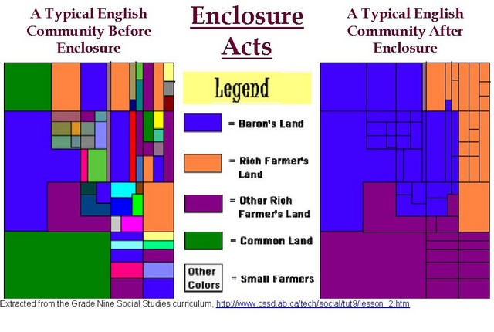
Enclosure Movement in England

Slide 11
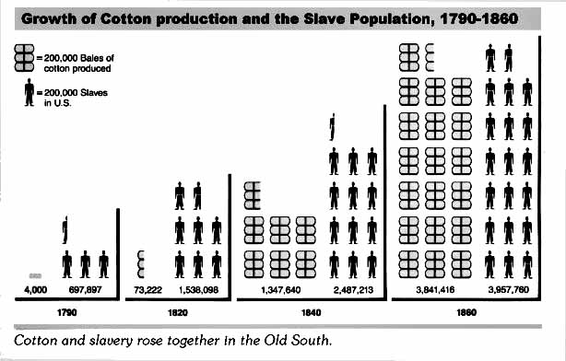
The cotton gin led to an increase in slavery.

Slide 12
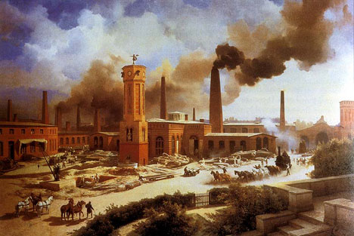
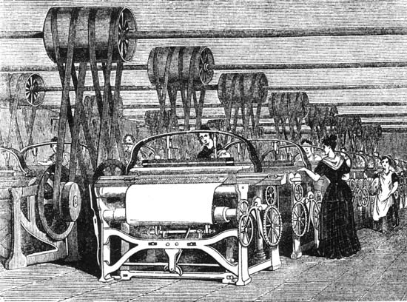
Factories in England

Slide 13
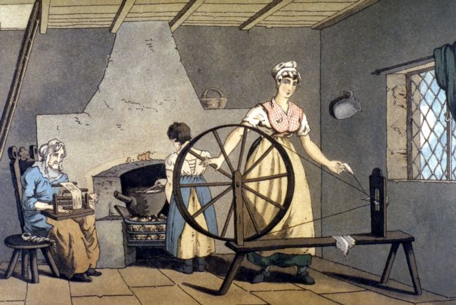
Factories replaced cottage industries also known as the putting-out system
The putting out system was a way of spinning thread by giving bundles of wool to women who would spin at home

Slide 14
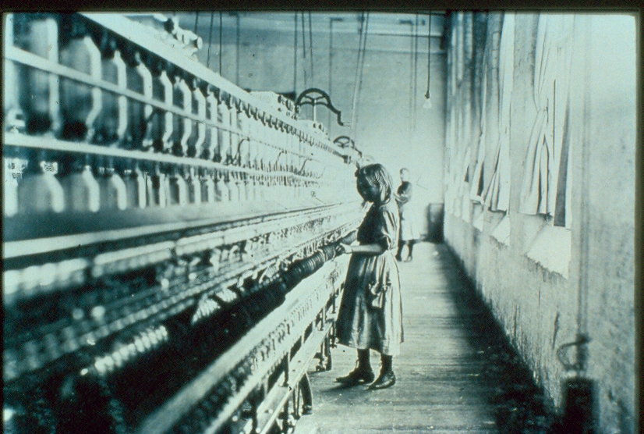
The Factory System
Harsh working conditions with men competing with women and children for wages
Child labor that kept costs of production low and profits high
Owners of mines and factories had control over employees lives

Slide 15
Social Effects
Labor Unions
Women and children entering the workplace as cheap labor
Introduction of reforms to end child labor
Expansion of education
Women’s demands for suffrage
Encouraged strikes to improve working conditions
Lobbied for laws to improve the lives of workers
Wanted worker rights and collective bargaining between labor and management

Slide 16
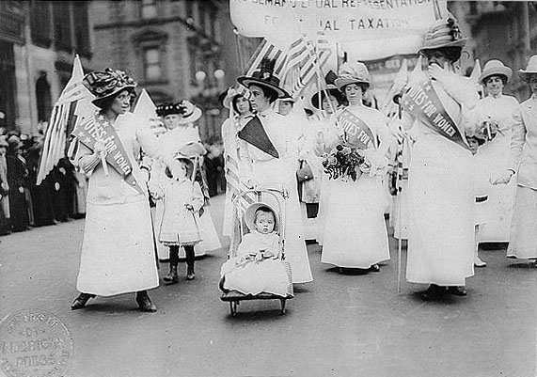
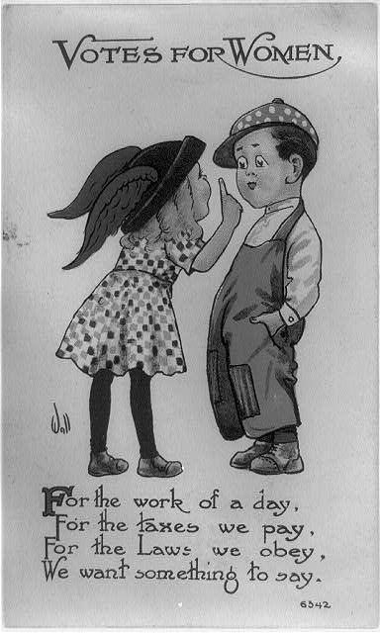
Women’s Suffrage

Slide 17
Capitalism
Socialism
Adam Smith’s Wealth of Nations
Role of market competition and entrepreneurial abilities
Karl Marx’s Communist Manifesto and Das Capital
Response to the injustices of capitalism
Importance of redistribution of wealth

Slide 19
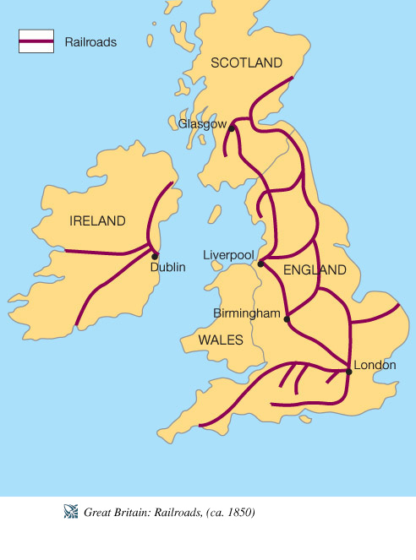
Impacts of the Industrial Revolution
Population Increase
Improved Transportation
Urbanization
Environmental Pollution
Increased Education
Growth of the Middle Class

Slide 20
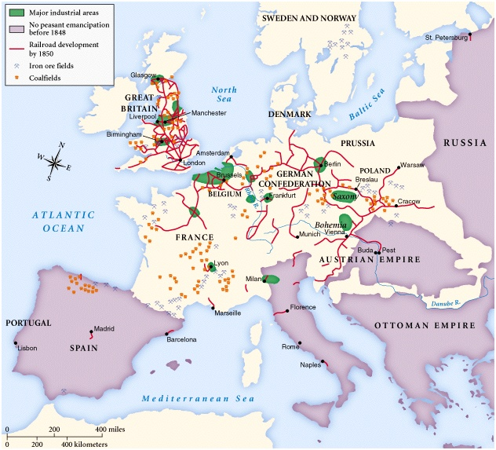

Slide 21
Imperialism
Industrial nations in Europe needed natural resources and markets to expand their economies
These nations competed to control Africa and Asia to secure their economic and political success
Colonies (areas directly ruled by home country)
Protectorates (Egypt/Britain)
Spheres of Influence (China)

Slide 22
Imperialism in Africa and Asia
European domination
European conflicts carried to the colonies
Christian missionary efforts
Spheres of influence in China
Suez Canal
East India Company’s domination of Indian States
American opening of Japan to trade

Slide 23
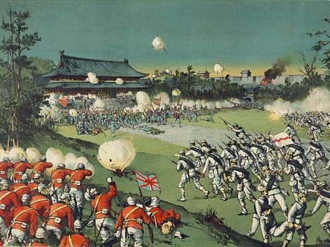
Response to Imperialism
Rise of nationalism in colonized countries such as India
Armed rebellions such as Boxer rebellion in China in 1899 - 1901

Slide 24
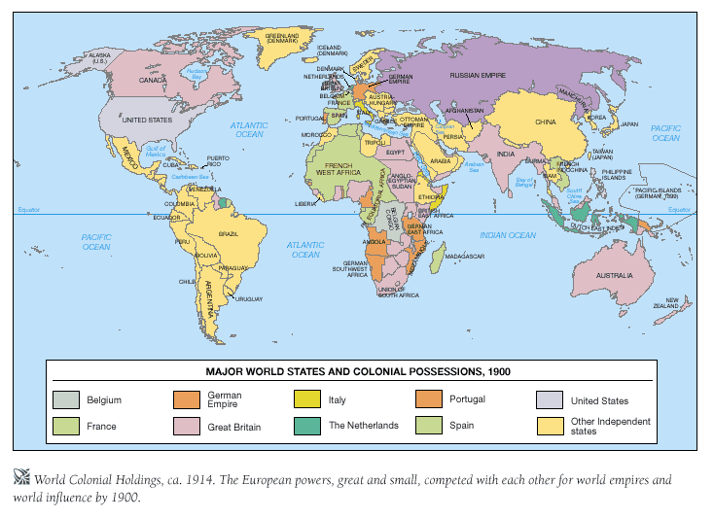

Slide 25
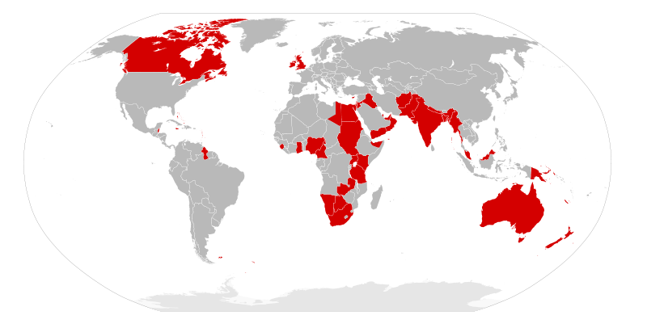

Slide 26
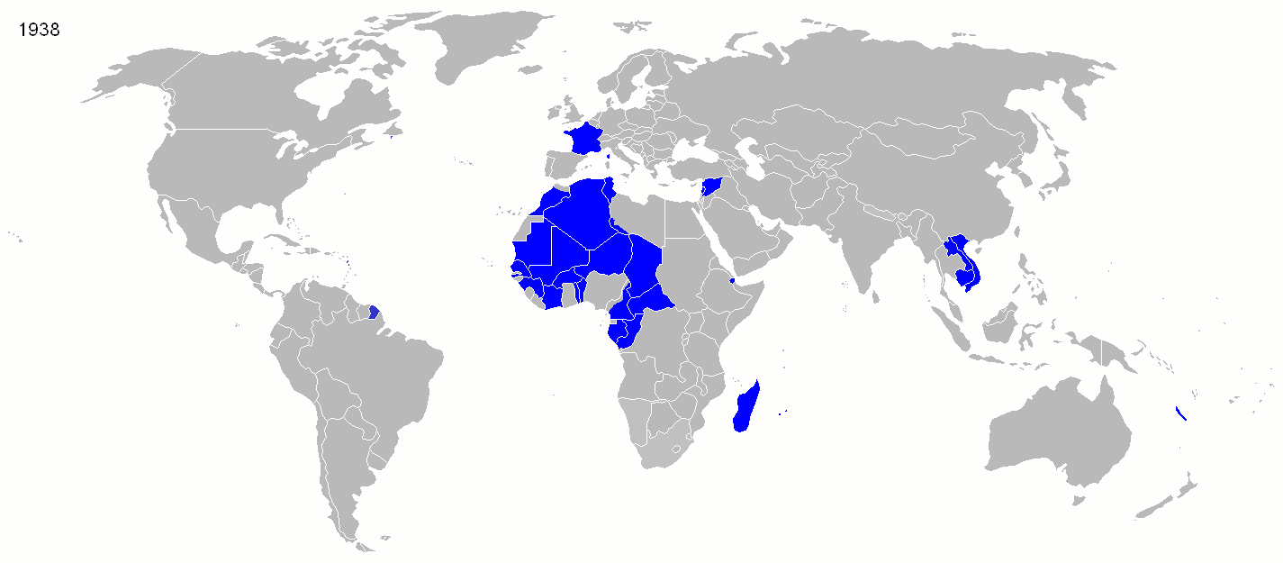

Slide 27
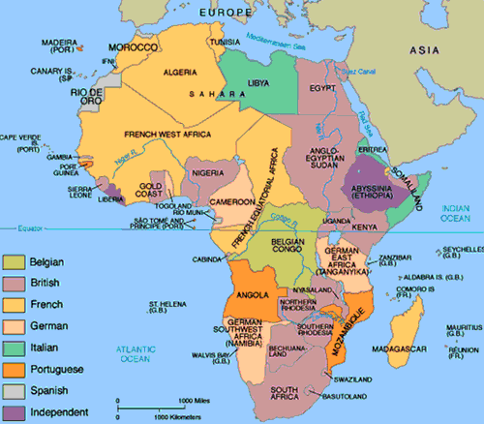

Slide 28
