Slide 1
International Relations
Theories and Systems

Slide 2

What is IR?
IR is the study of foreign affairs and global issues among states within the international system.
IR includes the study of non-governmental organizations, multinational corporations, and inter-governmental organizations.

Slide 3
Definitions
State
Nation
Nation-State
Stateless Nation
Nationalism
Sovereignty
Supranational
Power
Soft Power
Hard Power
Polarity
Balance of Power
Globalization

Slide 4
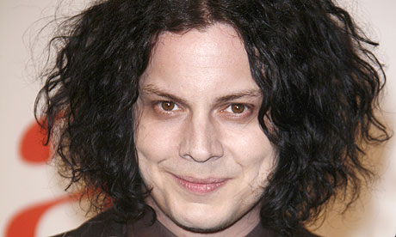
Nation
Hey guys, I am Jack White. I look like a creepier version of Johnny Depp. My song Seven Nation Army has absolutely nothing to do with IR. But it does have nation in the title.
Community of people who share a common language, culture, ethnicity, or descent
OR people who share a common territory and government

Slide 5
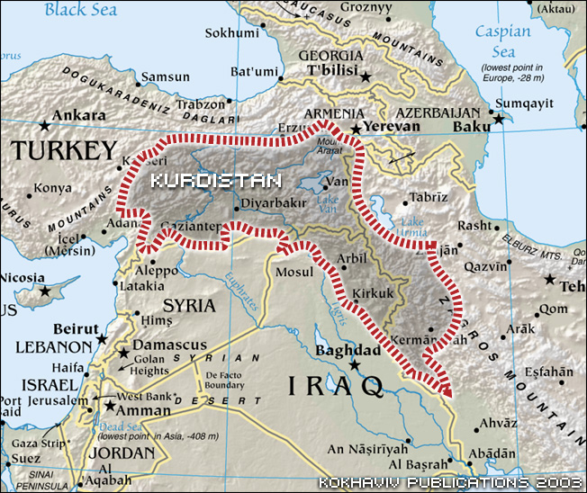
Stateless Nation
A group, usually a minority ethnic group, considered as a nation entitled to its own state
Kurds – Inhabit a region known as Kurdistan which includes parts of Iran, Iraq, and Syria

Slide 6
Stateless Nation | Population | Location
Kurds | 35 m | Iraq, Syria, Iran, Turkey
Tibetan People | 5.5 m | China
Sikhs | 27 m | India
Palestinians | 11 m | West Bank, Gaza Strip, Jordan, Lebanon
Basque | 2.6 m | France/Spain

Slide 7
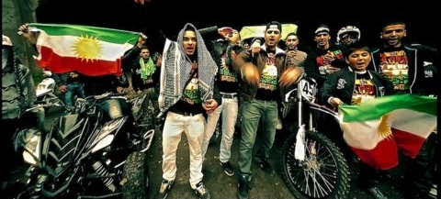

Battle of the Stateless Nation Rappers
These guys seem to be really excited about being Kurdish
I have no idea what these guys from Tibet are saying. It could be a rap about Yak milk.

Slide 8

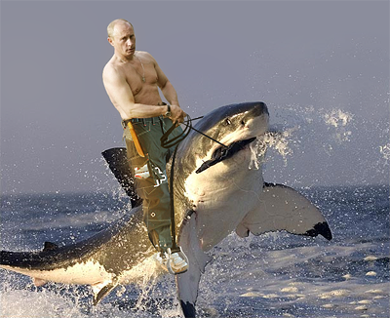
Nationalism Loyalty and devotion to a nation or exalting one’s nation above all others
Hey guys, it’s me, the Hoff. I just want to say German’s are the best and they rule!
Hey guys, it’s me, Vladimir Putin. Russians rule!

Slide 9
Theories
Realism
Idealism/Liberalism
Hans Morgenthau, Carr
Based on ideas of Machiavelli and Hobbes
Inspired by Thucydides History of the Peloponnesian War
Also known as Wilsonianism
Based on ideas of Woodrow Wilson, clarified by Hans Kochler

Slide 10
Realism
Idealism
Politics is based on objective laws that have their roots in human nature
Realism can be characterized as pessimism
Stresses power and national interest
International system is characterized by anarchy
Stresses optimism, enlightenment ideas and liberalism
Reason and morality can structure nations’ international behavior toward peace
Example – Woodrow Wilson and the League of Nations

Slide 11
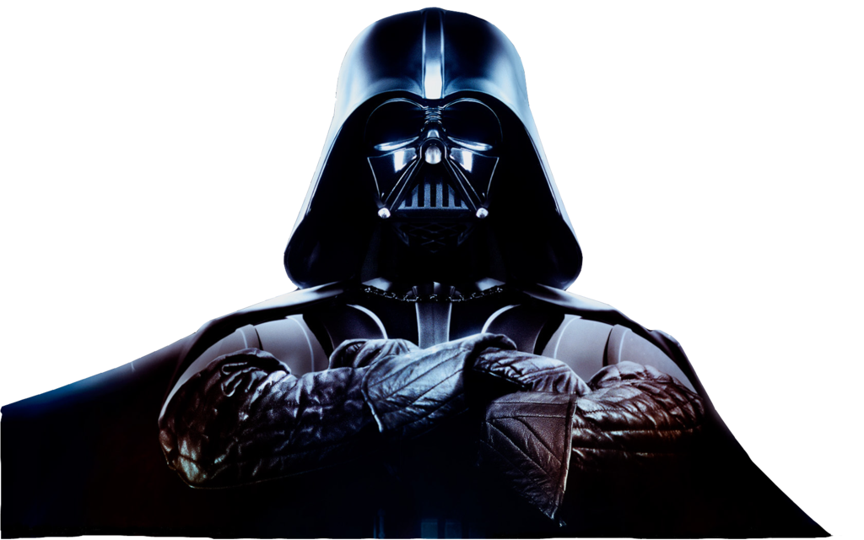
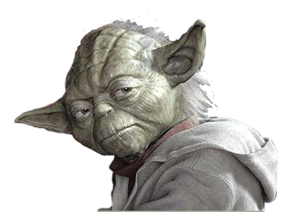
Realists say that people are basically interested in self preservation. Nation’s need to maximize their power and create alliances to protect their survival.
Idealists say that people are basically good. They support cooperation between countries, human rights, and environmental issues.

Slide 12
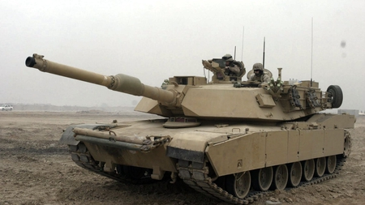
Power
The degree of resources, capability, and influence in international affairs that a country has
Hard power – Military
Soft power – Economics, diplomacy, and cultural influence

Slide 13
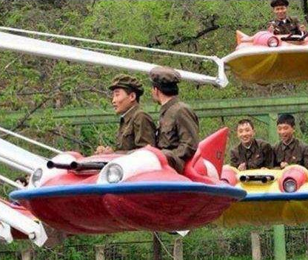
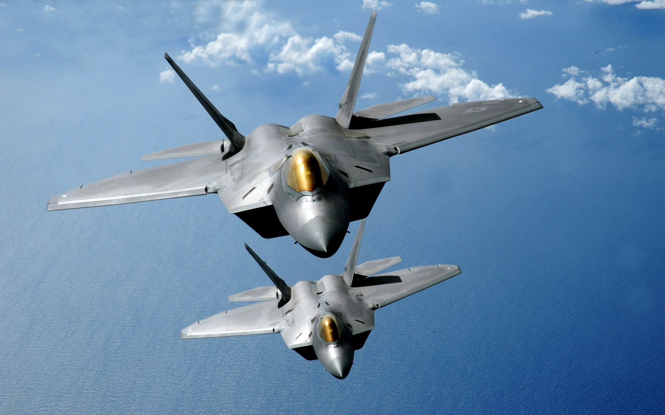
Military Power quality vs. quantity
U.S. Air Force F22 Raptors
North Korean Air Force

Slide 14
Power
Superpowers – United States
Great Powers – China, Russia, France, Britain, Germany, Italy, Japan
Middle Powers – India, Mexico, Brazil, Canada, Australia, South Africa
States with nuclear weapons
U.S., China, U.K., France, Russia
India, Pakistan, North Korea
Israel *possible*
South Africa, Belarus, Ukraine, Kazakhstan

Slide 15
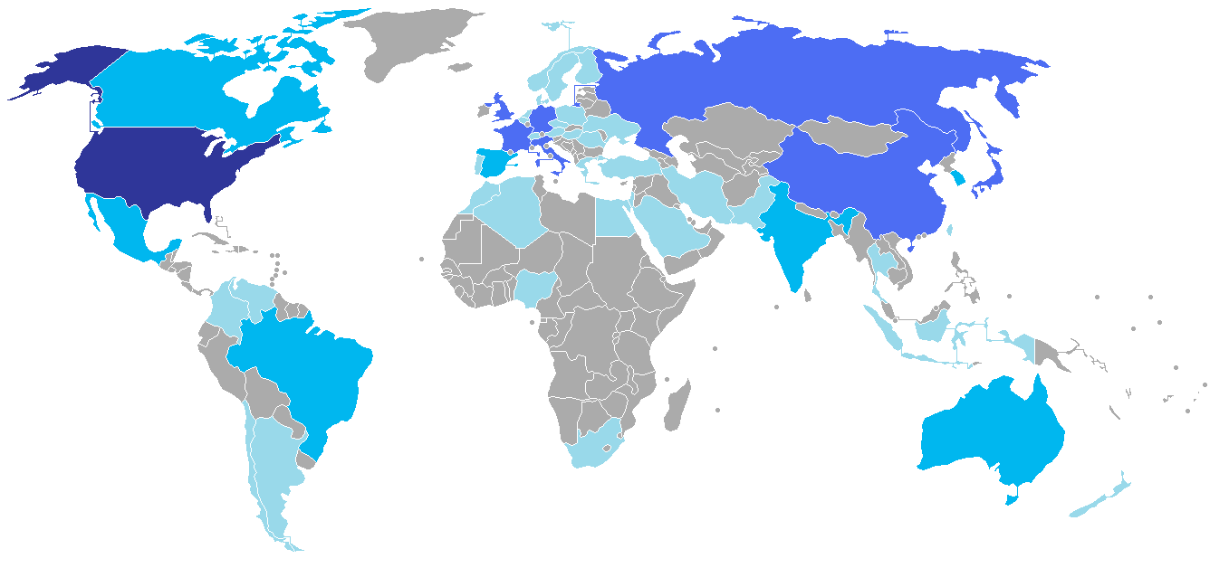

Slide 16
Systems
The interaction of many components so that one cannot change without changing others
States and other components in a system interact to ward off threats and advance their interests
Balance of Power
Bipolar
Unipolar
Multipolar
Stratified
Globalized

Slide 17
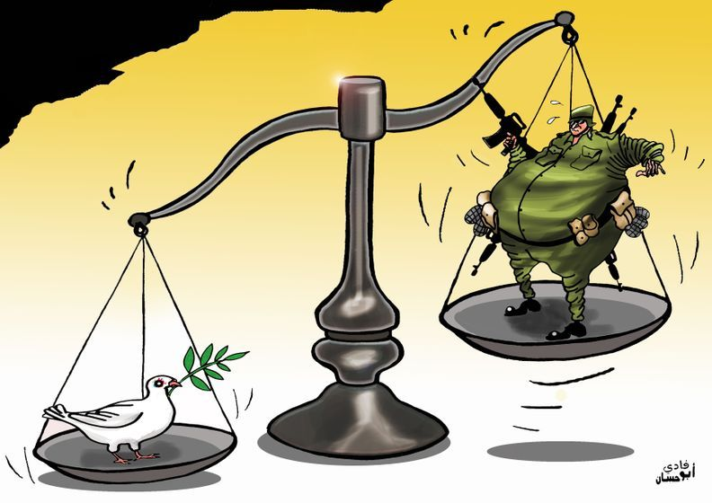
Balance of Power
States ally themselves with other states to balance the power of threatening states
Example – 1648 – 1789 Europe
Peace of Westphalia to French Revolution
Example – 1814 – 1914
Post Napoleon to WWII

Slide 18
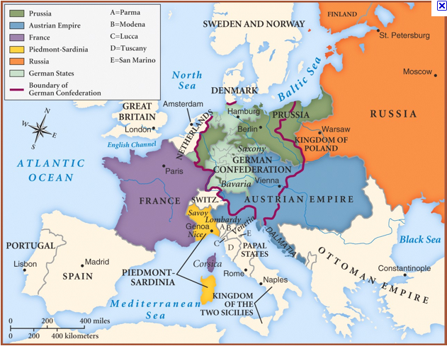

Slide 19
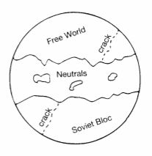
Bipolar World
Bipolar World – 1945 – 1991
Two superpowers – U.S. and Soviet Union
NATO and Warsaw Pact
Most countries had to choose a side

Slide 20
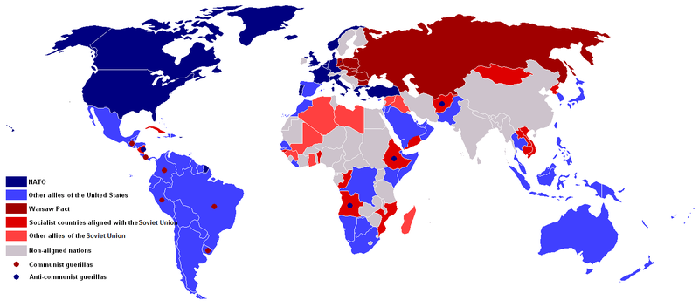
Bipolar World

Slide 21
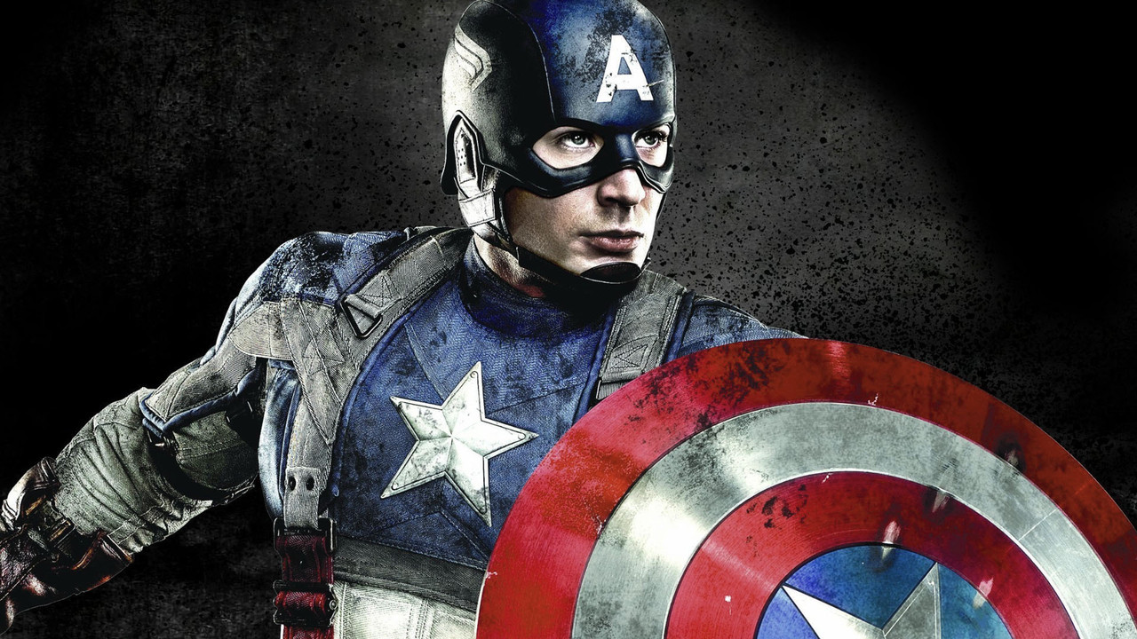
Unipolar
Single superpower dominates international politics
Example – U.S. after end of Cold War
U.S. leads that United Nations and middle powers to stop aggressors

Slide 22
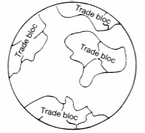
Multipolar
System with several centers of power, some of them trading blocs, and all engaged in tough economic competition

Slide 23
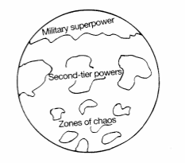
Stratified
Militarily the United States predominates but economics is a multipolar picture
U.S. military power on top
Second tier of major economic and military powers
Third tier of weaker countries or zones of chaos

Slide 24
Globalized
Clash of Civilizations
Most countries are economic players on world market
Motto: make money, not war
Countries who don’t want to play such as N. Korea and Cuba, live in isolation and poverty
World is divided into 8 civilizations each based mostly on religion
Western
Slavic/Orthodox
Islamic
Hindu
Sinic
Japanese
Latin America
Africa

Slide 25
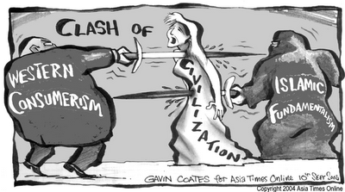
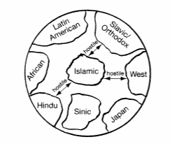
Clash of Civilizations

Slide 26
