Slide 1
Case Study: Israel

Slide 3
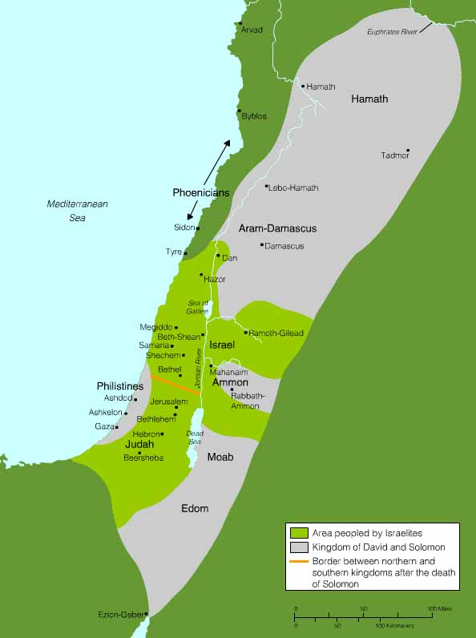

Slide 4
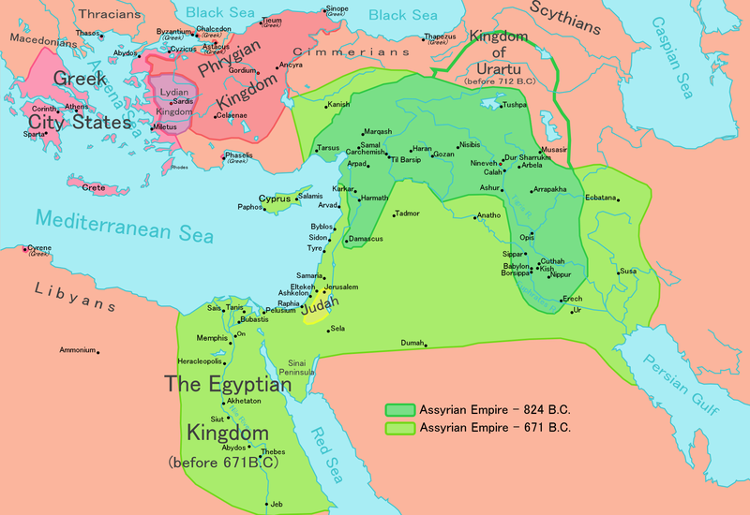

Slide 5
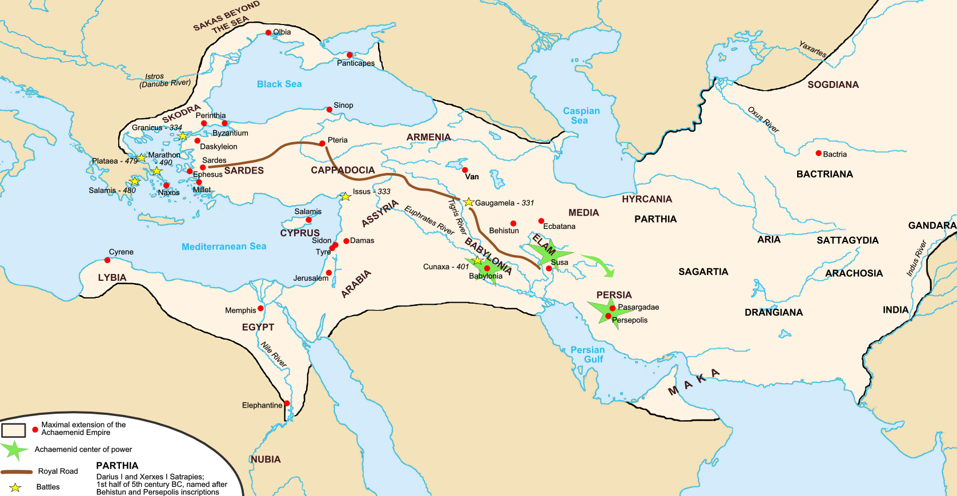

Slide 6
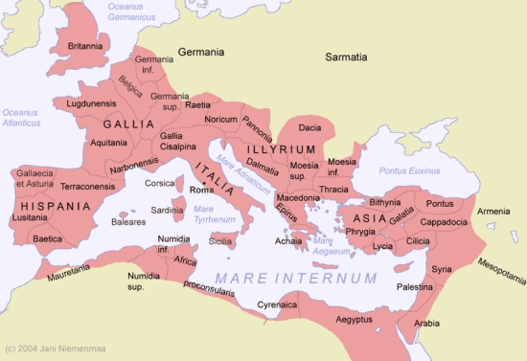

Slide 8
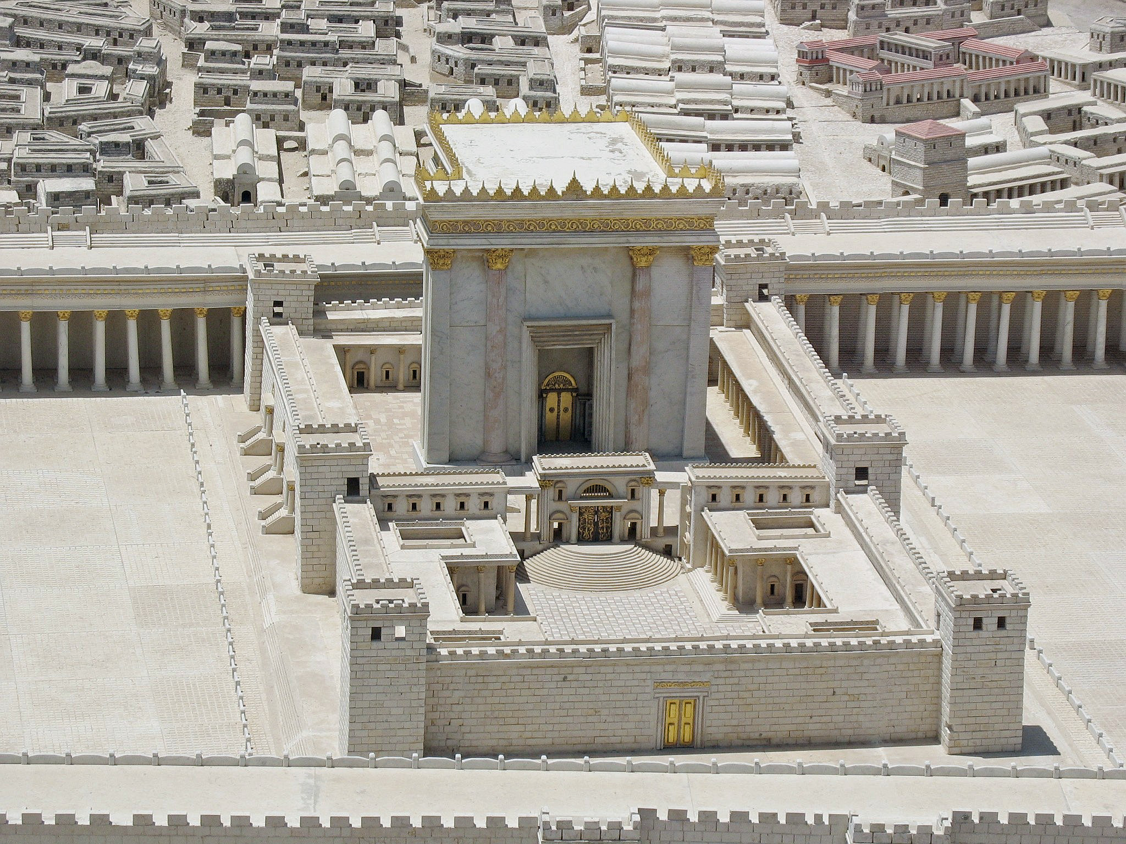

Slide 9
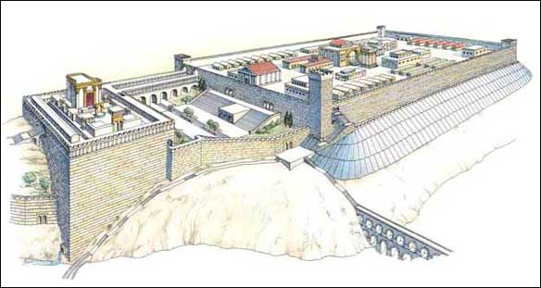

Slide 10
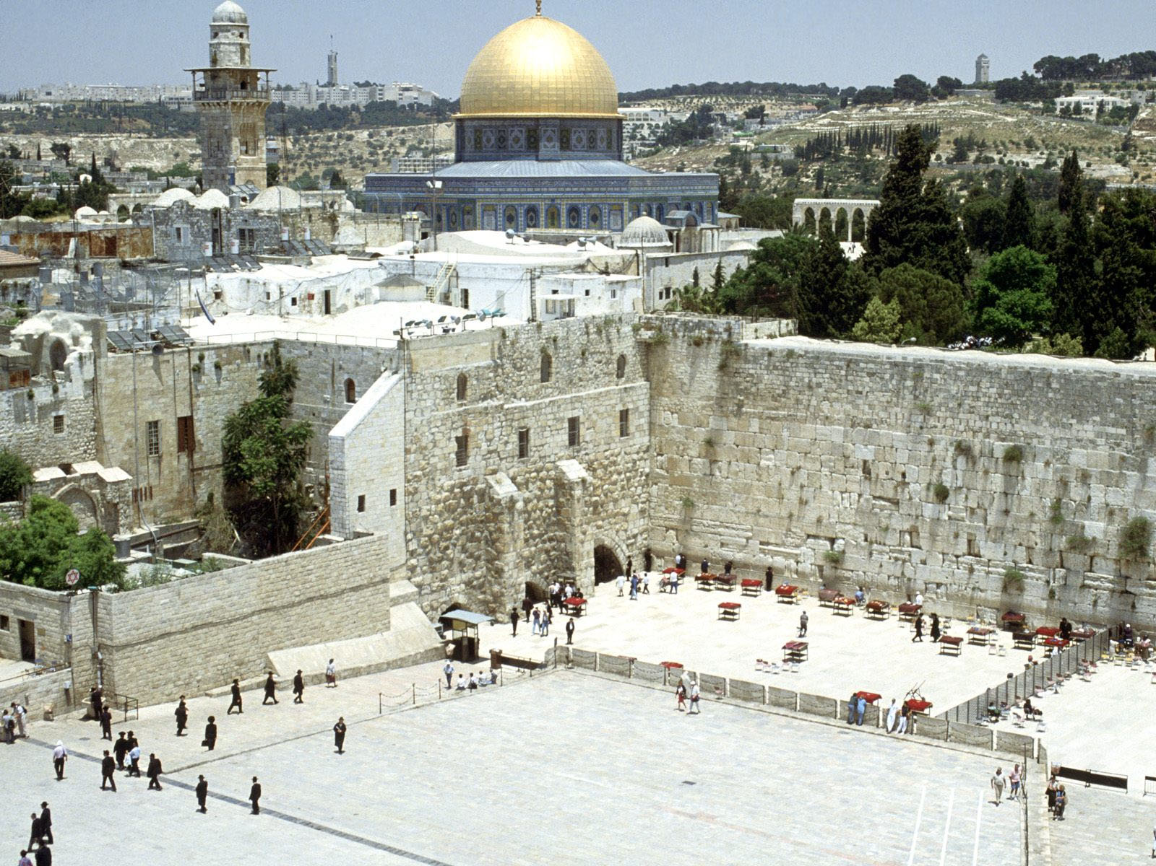

Slide 11
Jewish Diaspora
Forced migrations or enslavement of Jewish people after the Assyrian, Babylonian, and Roman conquests of the Jewish Kingdom
Used mostly to refer to enslavement and exile after Jewish revolt in 70 C.E.
Jews set up communities across the Middle East and in the Roman Empire, later in Europe and Russia

Slide 12
Zionism
Nationalist Jewish political movement
Supports self-determination and creation of Jewish homeland

Slide 13
Balfour Declaration
Formal statement of policy by the British government that said,
"His Majesty's government view with favour the establishment in Palestine of a national home for the Jewish people, and will use their best endeavors to facilitate the achievement of this object”

Slide 14
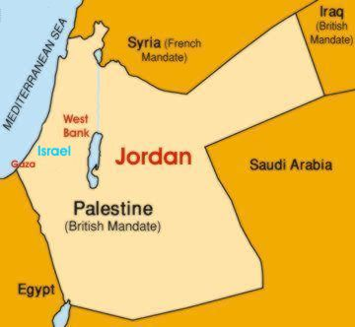
Mandate System

Slide 15
The White Paper
Idea of partitioning Palestine Mandate abandoned
Favored creation of independent Palestine governed by Palestinian Arabs and Jews in proportion to their numbers in the population by 1949
Limit of 75,000 Jewish immigrants from 1940 - 1944

Slide 16
Emigration
Genocide of 6 million European Jews during WWII
Before and during the war the United States did not lift restrictive immigration policies
After the war Jews were interred on Cyprus
SS Exodus

Slide 17
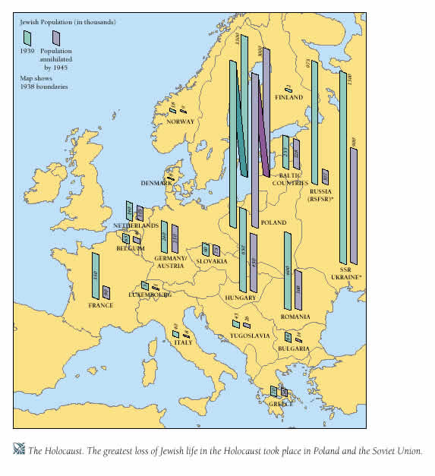

Slide 18
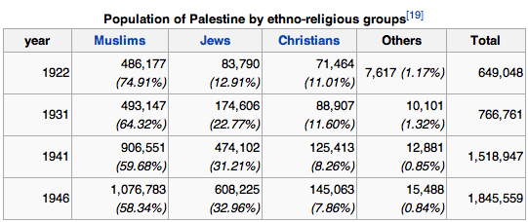

Slide 19
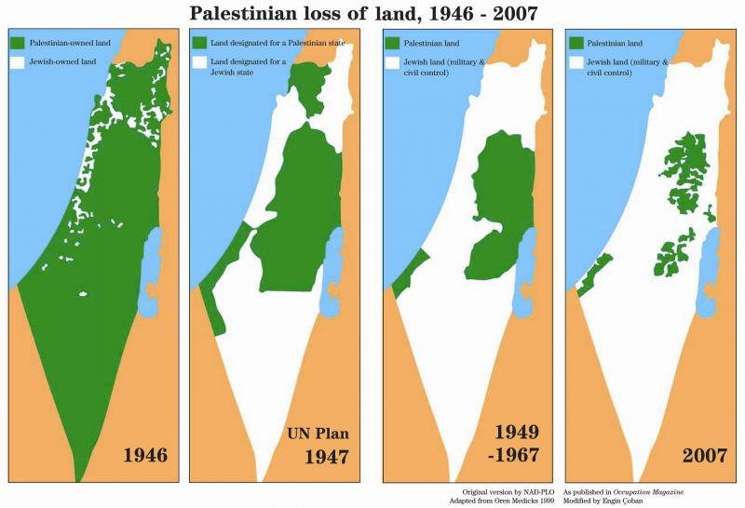

Slide 20
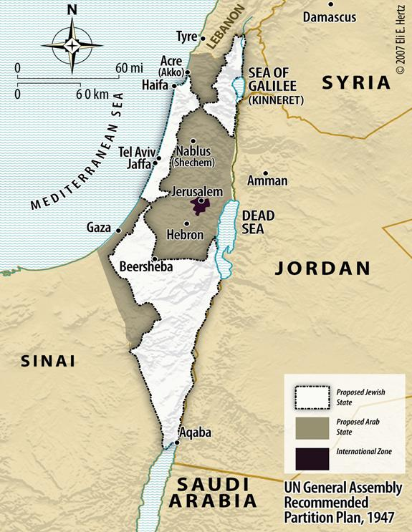

Slide 21
1956 Suez Crisis
France
United Kingdom
Israel
Egypt

Slide 22
1956 Suez Crisis
Egypt nationalizes the Suez Canal
France and the United Kingdom invade Egypt with Israeli help
Political and economic pressure force France and the United Kingdom to withdraw
UNEF Force in Sinai
Anglo-French relations damaged

Slide 23
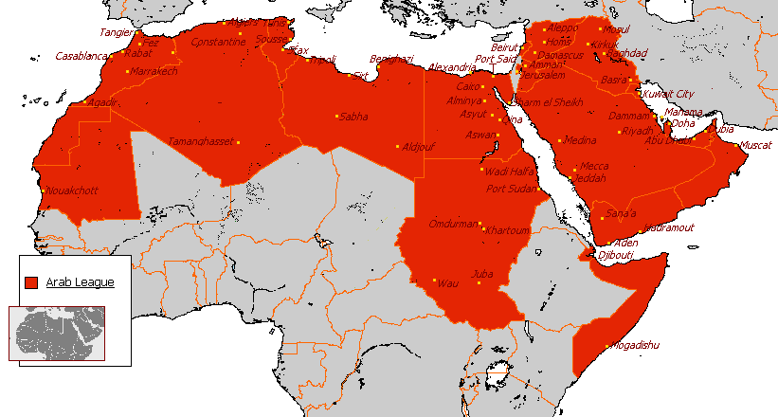
Pan-Arabism

Slide 24
Six Day War 1967
Israel
Egypt
Jordan
Syria

Slide 25
Six Day War

Slide 26
Outcomes

Slide 27
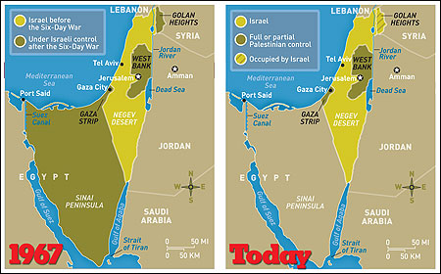

Slide 28
Yom Kippur War
Also known as 4th Arab-Israeli War
In 1973, Israel was invaded by Syria and Egypt on the Jewish holy day of Yom Kippur
The United States resupplied Israel and the Soviet Union resupplied Egypt and Syria

Slide 29
Camp David Accords
Peace agreement signed in 1978, between Egypt and Israel, brokered by U.S. President Jimmy Carter
Egypt recognized Israel as a country
Israel gave back Sinai to Egypt

Slide 30
Oslo Accords
Agreement between the Palestinian Liberation Organization and Israel signed in 1993
Granted Palestinians right to self government in Gaza Strip and city of Jericho in the West Bank
Created Palestinian Authority (Yasser Arafat appointed president)
PLO recognized Israel

Slide 31
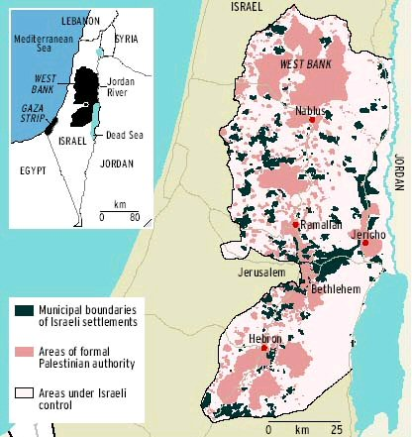

Slide 32
