Slide 1

The United Nations and other organizations

Slide 2
League of Nations
Wilson’s Fourteen Points for Peace
Paris Peace Conference
Major goal of preventing future wars

Slide 3
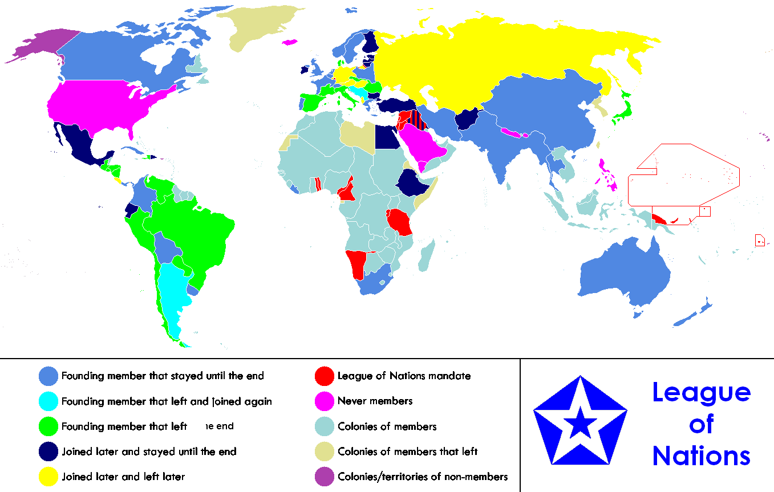

Slide 4
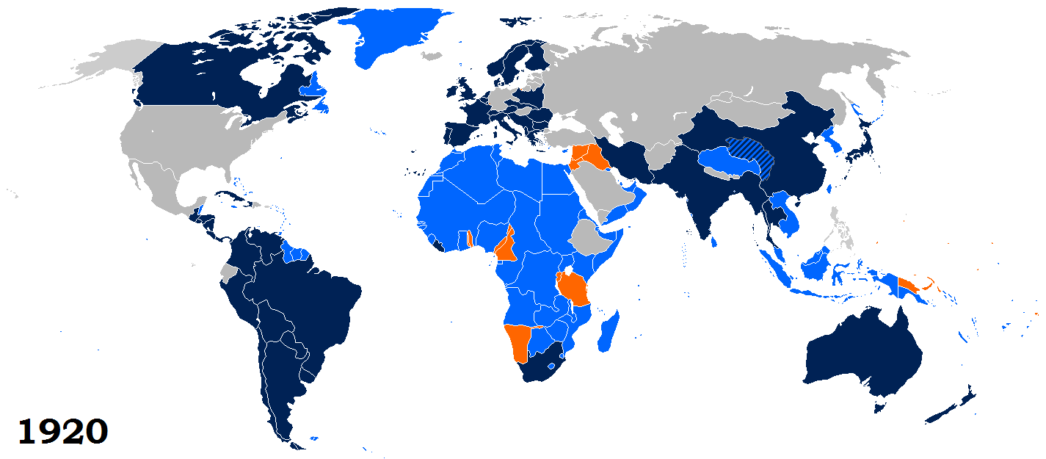

Slide 5
League of Nations
Assembly – Representatives of all member countries
Council – Began with four permanent members (Great Britain, France, Italy, Japan) – Germany added later

Slide 6
Why did the League Fail?
Did not have full world participation
Seen as “League of Victors”
Members were unwilling to enforce sanctions or use military action
Collective Security vs. International Relations

Slide 7
Mandates
Tried to administer former German colonies in Africa and the Pacific and several non-Turkish provinces of the Ottoman Empire
System of national responsibility subject to international supervision

Slide 8
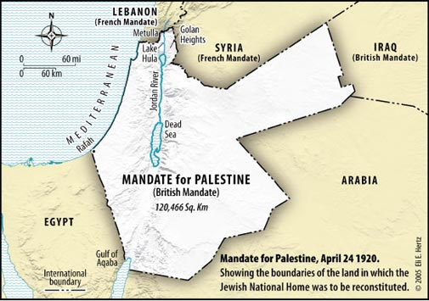

Slide 9
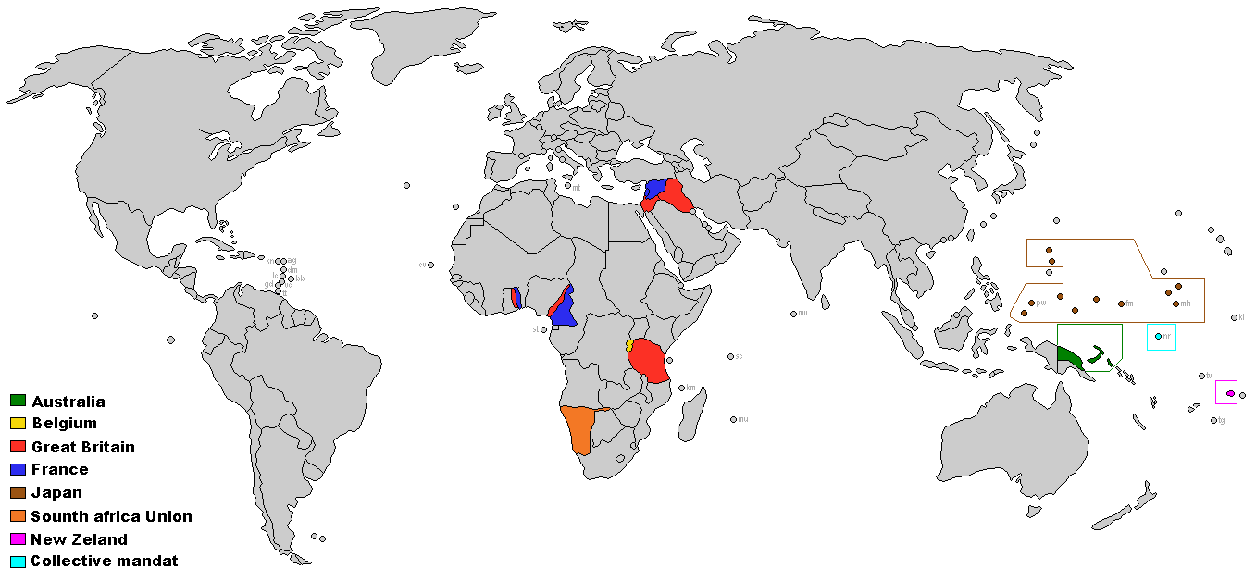

Slide 10
The United Nations
Supported by Franklin Roosevelt and later Harry Truman
Founded in 1945, after WWII

Slide 11
U.N. Charter Article 1
1. To maintain international peace and security, and to that end: to take effective collective measures for the prevention and removal of threats to the peace, and for the suppression of acts of aggression or other breaches of the peace…

Slide 12
U.N. Charter Article 4
1. Membership in the United Nations is open to all other peace-loving states which accept obligations contained in the present Charter and, in the judgment of the Organization, are able and willing to carry out these obligations.

Slide 13
U.N. Structure
General Assembly
Security Council
Secretariat
International Court of Justice
Economic and Social Council

Slide 14
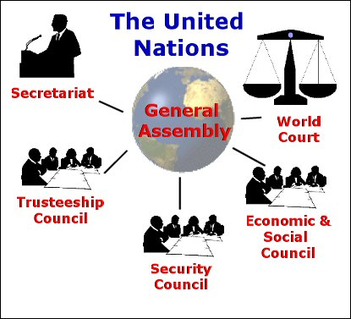

Slide 15
Security Council
Originally 10 members, enlarged to 15
5 permanent members, each with veto power
10 nonpermanent members elected by the GA for two-year terms
5 countries elected every year based on geographic regions

Slide 16
Security Council

Slide 17
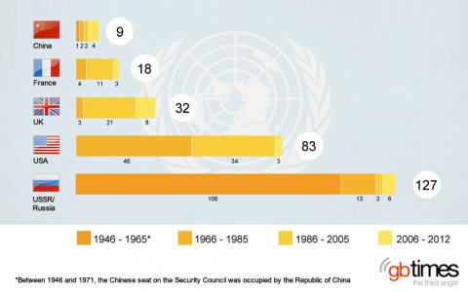

Slide 18
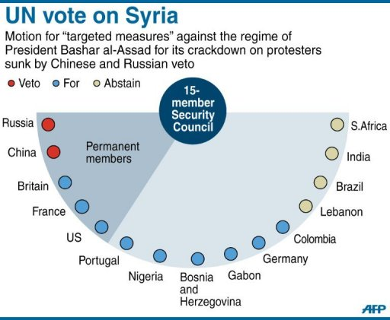

Slide 19
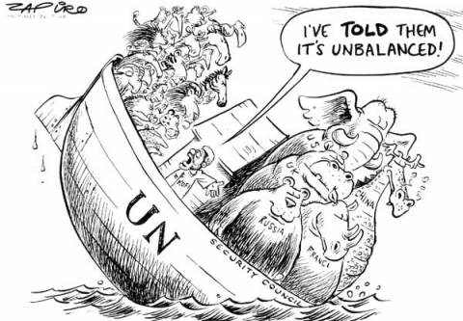

Slide 20
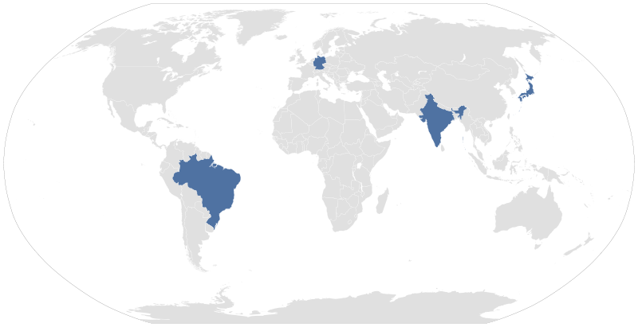

Slide 21
Secretariat
General Secretary is spokesman of the United Nations
Appointed by General Assembly after being recommended by the Security Council, any member of which can veto.
No specific criteria for post
One or two terms of five years
Geographical Rotation

Slide 22
Economic and Social Council
54 members elected by GA for three year overlapping terms
Promotes international social and economic cooperation
Works with World Bank and International Monetary Fund

Slide 23
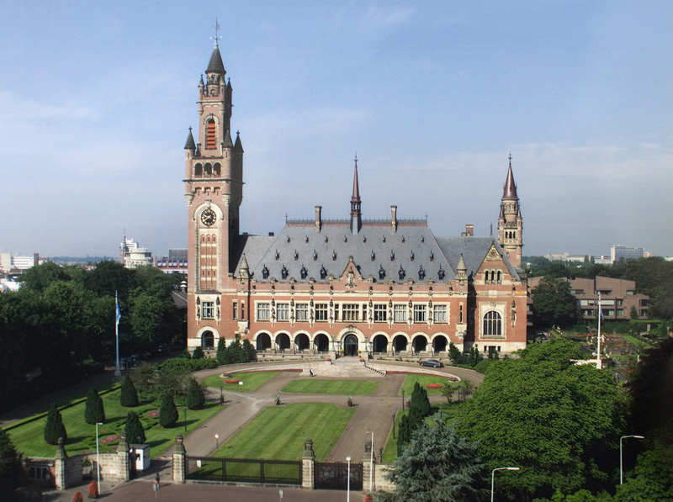
Court of Justice
Judicial branch of the UN located in The Hague, Netherlands

Slide 24
Sample Cases
Burkina Faso/Niger border dispute
Whaling in the Antarctic Australia vs. Japan
Maritime dispute Peru vs. Chile
Passage through the Great Belt Finland vs. Denmark

Slide 25
Funding
Assessed and voluntary contributions from member states
GA determines assessment for each member based on gross national income (GNI)
No country can donate more than 22% of budget

Slide 26
Funding

Slide 27
Peacekeeping Missions
First United Nations Emergency Force (Egypt/Israel) (1956 – 1967)
Second United Nations Emergency Force (Egypt/Israel) (1973 – 1979)
United Nations Peacekeeping Force in Cyprus (1964 – Present)
United Nations Mission in Bosnia and Herzegovina (1995 – 2002)

Slide 28
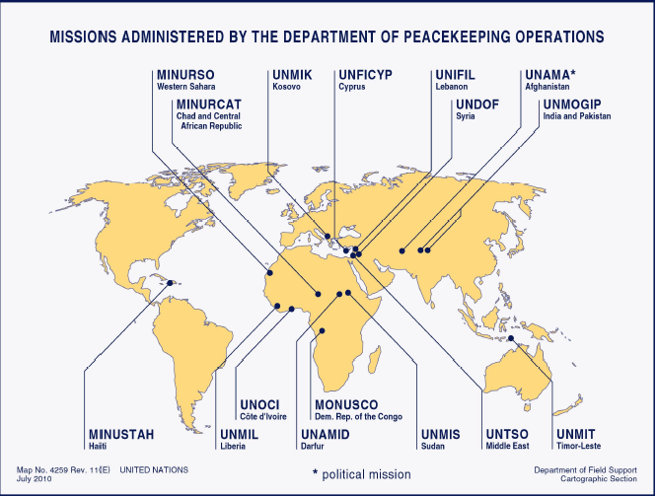

Slide 29
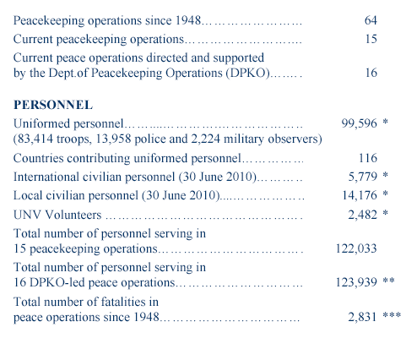

Slide 30
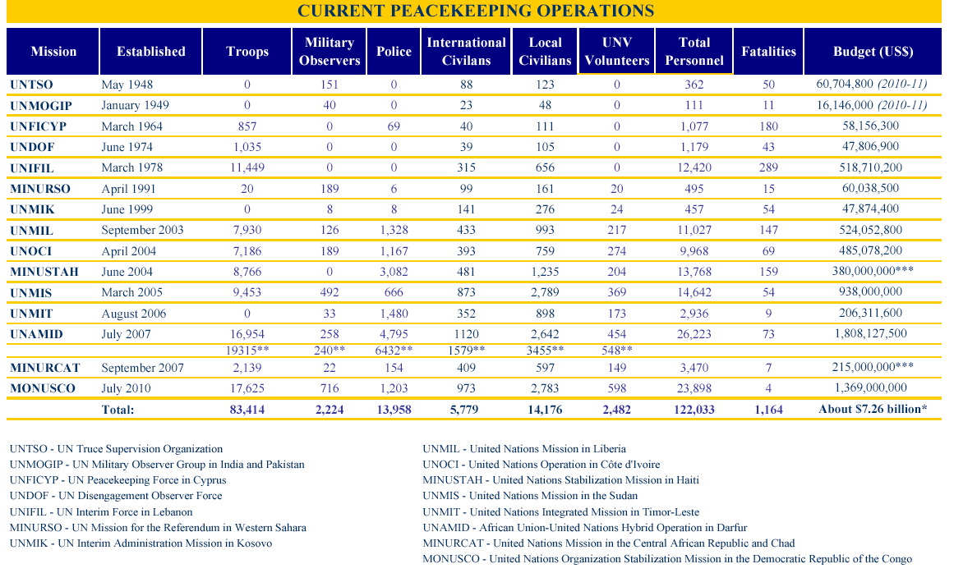

Slide 31
Other Organizations

Slide 32
Greenpeace
Goals
Reversing climate change
Zero deforestation
Challenging wasteful and destructive fishing
Elimination of all nuclear weapons
Sustainable agriculture

Slide 33
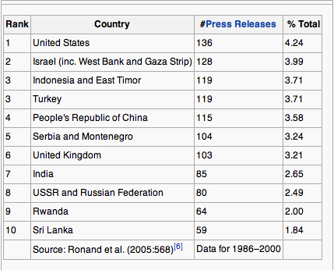
Amnesty Reporting

Slide 34
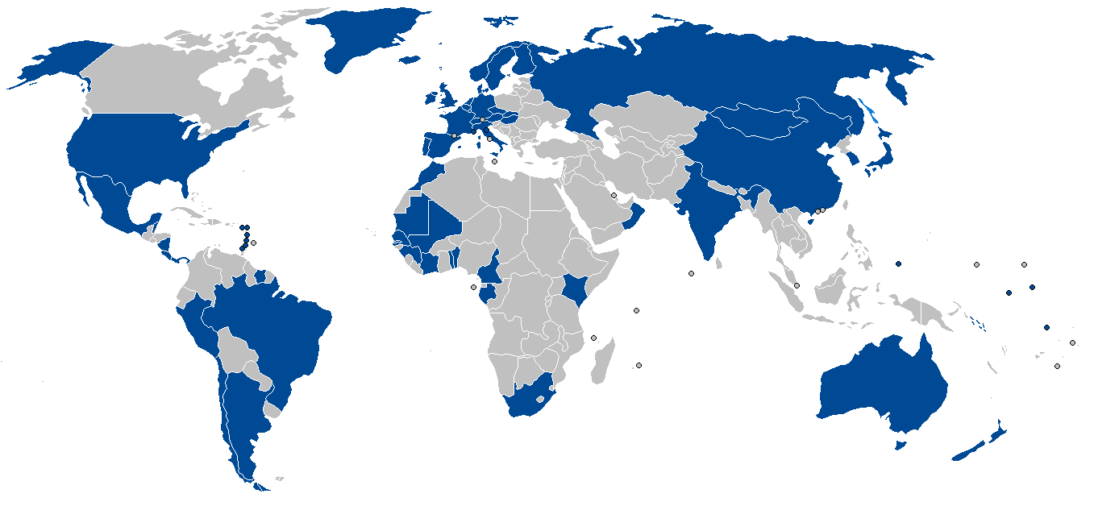
IWC

