Slide 1
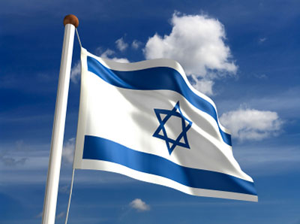
Israeli Knesset

Slide 2
The Basics
Israel has a multi-party parliamentary system.
Ballots are not cast for candidates but for political parties, whose members receive seats on a proportional basis
The legislative authority is the Knesset.
The Knesset is composed of 120 members elected for 4 year terms in national elections.
A party must receive at least 2% of the vote to get seats

Slide 3
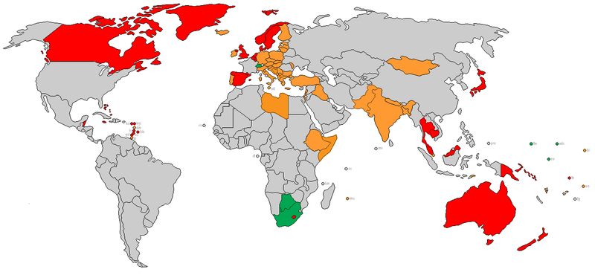
Countries with a Parliamentary System

Slide 4
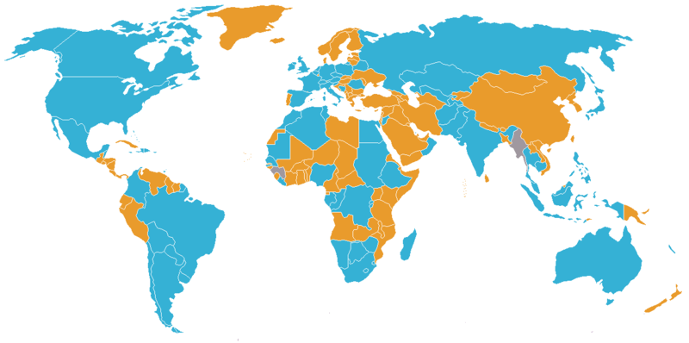
Countries with Unicameral Legislature

Slide 5
The Basics
The Prime Minister is usually, but not always a member of the party which wins the most seats.
The Knesset and the PM have the power to dissolve the Knesset and hold elections early, this normally only happens when the PM has difficulty holding together a coalition or passing a budget.
The PM is tasked with forming a coalition government and cabinet from allied political parties.

Slide 6
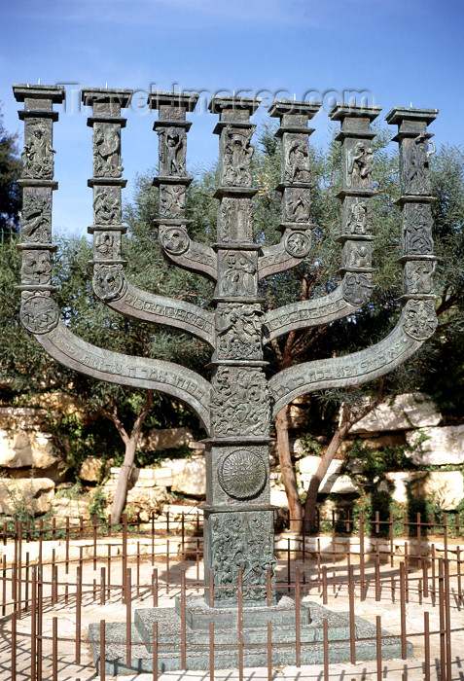
Did you Know?
Senior military officers must wait 3 years after military service before entering civilian politics
Parliamentary election campaigns use public funding, which is given to parties based on the number of seats it has in the Knesset
Israel has no constitution

Slide 7
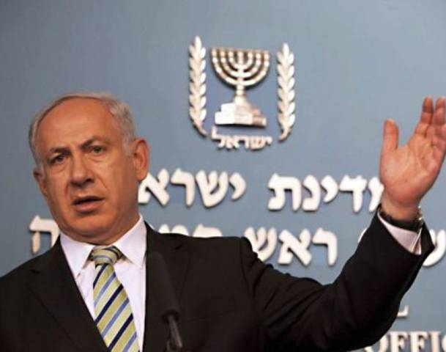
Benjamin Netanyahu became PM from the Likud Party
18th Knesset
12 Parties
Kadima – 28
Likud – 27
Yisrael Beitienu – 15
Labor – 13
Shas - 11

