Slide 1
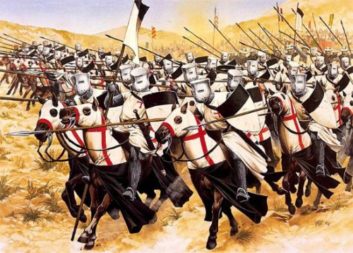
The Crusades, Mongols, and the Black Plague
SOL WHI 12b, c

Slide 2
Essential Questions
What were the key events and effects of the Crusades?
What were the effects of the Mongol invasions?
What were the effects of the Ottoman invasions of Europe?

Slide 3
Crusades

Slide 4
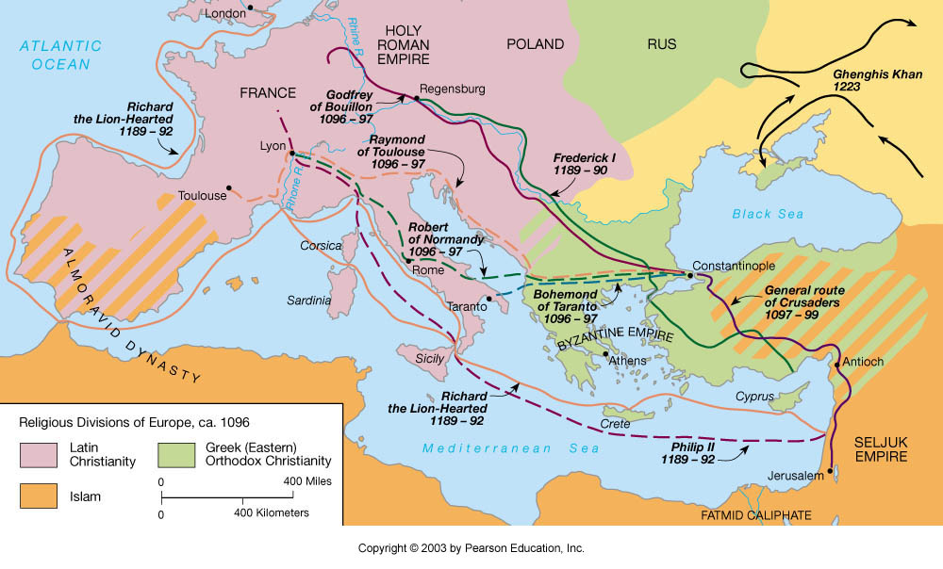

Slide 5
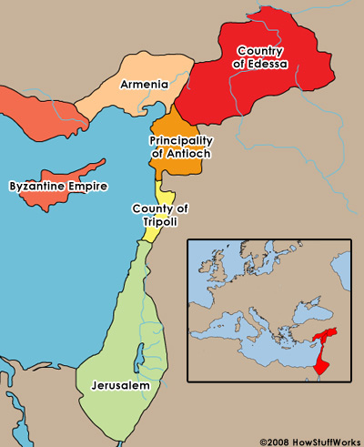

Slide 7
Effects of Crusades
Weakened the Pope and nobles; strengthened monarchs
Stimulated trade throughout the Mediterranean area and the Middle East
Left a legacy of bitterness among Christians, Jews, and Muslims
Weakened the Byzantine Empire

Slide 8
Economic Effects of the Crusades
Increased demand of Middle Eastern products such as spices
Stimulated production of goods to trade in Middle Eastern markets
Encouraged the use of credit and banking

Slide 9
The Mongols

Slide 10
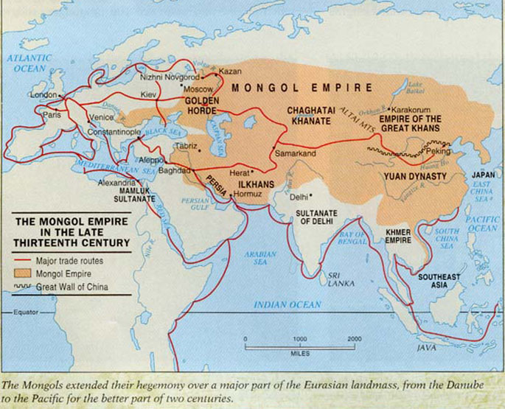

Slide 11
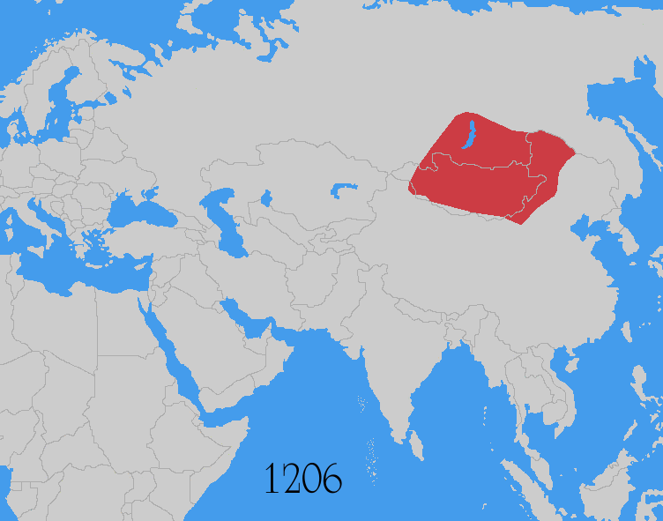

Slide 12
The Black Death (Plague)
The Black Death was the bubonic plague that spread rapidly through Europe starting in the 1300s
The Black Death killed one third of the population of Europe – more than 25 million people

Slide 13
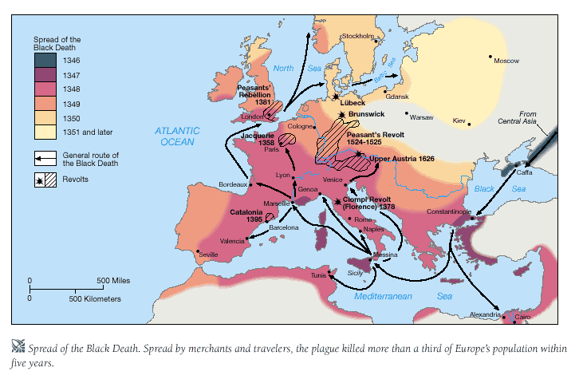

Slide 14
Impact of the Black Plague

Slide 15
Fall of Constantinople
The Byzantine Empire ended in 1453, when the Ottoman Turks took the capital of Constantinople
Constantinople became the capital of the Ottoman Empire and they changed the name to Istanbul
Muslims ruled all of Turkey and most of the Balkan Peninsula

Slide 16
