Slide 1
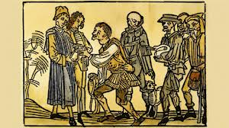
Early Middle Ages
World History SOL 9a – 9d

Slide 2
Charlemagne
Franks emerged as a force in Western Europe
Charlemagne was crowned Holy Roman Emperor by the Pope
Most of Western Europe was in the new empire
Power of the Church was established in political life
Churches, roads, and schools were built to unite the empire
Roman culture was reinterpreted

Slide 3
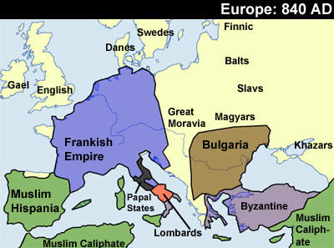
Frankish Empire

Slide 4
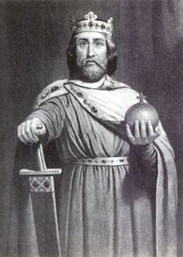
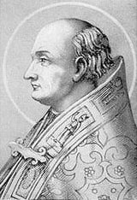
Holy Roman Emperor
Charlemagne
Pope Leo III
I gained the religion authority to revive the idea of the Roman Empire! Win for me!
I gained protection for Church lands and political influence. Win for me!

Slide 5
Feudalism
Decline of Roman influence left people with little protection. They entered into feudal agreements with landholding lords for protection.
Fief – land given to a vassal by a lord
Vassal – Someone who pledges loyalty to a lord
Serfs – Peasants who are tied to the land
Feudal Obligations – Things a peasant or vassal must do for a lord

Slide 6
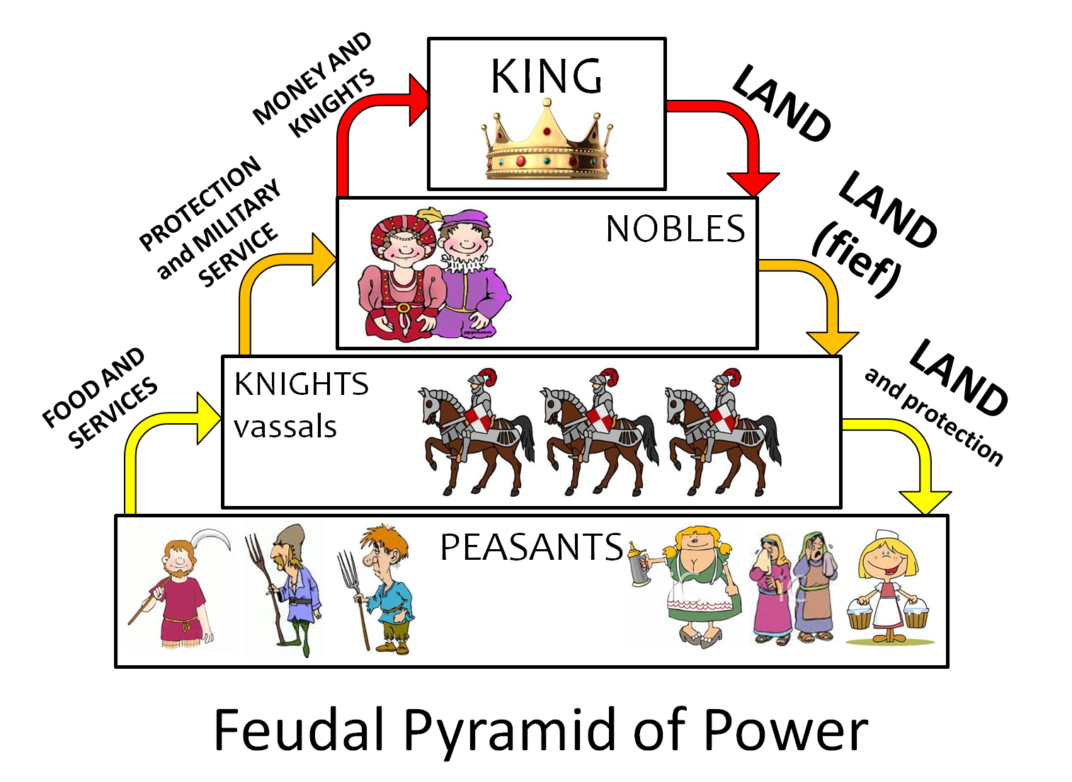
Feudal Obligations

Slide 7
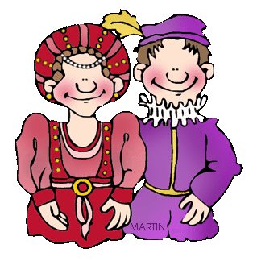
Manor
Manor – The smallest economic unit of a fief. A fief could have many manors.
Village
Church
Common Land
Mill
Blacksmith
House for lord
Life was great if you were a noble during The Middle Ages!

Slide 8
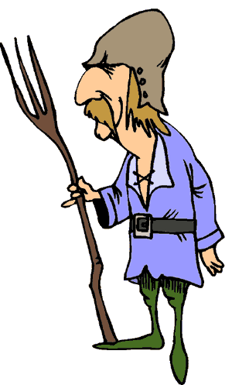
Life in the Middle Ages
I am a peasant. I am not a slave but close to it. I have to work all day except for Sunday. I don’t own my land and I have to work for my lord fixing roads or fences part of the year.

Slide 9
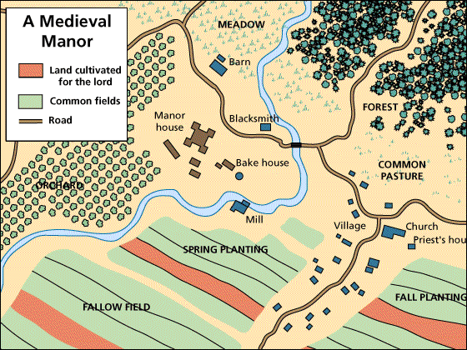
Manor

Slide 10
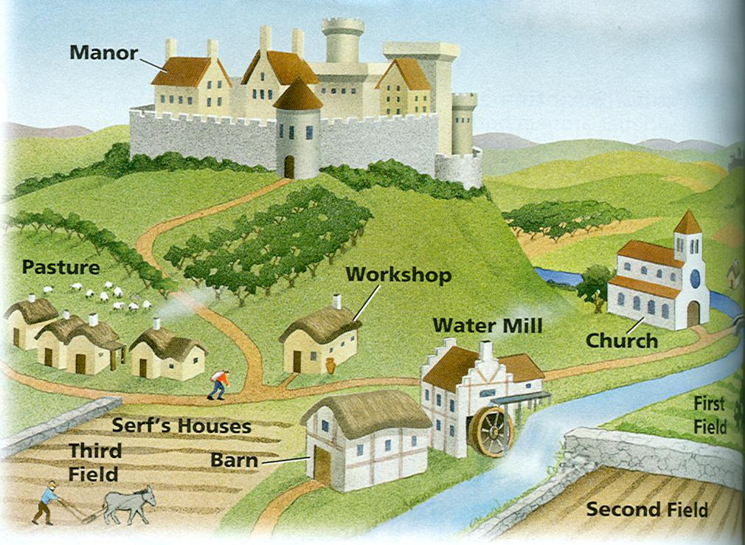
Manor

Slide 11
The Church
The Roman Catholic Church grew in importance after Roman authority decline. It became the unifying force in Western Europe.
Secular authority decline while Church authority grew.
Monasteries preserved Greco-Roman culture.
Missionaries carried Latin alphabet and Christianity to Germanic tribes.
Parish priests served religious and social needs of people.

Slide 12
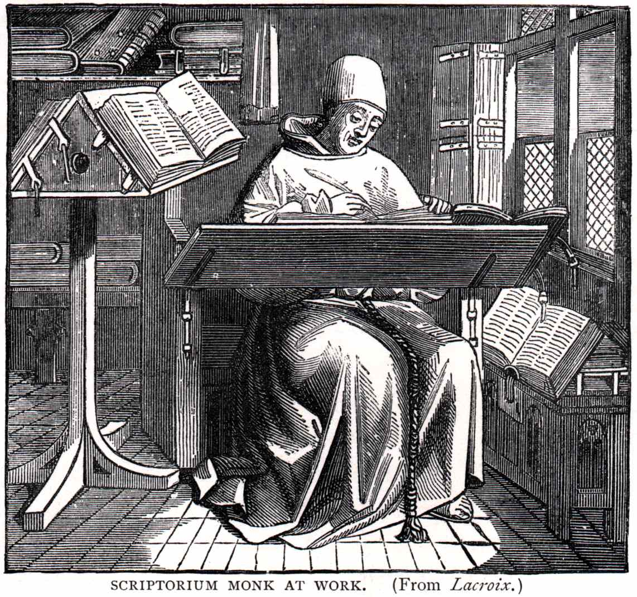
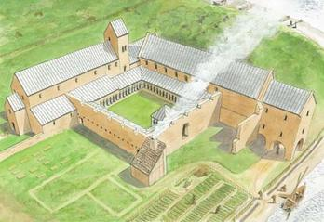
Monasteries
A monk working in a monastery.

Slide 13
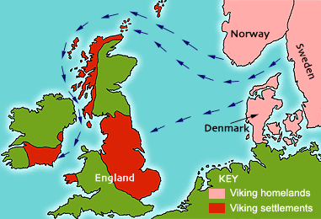
Vikings

Slide 14
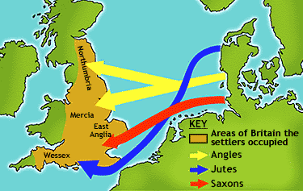
Angles, Saxons, and Jutes

Slide 15
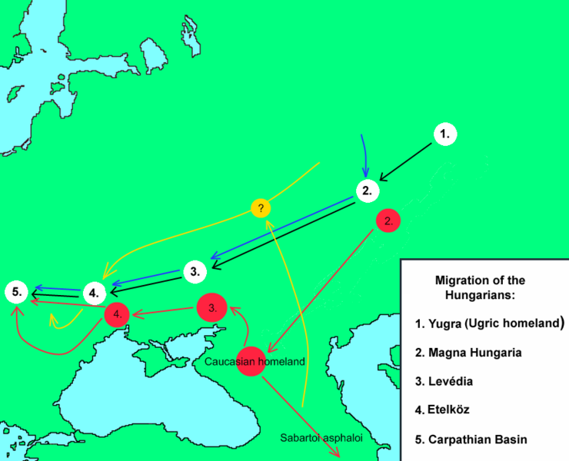
Magyars

Slide 16
Migrations

Slide 17
Effects of Migrations

Slide 18
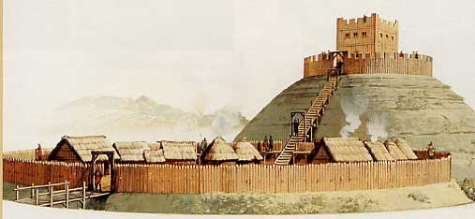
Early Castle

