Slide 1
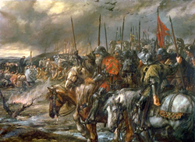
Emergence of Nation States
World History SOL WHI 12a

Slide 2
Essential Question
How did European Nation States expand their territories and consolidate their power?

Slide 3
England

Slide 4
What was common law?
Common law was a system of royal justice
Common law established royal courts
Common law was based on customs and traditions

Slide 5
What was the Magna Carta?

Slide 6
Parliament
The King of England had to summon his nobles to a council in order to raise taxes
The council had nobles, clergy, and commoners
The council became known as Parliament

Slide 7
Hundred Years War

Slide 8
Hundred Years War

Slide 9
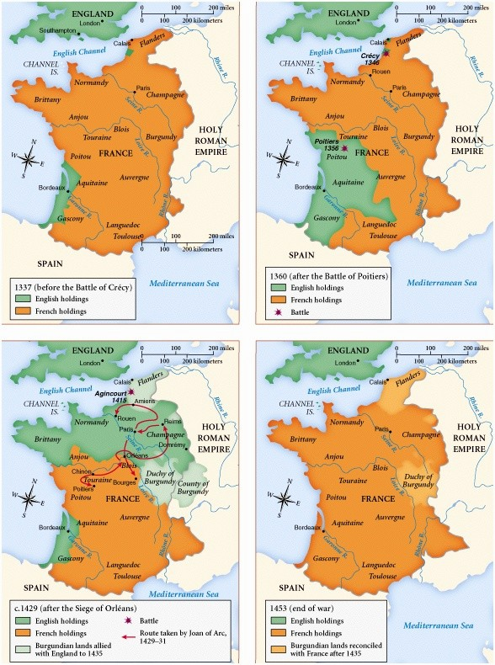

Slide 10
France
Hugh Capet elected King of France in 987
Hugh Capet and his heirs increased royal power
The Hundred Years War also helped define France as a country

Slide 11
Spain (Reconquista)

Slide 12
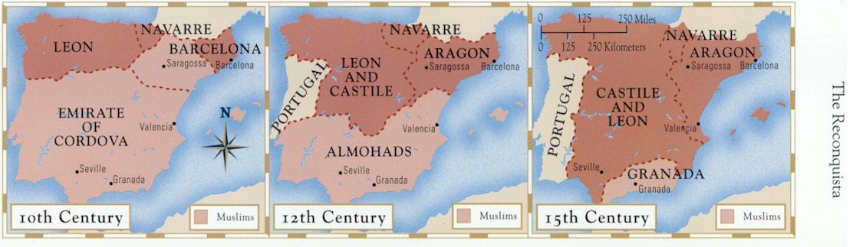

Slide 13
Spain

Slide 14
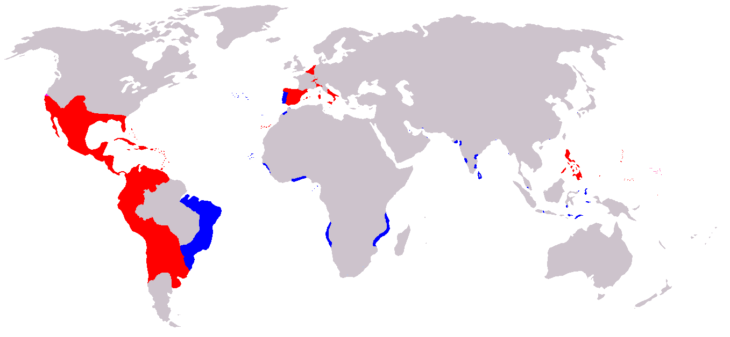

Slide 15
Russia

