Slide 1
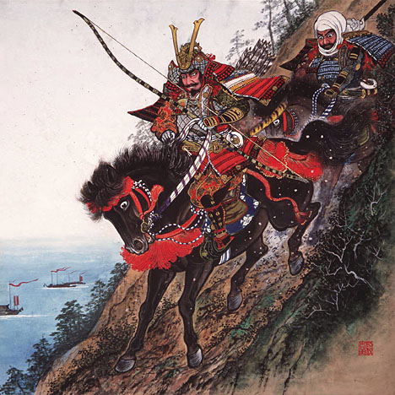
Africa and Asia
World History
SOL WHI 10c, d

Slide 2
Essential Questions

Slide 3
Essential Questions

Slide 4
Japan Location and Place

Slide 5
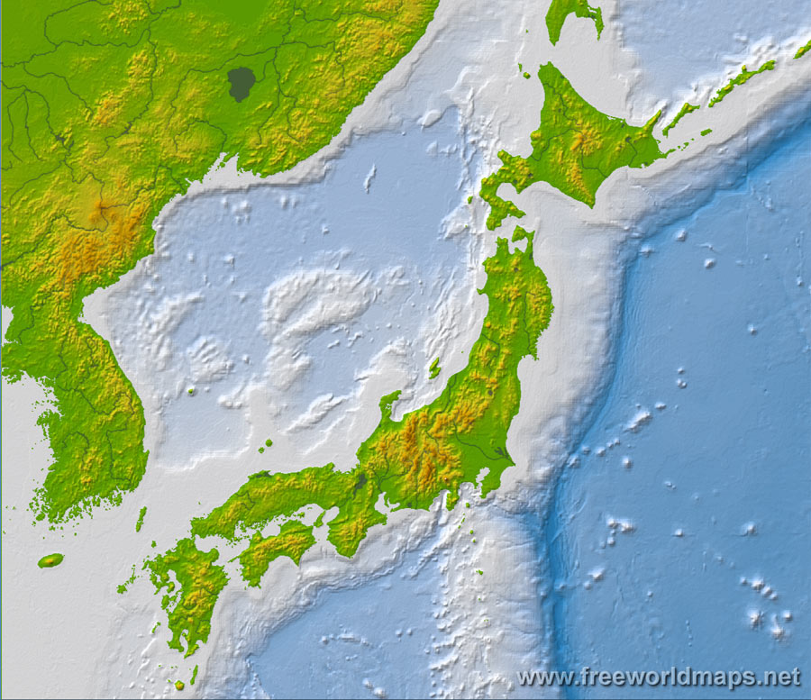
Hokkaido
East Sea or
Sea of Japan
Korean
Peninsula
Honshu
Korean Strait
Shikoku
Kyushu

Slide 6
Chinese Influences on Japan

Slide 7
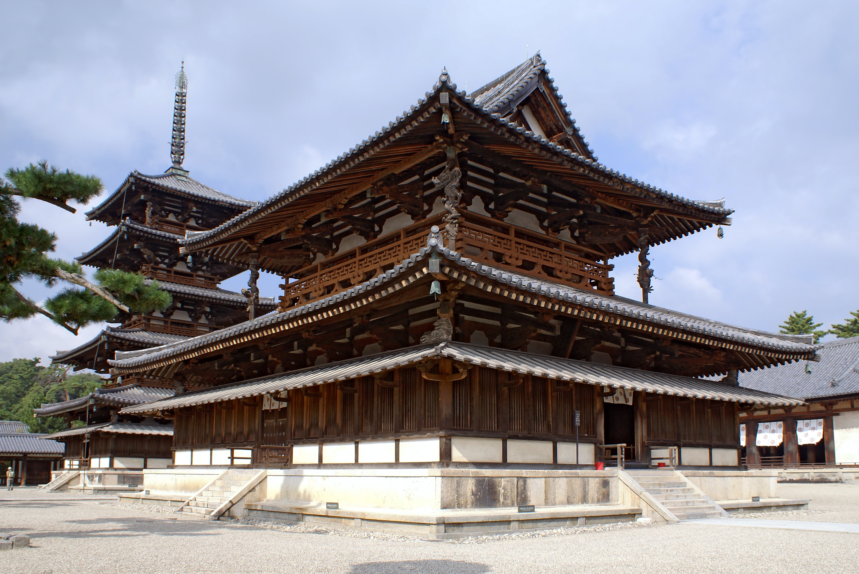
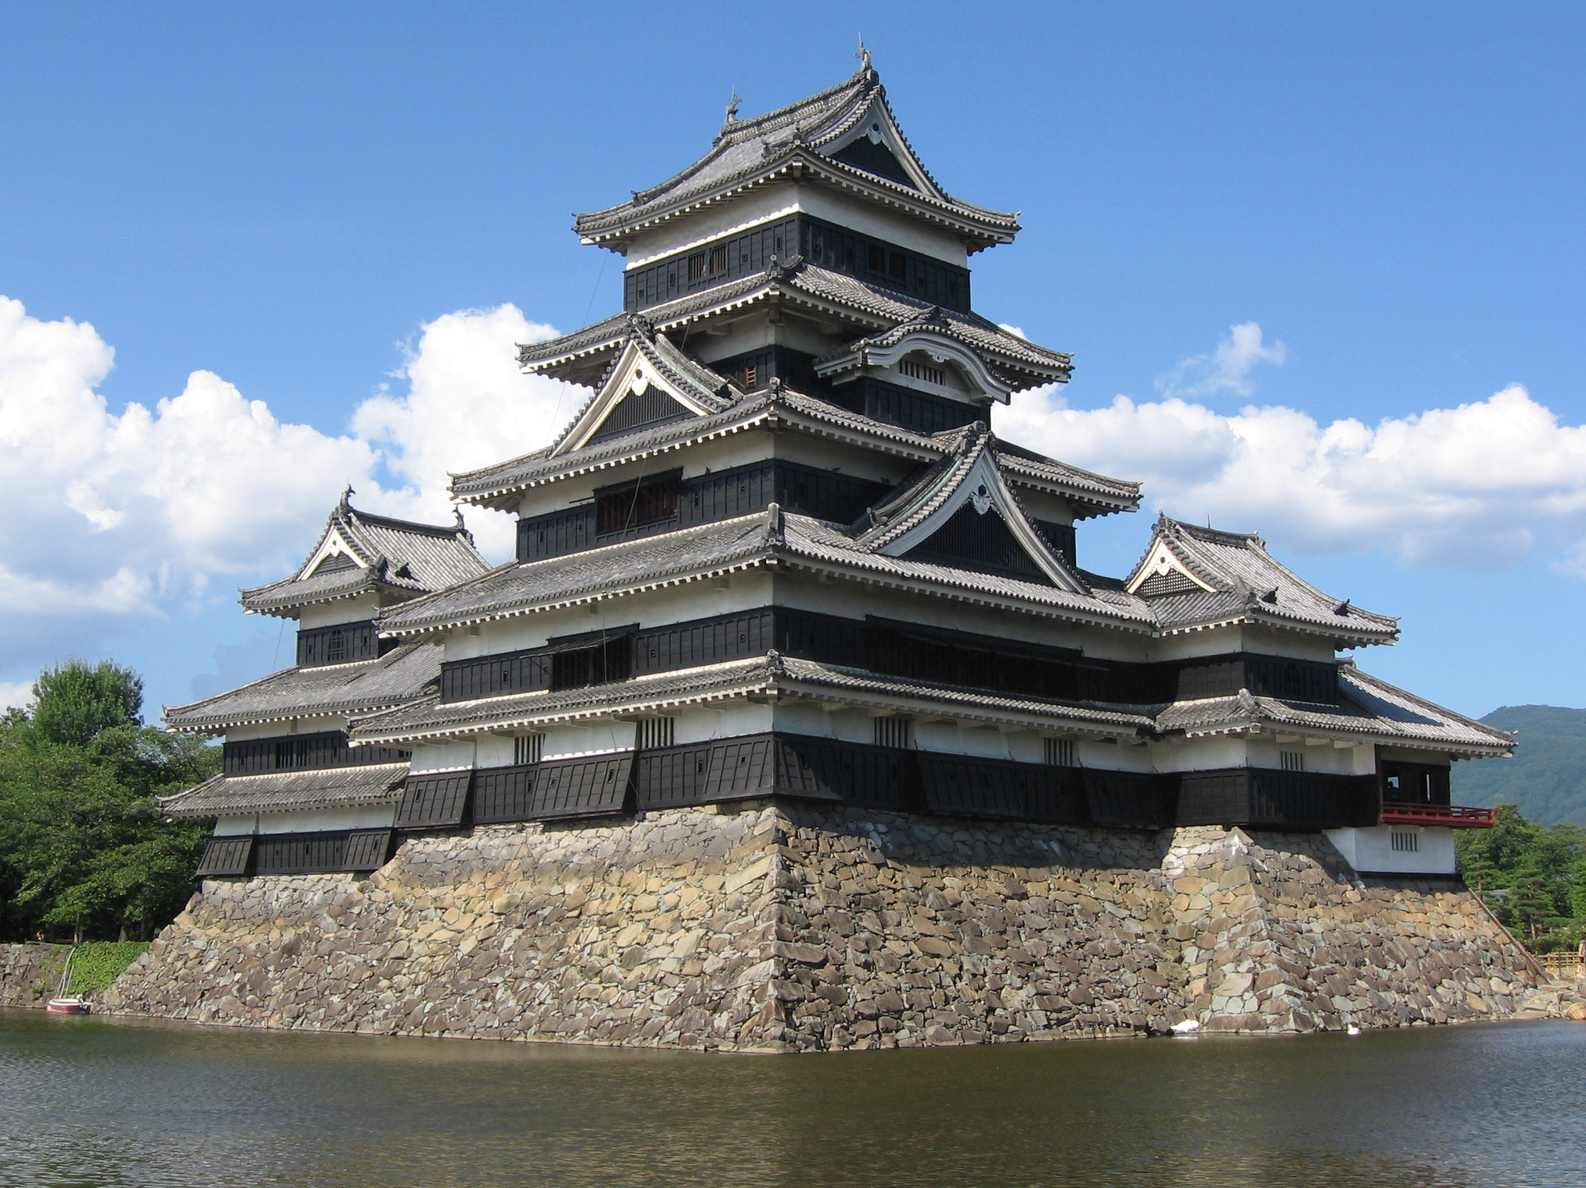
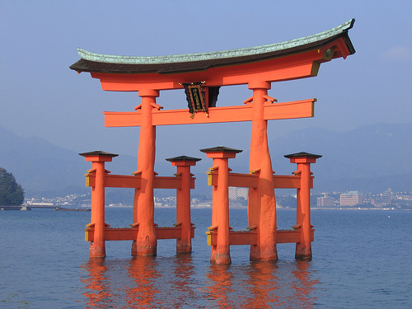
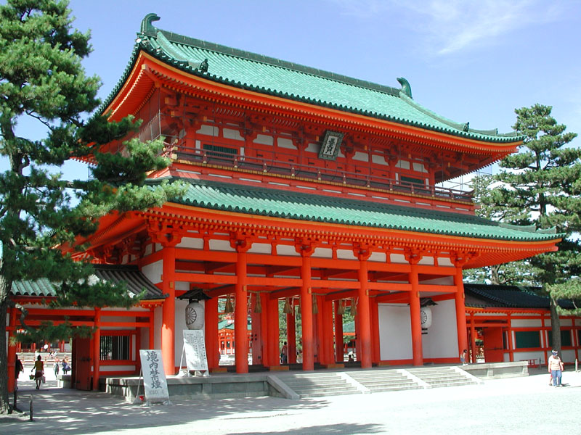

Slide 9
Shintoism and Kami
Kami
Kami are spirits or gods in Shintoism
When a person dies they become a kami, therefore there is an element of ancestor worship in Shintoism
The emperor of Japan was considered a kami
Natural features can be kami
Shinto beliefs have blended with Buddhist beliefs
There are shrines to kami around Japan

Slide 11
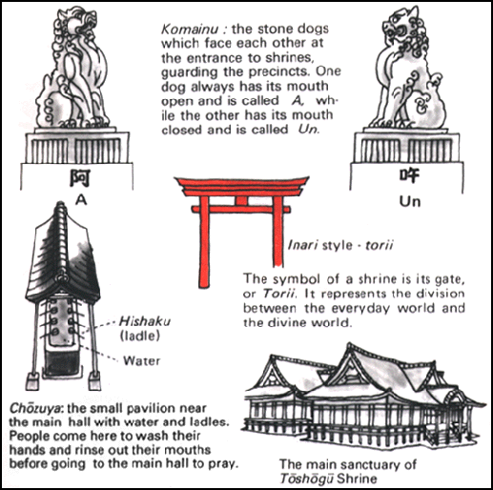

Slide 12
African Civilizations
Axum (Northeast Africa)
Zimbabwe (Southeast Africa)
Ghana (West Africa)
Mali (West Africa)
Songhai (West Africa)

Slide 13
Ghana, Mali, Songhai
West African Kingdoms located near Niger River and Sahara Desert
Economy relied on the Trans-Sahara trade route. Salt, gold, and ivory was traded for Mediterranean goods.
City of Timbuktu was center of trade and Islamic learning
The religion of Islam spread peacefully into West Africa

Slide 14
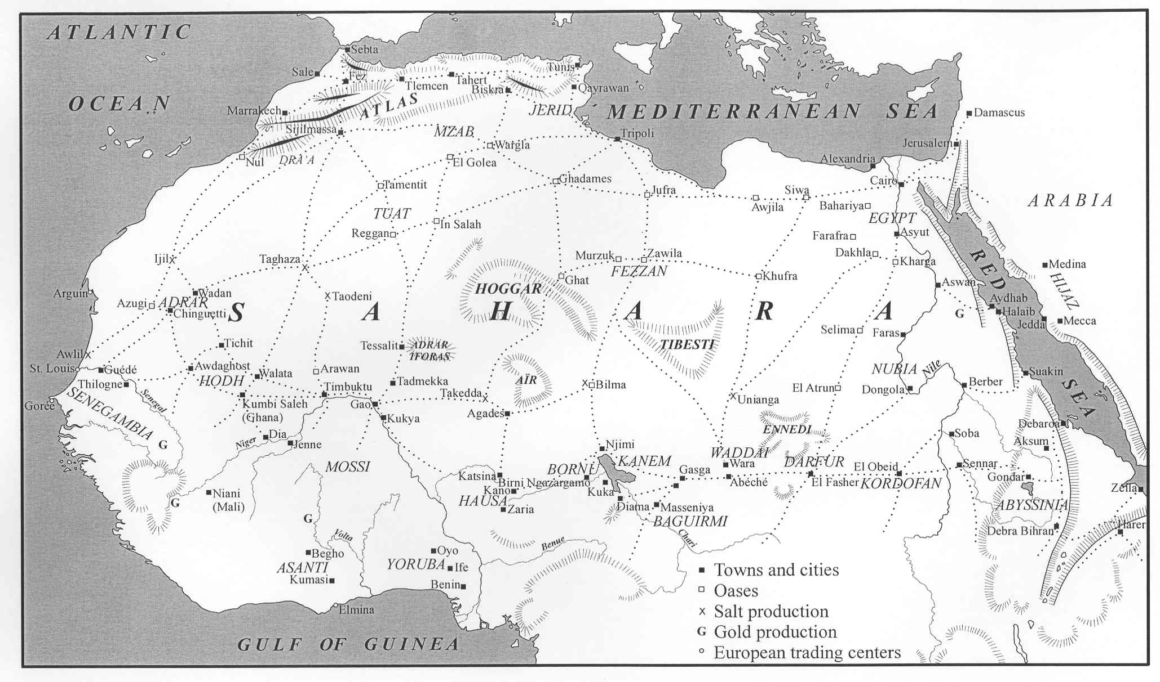

Slide 15
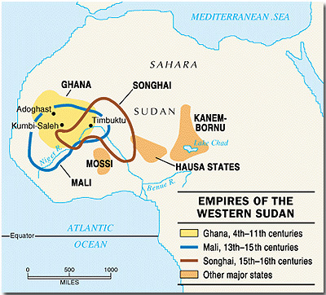

Slide 16
Great Zimbabwe
African Kingdom in Southeastern Africa between the Limpopo and Zambezi Rivers
Economy based on gold and ivory trade to East Africa and from the Indian Ocean trade to India and East Asia
Religion was animism

Slide 17
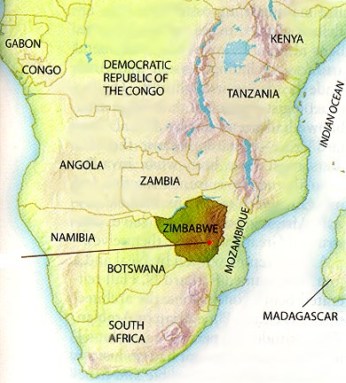

Slide 18
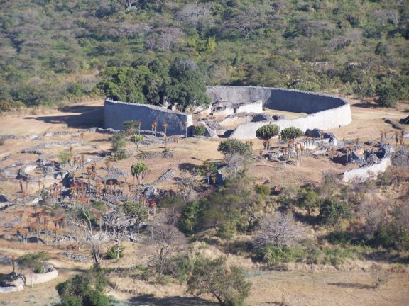
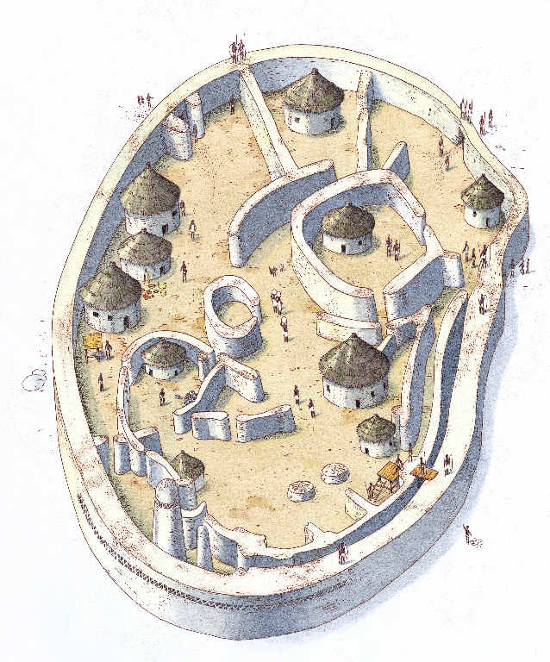
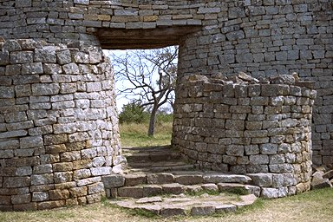

Slide 19
Axum
Located in the Ethiopian Highlands near the source of the White Nile River and extended to the Red Sea
Economy based on trade of gold, ivory, and animal hides with interior Africa and India/Arabia
Axum’s king converted to Christianity around 300 C.E. making it a Christian kingdom

Slide 20
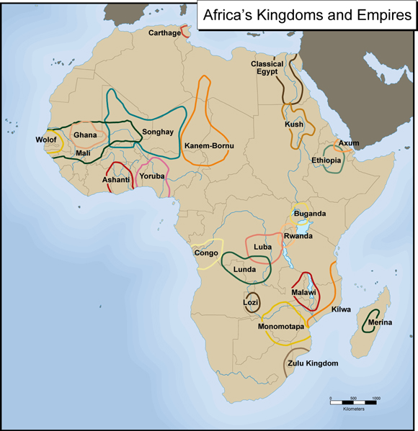

Slide 21
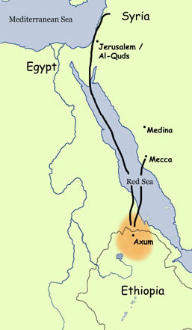
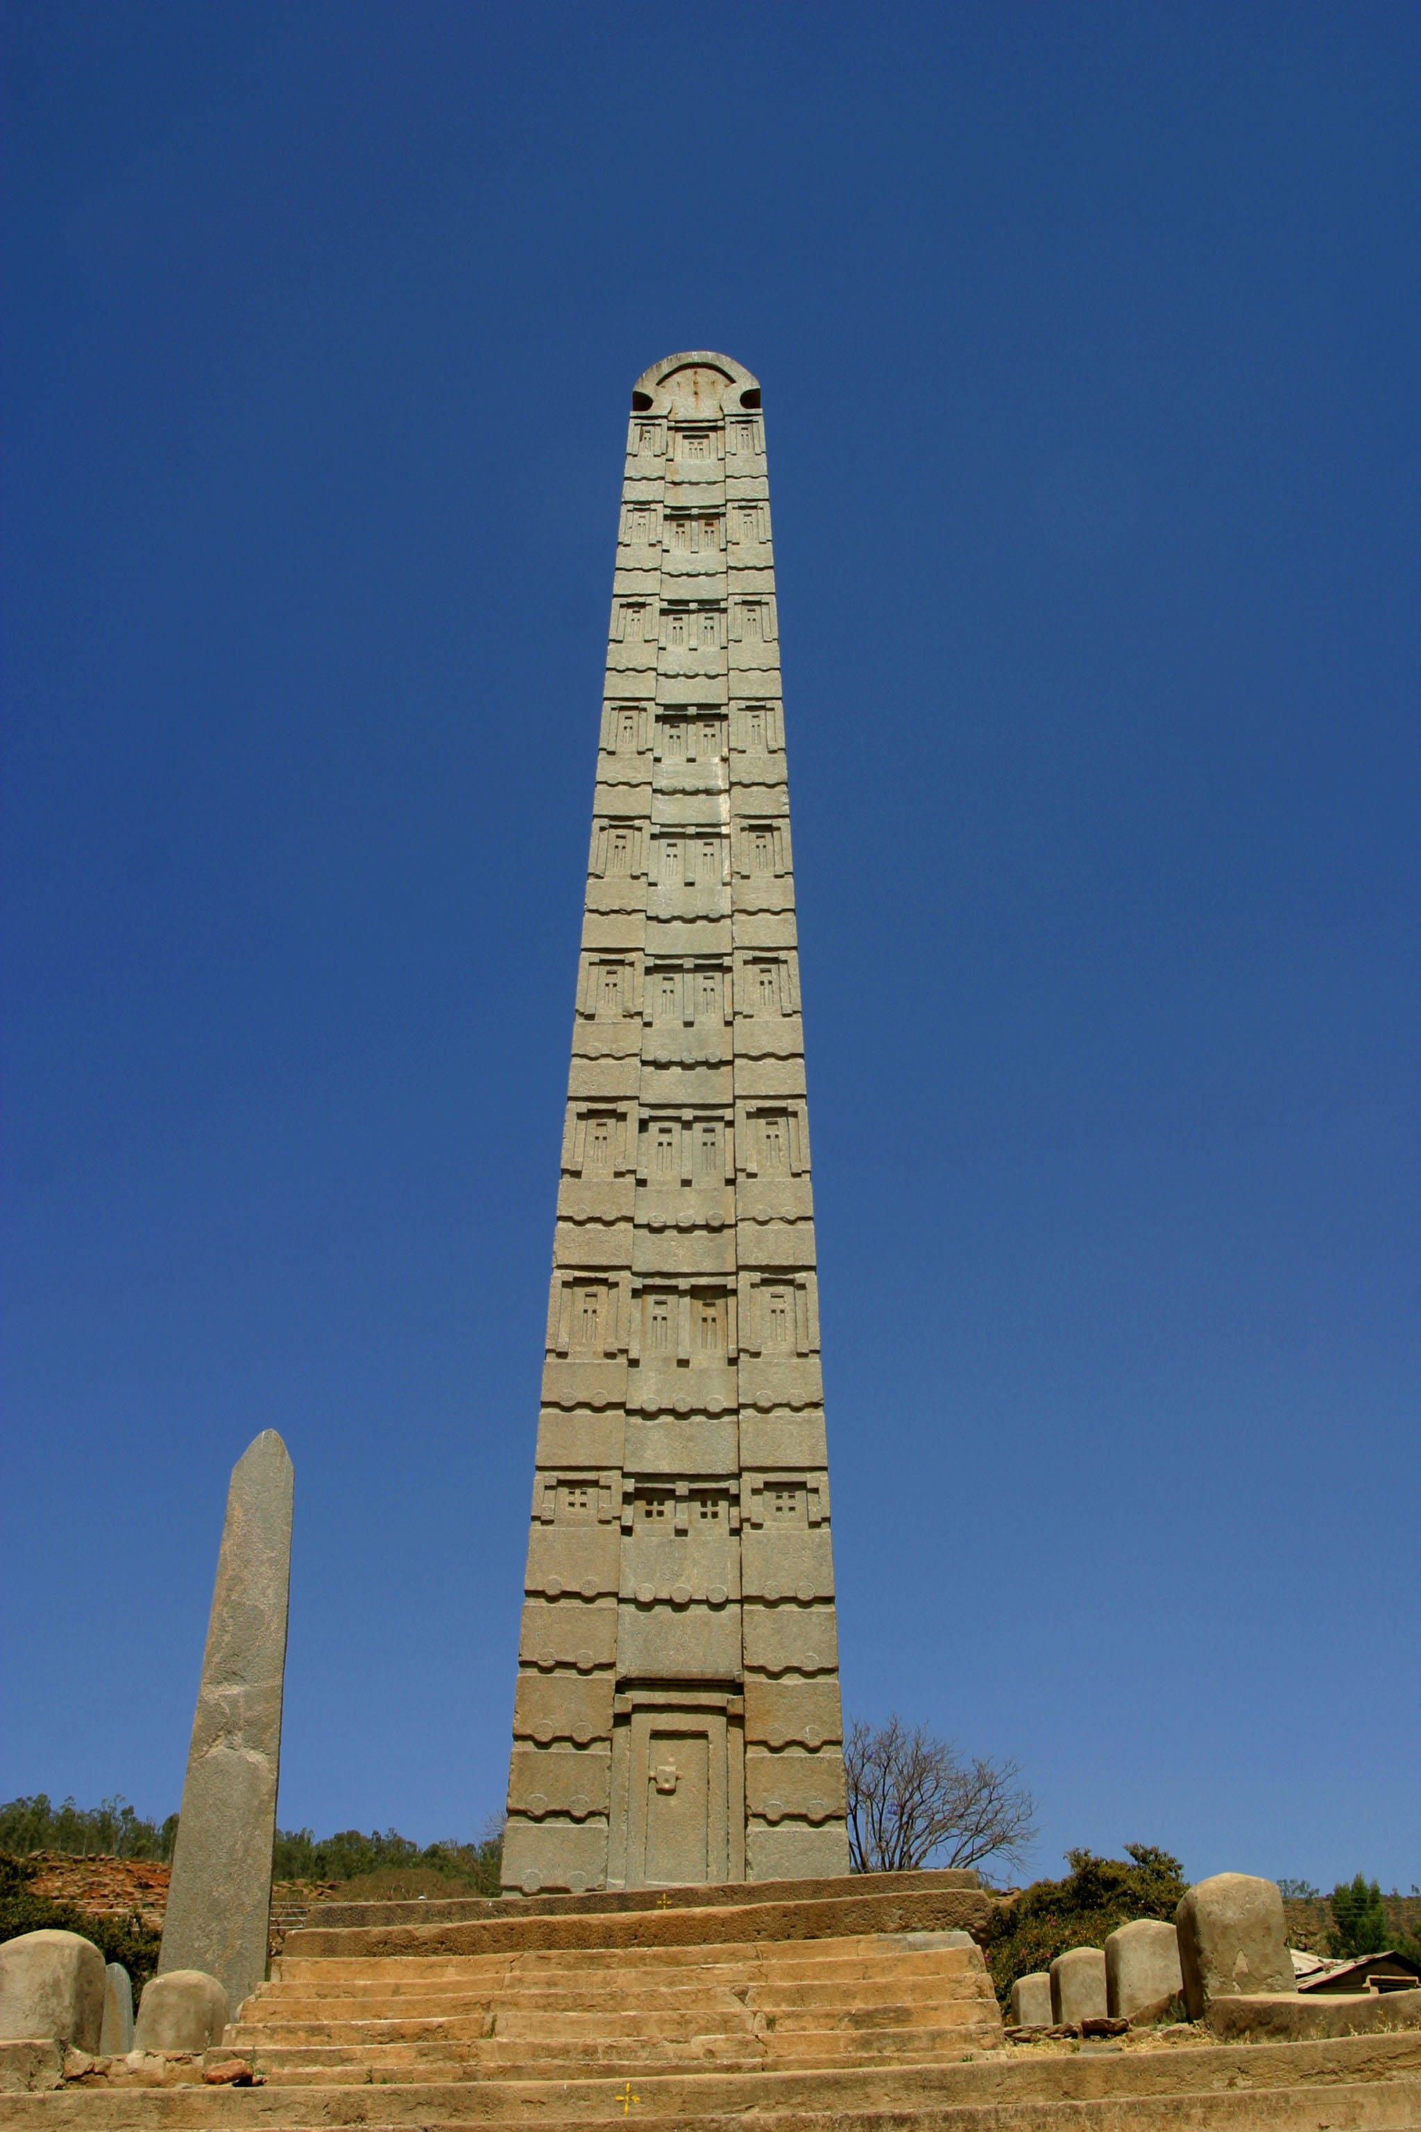

Slide 22
Ghana, Mali, Songhai | Axum | Zimbabwe
Located near Niger River and Sahara Desert in West Africa | Located near White Nile and Red Sea, Ethiopian Highlands | Located between Limpopo and Zambezi Rivers in Southeastern Africa
Traded gold, ivory, salt on the Trans-Sahara trade route | Trade gold, ivory, animal hides to Red Sea and Indian Ocean | Traded gold and ivory to East Africa and Indian Ocean
Converted peacefully to Islam | Converted to Christianity | Animistic
Timbuktu became center of Islamic learning and culture | Capital city was Axum, located in Ethiopia today | Largest city was Great Zimbabwe
800 – 1500 CE | Kingdom at its greatest around 300 – 400 CE | Important trading center from 1300 – 1500 CE

