Slide 1
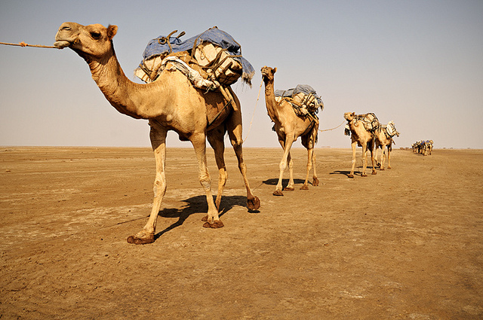
Trade Networks
World History
SOL WHI 10 a

Slide 2
Essential Questions

Slide 3
Essential Questions

Slide 4
Silk Road
Major trade route from East Asia to the Middle East
Items traded – Silk, Porcelain, Spices
Innovations – Paper, compass, gunpowder
Religion – Buddhism from India into China

Slide 5
Indian Ocean Maritime Trade
Major trade route connecting East Africa, Middle East, and South Asia
Items traded – Textiles, spices, gold, ivory
Innovations – Lateen sail to Middle East and Europe from India
Spread of Religion – Islam spread to East Africa and Southeast Asia, Hinduism and Buddhism spread from India to Southeast Asia

Slide 6
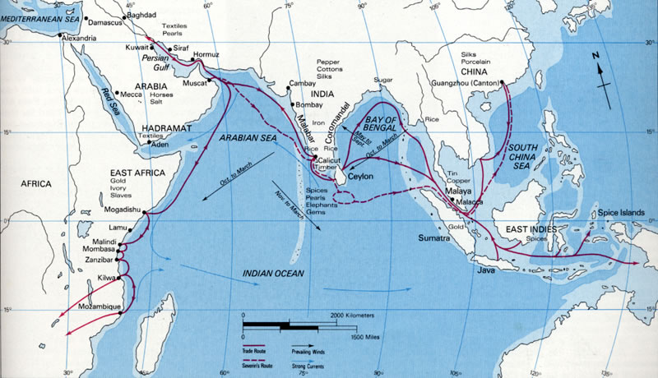

Slide 7
Trans-Sahara Trade Route
Major trade route across the Sahara Desert in North Africa, connected Mediterranean lands with Sub-Saharan Africa
Items traded – Gold, salt, ivory
Spread of Religion – Islam spread into North Africa

Slide 8
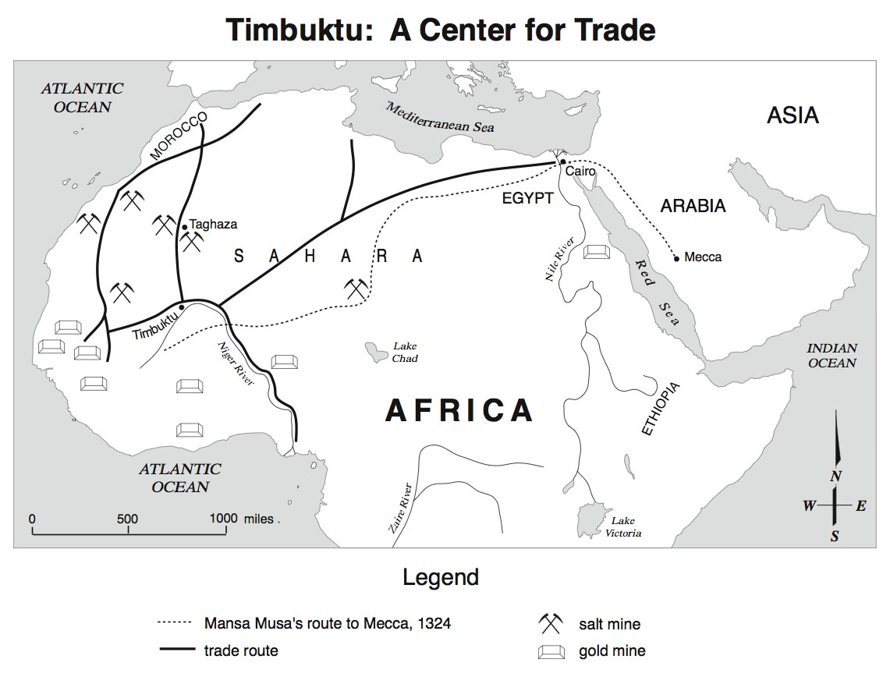

Slide 9
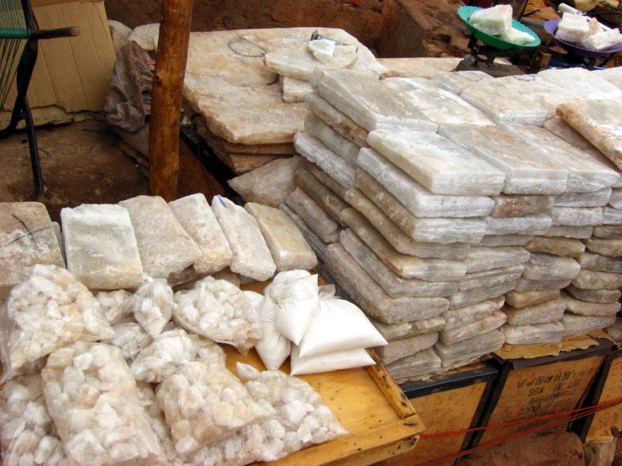
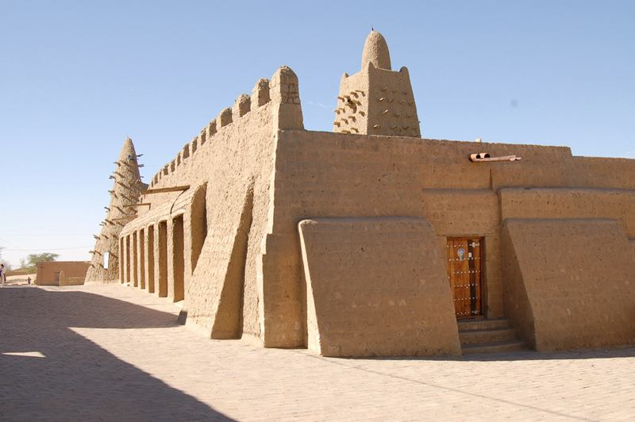

Slide 10
Northern European Trade
Major trade route from the Baltic Sea region south to Black Sea and West to Western Europe
Items traded – furs, amber, fish, and timber from Northern Europe to Southern Europe
Spread of religion – Christianity spread into Northern Europe (Catholic and Orthodox)

Slide 11
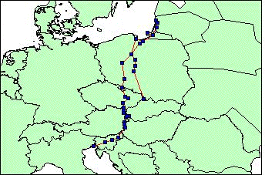
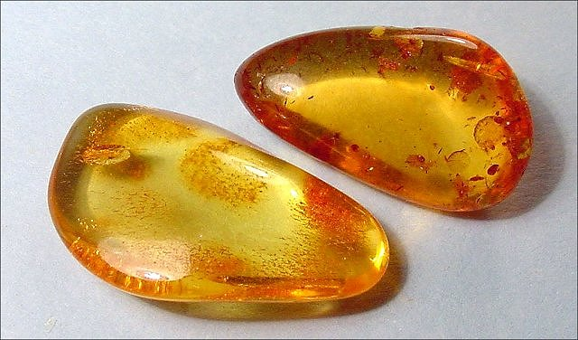

Slide 12
South China Sea Trade
Major trade route from Southeast Asia to China and Korea
Items traded – Porcelain, silk, textiles, from China and spices from Southeast Asia
Spread of Religion – Buddhism to China, Korea, Japan

Slide 13
China | South Asia (India) and Southeast Asia | Africa/Middle East | Europe
Silk, porcelain, textiles | Textiles, spices | Gold, slaves, salt, ivory, animal hides | Timber, amber, fish, furs
Paper, compass, gunpowder, waterwheels, windmills, printing (paper money) | New crops such as sugar, lateen sail
 | Hinduism and Buddhism to China, Korea, Japan, and Southeast Asia | Islam from Middle East to Africa, India, Southeast Asia

