Slide 1
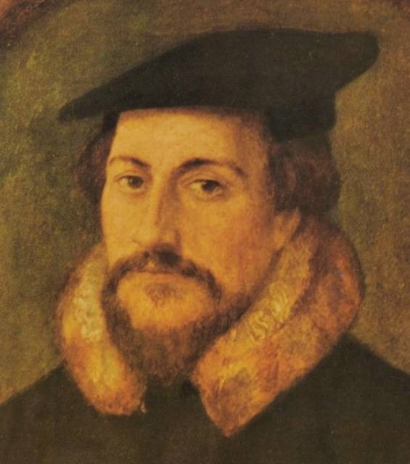
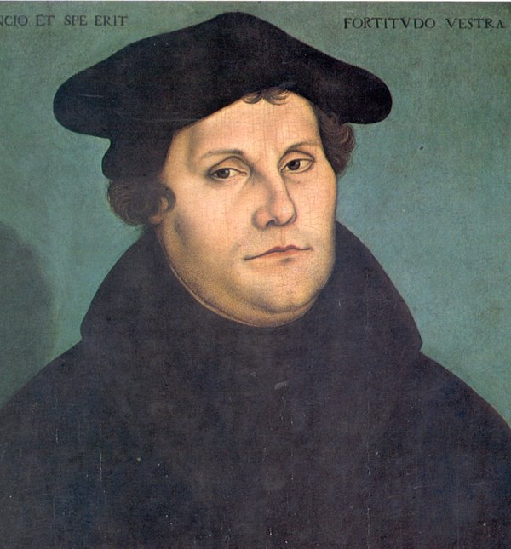
Reformation

Slide 2
What was the Reformation?
The Reformation was a time during the 1500s when people tried to reform the Catholic Church because they disagreed with Church practices and corruption.
The Reformation started in northern Europe and was most successful in Germany, Scandinavia, England, and Switzerland

Slide 3
Why did people want to reform?

Slide 4
Dissenters to the Catholic Church
Jan Huss – Czech Priest who was burned at the stake in 1415, for preaching against the Catholic Church
John Wycliffe – English philosopher and preacher who tried to reform the Church. He died in 1384, of natural causes.

Slide 5
Reformers
Martin Luther | John Calvin
Salvation by faith alone Bible is ultimate authority All humans are equal before God Wrote 95 theses | Predestination Faith revealed by living a righteous life Strong work ethic
Views led to birth of the Protestant Movement | Expanded the Protestant Movement in Europe

Slide 6
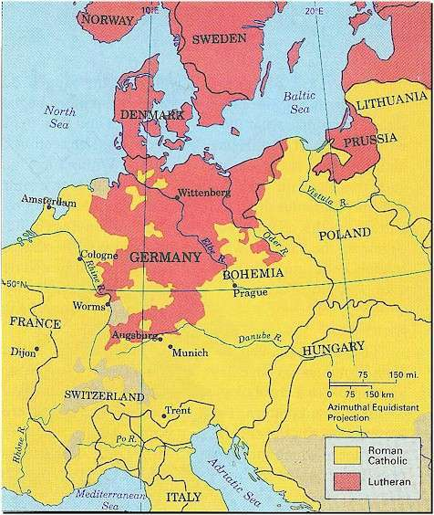

Slide 7
Reformers
Henry VIII (1509 – 1547) | Elizabeth (1558 – 1603)
King of England who wanted a divorce but the Pope would not give him a divorce Dismissed authority of Pope in Rome Established Anglican Church in England (Act of Supremacy) Appropriated land and wealth of Catholic Church in England | Daughter of Henry VIII Established tolerance for Catholics in England (Elizabethan Settlement) Expanded British Empire Defeated the Spanish Armada in 1588

Slide 8
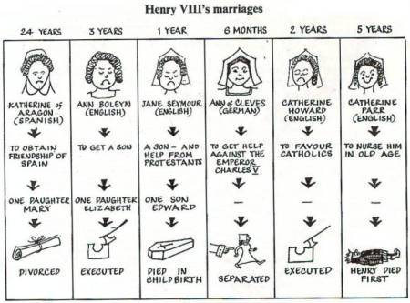

Slide 9
Why did Spain try to invade England?
Phillip II of Spain tried to invade England with a large fleet of ships called the Spanish Armada
Spain was the most powerful country in the world and everyone thought he would win
Phillip had married Elizabeth’s sister Mary and when Mary died he said he was King of England
Phillip was Catholic and a supporter of the Pope

Slide 10
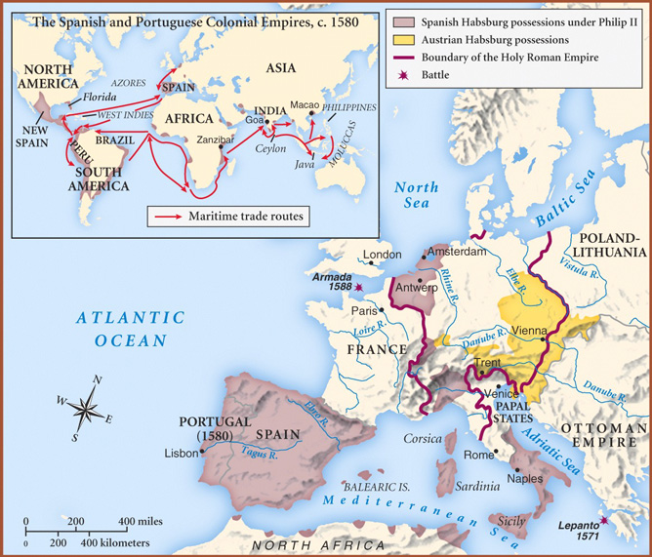

Slide 11
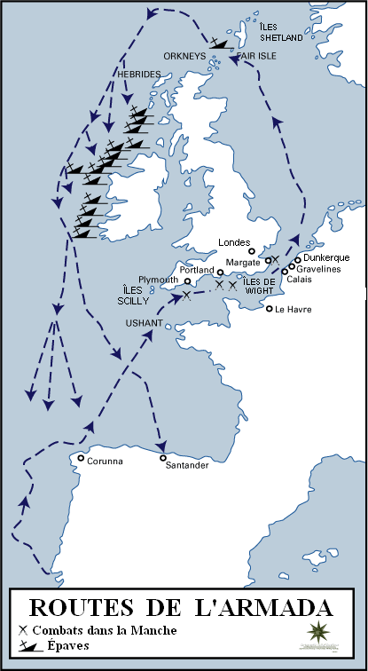
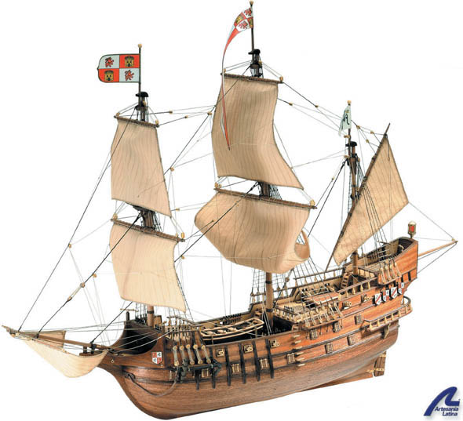

Slide 12
Reformation in Germany

Slide 13
Reformation in France

Slide 14
Counter Reformation

Slide 15
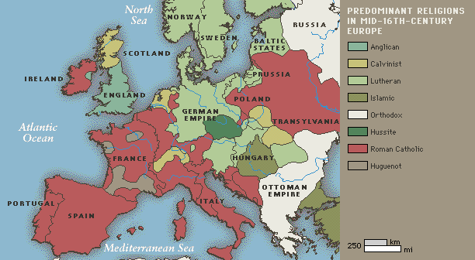

Slide 16
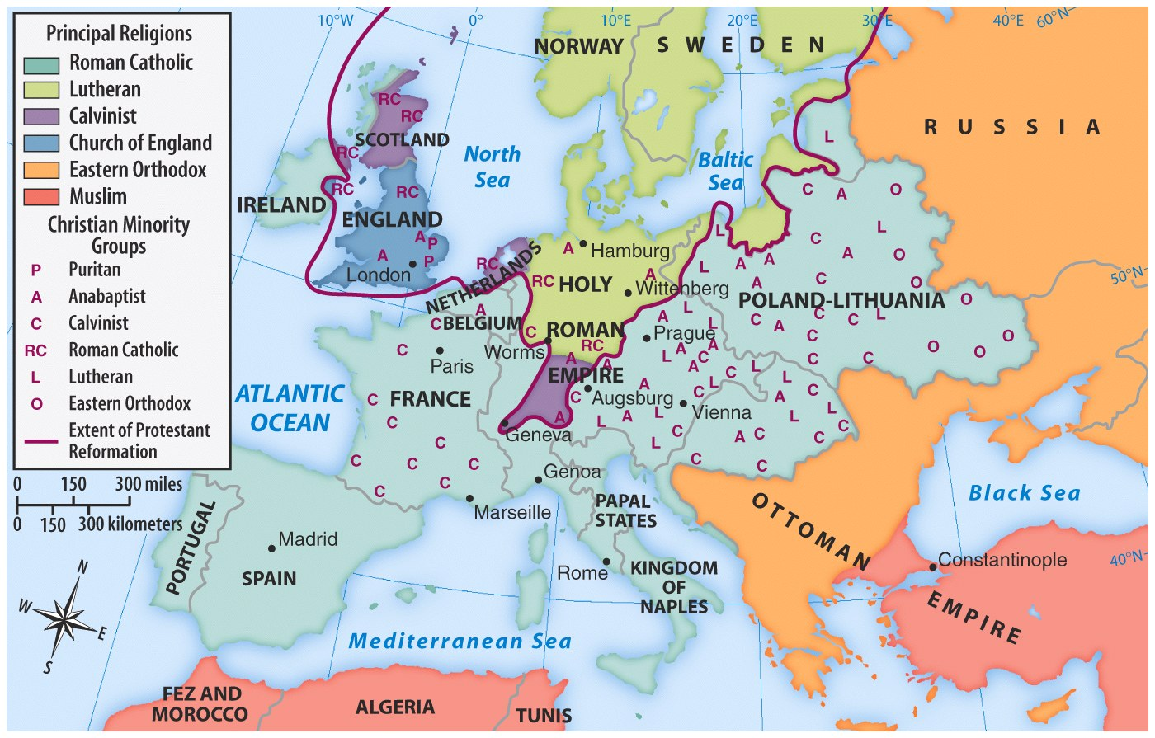

Slide 17
Changing Cultural Values During Reformation

Slide 18
Scientific Revolution

Slide 19
Scientific Revolution

Slide 20
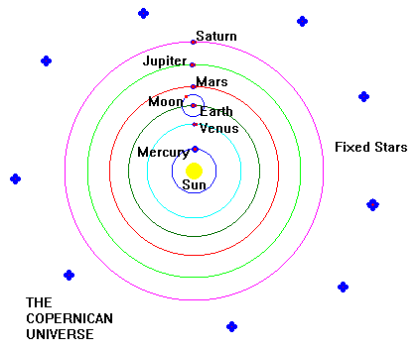
Heliocentric Theory

Slide 21
Importance of the Scientific Revolution

