Slide 1
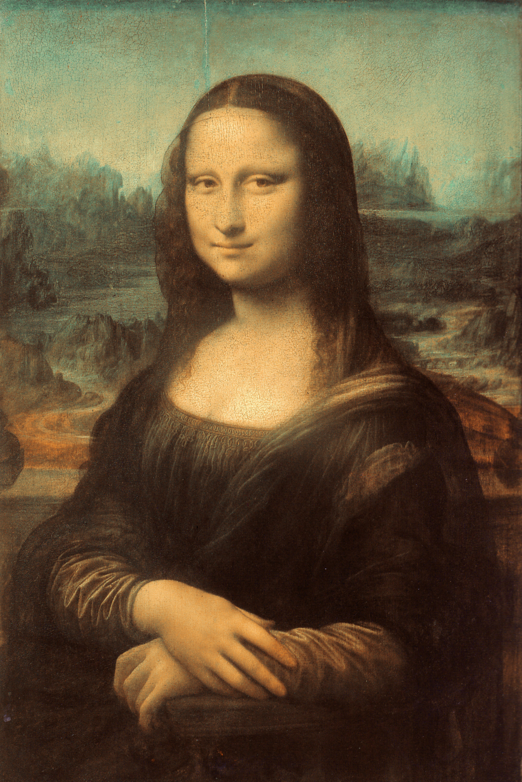
Renaissance
SOL 13 a - d

Slide 2
Essential Questions

Slide 3
What was the Renaissance?
Renaissance means rebirth. It was a time from the 1300s – 1500s when Greek and Roman knowledge was reintroduced to Europe.
The Renaissance stimulated new forms of art, literature, and scholarship.
The Renaissance began in the Italian city-states and moved to northern Europe.

Slide 4
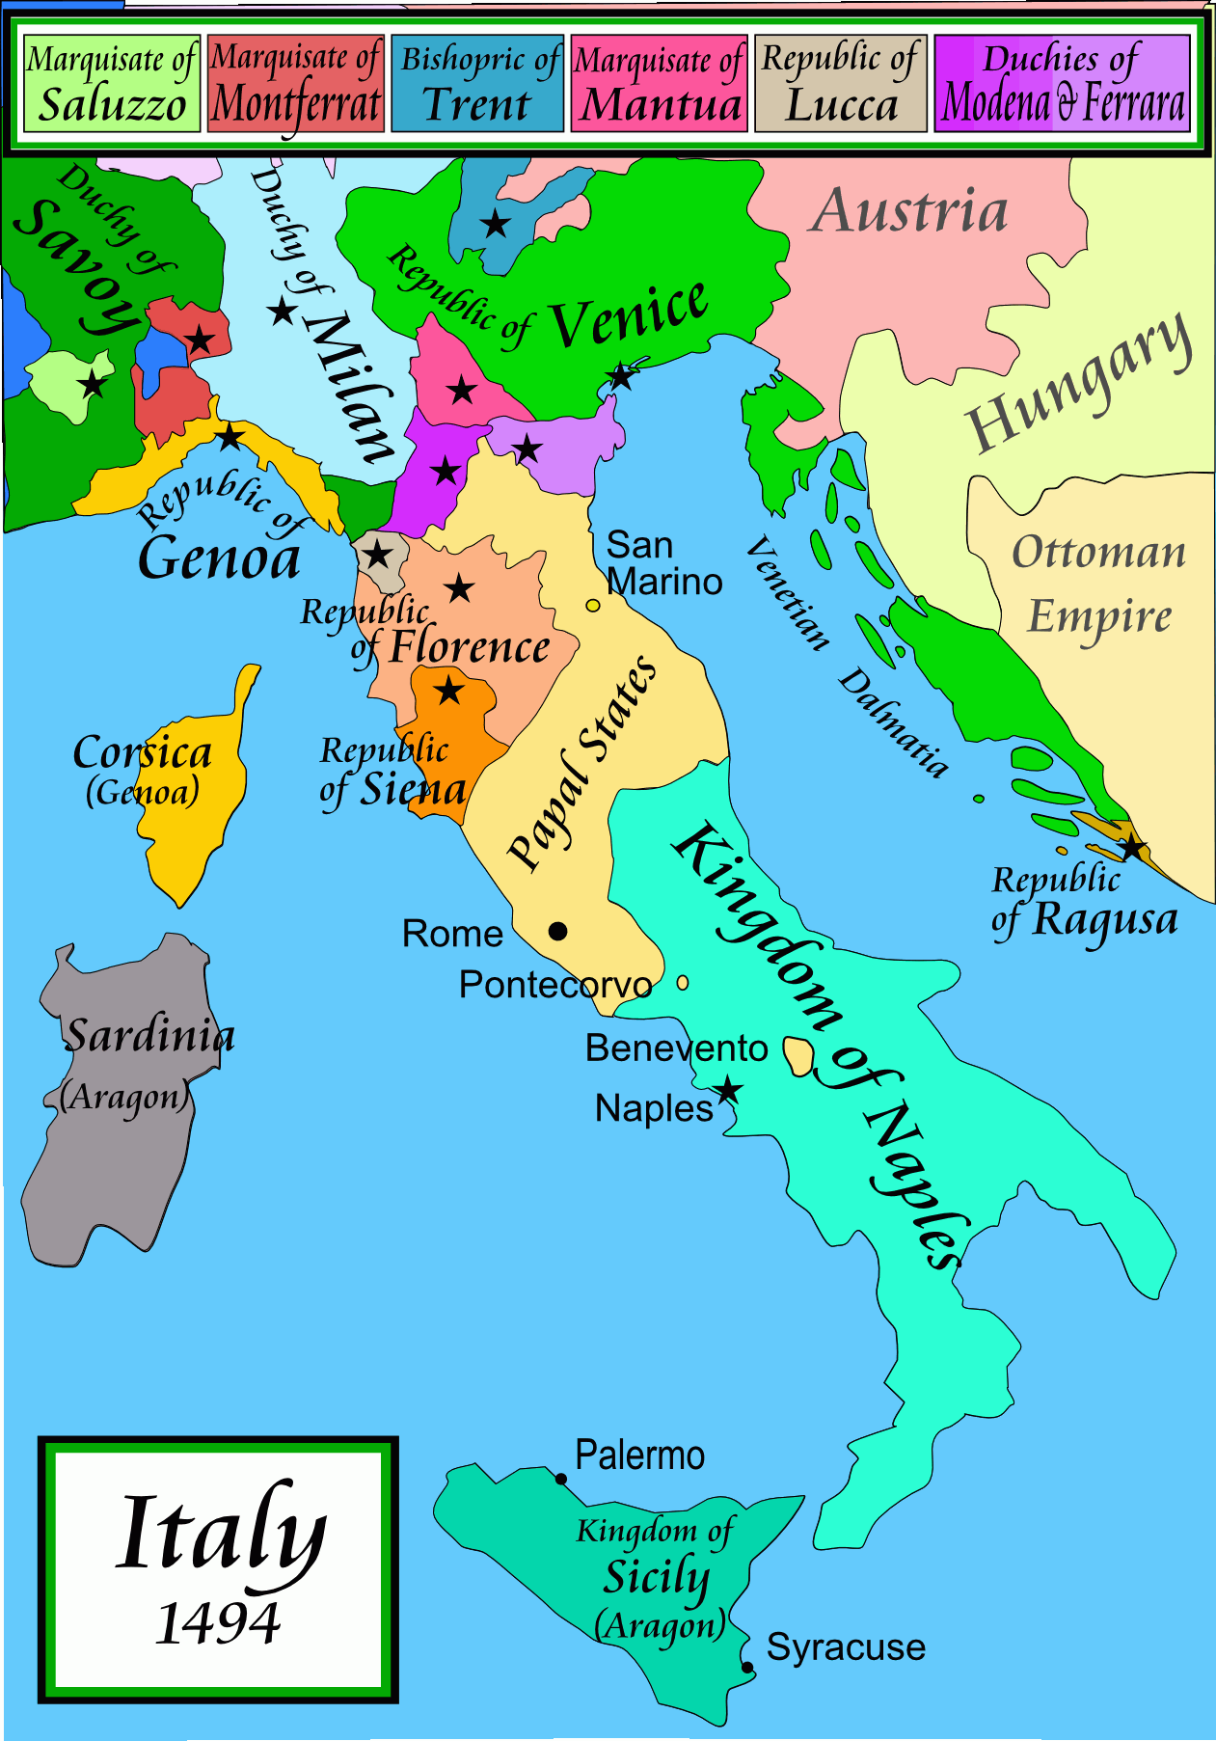

Slide 5
Why did the Renaissance happen in Italy?

Slide 6
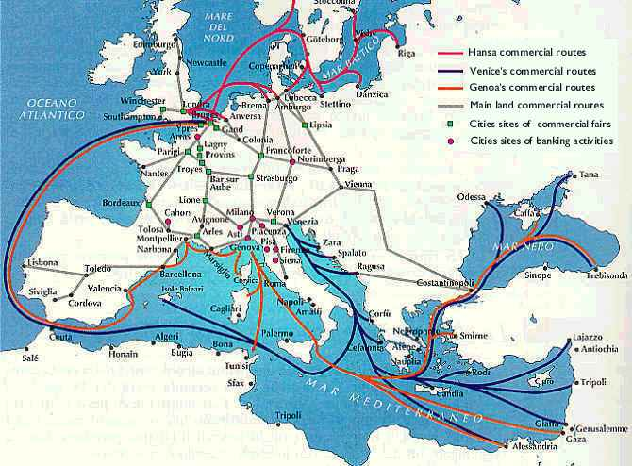

Slide 7
Machiavelli

Slide 8
Renaissance vs. Middle Ages
Renaissance | Middle Ages
Renaissance art and literature focused on individuals and worldly matters, along with Christianity | Medieval art and literature focused on the Church and salvation

Slide 9
Renaissance
Artists | Writers
Leonardo da Vinci – Mona Lisa, Last Supper Michelangelo – Ceiling of the Sistine Chapel and statue of David | Petrarch – Sonnets, humanist books Erasmus – The Praise of Folly Sir Thomas More – Utopia Machiavelli – The Prince

Slide 10
Humanism

Slide 11
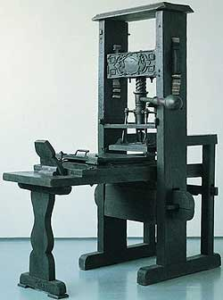
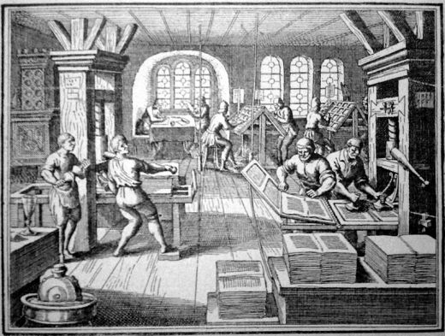
The Printing Press

Slide 12
Mona Lisa by Leonardo da Vinci

Slide 13
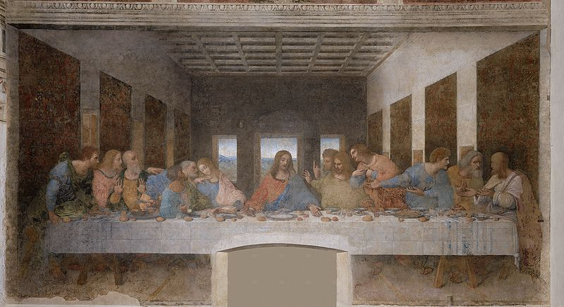
Last Supper by Leonardo da Vinci

Slide 14
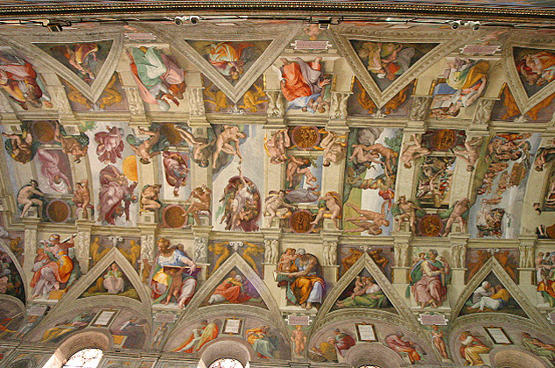
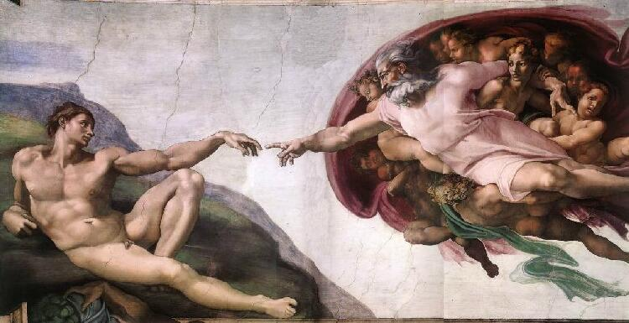
Ceiling of Sistine Chapel painted by
Michelangelo

Slide 15
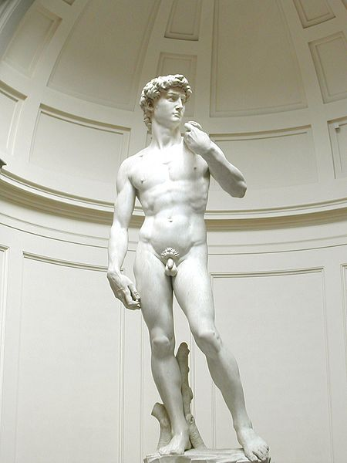
Statue of David carved by Michelangelo

