Slide 1
Chinese Civilizations
World History
SOL WHI 4E, F

Slide 2
Essential Questions
Why was the Great Wall of China Built?
What were the contributions of classical China to world civilization?
Why were Confucianism, Taoism, and Buddhism important to the development of Chinese culture?

Slide 3
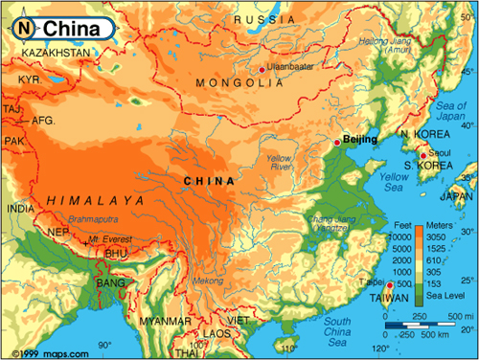
Physical Geography

Slide 4

Physical Geography

Slide 5
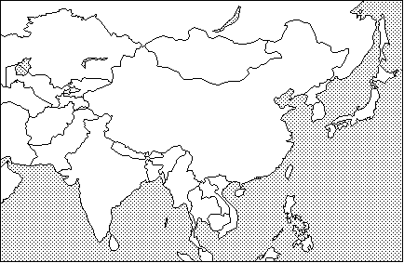

Physical Geography

Slide 6
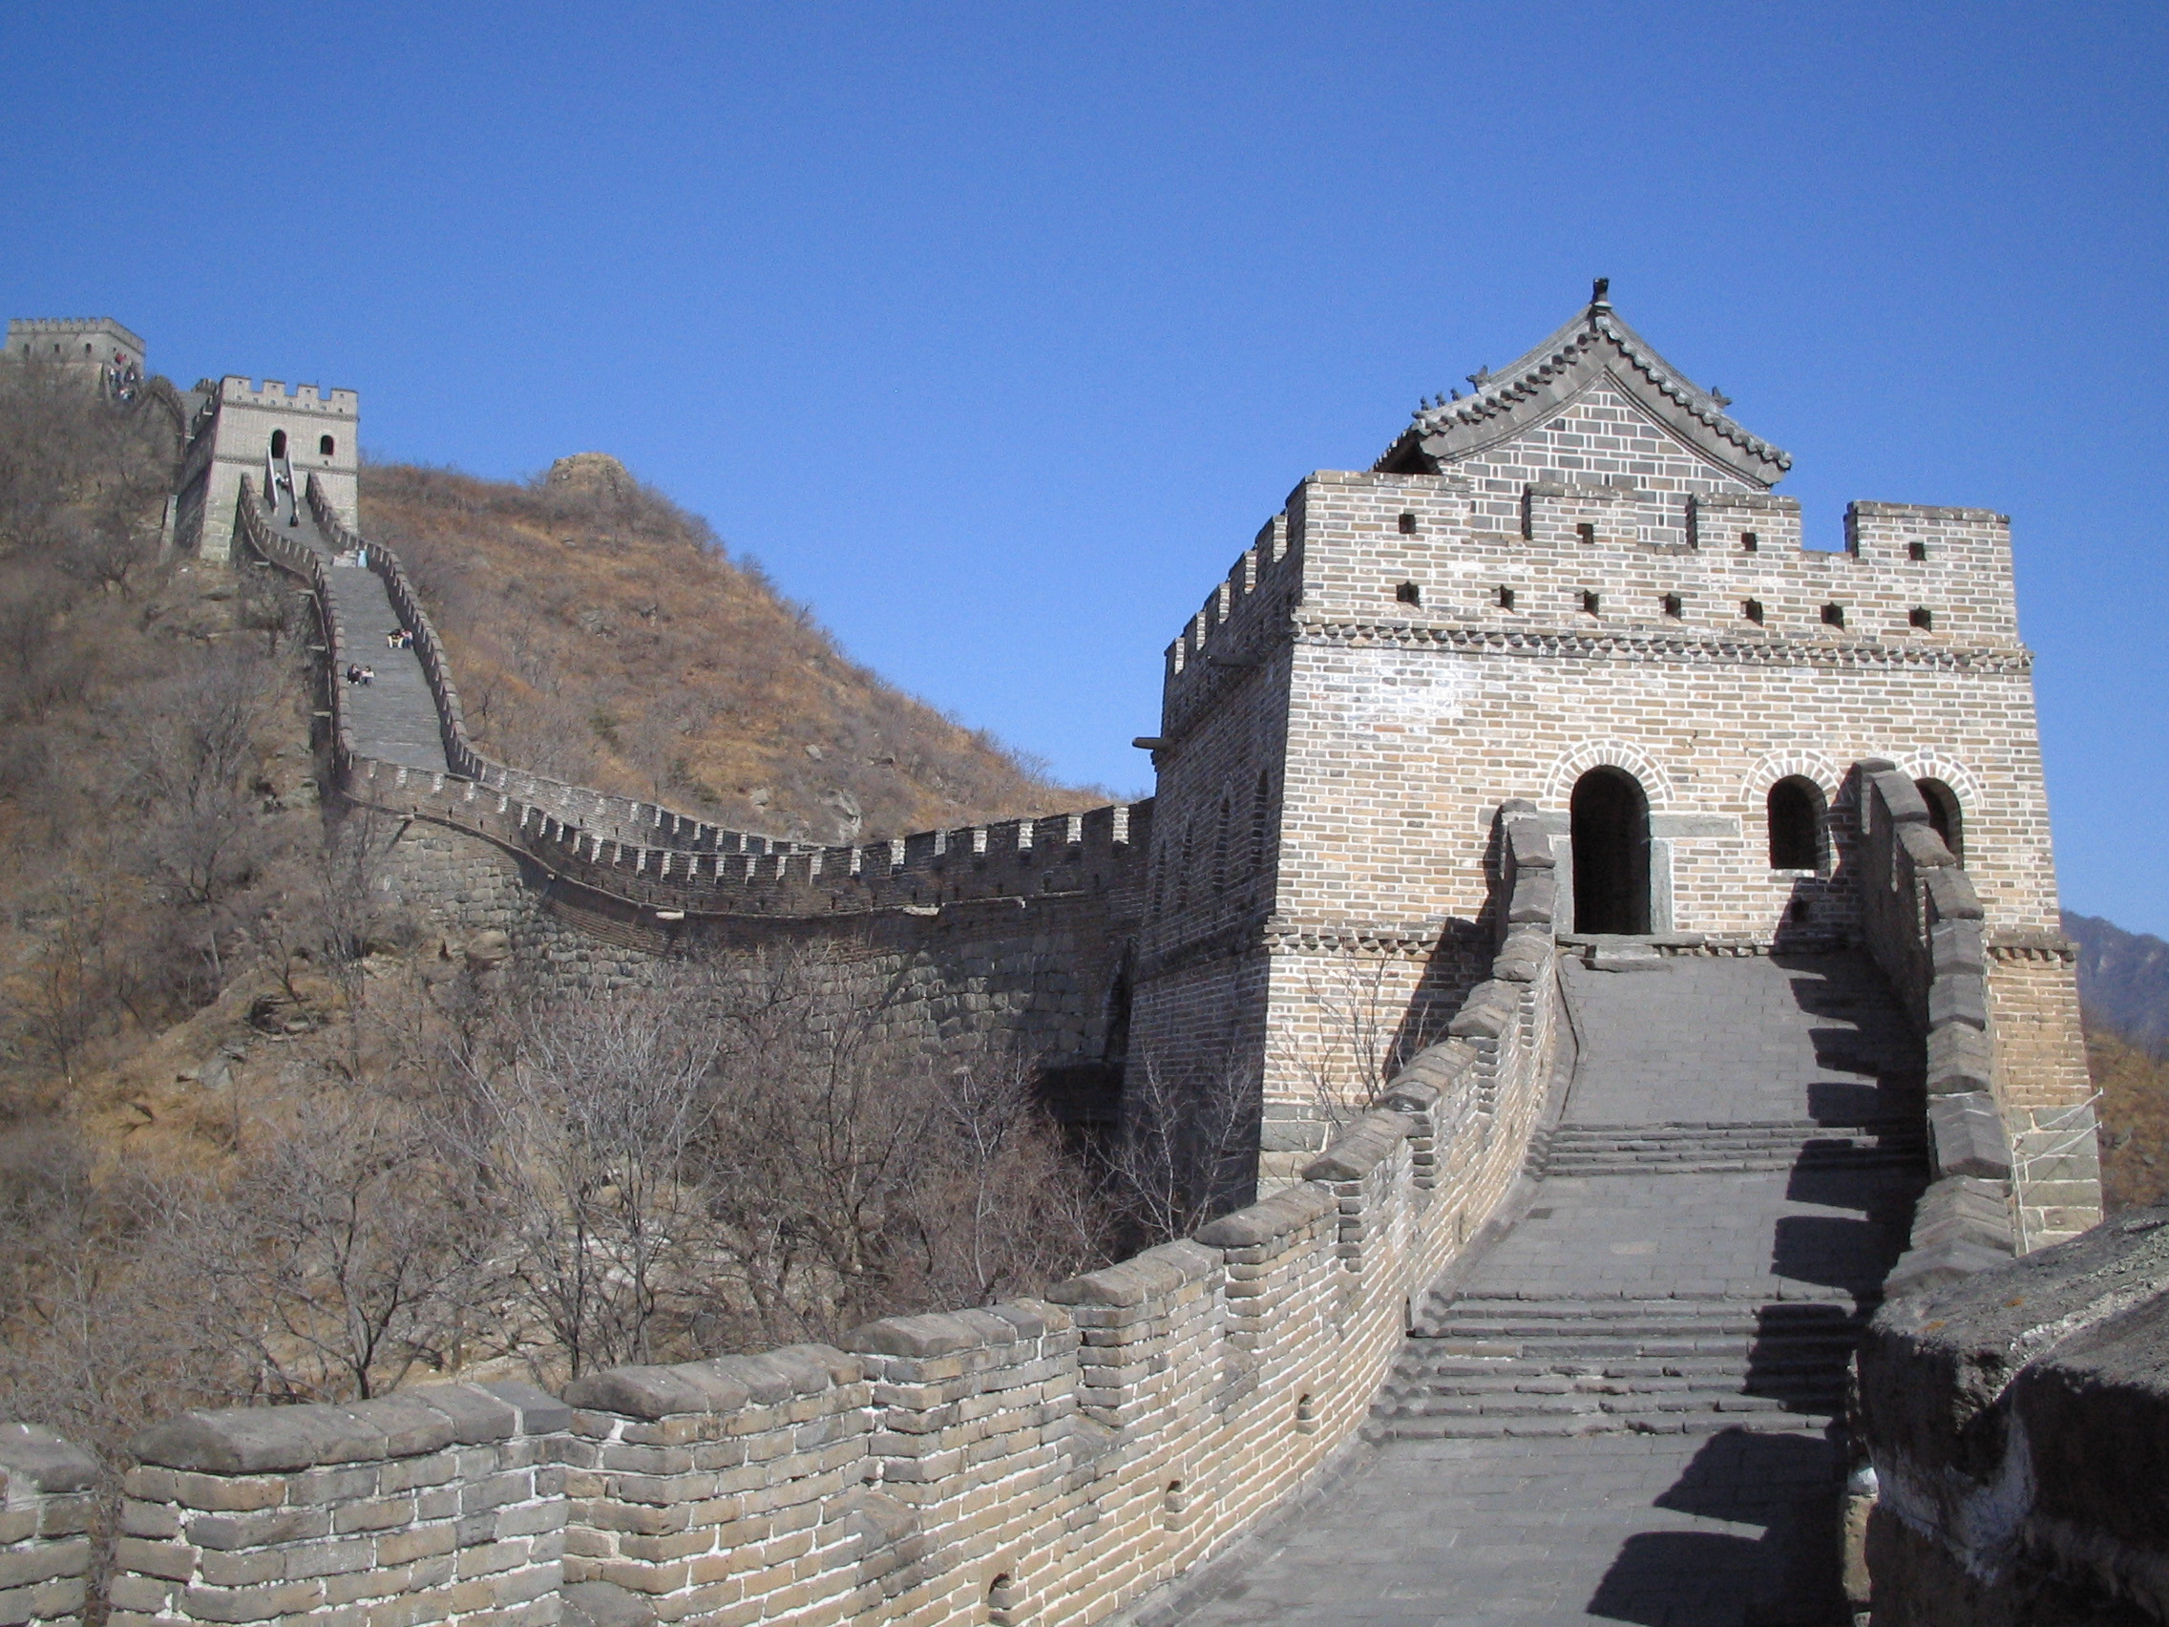
Great Wall of China

Slide 7
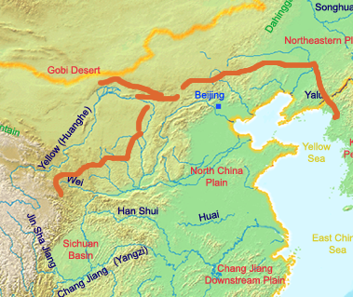
Great Wall of China

Slide 8
Rulers

Slide 9
Mandate of Heaven
Chinese Emperors ruled with the Mandate of Heaven. Emperors had divine sanction to rule but they also had the responsibility to be just and good rulers. If they were not good they could be replaced by a new ruler.

Slide 10
Chinese Dynasties

Slide 11
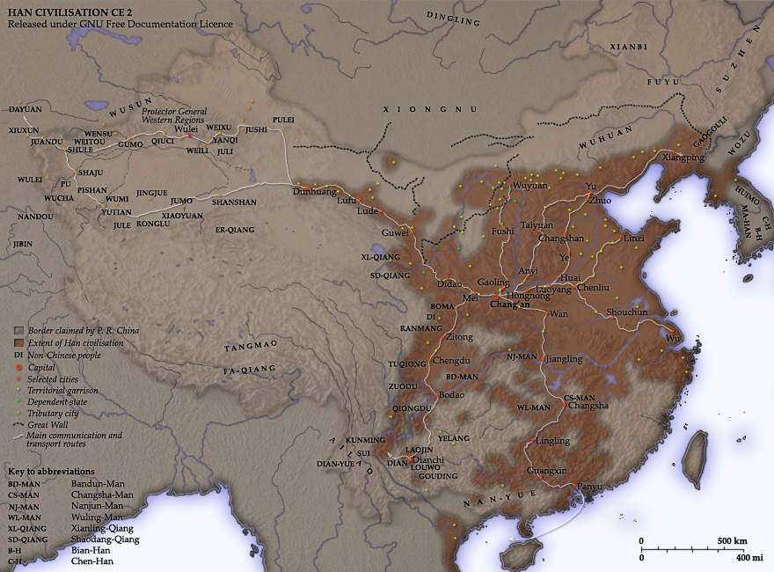
Han Dynasty

Slide 12
Chinese Religions

Slide 13
Confucianism

Slide 14
Taoism

Slide 15

Taoism

Slide 16
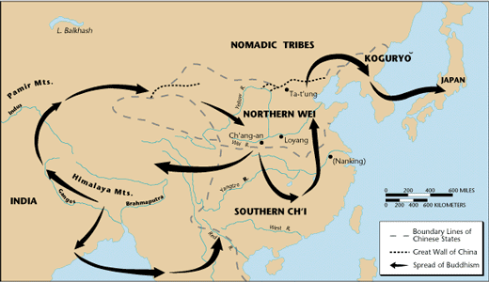
Buddhism

Slide 17
Chinese Contributions

Slide 18
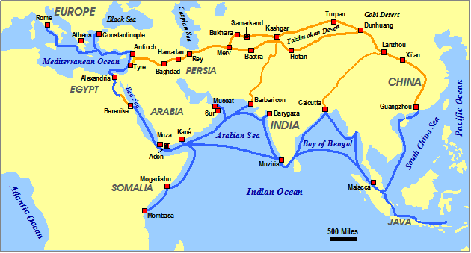
Silk Road

