Slide 1
Indian Civilizations
SOL WHI 4B, C, D

Slide 2
Essential Questions

Slide 3
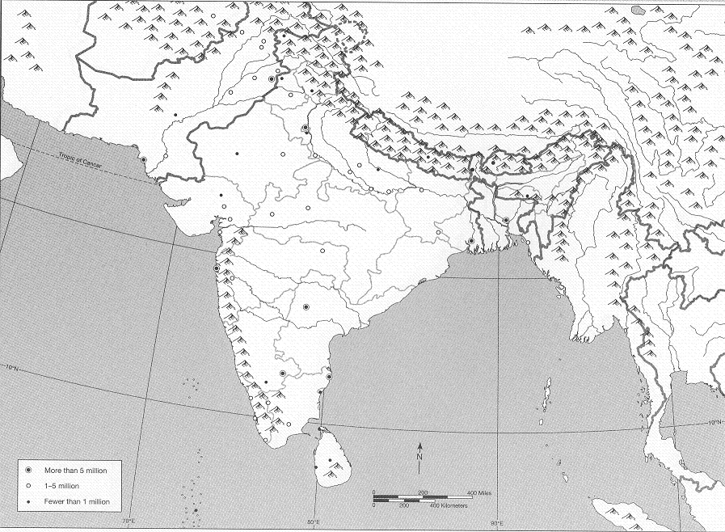
Physical Barriers
Hindu-Kush
Himalayas
Khyber Pass

Slide 4
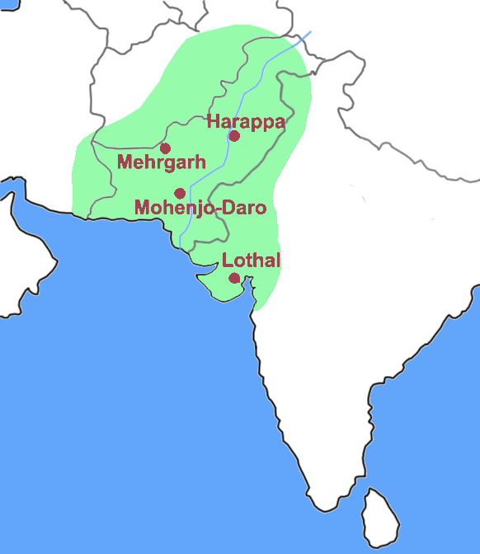
Indus River Valley

Slide 5
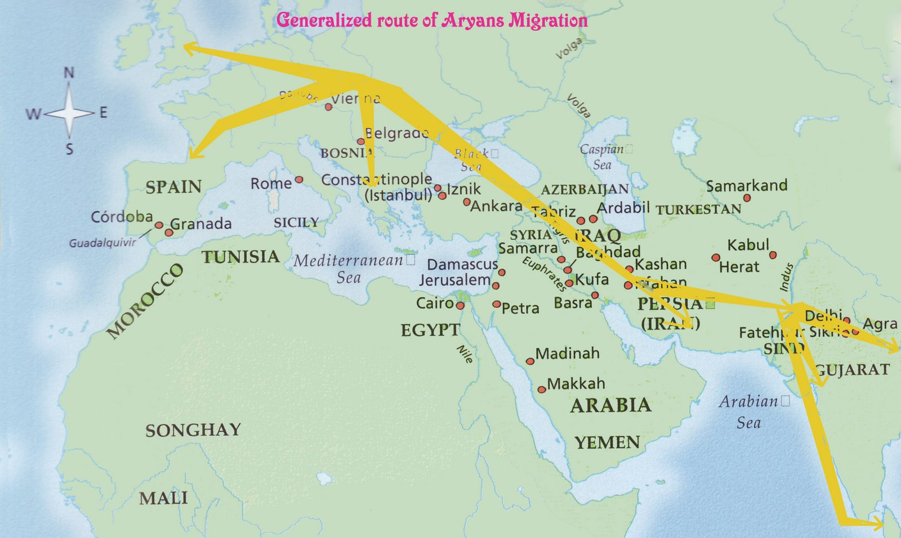
Aryan Migration

Slide 6
Aryan Migration

Slide 7
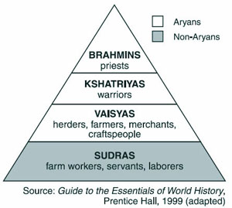
Caste System

Slide 8
Mauryan Empire 300 – 185 BCE

Slide 9
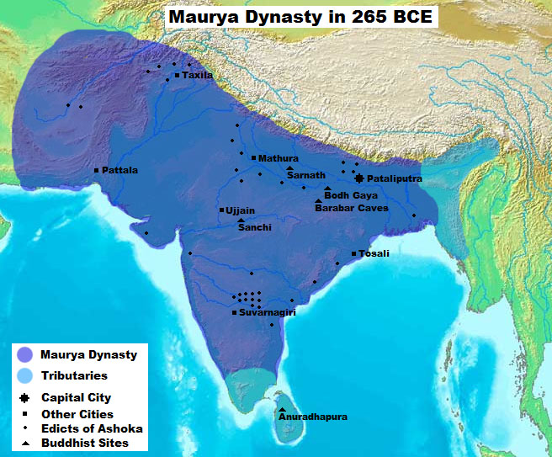
Mauryan Empire

Slide 10
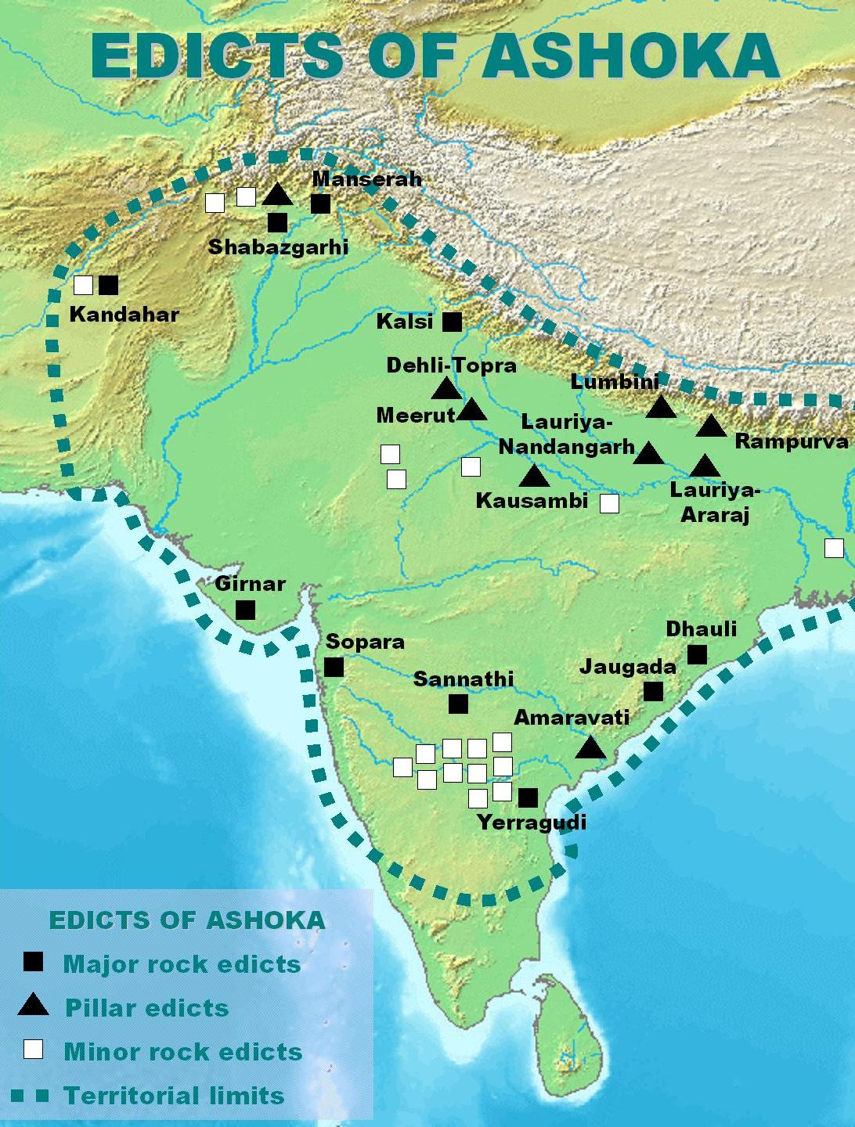
Asoka’s Edicts

Slide 11
Gupta Empire 320 – 600 CE

Slide 12
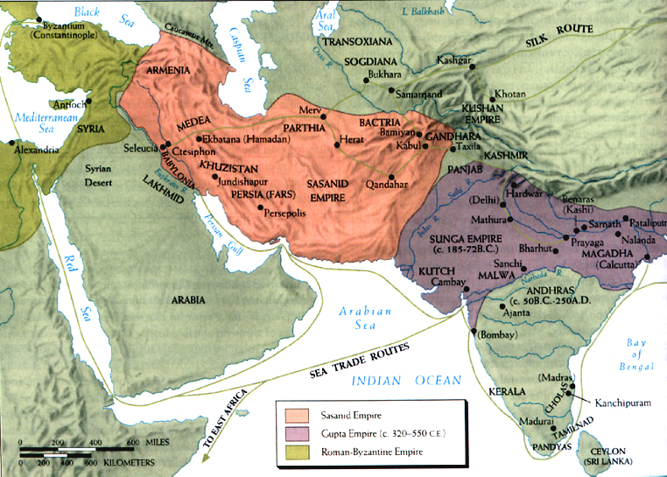
Gupta Empire

Slide 13
Indian Religions

Slide 14
Hinduism

Slide 15
Buddhism

Slide 16
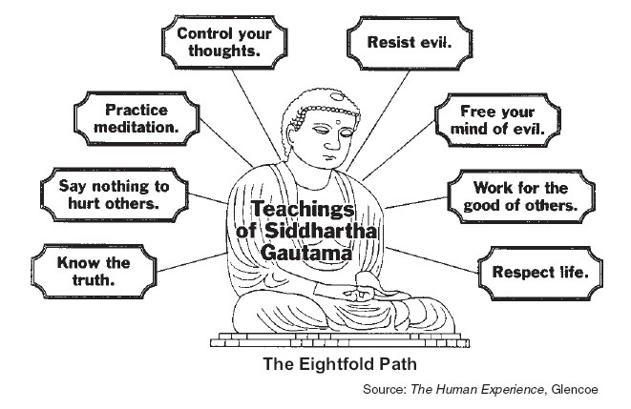
Eightfold Path

Slide 17
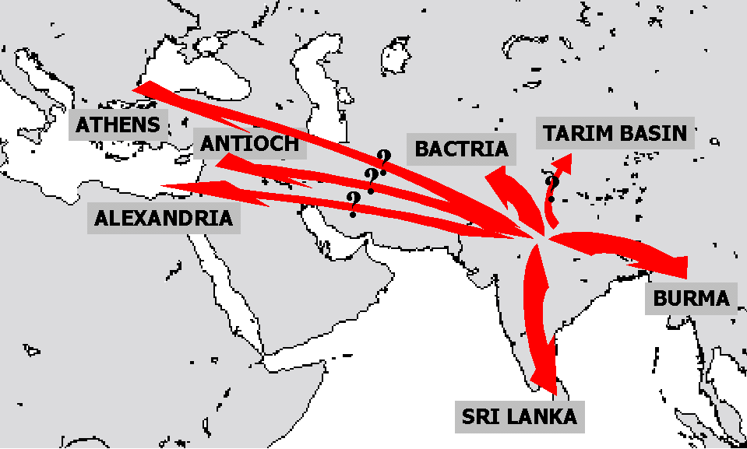
Spread of Buddhism

Slide 18
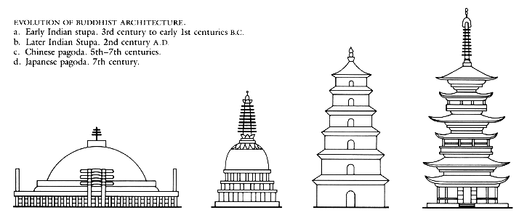
Buddhist Temples

