Slide 1
Nubia, Phoenicia, and Judaica
SOL WHI 3A, B, C, D

Slide 2
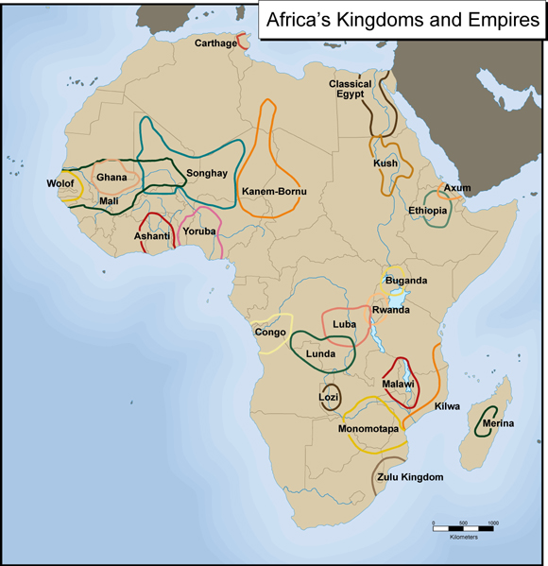
Nubia (Kush) 800 – 350 BCE

Slide 4
Phoenicia

Slide 5
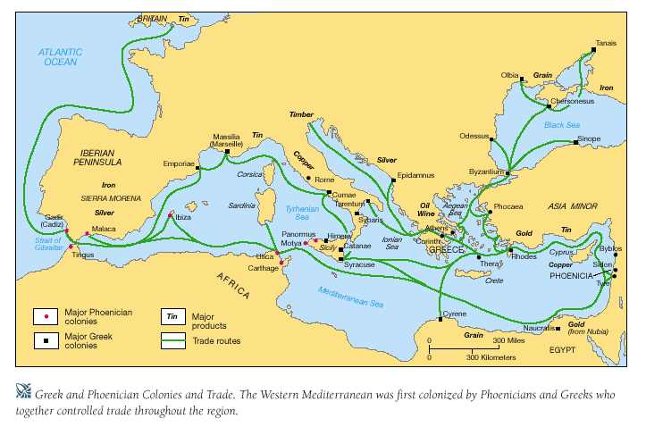

Slide 6
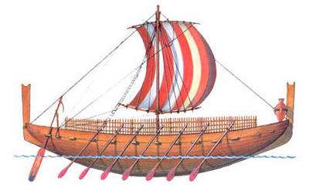

Slide 8
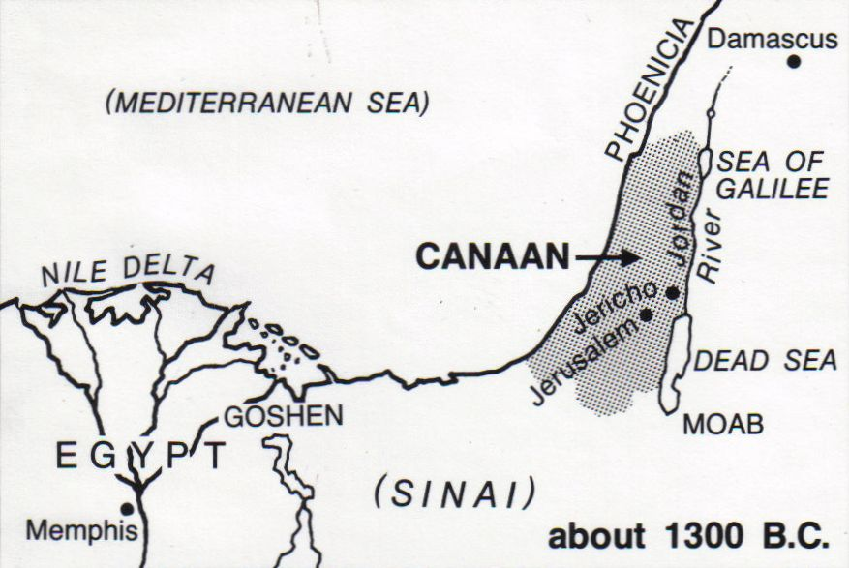
Hebrews

Slide 9
Israel

Slide 10
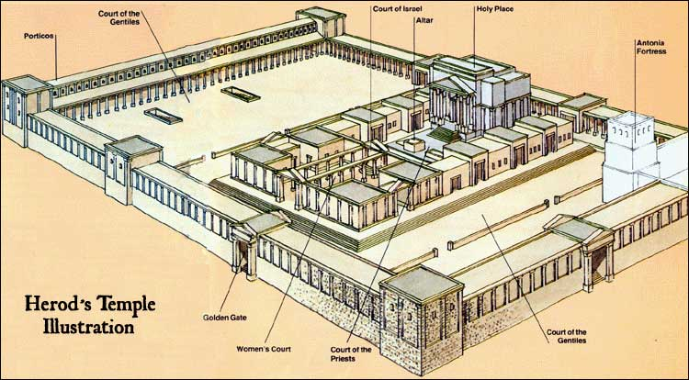
Jewish Temple

Slide 11
Judaism

Slide 12
Diaspora

