Slide 1
Egypt and Mesopotamia
SOL WHI 3A, B

Slide 2
Essential Questions

Slide 3
River Valley Civilizations

Slide 4
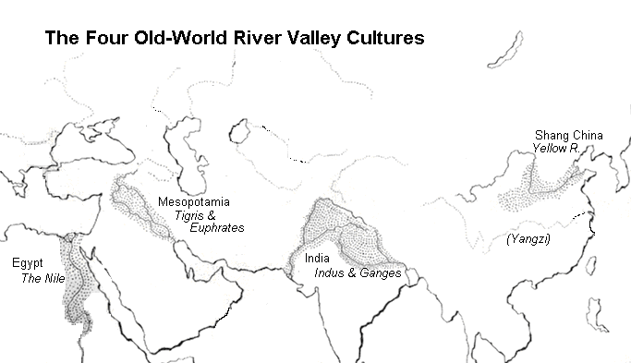
River Valley Civilizations

Slide 5
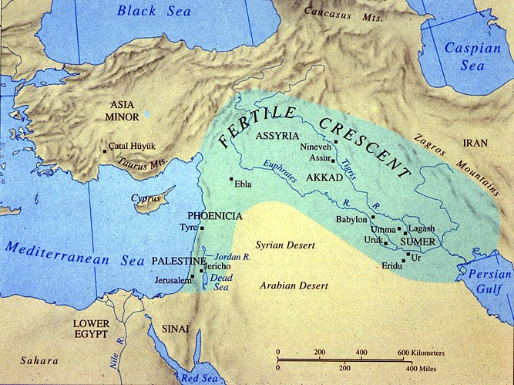
Mesopotamia

Slide 6
Sumerians

Slide 7
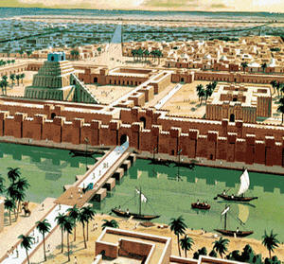
Sumerian City

Slide 8
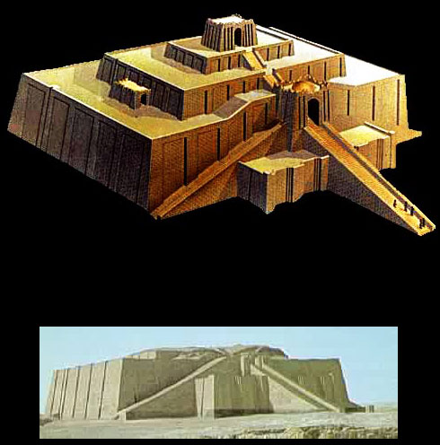
Ziggurats

Slide 9
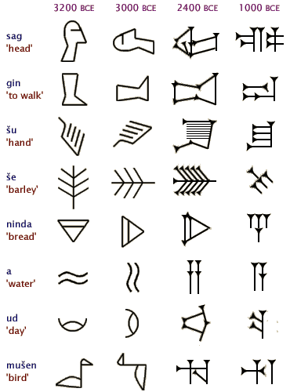
Cuneiform

Slide 10
Mesopotamia

Slide 11
Hammurabi’s Code

Slide 12
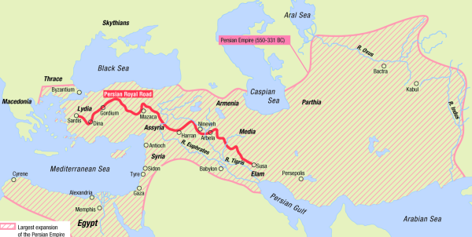
Persian Empire 550 – 330 BCE

Slide 13
Persia

Slide 14
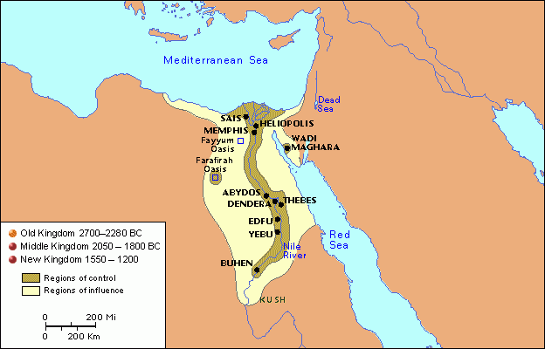
Egyptian Civilization

Slide 15
Egyptian Civilization 3000 – 1000 BCE

Slide 16
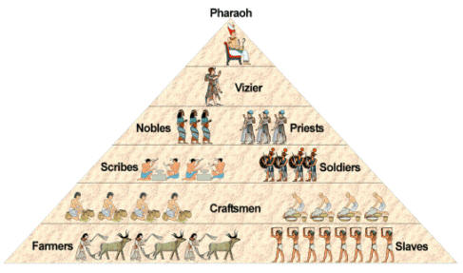
Egyptian Classes

Slide 17
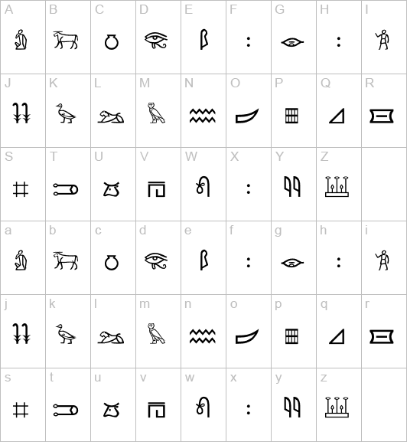
Hieroglyphics

Slide 18
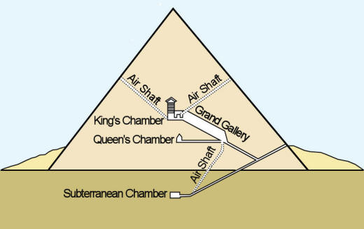
Pyramids

Slide 19
Early Civilizations

Slide 20
Early Civilizations

